Slide 1
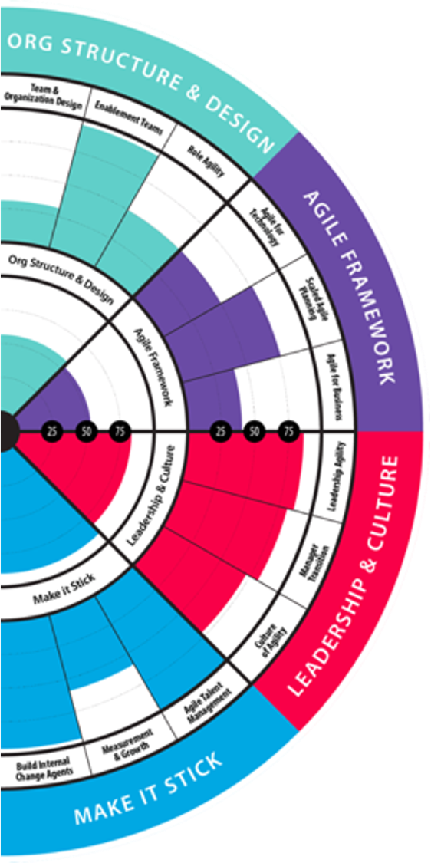
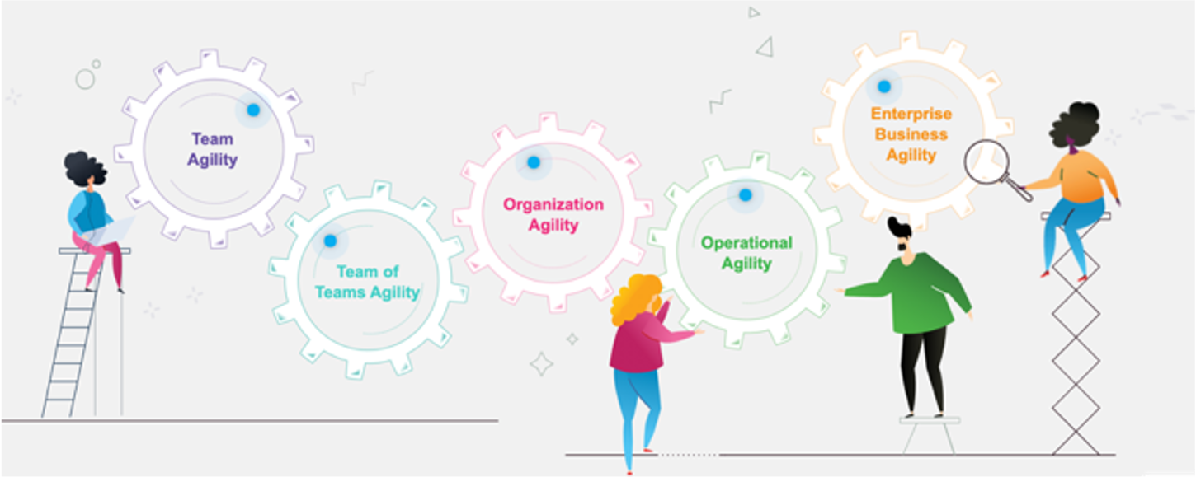
Standard Integration Package for Jira

Slide 2
Why Integrate the two platforms?
Managing AgilityInsights Growth Items through your Jira platform makes it more likely that your teams will complete growth items due to increased visibility and ease of managing Jira tickets and Growth Items on the same platform. This solves the problem of teams forgetting to login to AgilityInsights to complete their growth items.
Integrating with Jira allows your teams to capture accurate quantitative performance metrics on their Team Health assessments . This solves the problem of having to guess your performance metrics.
Integrating with Jira, allows leaders who are using the Outcomes Dashboard, to track the progress of their Outcomes and Epics against linked work items in Jira. As these linked Jira work items get completed, the progress bar of the Outcomes and Epics automatically updates.
Visualize your DORA Metrics from Jira on the 4 Lenz dashboard

Slide 3
Included in Standard Package
Manage Growth Items in Jira through the bi-directional synch.
Visualize your DORA Metrics on the 4 Lenz Dashboard ( FLOW and Quality)
Let Jira automatically answer your Performance Questions for Team Health Assessments.
Link you Jira Work items to OKR’s and Epics on the Outcomes Dashboard to allow the completion of Jira work items to automatically update the status of your Outcomes and Epics.

Slide 4
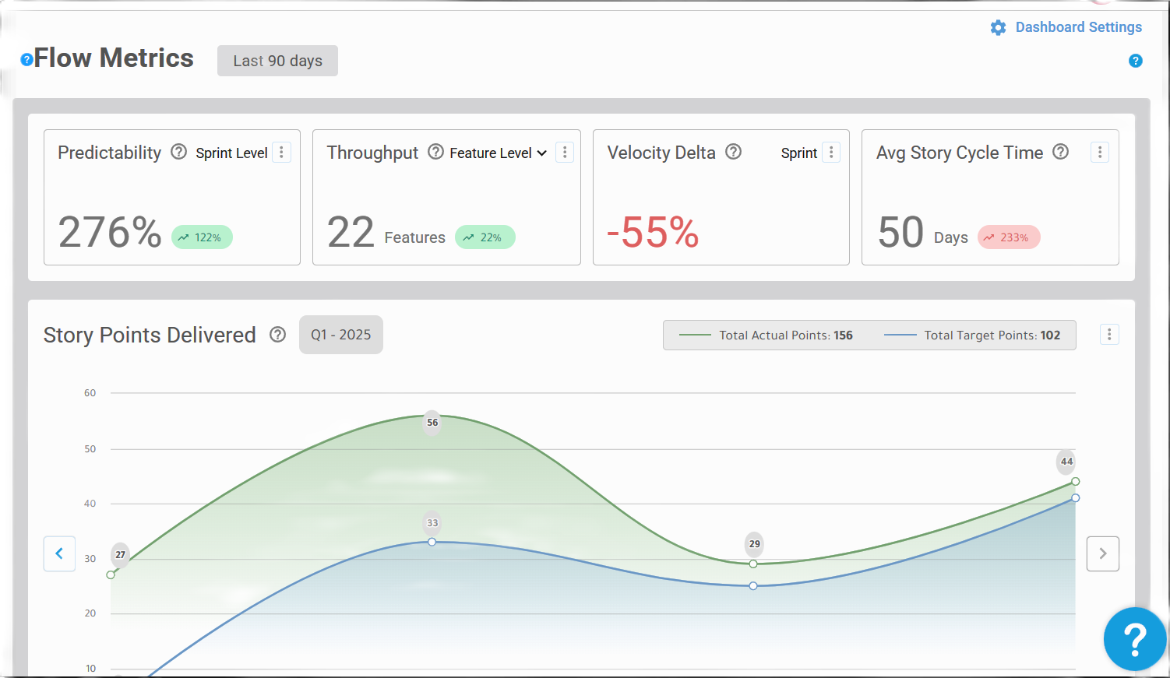
Visualize your DORA Metrics on the 4 Lenz Dashboard
FLOW Metrics
Sprint Predictability
Story Throughput
Feature Throughput
Velocity
Story Cycle Time
Points Completed vs Points Committed
ROI Efficiency
Quality Metrics
Defect Ratio
Lead Time for High Severity Incidents

Slide 5
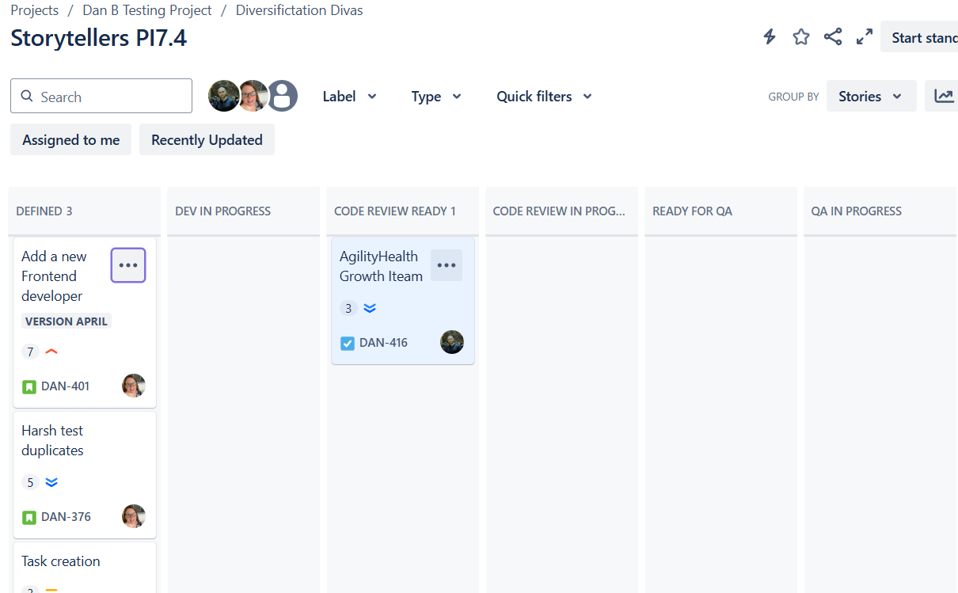
Manage Growth Items in Jira via our bi-directional Synch
Growth items created in AgilityInsights can be synched and managed in Jira. Once synched, any updates made in Jira will automatically update the growth item in AgilityInsights.

Slide 6
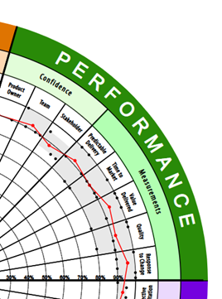
Let Jira answer your Performance Questions for you
Instead of guessing your teams’ performance, the Jira integration pulls and calculates this data directly from a teams Jira board.

Slide 7
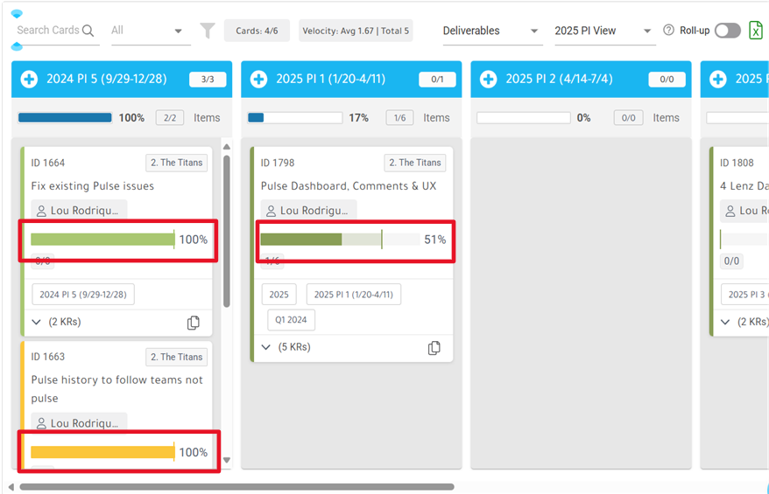
Link your Jira work items to the Outcomes Dashboard
Linking your Jira work items to the Outcomes Dashboard allows your Outcomes and Epics to have their progress bars updated as linked Jira work items are completed.

Slide 8
What data do we pull from your Jira instance?
For Dora Metrics:
Workflow status for Jira issues
Issue history, sprint data, story points, stories completed, epics completed, defects in backlog, labels, release data.
For Growth Items (we map Jira fields to growth item fields in AgilityInsights):
Title
Description - This description originates in AgilityInsights not in Jira.
Status
Priority
labels

Slide 9
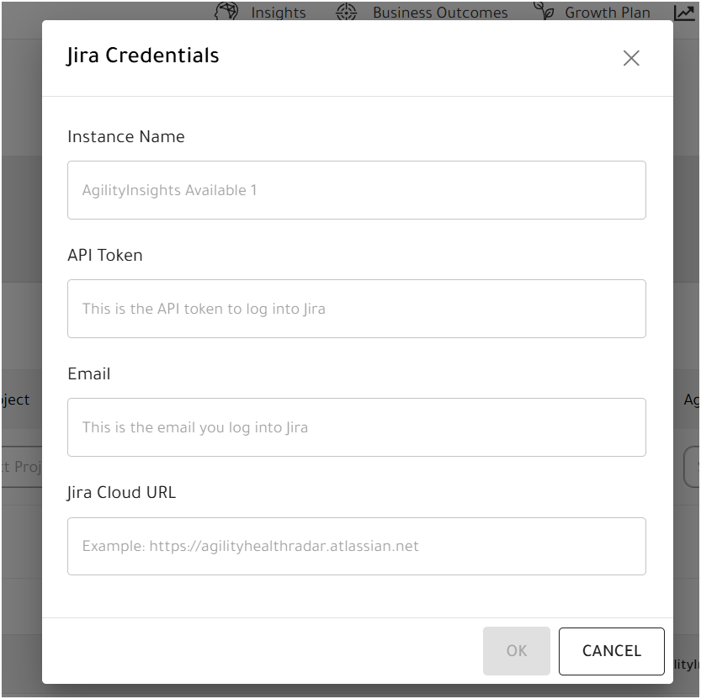
Connection String
Use your Jira token to authenticate Jira and AgilityInsights
Link your Jira projects and boards to your teams in AgilityInsights

Slide 10
Recommended Jira Configuration
Workflow statuses must be same color as status category
Gray = To Do
Blue = In Progress
Green = Done
Remove duplicate fields on your create/edit issue screens as this can confuse our logic
For example, 2 sprint fields or 2 points fields
Token used
Must have create issue permission on all projects you wish to synch growth items to.
Must have permissions to view Jira projects that we wish to link in AgilityInsights.
Must have permission to view projects that we wish to pull metrics from.
Scrum boards must be used to track sprint metrics like predictability
Must close out sprints to pull sprint data
Must move work items through all flow states (to do, in progress, done) to track metrics
Stories must be pointed to track story points

Slide 11
Metric | Fields and Objects | Formula
Sprint Predictability | Story Issue Type Sprint Field Points Field Sprint Start/End Dates Status Category Issue Histories | Sprint Predictability = Total aggregated predictability for all sprints in the Last 90. 180, 365 Days / Number of sprints.
Story and Feature Throughput | Story and Epic Issue Types Status Category Issue Histories | Throughput displays the number of stories or features that were completed by the team in the last 90, 180, or 365 days.
Velocity / Velocity Delta | Story Issue Type Sprint Field Points Field Sprint Start/End Dates Status Category | Sprint Velocity = Aggregated completed story points for all sprints in last 90, 180, 365 days / number of sprints
Story Cycle Time | Story Issue Type Status Category Issue Histories. (in progress to done time) | Story Cycle Time = Total Cycle Time of Aggregated Stories in the last 90, 180, 365 days / Number of Stories
Defect Ratio | Ratio of Bug issue types to other issues types in project backlog | Defect Ratio as a percent = Bugs in backlog x 100 / Work items in the backlog
Lead Time High Severity Incident | Bug Issue Type (customizable) Status Category Priority Field Issue Histories (created to done time) | Avg Lead Time High Severity Incidents = Aggregated lead time for all high severity bugs / number of high severity bugs

Slide 12
AgilityInsights
Website: https://agilityinsights.ai/
Email: support@agilityinsights.ai

Slide 13
New AgilityInsights Capabilities

