Slide 1
AgilityHealth® Facilitator Certification – EBA

Slide 2
Organizing Tools
Your Ideaboardz link for this course is in your invitation
Sign In Sheet
Our Team Norms
Start / Finish / Breaks
Parking Lot
Course Feedback
Notes:
2
5/15/19- Added from TH 2.5 Master
2

Slide 3
About Me

Slide 4
About YOU!
Name
Role
Location
Experience with AgilityHealth®

Slide 5
Purpose of This Course
To Learn How to Facilitate an
Enterprise Business Agility Retrospective
Become a Certified AgilityHealth® Facilitator
Notes:
5
5

Slide 6
Learning Objectives
After completing this class, participants will be able to:
Explain the benefits of the Enterprise Business Agility Strategic Retrospective
Set up a team and launch an assessment
Analyze an Enterprise Business Agility Radar
Build Transformation Team Continuous Improvement Plan
Engage with Leadership on an Organization Continuous Improvement Growth Plan

Slide 7
Course Agenda
Enterprise Business Agility Overview
Retrospective Simulation
Outcomes and Growth Plan
Next Steps
Facilitating an Enterprise Business Agility Retrospective
Radar Analysis
Post Retrospective Activities
Preparing for an EBA Retrospective
AgilityHealth® Overview
Notes:
7
5/15/19- Updated from TH 2.5

Slide 8
Challenges
What challenges have you faced at your company with transforming to the new ways of working?
Submit your ideas on the shared Ideaboardz.

Slide 9
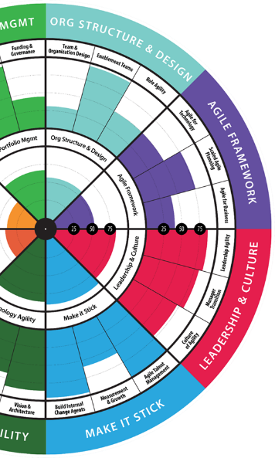
Enterprise Business Agility Overview
What are the Pillars of Enterprise Business Agility?
Common Challenges when transforming an organization
About the Enterprise Business Agility

Slide 10
Enterprise Business Agility Journey
Team Agility - Measure TeamHealth - Enable Self-learning - Develop Talent
Org Agility - Lean Portfolio Mgmt. - Value Stream Structure - Lean Product Maturity
Enterprise Business Agility - Anticipate Customer Needs - Disrupt Before Being Disrupted - Relentless Improvement
Team of Teams Agility - Scaling Agile - DevOps Maturity - Leadership & Culture
Operational Agility - Customer Seat at the Table - Talent Development, HR Transformation - Ops, Finance, Legal, Audit, Sales/Mktg
Measure What Matters | Team Agility (Outcomes, Maturity & Performance) | Enterprise Agility (Flow, Value, Quality)

Slide 11
Business Agility Definition
The ability to adapt to change, learn and pivot, deliver at speed, and thrive in a competitive market
- Evan Leybourn, Sally Elatta
… because, gone are the days when big eats small. Today fast is eating slow. The ability to learn and deliver faster than competitors may be the only sustainable competitive advantage

Slide 12
Problems We Are Trying to Solve
Teams not empowered to solve problems
Ineffective team design, cross-team dependencies
Not measuring what matters
Limited voice of the customer
Teams not aligned to business outcomes
Leaders still using command and control
Competing business priorities
Tech vs. Business Teams
Missing portfolio leadership teams
No discovery process
Focus on delivering output not outcomes
Painful enterprise planning processes
Demand and Capacity are not aligned
Feature factories with large never ending backlogs
Tech is sprinting while org still stuck
Slow time to market

Slide 13
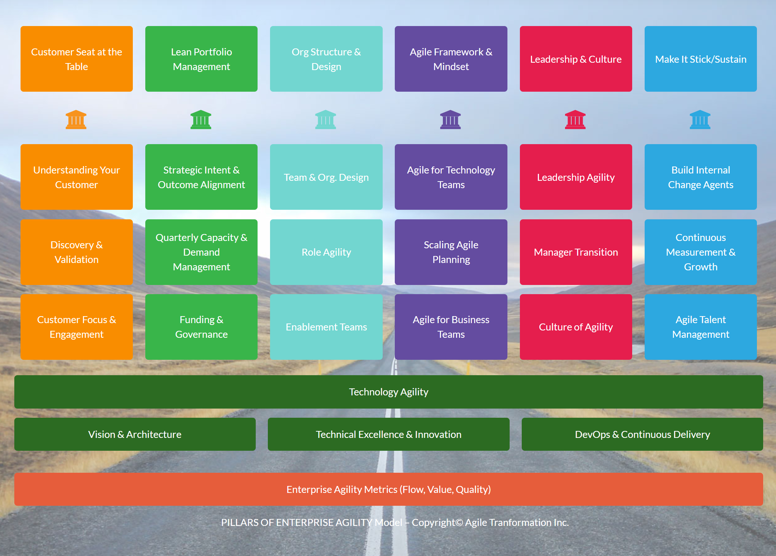
Enterprise Business Agility
http://www.agilityhealthradar.com/EBA

Slide 14
What is EBA?
http://www.agilityhealthradar.com/EBA
The Enterprise Business Agility model provides senior leaders with an integrated strategy for where to invest in order to accelerate and achieve their Enterprise Business Agility vision. It is a non-prescriptive, pull-based model that provides proven patterns and integrates with Agile, Scrum, Kanban, & SAFe®.
Define an Integrated Transformation Strategy
Align Teams to Business Outcomes
Develop Agile Talent
Assess Maturity & Performance
Enable Self-Learning & Growth
EBA 7 Pillar Model
Outcome Alignment Dashboard
Role Based Talent Dev.
Team and Org Radars
The Growth Portal

Slide 15
EBA Guiding Principles
Build the right products by maturing product management and discovery practices.
Design ‘virtual’ organizations that enable the flow of business outcomes/value and break dependencies.
Align all teams to measurable outcomes and shift focus from ‘outputs’ to ‘outcomes’.
Align strategic Demand to Delivery through quarterly face to face outcomes based planning cadences.
Enable role agility by defining new roles, developing talent, managing the change and enabling talent agility.
Invest in Technology Agility through modern architectures, technical practices and DevOps adoption.
Transform leaders at all levels to leading modern ways of working and enabling autonomy, mastery and purpose driven organizations.
Enable the Agile/Lean mindset across the enterprise, not just technology, to achieve true business agility.
Enable organizations to ‘make-it-stick’ by building internal change agents, sustaining the cultural investment and transforming HR.
Measure what matters by focusing on Value-Flow-Quality and Happiness metrics across all levels.

Slide 16
EBA Journey | Enablement Jump Starts
Getting
Started
EBA Seminar
1 Day EBA Overview for Leaders OR 2 Day EBAS
1 Day
EBA
Overview for Leaders
EBA
Baseline Assessment
OPT-IN?
Start EBA Journey

Slide 17
EBA Journey | Enablement Jump Starts
Getting
Started
EBA Seminar
1 Day EBA Overview for Leaders OR 2 Day EBAS
1 Day
EBA
Overview for Leaders
EBA
Baseline Assessment
OPT-IN?
Start EBA Journey

Slide 18
When to do a Baseline?
Pre-Transformation baseline
Organization has recently embraced as Enterprise Wide Agile Mindset & is committed to continuing their journey towards true Enterprise Business Agility
Transformation Baseline
After 2-3 quarters of working in the new way
When the organization identifies that their transformation has stalled and they need to understand why

Slide 19
AgilityHealth® Overview
What is AgilityHealth® and Why
The 3 Metrics that Matter
Growth Framework
AgilityHealth® Demo
Notes:
5/15/19- Updated from TH 2.5

Slide 20
Problem to Solve: Are We Seeing the Value From Agility?
“How are we measuring this?” Typically, in the past…
No consistent measurement methodology, subjective opinions
Individual approaches weren’t repeatable, consistent or comprehensive
Data ended up in Excel or assessment tools
Not enough coaches for all teams
Little to no trending over time, growth isn’t measurable
No cross-team rollup view or analysis
Not ‘hearing the team voice’ of where help is really needed
We don’t really know how we’re doing.
Notes:
5/15/19- Updated from TH 2.5 – This slide was added to this deck.

Slide 21
What is the AgilityHealth® Measurement Platform?
AgilityHealth® is the world’s leading measurement & continuous improvement platform for accelerating the maturity and productivity of teams and enterprises.
Measure
Grow
Accelerate

Slide 22
Six Key Capabilities of the AgilityHealth® Platform
Notes:
What is your enterprise platform for teams – the people – not the work (ALM)?

Slide 23
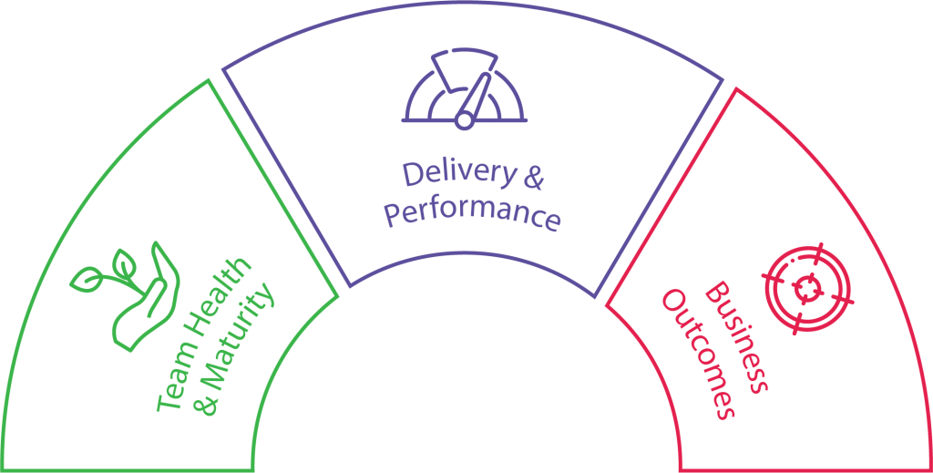
What Should We Measure? The Three Metrics That Matter
Outcomes are THE Metrics that Matter
Maturity and Performance tell us WHY we’re not achieving outcomes.
Performance
Collected via Agile Work Mgmt. Platforms
Maturity
Collected via Team
Assessments/Radars within AgilityHealth
Outcomes
AgilityHealth OKR Dashboard
Notes:
Let’s focus on the “people” – Their health and the maturity of their agile practices and behaviors
Agile work management platforms – Do not forget to mention LeanKit

Slide 24
Measurement Challenges

Slide 25
Moving Towards A Growth Mindset
We’re doing the best we can and have no time for growth
We can continuously improve our way of working
Strategic Retrospectives help a team adopt a Growth Mindset.
In order to have a Growth Mindset, the team must make time and space for Intentional Growth.

Slide 26
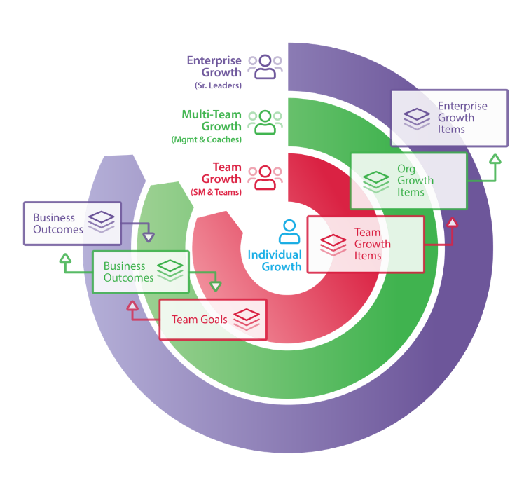
AgilityHealth® Continuous Improvement Model
Org Leaders
Agile Coaches
Managers
‘If you want to teams to align and achieve outcomes, you’ll need to hear their voice and remove obstacles.” – Sally Elatta
Teams
Scrum Masters
Product Owners

Slide 27
Enterprise Business Agility Radar
Radar Deep-Dive
EBA Roles
Preview Questions

Slide 28
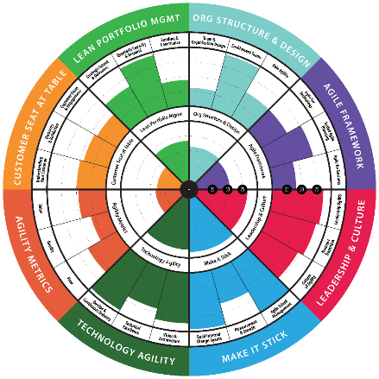
Enterprise Business Agility Radar Introduction
The Enterprise Business Agility (EBA) Radar allows Transformation Teams to assess their foundational Enterprise Agility maturity and structure clear and actionable growth plans for increased maturity and value delivery over time.
The radar focuses on seven pillars of Business Agility in addition to the Agility Metrics of Quality, Flow & Value, allowing the organization to have clarity and alignment on what healthy means and can work collective toward increased maturity over time.
The assessment allows you to see how the various pillars of Business Agility can be in differing stages of maturity across a portfolio or an enterprise.
The results are used in the formation of a roadmap for transformation that focuses on transforming the highest value pillar in the upcoming iteration.
The maturity scale follows Pre-Crawl, Crawl, Walk, Run, Fly.

Slide 29
Enterprise Business Agility Radar
Purpose
To help the transformation leadership team assess their current state, develop a quarterly roadmap & plan for the new quarter.
Audience
Senior Leaders from IT, Business, HR & other stakeholder groups who wish to create an overall strategy for an Enterprise Business Agility Transformation.
Benefits
Assesses the overall health and maturity of an Enterprise Agile Transformation
Indicates areas and practices where the transformation effort has opportunities for improvement
Develop a roadmap for the transformation

Slide 30
Enterprise Business Agility Radar
Cadence
Baseline, then every 6 months to check-in on the Enterprise Business Agility progress
Facilitation
Certified AgilityHealth® Facilitator to facilitate the retrospective and pre/post‐retrospective activities
Facilitator needs to be an experienced enterprise‐level coach
EBA Transformation Strategy Session
EBA Executive Seminar
EBA Strategist to provide the Executive Overview and to facilitate the strategy and planning sessions
EBA Planning/Roadmap Sessions
Team Retrospective
Supporting Ceremonies/Activities

Slide 31
Enterprise Business Agility Roles
Transformation Leader
Agile Coaches
AgilityHealth® Facilitator
Lead efforts to define program strategy & roadmap
“Blocker-Buster” for team-level blockers
Develop internal change capacity
Multi-portfolio roll up analysis
Coaching the leaders
Measure coaching impact
Facilitator and Transformation Sponsor Prep, Conduct and Close Assessment
Engages with Transformation Stakeholder to Manage Team
EBA Strategists & Coaches
Organizational Leaders
Change Agents
Assist in operationalizing program strategy
Provide executive coaching
Engage in high-priority team coaching
Lead retrospective efforts
Provide strategic clarity, priority, and sponsorship
“Blocker-Buster’ for Organizational blockers
Embrace and “live” New Ways of Working
Develop leadership talent
Visibly embrace transformation efforts
Play critical “influencer” and “momentum building” role
Provide SME assistance for proposed changes

Slide 32
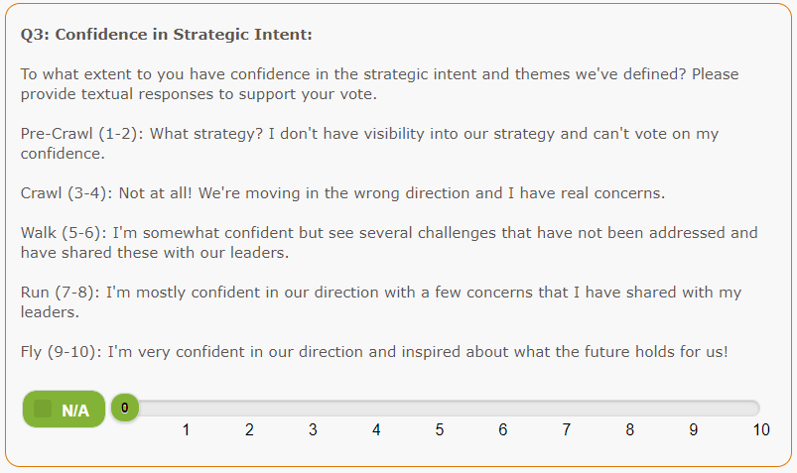
EBA Assessment Questions
Preview Questions

Slide 33
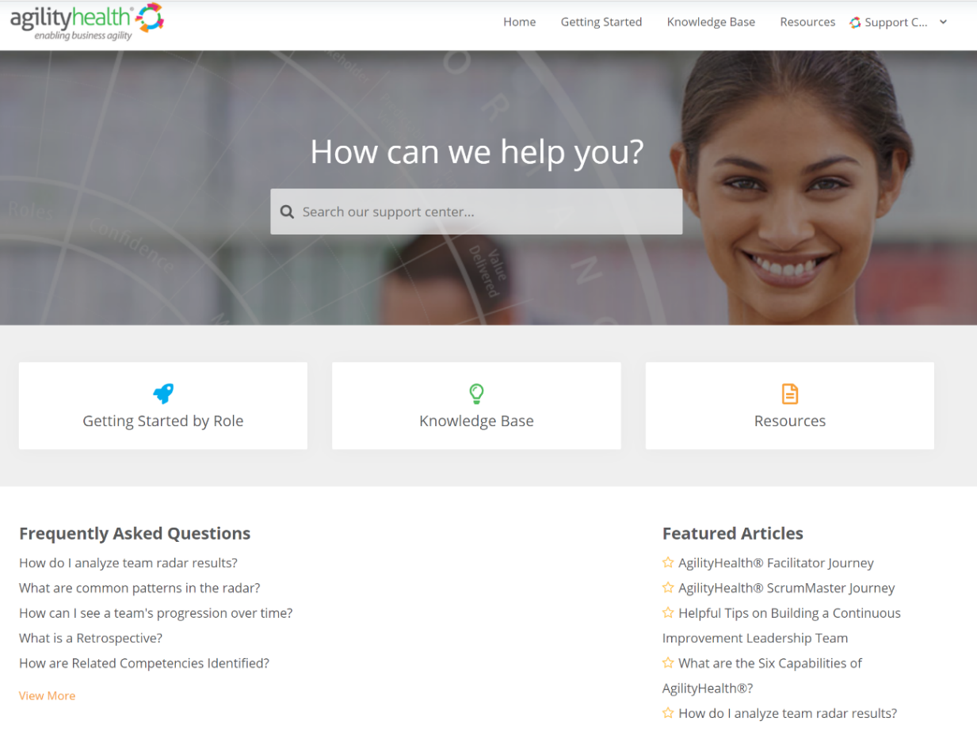
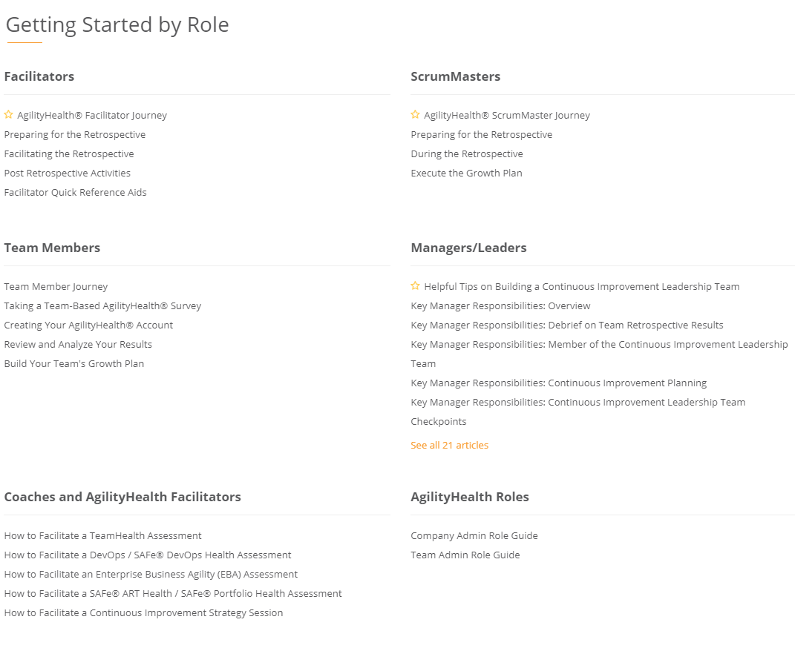
Questions? Check Out Our Customer Support Center
https://support.agilityhealthradar.com
Role based guides, page by page tutorials, FAQ’s, downloadable resources and more!

Slide 34
Preparing for an EBA Retrospective
Education, awareness and excitement
Creating a team
Creating and scheduling an EBA assessment
Preparing for the retrospective

Slide 35
AgilityHealth® EBA Facilitator Journey
Step 1
Step 2
Step 3
Prepare for Retrospective
Conduct Retrospective
Execute
Growth Plan
Create Team
Create Assessment
Schedule Assessment
Educate the Team
Prepare to Facilitate
Launch Assessment
Take Assessment
Review Results
Analyze Radar
Create Growth Plan
Access to AH
Next Steps Email
Growth Items: Retros
Growth Item Ownership
Growth Strategy Mtg.

Slide 36
Pre-Retrospective Activities
Support Center Article
Ensure the right attendees are invited and create team
Conduct EBAS Overview 2 Hour Workshop and schedule session Provide purpose, agenda and reminder to bring laptop
Educate the workshop invitees on the value and purpose of EBA See Leadership and Team Engagement Overview decks.
Prep for retrospective by reviewing the questions and the EBA Pillars with the Transformation Leader
Create the Assessment
1
2
3
4
5

Slide 37
1) and 2) Activity – Your Turn!
Link to Article on Facilitating an EBA Assessment, Team Set-Up and Launching the Assessment [See Video 2]
Following the Article in the Support Center
Login into the Company [Company for Practicing – Sandbox]:
Create account
Create a team
Add team members (yourself)
Launch an assessment
Check your email, search ‘Sandbox’

Slide 38
3) Sample Email/Calendar Invitation
Subject Line: EBA Retrospective Workshop
As a reminder, your team has been selected to participate in an AgilityHealth® Enterprise Business Agility (EBA) Retrospective. Please attend your retrospective session at [DATE] and [TIME]. The EBA Retrospective is a strategic retrospective that dives deeper into the top areas that affect our organizations transformation and health by analyzing the 7 Pillars of Business Agility. The final output is a Growth Plan with actionable items you want to achieve within the next quarter and an organizational roadmap for achieving the outcomes you’ve defined.
Desired Outcomes:
Analyze your radar and engage in an open/honest conversation about your organization’s strengths and growth opportunities
Develop an actionable growth plan for your team for the next quarter/release
Develop a roadmap for transforming to the new way of work
Have FUN!
Pre Retrospective:
You can watch the 3 Minute TeamHealth Overview Video for background on AgilityHealth®
You can watch this 7min Overview of EBA Video to gain an understanding of the EBA Model
Post Retrospective:
We'll ask for your feedback on the session
We will create a Continuous Improvement Leadership team to help ensure we are moving forward with our goals
Thank you for participating in the AgilityHealth® Retrospectives!

Slide 39
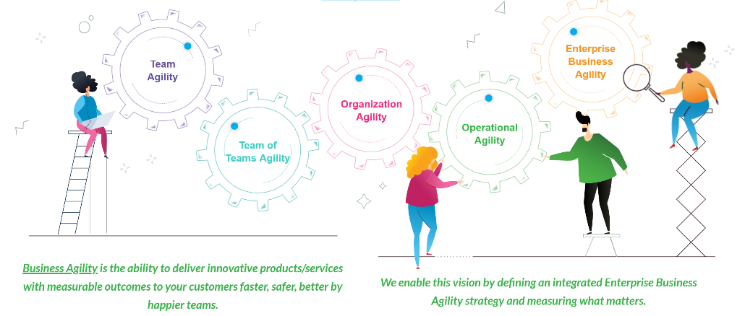
4) Generating Excitement and Engaging Leaders
EBA Seminar for Leaders
EBA Transformation Journey
Overview of EBA & AgilityHealth® for Leaders and Stakeholders

Slide 40
5) Prep for the Retrospective
Meet with the Transformation Sponsor
Review the 7 Pillars of Business Agility
Background and details on the Team
Which Transformation leaders are actively engaged in the transformation and which one are new to the conversation
What are the strategic goals of the organization as it pertains to their transformation
Are there significant roadblocks to transformation that have already been identified
Find out where to gain visibility into the measures of Flow, Value and Quality and who will answer them

Slide 41
Retrospective Simulation
Retrospective Process
Take the Assessment
Review Meeting Agenda and Best Practices

Slide 42
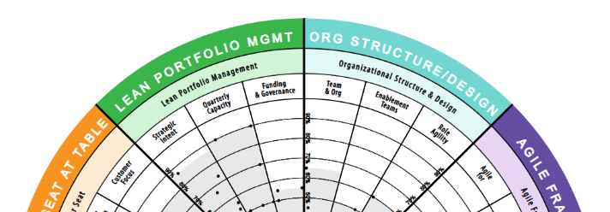
EBA Retrospective
STRATEGIC RETROSPECTIVE: A retrospective that aims to help teams reflect on their last quarter or release and improve the next one. Facilitated by certified AgilityHealth® facilitators.
Analyze real-time
radar and textual responses. Have “real” conversations
Team members
complete the assessment on their phone or laptop
STEP 2
Build actionable
Continuous Improvement plan for the team and for
their leaders
STEP 1
STEP 3

Slide 43
Workshop – Complete the EBA Assessment
The Facilitator has created an assessment.
You have an email with a link to the assessment in your inbox.
Follow the Class Facilitator’s Directions.

Slide 44
EBA Introduction Talking Points
Describe the purpose of the workshop & answer questions
Introduce yourself as their neutral AgilityHealth® Facilitator
Drivers for Change workshop
Capture meeting norms
Responses are anonymous
Emphasize entry of detailed textual responses to provide context
Ratings follow the CRAWL(1-2), WALK(3-5), RUN(6-8), FLY(9-10) | Additive
Review EBA Model
Use upper/lower range when question has two parts/acceptance criteria

Slide 45
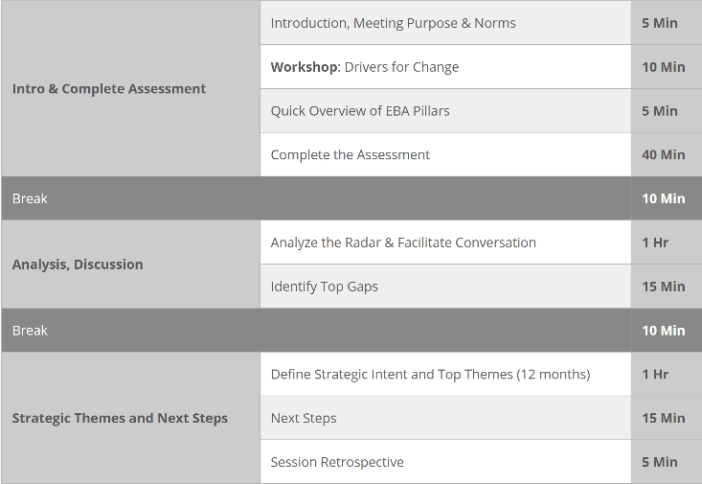
EBA Meeting Agenda
Detailed Meeting Agenda

Slide 46
Radar Analysis
Reading EBA radars
Learn About Maturity Stages
Analyze and Assess EBA Sample Radars

Slide 47
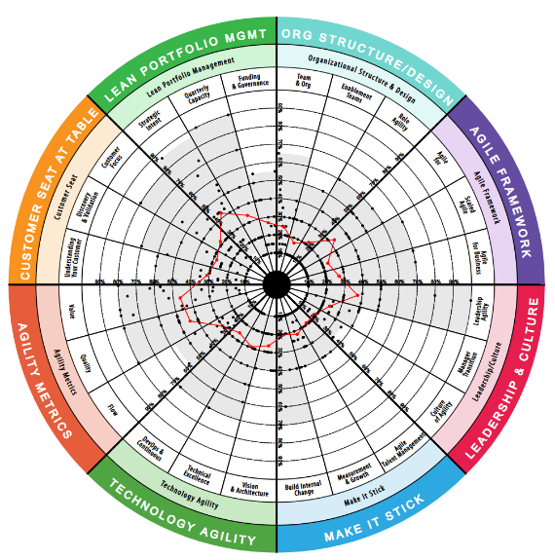
Reading EBA Radars
What is the overall maturity level of this team?
What potential cause & effect relationships can you identify?
What actions/ improvements will provide the greatest return?
Do you see any low-hanging fruit?

Slide 48
Workshop – Analyze the Radar
Break up into smaller sub-groups. Login to Enterprise Business Agility in training.agilityhealthradar.com.
Team to analyze: EBA Team
1- Analyze the radar
2- Document Strengths, Improvement areas, 2-3 recommendations, Maturity level
Link
Site: Training.agilityhealthradar.com
Company: Enterprise Business Agility
Team: Example EBA
Assessment: Baseline

Slide 49
Outcomes and Growth Plan
Build Outcomes and OKR’s
Build an Actionable Growth Plan

Slide 50
AgilityHealth® Continuous Improvement Model
Org Leaders
Agile Coaches
Managers
‘If you want to teams to align and achieve outcomes, you’ll need to hear their voice and remove obstacles.” – Sally Elatta
Teams
Scrum Masters
Product Owners

Slide 51
Alignment to Strategy at Every Level
Today we create 3 year strategy then focus all our effort on the ‘Work’ alignment column. Tomorrow, we need to shift focus to ‘Strategy’ alignment and outcome delivery over output.
Strategy
Funding
Work
Results
Growth
3 Year Outcomes
Budget
1 Yr.
Enterprise
Growth Items
3 Yrs.
Portfolio Business Plan
KPIs & Enterprise Performance
Enterprise
< 1 Yr.
Investment
3 – 12 Months
Portfolio Outcomes & Performance
Portfolio
Growth Items
1 Year Outcomes
Epics and Capabilities
Portfolio
Align and Achieve Outcomes
Roll-up and Remove Obstacles
3 Months
Team of Teams Capacity
Features
Team of Teams
Growth Items
Team of Teams
Quarterly Outcomes
1 - 3 Months
Team of Teams Outcomes & Performance
Outcomes & Goals
< 3 Months
Team
Capacity
User Stories
Iteration Outcomes & Performance
Team
Growth Items
< Iteration
Team

Slide 52
What is a Business Outcome?
The outcome or result sought by the business strategy or direction (what you're trying to achieve)
- Gartner 2017
Specific
Measurable
Meaningful
Business Value is realized when Outcomes are achieved!
Outcomes are valuable, planned, slowly changing and align our work to a common strategy.
- Evan Leybourn, Business Agility Institute
Notes:
@glenn – we don’t use this slide anymore, in our EBAS Cert course,

Slide 53
Types of Key Results
IMPACT/LAGGING
Measure the Business or Customer results you aim to achieve, make take more than a quarter to measure.
LEADING
Metrics we have control over that we can measure within the quarter/PI to validate we’re on track.
BALANCING
Guardrail metrics defined to protect against unintended consequences
IMPACT/LAGGING
Acquisition, Activation, Revenue, Retention, Referral, Cost Reduction, Market share
LEADING
Successful experiments, confidence of pilot users, page performance improvement, search results matching new offering,
BALANCING
Ensure quality doesn’t decrease if you have a ‘go faster’ metric.
Examples

Slide 54
Limiting Outcome WIP
Quarterly Outcomes can be:
A slice of one of the portfolio’s annual results
An outcome that will contribute to one of the annual results
Identify:
5 Key Results
1 to 2 outcomes that are tough but achievable – Provides Focus & Limits WIP

Slide 55
Types of Quarterly Goals
TEST IT (EXPERIMENTS)
Your idea is new and hasn’t been proven so you should focus this quarter on running experiments and validating your assumptions. This goal is usually owned by your Discovery team members.
For your quarterly outcomes, identify the right key results based on the goal
NAIL IT (MVP)
You’ve validated the idea and are now ready to build an MVP so you should pick metrics that prove the MVP is valuable, usable, feasible. Also consider performance and quality metrics.
SCALE IT (MMP)
You’re ready to hit the market so now you can measure Pirate like metrics and market share expansion, revenue and customer success metrics. Consider balancing metrics.

Slide 56
Team of Teams: Quarterly Outcomes
Team of Teams’ Outcomes to achieve in the next quarter that align back to the Annual Outcomes
Each outcome should:
Be clearly stated
Have measurable results
Be able to be completed in a quarter

Slide 57
Template: Outcome Card
Title:
Overall Progress:
Hypothesis:
Key Results / Metrics:
Title | Progress | Metric | Now | Target | Team of Teams
Customer/org Impact metric

Slide 58
Quarterly Outcome: Example
Title:
“Got to Have it” Small Business Vision Insurance Product
Overall Progress:
Hypothesis:
We believe that by launching a modern and innovative SMB vision insurance product to the market we will increase our market share for small business members.
Key Results / Metrics:
Title | Progress | Metric | Now | Target | Team of Teams
Increase SMB membership |  | Active Members | 30K | 37k | SMB Sales
Maintain Conversion Rate |  | Activation | 72% | 72% | SMB Delivery
Quote applications for vision insurance |  | Quotes | 0 | 12K | SMB Marketing
Customer/org Impact metric

Slide 59
Example: Team Quarterly Outcome
Title:
Increase quality and reduce escaped defects
Overall Progress:
Hypothesis:
We believe that by investing in test automation for our critical path customer journey use cases we will decrease the number of escaped defects in production.
43%
Key Results / Metrics:
Title | Progress | Metric | Now | Target | Team of Teams
Customer satisfaction |  | Active Members | 30K | 37k | SMB Sales
Test automation coverage for critical path |  | Activation | 72% | 72% | SMB Delivery
Reduce escaped defects in production |  | Quotes | 0 | 12K | SMB Marketing
60%
25%
50%
Customer/org Impact metric

Slide 60
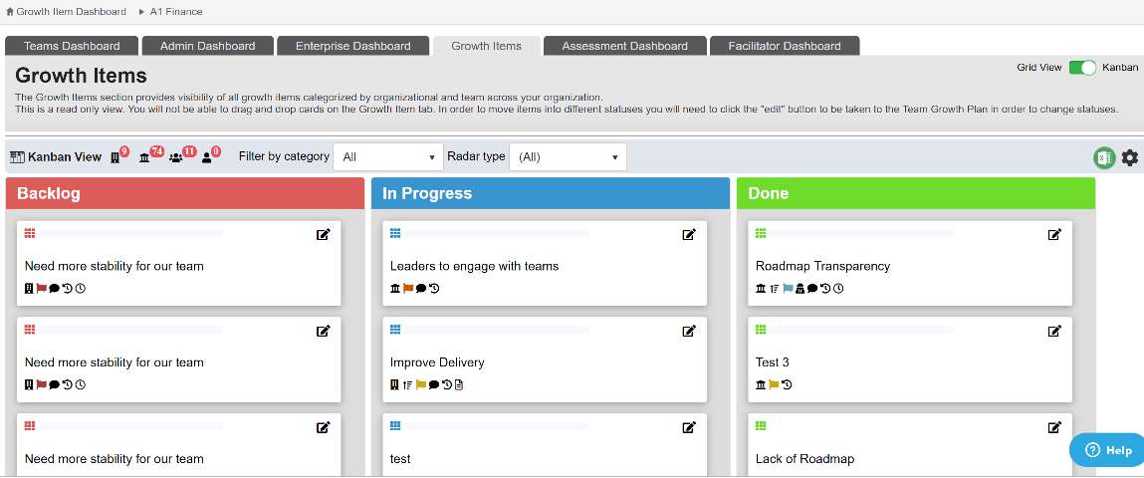
Growth Items Backlog

Slide 61
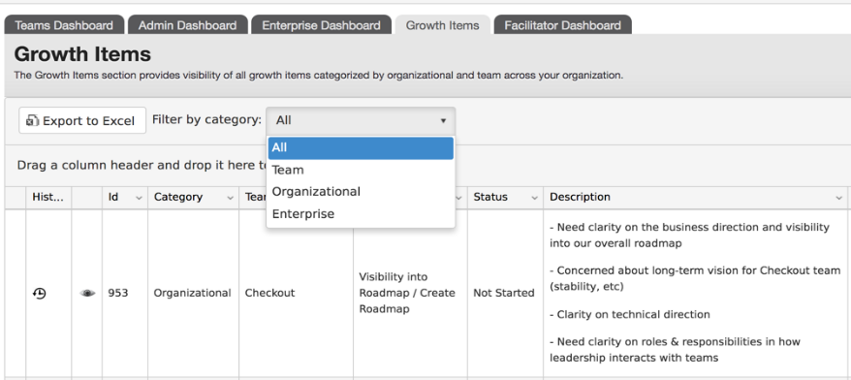
Growth Items Backlog

Slide 62
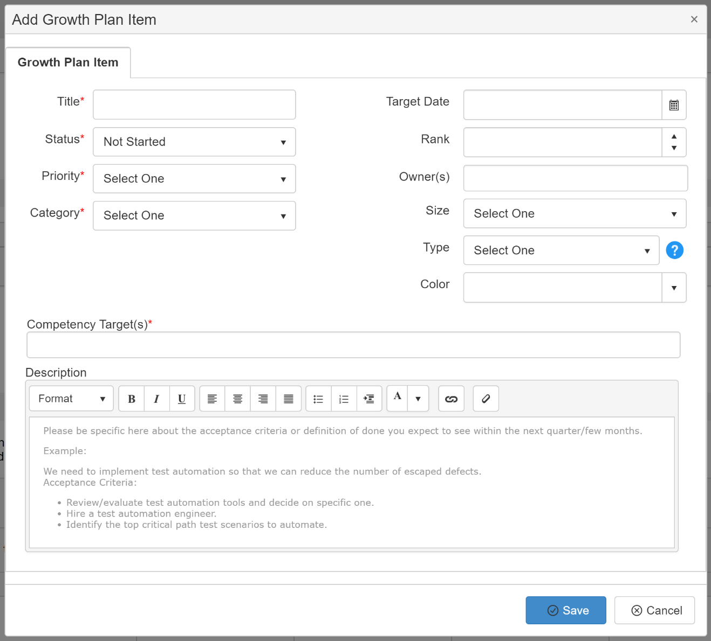
Create Growth Item
Notes:
Use this to clarify responsibility.

Slide 63
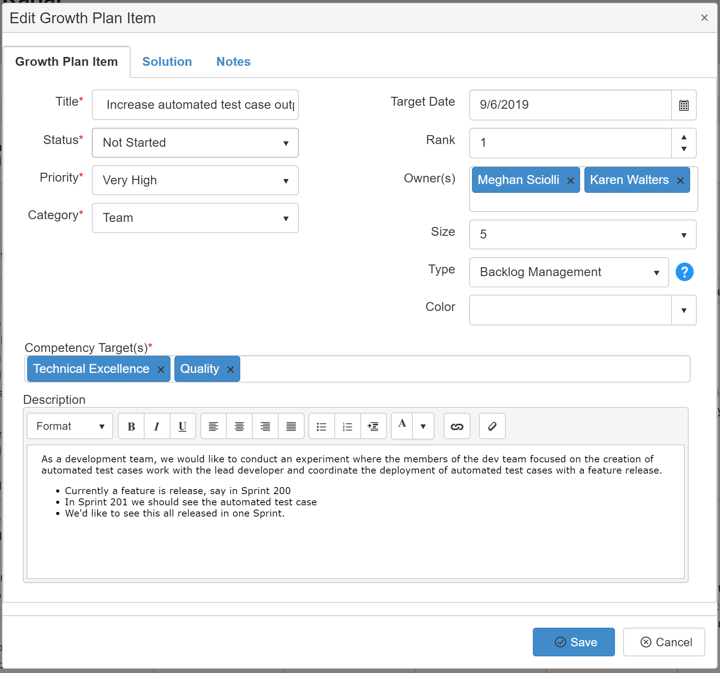
Creating Growth Items
Ensure Growth Items are added to the backlog to be worked by the Team
The self-organizing team functions as their own Product Owner for growth items
Ensure Growth Plan Items are tied to Competency Targets
Ensure Growth Plan Items, like good stories, are well-defined with acceptance criteria.

Slide 64
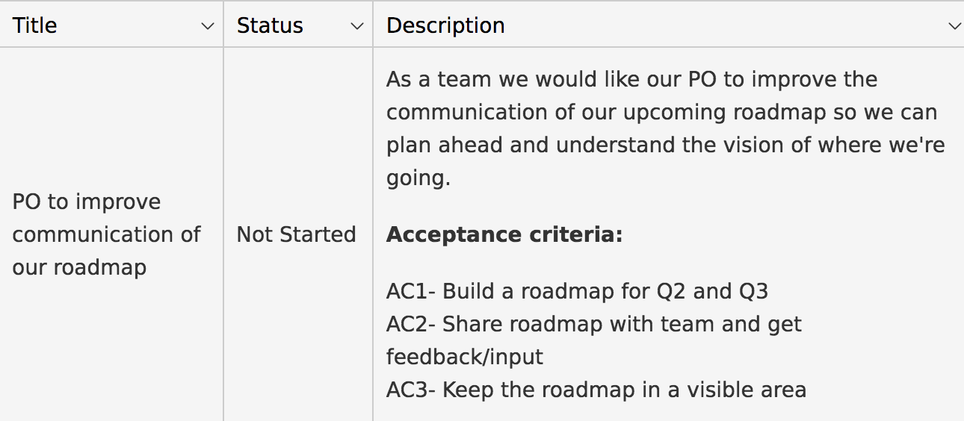
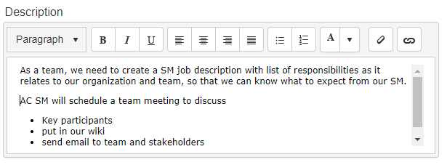
Good Growth Items Are Like Good Stories
S
pecific
M
easurable
A
chievable
R
ealistic
T
ime-Bound
Notes:
.

Slide 65
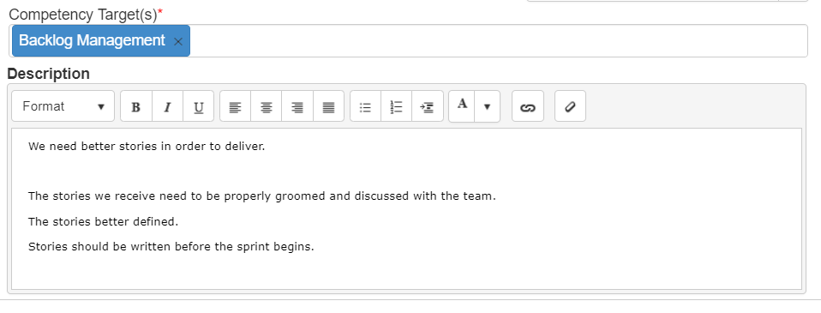
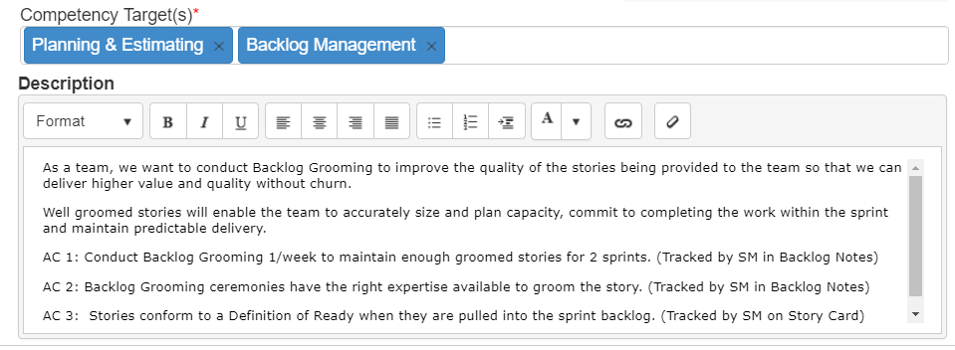
What Makes A Good Growth Item?
Not Good
Good
Written as a good user story
(INVEST or SMART)
Well defined acceptance criteria

Slide 66
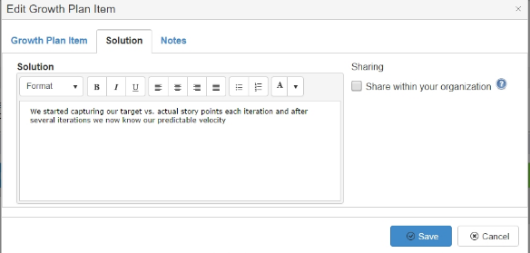
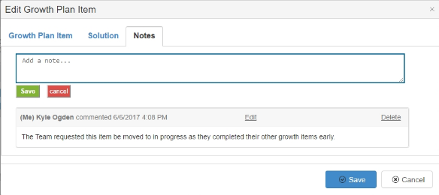
Growth Items - Solutions
Solutions for Growth Items can be added in the Solutions Tab. What did you do?
Sharing your solution with the organization means they will appear in the growth portal for this competency.
As Growth Items are being worked, the team can add notes to each item in the Notes tab.

Slide 67
Workshop – Build Actionable Growth Items
Working in groups, build 1-2 actionable growth items in our transformation team’s growth backlog.

Slide 68
Post Retrospective Activities
Assessment Notes
Engage Transformation Sponsor
Executive Debrief

Slide 69
Post-Retrospective Activities
Communicate to Transformation Sponsor their role in keeping the radar visible during each iteration and retrospectives
Add your assessment notes/observations and team maturity rating in the “Edit Assessment” page
Follow through with making sure organizational growth items are brought to leadership attention
Ensure all team members have access to results
Engage with Leadership to execute the transformation
1
2
3
4
5

Slide 70
1) Roles & Expectations
AgilityHealth® Facilitator
Transformation Sponsor
Execute Pre and Post retrospective activities
Facilitate retrospective and build continuous improvement plan
Rollup Org Growth Items and engage in analysis
Learn about Enterprise Business Agility and engage team
Help AHF with pre and post retrospective activities
Own the growth items, bring up during retrospectives

Slide 71
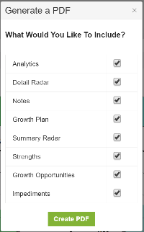
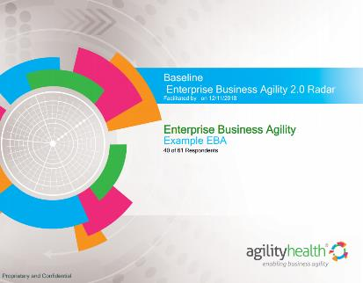
2) Make sure all Participants have access to results

Slide 72
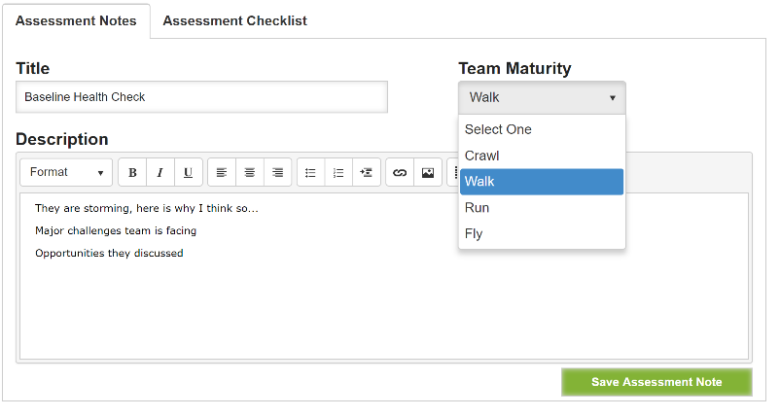
3) Assessment Notes
Making notes after the assessment is a very important step.

Slide 73
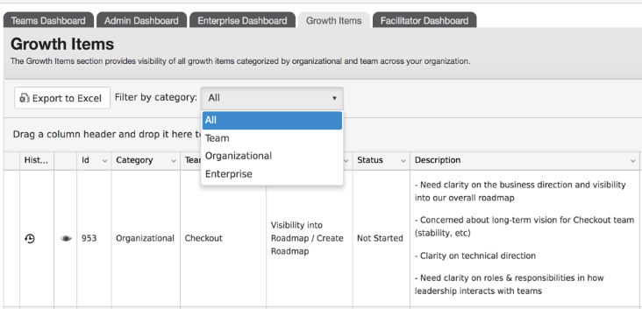
4) Organizational Growth Items

Slide 74
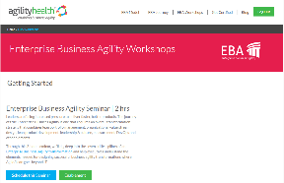
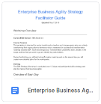
5) What Comes Next?
https://agilityhealthradar.com/eba-workshops/
1
Log into the EBA Portal
Watch Enablement Videos
2
Review Facilitator Videos / Guide for: EBA Seminar, EBA Assessment & EBA Strategy Session
3
Conduct an EBA Seminar
Facilitate an EBA Assessment
Facilitate an EBA Strategy Session

Slide 75
Enterprise Business Agility Journey
Team Agility - Measure TeamHealth - Enable Self-learning - Develop Talent
Org Agility - Lean Portfolio Mgmt. - Value Stream Structure - Lean Product Maturity
Enterprise Business Agility - Anticipate Customer Needs - Disrupt Before Being Disrupted - Relentless Improvement
Team of Teams Agility - Scaling Agile - DevOps Maturity - Leadership & Culture
Operational Agility - Customer Seat at the Table - Talent Development, HR Transformation - Ops, Finance, Legal, Audit, Sales/Mktg
Measure What Matters | Team Agility (Outcomes, Maturity & Performance) | Enterprise Agility (Flow, Value, Quality)

Slide 76
5) Executing Enterprise Business Agility
Define the Transformation Team
Socialize the EBA Assessment Results
Conduct Workshops
Build the Continuous Improvement Leadership Team & Select Growth Items
Certify Enterprise Business Agility Strategists
Provide EBA Overviews (as needed)
Develop Transformation Roadmap
Identify Ownership & Next Steps

Slide 77
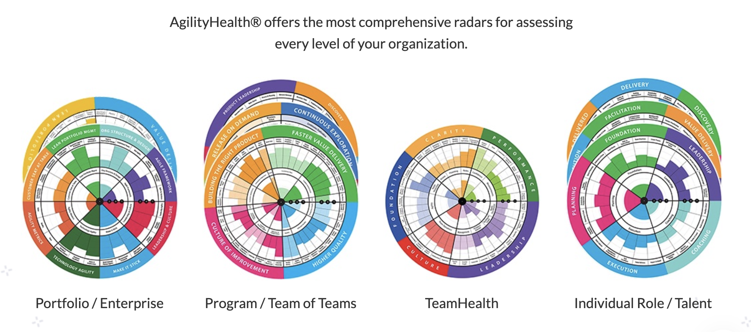
Assess Team and Talent Maturity at All Levels of the Org.
Notes:
Team Radars for all teams including leadership teams.
TeamHealth for all teams – our most popular and where most of our customers begin.
Team of Teams – The leadership teams (and key team members) for DevOps and Programs
Portfolio – The portfolio leadership teams, or multiple portfolio teams can be rollup/combined for a cross-enterprise view.
Individual Roles (talent). Such as agile coach, scrum master, manager, leader, etc.
For your customers using the SAFe scaling framework we have SAFe specific radars too.

Slide 78
Keys to Success
Educate Executives and Leaders on AgilityHealth Continuous Growth Program
Create Energy and Excitement, ‘Pull’ vs. ‘Push’
Communication and Marketing
Leaders Use Agile by Committing to Organizational Growth Stories for the Quarter
NEVER Punish or Reward Teams or Leaders Based on their Assessment Results

Slide 79
Learning Objectives
After completing this class, participants will:
Explain the benefits of the Enterprise Business Agility Strategic Retrospective
Set up a team and launch an assessment
Analyze a Enterprise Business Agility Radar
Build Transformation Team Continuous Improvement Plan
Engage with Leadership on an Organization Continuous Improvement Growth Plan

Slide 80
Next Steps
How do you start?
Completing your Certification
Piloting in AgilityHealth®
Partner Information

Slide 81
How Do You Start?
AgilityHealth® Assessments are created for companies and Partners who have purchased AgilityHealth® Assessments or Subscriptions
Each Facilitator must be assigned to a company and flagged as a Facilitator in order to create assessments
Your AgilityHealth Relationship | Getting Started
Your company is already using AgilityHealth® | Contact your Company Feature Admin to add you as a user in your company and flag you as an AgilityHealth® Facilitator
Your company is just starting a pilot | Contact your Company Feature Admin or team responsible for AgilityHealth® at your company to be added as a user in your company and flagged as a Facilitator
Your company does not have AgilityHealth® | Contact Us to Begin! https://agilityhealthradar.com/contact/
You are a New Partner | Email partnersales@agilityhealthradar.com to be set up as an AgilityHealth® Partner

Slide 82
Completing your Certification
Go to Learn.AgilityHealthRadar.com.
Complete the Course Feedback.
Complete the Quiz.
Once you have completed the feedback and the Quiz, you are done with the Course.
Upon completion of the course, you will be able to print your certificate and download you Badge.
Links to resources to get you started: AgilityHealth Implementation Resources on the Support site are also found through Learn.AgilityHealthRadar.com.

Slide 83
Next Steps - Piloting AgilityHealth®
Identify Pilot Teams and Purchase Assessments
Certify AgilityHealth® Facilitators
Execute Pilot Assessments
Build Continuous Improvement Plan with Leaders
Develop AgilityHealth® Rollout Plan

Slide 84
Next Steps for Partners
Already a Partner?
Go to https://agilityhealthradar.com/partner-enablement/ to get started
Need to become a partner?
Contact partnersales@agilityhealthradar.com to see if you qualify
Resources to help get you started.
Go to https://support.agilityhealthradar.com/hc/en-us/articles/360008189474-AgilityHealth-Implementation-Resources

Slide 85
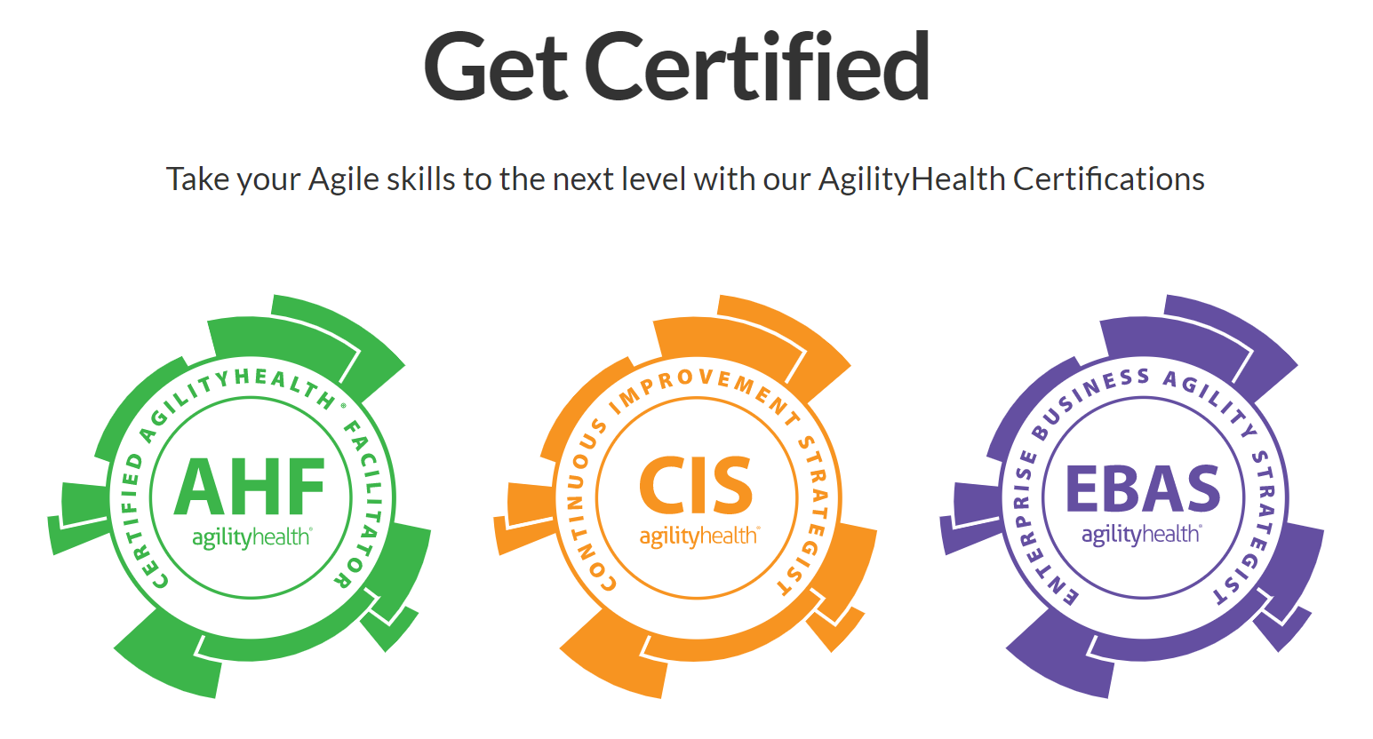
AgilityHealth® Certifications

Slide 86
Other EBA Resources
EBA Model
EBA Journey & Video
EBA Workshops
Upcoming Webinars
Upcoming Classes
Blogs
Email us: eba@agilityhealthradar.com

Slide 87
Thank You!

