Slide 1
Enterprise Business Agility Overview

Slide 2
<REPLACE WITH YOUR SLIDE>
Sally Elatta
AgilityHealth® CEO, Founder
Founder of AgilityHealth, AgileVideos.com
Frequent industry keynote speaker
2+ decades of experience in enterprise business agility transformation
Mother, Entrepreneur
Activist, founder of Sudan NextGen
Sally@agilityhealthradar.com
MEASURE & GROW PLATFORM
On-DEMAND LEARNING VIDEOS
STRATEGY & ENABLEMENT

Slide 3
Business Agility Definition
What Does Business Agility mean to YOU?
The ability to adapt to change, learn and pivot, deliver at speed, and thrive in a competitive market
- Sally Elatta, Evan Leybourn
… because, gone are the days when big eats small. Today fast is eating slow.
The ability to learn and deliver faster than competitors may be the only sustainable competitive advantage

Slide 4
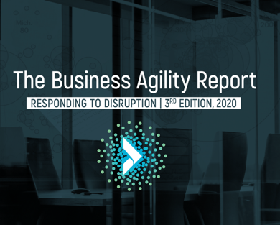
Why Business Agility?
Increased
Operating
Efficiencies
Improved
Relationships
With Customers
Greater Transparency
And Higher Employee
Engagement
Increased Revenue,
Market Share, and
Brand Recognition
Faster Turnaround
Times and Higher
Quality Offerings
https://agilityhealthradar.com/business-agility-report-2020-results/

Slide 5
The Enterprise Business Agility Journey
Team Agility - Agile Adoption (Scrum, Kanban) - Cross-Functional Teams - Agile Tools and Workspace
Org Agility - Lean Product & Portfolio Mgmt. - Value Stream Structure - Digital Transformation
Enterprise Business Agility - Anticipate Customer Needs - Disrupt Before Being Disrupted - Sustain a Learning Culture
Team of Teams Agility - Scaling Agile - DevOps Maturity - Leadership & Culture
Talent Development, Innovation, & Operational Agility - Customer Seat at the Table - Talent Development, HR Transformation - Ops, Finance, Legal, Audit, Sales/Mktg
Measure What Matters | Team Agility (Outcomes, Maturity & Performance) | Enterprise Agility (Flow, Value, Quality)

Slide 6
Workshop: Your Top Challenges
What gets in our way?
What are the TOP challenges you face with executing on your strategic priorities?

Slide 7
Problems We Are Trying to Solve
Competing business priorities
Focus on delivering output not outcomes
Painful enterprise planning processes
Demand and Capacity are not aligned
Can’t find or upskill talent fast enough
Unsustainable pace, burnout, low morale
Ineffective team design, cross-team dependencies
High waste - features delivered with little customer engagement
No portfolio leadership teams
Tech vs. Business Teams
Leaders still using command and control
Limited voice of the customer
Not measuring what matters
Teams not empowered to solve problems
Ineffective portfolio funding models

Slide 8
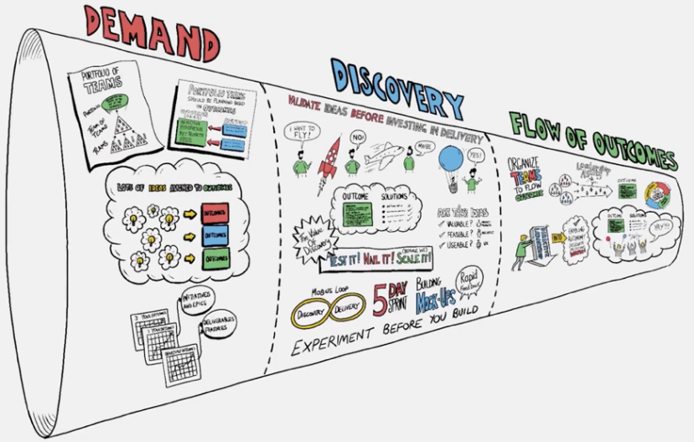
Enterprise Business Agility Explainer Video
https://agilityhealthradar.com/videos/business-agility/

Slide 9
The 7 Pillars to Invest In “At a Glance”
Develop a deeper understanding and engagement with your customers and deliver high-impact solutions to market faster…
Customer Seat at the Table
Develop core Agility-enabling Technical capabilities
Technology Agility
Lean Portfolio Management
Drive your strategy with alignment to outcomes
Build internal capabilities to sustain and scale Agility
Make it Stick / Sustain
Org. & Team Design
Simplify Delivery and Increase Collaboration & Innovation
Leadership Agility
Agile Mindset & Framework
Engage, Energize, and Empower Your Teams
Leverage Agile Practices to Optimize Iterative Delivery

Slide 10
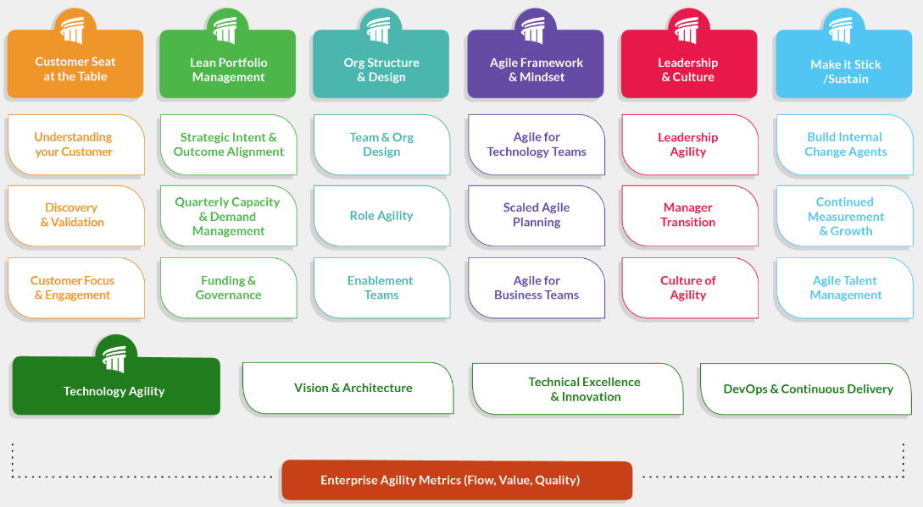
Enterprise Business Agility Strategy Model
http://www.agilityhealthradar.com/EBA

Slide 11
What is EBA Model?
http://www.agilityhealthradar.com/EBA
The Enterprise Business Agility model provides senior leaders with an integrated strategy for where to invest in order to accelerate and achieve their Enterprise Business Agility vision.
It is a non-prescriptive, pull-based model that provides proven patterns and integrates with Agile, Scrum, Kanban, & SAFe®.

Slide 12
10 EBA Guiding Principles
Invest in Technology Agility
Transform leaders at all levels
Enable the Agile / Lean mindset across the enterprise
Enable organizations to ‘make-it-stick’
Measure what matters (Flow, Value, Quality, Happiness)
Discover before we deliver
Design ‘virtual’ organizations that deliver outcomes
Align teams to measurable business outcomes
Align strategic Demand to Capacity
Enable role agility
Notes:
Notes:

Slide 13
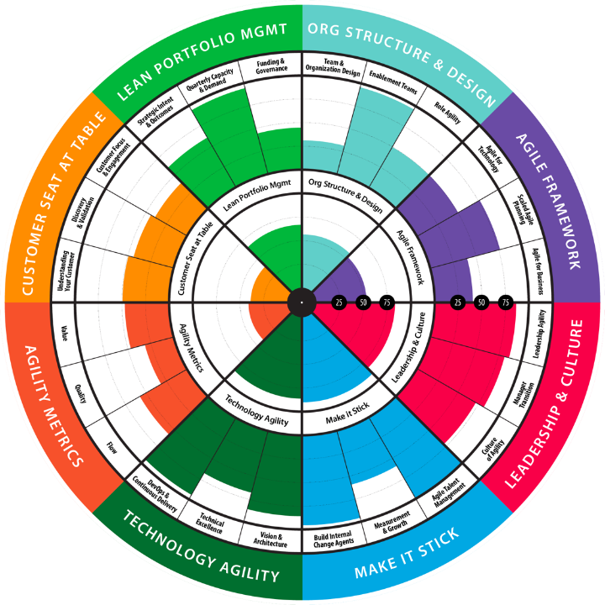
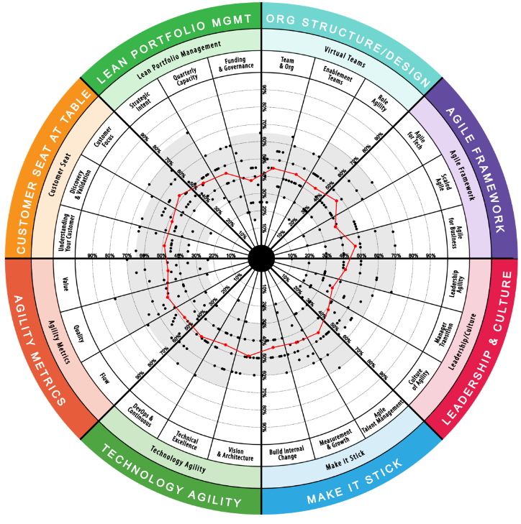
EBA Radar
Assess your current Enterprise Business Agility Maturity across the 7 pillars.
Notes:
Notes:

Slide 14
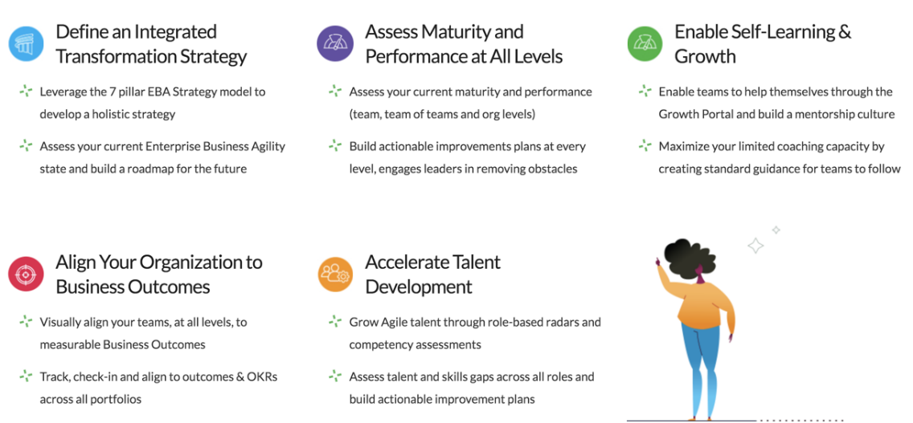
How to Accelerate the Journey
Notes:
These are the specific areas AgilityHealth can help with to accelerate the journey
Notes:

Slide 15
How we take the EBA journey matters
Line of Business Driven - Enterprise Enabled
Lines of business leaders opt-in and decide how to bring Enterprise Business Agility into their organization.
Each leader commits to bring the necessary talent, time and resources to the journey. They commit to exhibiting Leadership Agility.
The enterprise provides the coaches, patterns and support needed to enable the lines of business to successfully implement EBA.

Slide 16
Our Approach: The EBA Enablement Model
Education & Awareness
Educate leaders, change agents and stakeholders
Gain buy-in and generate energy for the need for change
Strategy & Measurement
Measure baseline maturity for Enterprise Business Agility and Team Agility
Define vision, outcomes and roadmaps. Define transformation team.
Design a continuous Improvement strategy
Jump
Starts
Identify the right 12-week EBA jump starts that align to current transformation priorities
Execute jump starts and mentor internal change agents
Enable
and Scale
Build internal change leaders to help scale and sustain
Train the trainer (T3) and license courseware
Build re-usable assets and toolkits
Scale learning across the enterprise
Notes:
This is the approach we take with an organization that wants to start the EBA journey to ensure internal capabilities are built for scaling EBA.

Slide 17
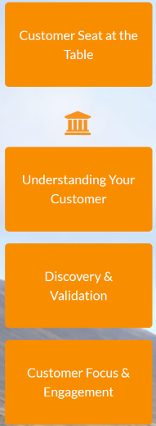
Customer Seat At The Table
Discover before you deliver

Slide 18
Customer Seat At The Table Is…
Deeply understanding your customer and engaging them from start to finish. Creating a customer-focused culture where everyone sees their day to day jobs to be done from the lens of how it affects the customer.

Slide 19
A Closer Look: Customer Seat at the Table
Deeply understanding
your customer
and engaging them
from start to finish
Identifying the qualities
you need to deliver
to win per
customer segment
Leveraging Experiment-Driven Discovery and
Rapid Prototyping for
concept validation and accelerated delivery

Slide 20
Enable the Enterprise FLOW of Value
Strategic Outcomes
Operations & Support
Grow
Transform
Run
Transform
Demand Management
Delivery Management
Opportunity Assessment
Solution Discovery
Agile Delivery
Solution Discovery
Customer Insights and Feedback
Who are the customers?
Is this the right market/ opportunity?
What outcomes do we want to achieve? At what cost?
What problem are we solving and for who?
How can we experiment and learn before scaling? Is our solution valuable, usable & feasible?
What are the min features we need to build? Who should we engage for feedback? How can we build quickly and iterate with feedback? How will we measure results?
Portfolio Team
Discovery Team
Delivery Teams
F L O W o f V A L U E

Slide 21
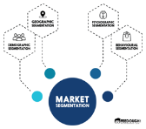
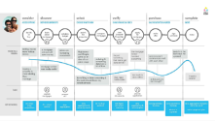
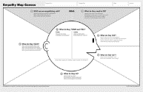
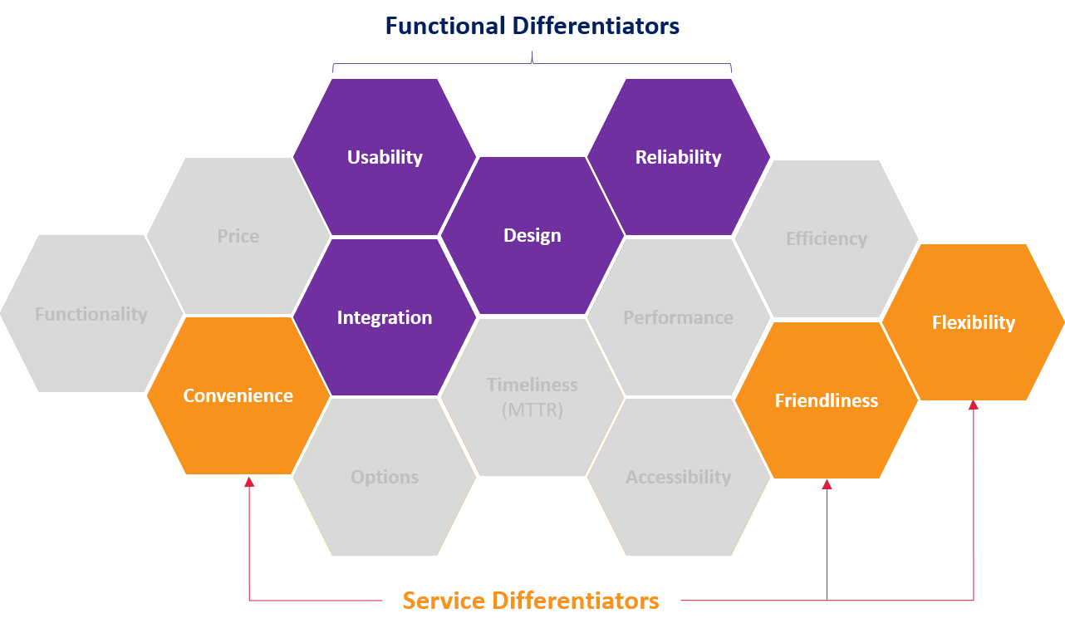
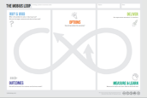
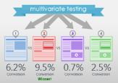
From Insights to High Impact Solutions!
Strategic
Segmentation
Strategic
Segmentation
Customer
Personas
Customer
Personas
Differentiated
Strategic Positioning
Empathy
Maps
Differentiated
Strategic Positioning
Empathy
Maps
Customer
Journeys
Customer
Journeys
Discovery to Delivery
With the Mobius Loop
Rapid Prototyping
& Testing Strategy
Measurement
Plan
Accelerating Your
Learning Process
Dual Track
Agile

Slide 22
Activity
Complete the Customer Seat assessment Questions
Notes:
Notes:

Slide 23
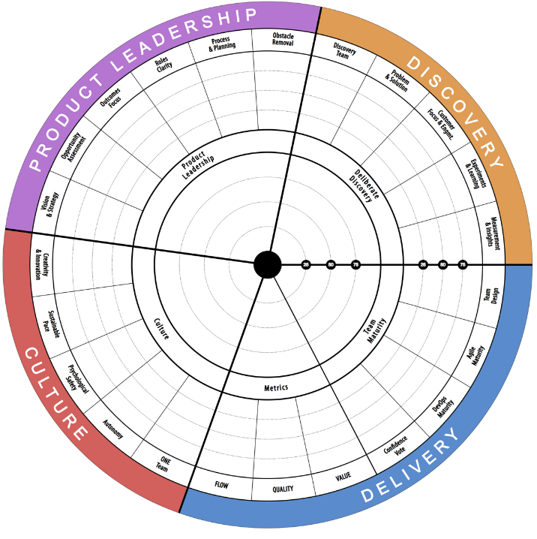
Product Health Radar
You can perform a deeper assessment of your Product Development Maturity using this radar.
Notes:
Notes:

Slide 24
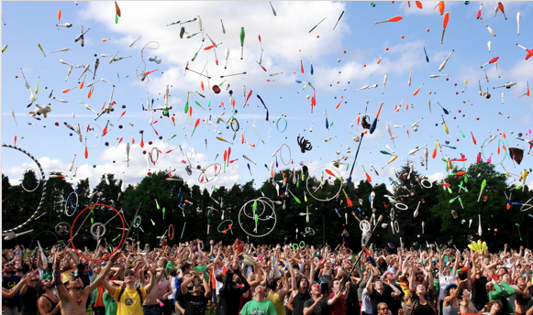
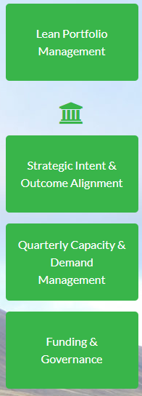
Lean Portfolio Management
Plan and align to outcomes

Slide 25
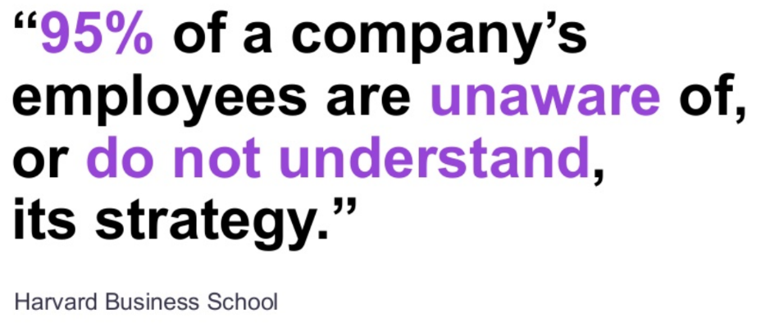
Why Lean Portfolio Management?

Slide 26
Problems we are trying to solve with LPM
Gaps in Strategic Clarity
& Rigid Funding Models
No Single Point of Entry due to Lacking Qualification Process
Focus on Outputs, Rather than Outcomes
False illusion of Progress by Starting New Initiatives
Lack of Alignment, Causing Serious “Delivery Friction”
Consistently Taking on Too Much Work
Constant People Shifting
and no Clear Understanding
of Capacity
Annual Planning is Painful & Ineffective
Informal, Ineffective Prioritization Practices
Unclear what ”Done” or ”Good” looks like
Notes:
False illusion of progress by starting new projects
Consistently Taking on Too Much Work
Annual Planning is Painful & Ineffective

Slide 27
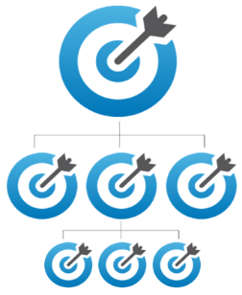
Lean Portfolio Management Is…
Providing clarity to strategy and alignment to outcomes at every level. Planning quarterly with a focus on delivering outcomes over outputs and matching demand to capacity

Slide 28
A Closer Look: Lean Portfolio Management
Ensure your Strategy is Clear, Pragmatic, and Aligned across your organization
Focus on what truly matters, the Business Outcomes you’re working to achieve
Define clear priorities, with a pragmatic approach to Capacity & Demand

Slide 29
Alignment to Strategy at Every Level
Today we create 3 year strategy then focus all our effort on the ‘Work’ alignment column. Tomorrow, we need to shift focus to ‘Strategy’ alignment and outcome delivery over output.
Strategy
Funding
Work
Results
Growth
3 Year Outcomes
Budget
1 Yr.
Enterprise
Growth Items
3 Yrs.
Portfolio Business Plan
KPIs & Enterprise Performance
Enterprise
< 1 Yr.
Investment
3 – 12 Months
Portfolio Outcomes & Performance
Portfolio
Growth Items
1 Year Outcomes
Epics and Capabilities
Portfolio
Align and Achieve Outcomes
Roll-up and Remove Obstacles
3 Months
Team of Teams Capacity
Features
Team of Teams
Growth Items
Team of Teams
Quarterly Outcomes
1 - 3 Months
Team of Teams Outcomes & Performance
Outcomes & Goals
< 3 Months
Team
Capacity
User Stories
Iteration Outcomes & Performance
Team
Growth Items
< Iteration
Team

Slide 30
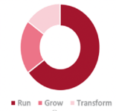
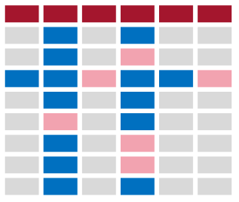
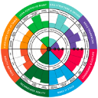
A Snapshot of LPM Best Practices
Strategy Development
Outcomes-Based
Strategic Planning
Organizational
Alignment
Current vs Target Capacity Allocation
Value Based Prioritization
Demand vs Capacity Mgmt.
Organizational & Team
Quarterly Planning
Outcomes & Obstacle
Transparency
Measurement &
Governance
LPM Team, Tools & Funding
Notes:
Create Poll in Zoom, which of these is most critical for your organization right now – up to 3 votes

Slide 31
Outcomes vs Output
Objective:
Create an Awesome Customer Experience
Key Results:
• Improve Net Promoter Score from X to Y.
• Increase Repurchase Rate from X to Y.
• Maintain Customer Acquisition Cost under Y
• Improve page load times to less than 2 sec
Output:
• Launch capability XYZ to market.
• Redesign the customer journey.
• Complete top 5 features requested.
Outcome
Output
The Outcomes/OKRs you are trying to achieve (Customer Value)
Things you are going to do to achieve your Outcomes (Deliverables, Activities, Features, Stories)

Slide 32
Sample: Annual Outcome
Title:
Auto-Form Data Fill Feature for Online Applications
Overall Progress:
Hypothesis:
We believe that by implementing the ability to auto-populate applicant data we already possess, it will improve completion rates and drive higher applicant customer satisfaction levels.
Key Results / Metrics:
Title | Progress | Metric | Now | Target | Team of Teams
TBD |  | TBD | TBD | TBD | TBD
TBD |  | TBD | TBD | TBD | TBD
TBD |  | TBD | TBD | TBD | TBD

Slide 33
Sample: Annual Outcome with Key Results
Title:
Auto-Form Data Fill Feature for Online Applications
Overall Progress:
Hypothesis:
We believe that by implementing the ability to auto-populate applicant data we already possess, it will improve completion rates and drive higher applicant customer satisfaction levels.
Key Results / Metrics:
Title | Progress | Metric | Baseline | Current | Target
Streamline Application Process |  | Avg. Time to Complete App. | 28 min. | 27 min. | 22 min.
Increase Application Completion Rate |  | % App. Completion Rate | 64% | 65% | 75%
Increase Applicant Customer Satisfaction |  | % NPV 8+ | 72% | 78% | 85%
Customer/org Impact metric

Slide 34
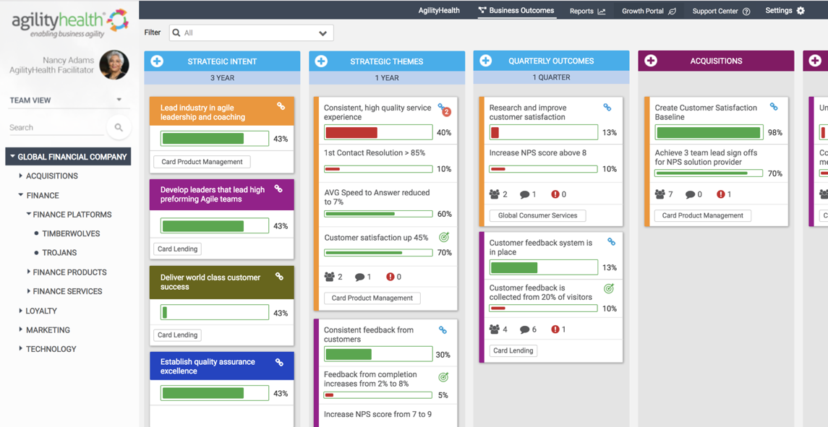
AgilityHealth | Outcome Alignment Dashboard

Slide 35
Workshop: Your LPM Maturity
Where to focus?
How mature is your current Strategy to execution alignment? Which LPM practices could be helpful to adopt?

Slide 36
Activity
Complete the LPM assessment Questions
Notes:
Notes:

Slide 37
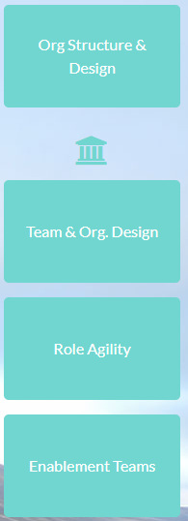
Org and Team Design for Agility
Optimize for FLOW of Outcomes - Break Dependencies

Slide 38
Organizational Structure & Team Design Is…
Intentionally designing the structure or your organization to maximize agility for FLOW of VALUE. Alignment of all teams (business & technology) to accelerate the delivery of measurable outcomes.
This is a virtual structure not physical re-org change. We care more about how outcomes FLOW rather than who reports to who.
FLOW
Notes:
Notes:

Slide 39
Current State: The Delivery “Spaghetti of Despair”
Demand Group 1
Demand Group 2
Demand Group 1
Demand Group 2
Demand Group 5
Demand Group 6
Demand Group 7
Demand Group 8
Delivery Group 1
Delivery Group 2
Delivery Group 3
Delivery Group 4
Delivery Group 5
Delivery Group 6
Delivery Group 7
Delivery Group 8

Slide 40
Many Organization’s Are Structured Like This Today…
Sales
Marketing
Product Mgmt.
Delivery
Compliance
Operations

Slide 41
… But This is How We Actually Work!
Sales
Marketing
Product Mgmt.
Delivery
Compliance
Operations

Slide 42
How Might We…
Align teams around business outcomes and enable FLOW?
Give them stability and focus with the right allocation?
Design true end to end cross-functional teams?

Slide 43
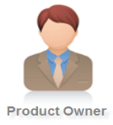
Basic Team Structure
Business Vision What? Why?
How?
Process Facilitator
Solution Vision

Slide 44
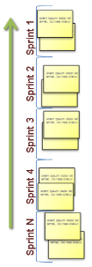
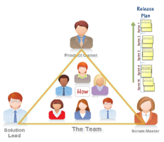
Team of Teams Level
What are the Jobs to be Done for each role?
Team of Teams Backlog
Product Manager
Stakeholders
PULL from the Backlog
System / Solution Architect
Program Mgr. / RTE
Notes:
Notes:

Slide 45
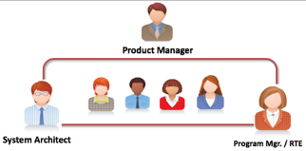
Portfolio – LPM Team
Portfolio Backlog
What are the Jobs to be Done for each role?
Portfolio Owner / Leader
PULL from the Backlog
Enterprise Architect / Business Architect
Portfolio Mgr.
Team of Teams 1
Team of Teams 2
Team of Teams 3
Notes:
Notes:

Slide 46
Role Agility | Enabling Success for New Roles
Team Level
Team of Teams
Portfolio Level
Scrum Masters
Product Owners
UX Designers
Agile Coaches
Product Managers
Program Mgrs./RTEs
Agile Managers/Leaders
DevOps Coaches
Portfolio Owners
Portfolio Mgrs.
Business and Tech Executives
Enterprise & Business Agility Coaches
Many of these roles are impacted. Need to invest in talent development and change mgmt.

Slide 47
The Buckets of Work | RGT
Run Operate & sustain
Sustain, retain and renew existing business
Run essential processes
Keep the lights on
Manage cost
Grow Enhance & expand
Extend current products/services
Enter new markets
Support sales and growth
Execute on strategic themes
Transform Innovate & Disrupt
Innovations & experiments
New capabilities & income streams
Disrupt yourself before being disrupted
Modernize platforms (could be Run)
Notes:
Notes:

Slide 48
Workshop: Your Org/Team Design
Where to focus?
How mature is your current org/team design? Where are the gaps?

Slide 49
Activity
Complete the Org/Team Design assessment Questions
Notes:
Notes:

Slide 50
Activity
Complete the Agile Framework assessment Questions
Notes:
Notes:

Slide 51
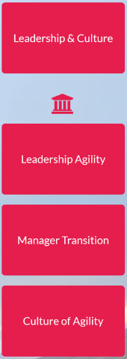
Leadership & Culture
Leading New Ways of Working

Slide 52
What is Leadership Agility?
Leadership Agility is the work of energizing, empowering and enabling teams to rapidly and reliably deliver business value by ...
engaging customer | continuously learning |adapting to an ever changing environment
– adapted from Jim Highsmith, Adaptive leadership

Slide 53
A Closer Look: Leadership and Culture
Evolve your Leadership mindset and behaviors to support the new modern ways of working
Provide strategic clarity and alignment, empower the teams and create a learning and experimentation culture
Embed a culture of relentless Continuous Improvement into your core DNA

Slide 54
A High Performance Culture
Clarity
Who are we and how do we behave?
What is important now? Why?
Healthy Culture
Predictable Execution
Focus
Can we deliver customer value predictably?
Can we stay focused till ‘Done’?

Slide 55
Top Unhealthy Leadership Behaviors
Telling the team HOW to do the work – managing daily tasks
Top down decision making, no input from teams
No clarity on vision, direction or measurable goals
Constantly shuffling people between priorities/teams
Command and Control style of leading
Tactical focus, no strategic foresight
Status Quo – no effort to improve processes
Unrealistic deadlines and expectations
Disengagement and lack of visibility into their backlog
Change resistance and no change management plan
Not investing in learning
Chasing shining objects, no focus or alignment
Planting weeds, fostering a negative culture
Adversary to the business instead of partner
Doesn’t seek or take input from others
Not transparent or authentic, leads through fear

Slide 56
Top Healthy Leadership Behaviors
Empowers and grows others
Collaborates on decision making
Provides clarity of purpose and clear goals
Maintains FOCUS. Let’s people finish what they start
Listens genuinely cares about their input
Strategic focus and foresight
Relentless about continuous improvement
Removes obstacles quickly
Transparent, authentic, humble
Welcomes and embraces change
In tune with ‘layer below surface’
Strong facilitator of team meetings
Builds healthy culture and norms
Partners with Business
Practices what s/he preaches
Influences others

Slide 57
Where Managers Focus Today
Opportunity : Shift from doing the work to enabling teams to deliver value
Focus: Provide Expertise, Solve Problems, Transfer Knowledge to Others
Focus: Get Work Done Resource allocation and shuffling
Task management and tracking
Fire fighting
Subject Matter Expert
Work Mgmt. & Fire Fighting
Future
People Development
Focus: Growth of Individuals
Provide 1:1 coaching Career Development
Performance Reviews
Process Improvement
Focus: Improve Processes
Address process inefficiencies
Provide Necessary Tools
Provide Training and Education
Establish Standards and Best Practices
-
Notes:
- Management should focus on ‘People Development’ and ‘Process Improvement’ and realizing that the team has the other two.
https://blog.versionone.com/the-role-of-functional-managers-in-agile-from-tactical-to-strategic/

Slide 58
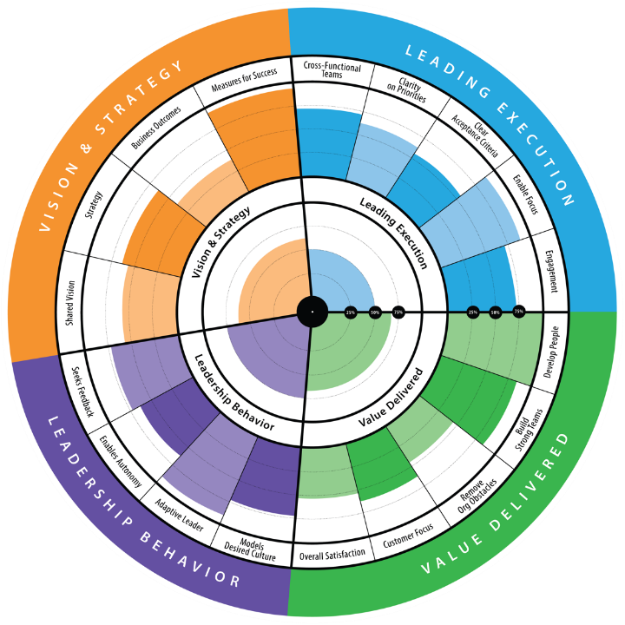
Leadership Agility Radar
Assess and grow leadership skills

Slide 59
Role Transition Paths
Managers can transition to new roles.
People/Team Leader
Operational Manager
Program Manager
Technical/ Business Architect
CoP/CoE Leader
Coach
Transition Managers to the Right Roles

Slide 60
Lessons Learned for Leadership Transformation
It’s a journey that takes time, it’s not a class
Design quarterly learning experiences
Enable self-learning
Start from the top, lead by example
Create accountability
Build a Community
Measure leadership growth

Slide 61
Workshop: Your Leadership Priorities
Where to focus?
Where should you focus to enable Leadership Agility?

Slide 62
Activity
Complete the Leadership assessment Questions
Notes:
Notes:

Slide 63
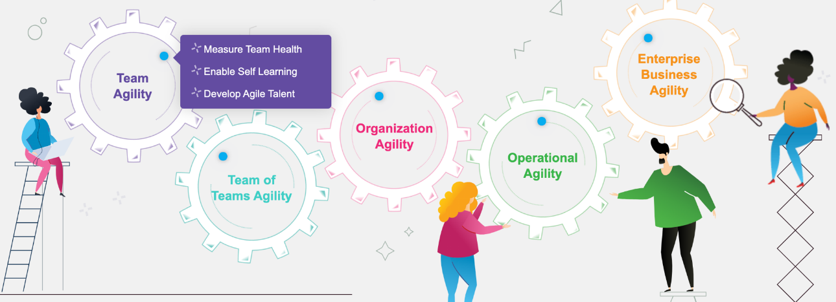
Measure & Grow at Every Level
Notes:
AgilityHealth DEMO VIDEOS: https://agilityhealthradar.com/videos/agilityhealth-demo/

Slide 64
The 6 Measurement Questions to Ask
1
2
3
Who are my teams and how are they organized?
Are they maturing and performing at every level?
Where can they grow? Where should leaders help?
4
Are they showing measurable growth and increased productivity over time?
5
6
Are the teams aligned to business outcomes and achieving results?
Where do we have talent gaps and how to address them?

Slide 65
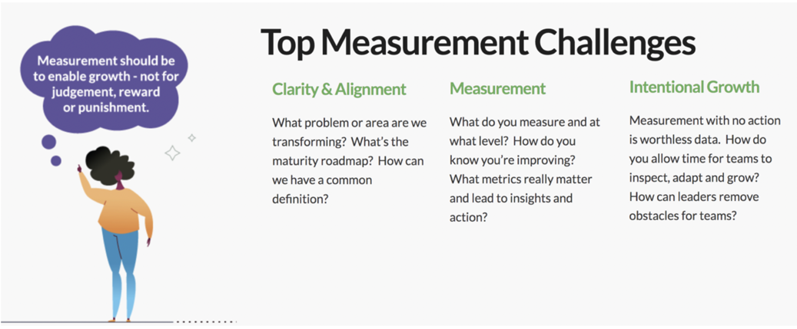
Measurement Challenges

Slide 66
AgilityHealth Measure & Grow Platform
AgilityHealth® is the world’s leading measurement & growth platform for accelerating Digital talent development & Enterprise Agility.
Measure
Grow
Accelerate
www.AgilityHealthRadar.com

Slide 67
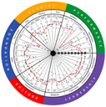
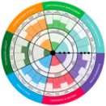
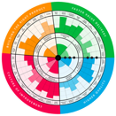
What to Measure at Each Level
Team Agility
Team of Teams Agility
Org Agility
Team Health & Performance
DevOps, Lean Product Mgmt. & ART Health
EBA, LPM or Digital Transformation
Product Managers, Agile Leaders,
RTE, Coach Health
Scrum Master, Product Owners
Portfolio Leaders and Managers
Notes:
Animated slide, I’ll speak to the team agility measures, then team of teams then org agility

Slide 68
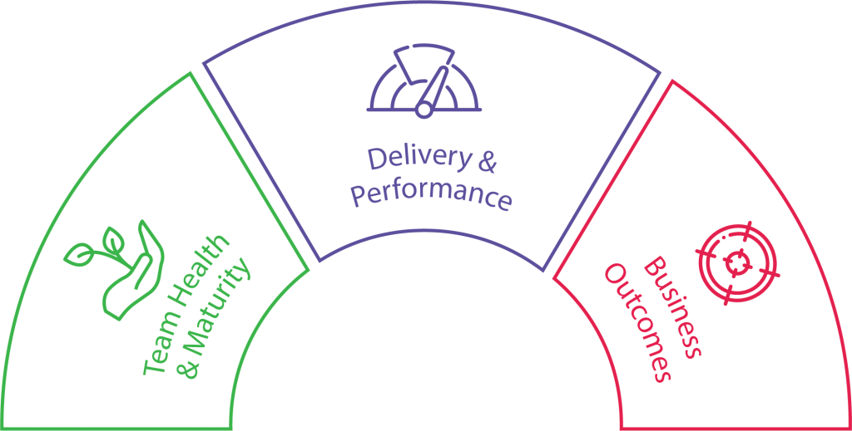
What Should We Measure? The 3 Metrics That Matter
Outcomes are THE Metrics that Matter
Maturity and Performance tell us WHY we’re not achieving outcomes.
Performance
Output metrics (features, quality, cycle time ..etc)
Maturity
Behaviors & practices
Outcomes
Results (OKRs)
Notes:
Let’s focus on the “people” – Their health and the maturity of their agile practices and behaviors
Agile work management platforms – Do not forget to mention LeanKit

Slide 69
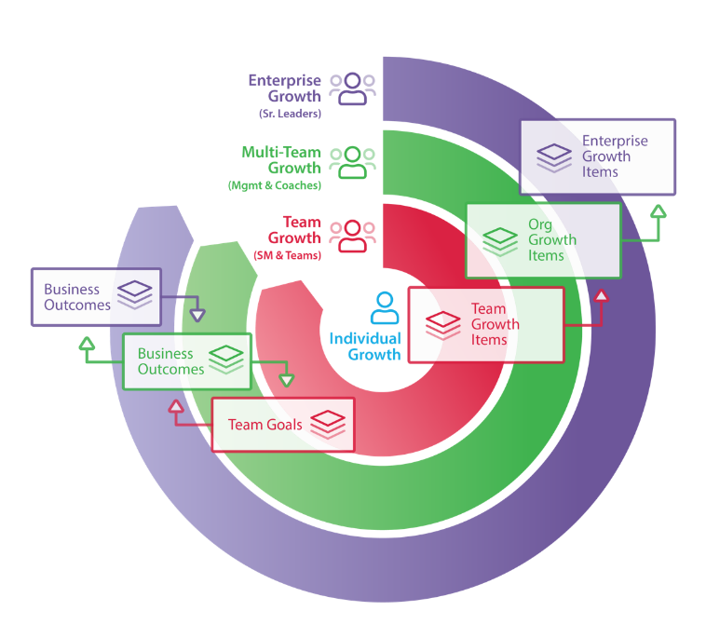
AgilityHealth’s Continuous Improvement Model
‘If you want to teams to align and achieve outcomes, you’ll need to hear their voice and remove obstacles.” – Sally Elatta
Notes:
Team Growth Enables growth at the team level. This backlog contains Team Growth and Organizational Items for leaders to address. Multi-Team Growth Enables growth at the Line of Business, Program or Product levels. This backlog contains Organizational Items from sub-teams and Enterprise Items for executives to address.
Enterprise Growth Enables growth at the Portfolio and Enterprise levels. This backlog contains Enterprise Growth Items from all levels of the organization.

Slide 70
Six Key Capabilities of the AgilityHealth® Platform
Watch Short Demo Videos

Slide 71
Measure & Grow at Every Level
Portfolio / Enterprise - Enterprise Business Agility® - Lean Portfolio Mgmt. - Digital Transformation*
Team of Teams / Product - Lean Product Health
- DevOps Health
- Scaling Agile
Team Level - TeamHealth®
- Technical Agility
- Remote Work Health
Role/Talent Dev - Scrum Master, Product Owner
- Agile Leader
- Agile Coach, RTE, others*
8 new SAFe® Radars have just been launched!
Notes:
We recommend starting with TeamHealth and EBA to get a top down and bottom up view and develop a clear strategy for growth.

Slide 72
Workshop: Your Measurement Priorities
Where to start measuring?
Based on your transformation priorities, what should you start measuring at each level?

Slide 73
Activity
Complete ALL remaining assessment Questions
Notes:
Notes:

Slide 74
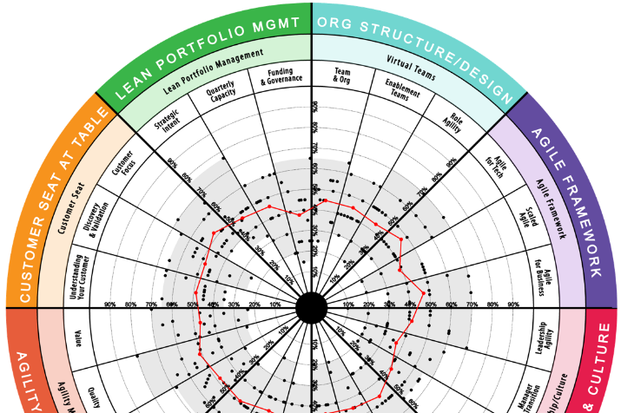
Review Results & Growth Planning
Notes:
DEMO VIDEOS: https://agilityhealthradar.com/videos/agilityhealth-demo/

Slide 75
Workshop: Review Results
Where are we now?
Log into AgilityHealth
Review radar and textual responses
Analyze and reflect

Slide 76
Workshop: Build Growth Plan
Identify 2 or 3 areas to focus
Write transformation objectives for 1 year
Write acceptance criteria for 3 months
Where should we focus?

Slide 77
Appendix

Slide 78
A Closer Look: Agile Framework & Mindset
Adopt and Internalize an agile/adaptive Mindset across your organization
Assess, customize, and adopt Agile practices optimized to deliver value for your specific culture and business needs
Architect and implement scalable Agile methods, where alignment, collaboration, innovation, and accelerated Time-to-Market are keys to success
Areas of Focus
Agile for Technology Team
Adoption of optimized Agile methods (if not already in place)
Where already adopted, increasing: Delivery Velocity, Quality, Predictability, & Adaptability
Scaled Agile Planning
Optimized Scaling methods
Strategic, Portfolio, & Release Planning alignment
Accelerated delivery and increased predictability for complex solutions
Agile for Business Teams
Adoption of Agile tailored specifically for business teams:
Visualizing work, Prioritization, Stand-Ups, Improved Estimation, Retrospectives, etc.

Slide 79
A Closer Look: Make it Stick / Sustain the Change
Identify and enable the internal capabilities and “Change Agents” responsible for leading, optimizing, and evolving your Business Agility efforts
Adopt the mindset, tools, and practices to enable sustained Continuous Improvement, Growth, and Adaptability across your culture
Proactively evolve your Talent Mgmt. capabilities to enable broad-based Agility
Areas of Focus
Building Internal Change Agents
Identify and enable internal Change capacity and leadership
Provide access to targeted enablers to accelerate their Agility path
Build clear, scalable Agility roadmap
Continuous Measurement & Growth
Align teams and stakeholders on “What Good Looks Like”
Assess current capabilities
Define targeted “Growth” Plans
Embed C.I. practices in cultural DNA
Agile Talent Management
Building targeted Learning Roadmaps
Assessing & Measuring capabilities
Enabling Self-Learning
Establishing Communities of Practice
Evolving Performance Mgmt. practices

Slide 80
A Closer Look: Technology Agility
Develop a clear Vision and Roadmap for increased Agility across the full range of your technical teams and practices
Evolve your Architectural Roadmap and practices for increased Agility & Flow
Adopt Best in Class Technical practices for increased Agility and Innovation
Implement E2E DevOps & Continuous Improvement
Areas of Focus
Vision & Architecture
Roadmap for Agility-enabling capabilities (Cloud, API, ML/AI, etc.)
Optimized Development guidelines
Minimizing Technical Debt & Increasing Reuse
Technical Excellence & Innovation
Discovery & Rapid Prototyping
Best Practices in UX & Design
API-enabled Serverless Computing
Enterprise Data Best Practices
Security & QA Automation
DevOps & Continuous Delivery
Integrated Delivery Teams
Unified Backlogs & Feedback Loops
Integrated Production Monitoring
“Push on Green” Automation
Blue Green / Feature Flag strategies

Slide 81
Case Study for Measure & Grow

Slide 82
Large Financial Enterprise | The Challenge
Leveraging SAFe for 3+ years | 90+ teams
I&A using PowerPoint and Excel
No visibility into common patterns across teams
Can’t hire more capacity, need to get current teams to deliver higher output aligned to value

Slide 83
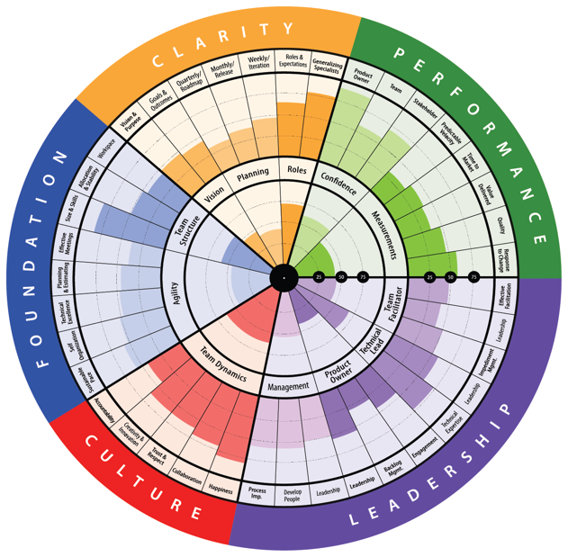
Completed a Baseline Across 90+ Teams
Clarity Do we have clarity on our vision and goals? Do we have clear plans? Do we understand our roles?
Performance – Quantitative
These performance results questions focus on hard data. How often does the team release to production? How long does it take to recover from a quality issue? What is the story and feature cycle time?
Leadership
Is their leadership team providing good servant leadership? Are they supportive of continuous improvement practices and providing good governance, guidance and effective facilitation?
Culture
Is accountability being taken seriously? Is Collaboration valued and do the team trust and respect each other? How good is the team and stakeholder engagement?
Foundation
Are the teams delivery capabilities sufficient and is the team structured appropriately for the needs of the backlog? Are Quality, Planning, Agile practices where they need to be?
Notes:
Sally will show live one on screen – walk the radar

Slide 84
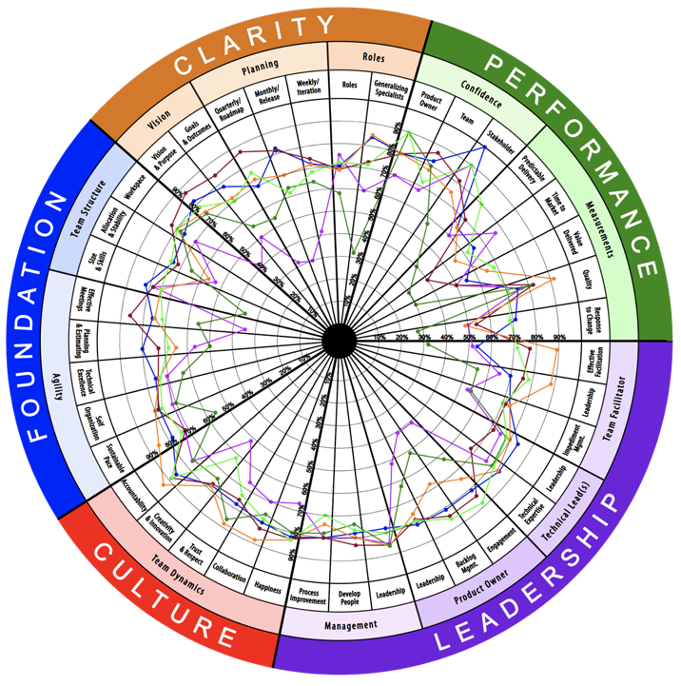
Multi-Team Rollup at Train Level

Slide 85
Found Patterns by Capturing The Voice of the Teams
“We did a lot of work, but business priority changed and it was never pushed to production. There was no value for a lot of our effort.”
“No Roadmap, No vision, we feel orphaned.”
“We've had throw-away work from frequently changing backlog.”
“There are no measures of success.”
“Stop changing intent after sprint starts.”
“Let us switch projects when intent is paused or blocked.”
“It would be good to know why we are doing certain things? How do we know we’ve succeeded?”
“Can we know what will happen after the 1-3 week horizon?”
“Want to understand why and how of roadmap priorities.”
“What will our work produce?”
“What is the value of our work?”
“We understand our day-to-day tasks but would like to know what is driving these epics?”
“Team wants to be part of vision, PO plays too many roles.”
“We want 2-3PIs worth of roadmap (18 weeks!).”
“No visibility beyond a few weeks.”
“Unstable vision, frequent priority and timeline shifts.”

Slide 86
Identified Areas to Improve
Monthly Release Plan | Vision & Purpose | Qtrly Roadmaps | Predictable Delivery | Impediment Mgmt.
We have a plan for the next few iterations but it changes so frequently | We have clarity on our teams purpose and our customer needs | We have a rough plan but it’s not shared with the team | We do not have a steady velocity, throughput or cycle time | Dependencies and impediments are effectively resolved
5 Lowest Competencies
Over 900 Growth Items, 386 Organizational
Impediment Management | Allocation & Stability | Roadmaps | Leadership | Innovation & Learning
Reduce external dependencies (73 OGI’s) | Fill open roles and keep teams stable (52 OGI’s) | Create, communicate and maintain clear roadmaps (47 OGI’s) | Practice servant leadership, be transparent (57 OGI’s) | Allocate time for team members to innovate and learn (30 OGI’s)

Slide 87
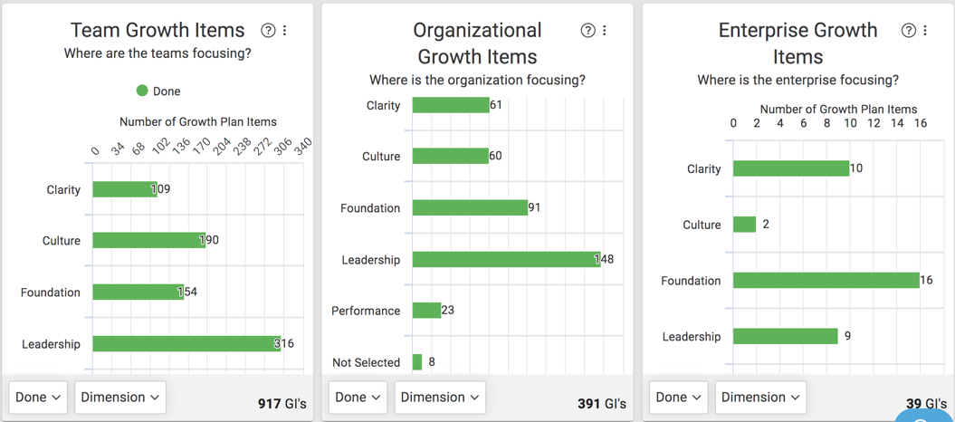
Committed to Actioning on Improvements at all Levels

Slide 88
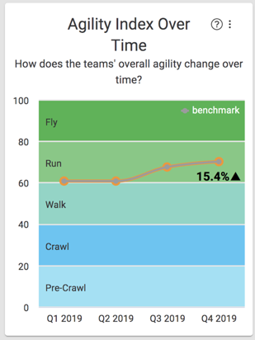
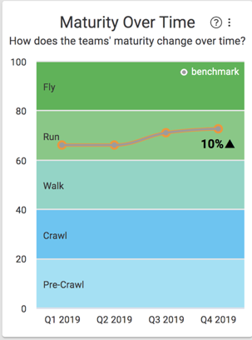
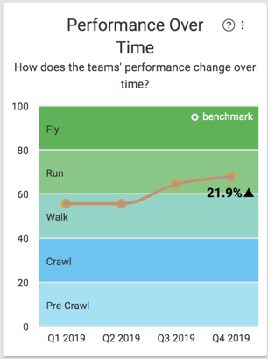
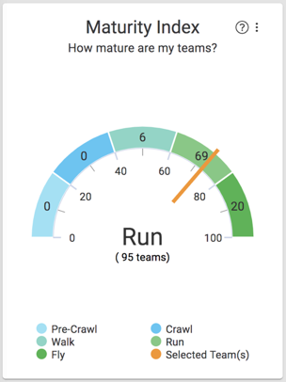
Achieved Growth | Agility Insights & ROI
More Predictable Delivery
Backlogs ‘ready’ reduced churn
Work Aligned to Strategy & Roadmap
EPICs delivered in 30 days increased by 267%
Focused teams were able to deliver 5 additional teams work!

Slide 89
Program Improvements – Over 6 months
Leadership Increased by 32%
Culture Improved by 62%
Foundation Improved by 110%
Clarity Improved by 86%
Performance Improved by 134%

