Slide 1
TeamHealth Retrospective

Slide 2
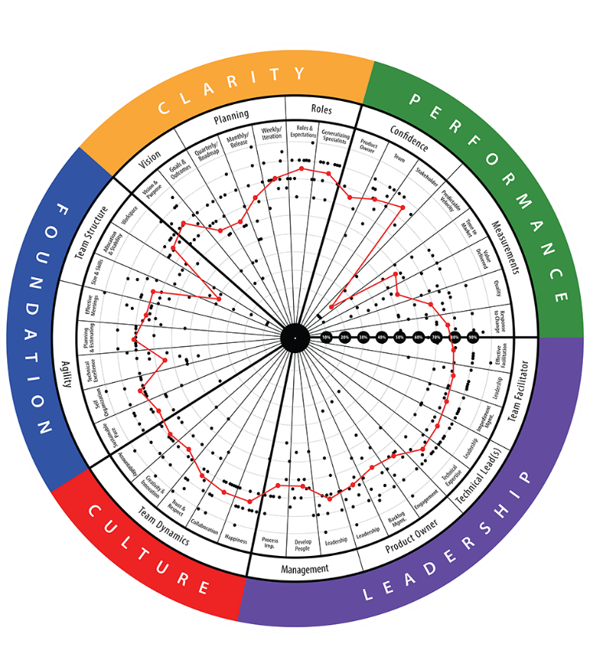
TeamHealth® Retrospective
STRATEGIC RETROSPECTIVE: A retrospective that aims to help teams reflect on their last quarter or release and improve the next one. Facilitated by certified AgilityHealth® facilitators.
Analyze real-time
radar and textual responses. Have “real” conversations
Team members
complete the assessment on their laptop
STEP 2
Build actionable
growth plan for
the team and for
their leaders
STEP 1
STEP 3
Duration: ~ 3 hrs Repeat: Every quarter/release/PI

Slide 3
Team Health Assessment – Three Hours
Team Members Complete the Assessment as a Group
Introduction | Meeting norms, review agenda, confirm participants have access, (Technical Team confirm Scrum Master is prepared for Quantitative questions) | 10 min
Assessment | The team takes the assessment. Allow the team to ask questions and reflect | 50 min
Part 1
BREAK 10 Mins
Analyze real-time radar and textual responses.
Review the Results | The team members individually review the radar dimension and comments, jot down top growth items into idea board; Compare to previous assessments | 25 min
Prioritize & Discuss | Team members group similar ideas, vote on top topics to address and clarify those items – Open Dialogue about teams Strengths, Opportunities and Impediments. | 35 min
Part 2
Build actionable growth plan for the team and for their leaders
Build Growth Plan | Limit team growth items to 2 to 3; Identify top 1 or 2 for leaders (organizational items). Breakout to build out the growth items. | 30 min
Readout | Each group reviews their growth item, others weigh in and identify co-owners | 15 mins
Close the Retro | Appreciation activity, capture next steps, retro of the retro | 5 min
Part 3
Notes:
Slide Purpose: Provide the Agenda and Timebox's for the session, customize to remove part 1 if the team already completed the assessment ahead of time
Part 3 - Build 1 org growth item together with the team, then break them out into small groups to build the rest.

Slide 4
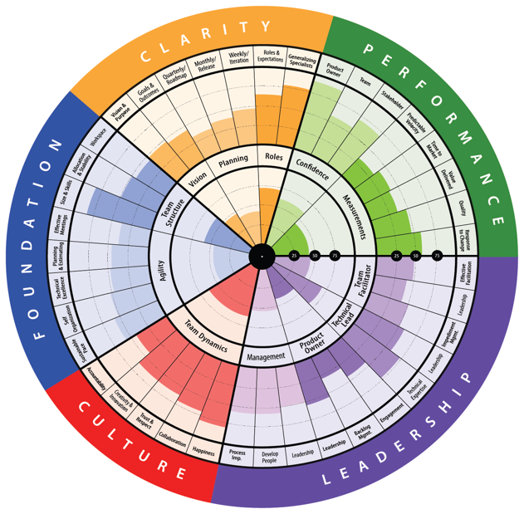
The TeamHealth® Radar
Leadership
Do we have the right Leadership for our team? Are they supportive of continuous improvement practices and providing good governance, guidance and effective facilitation?
Culture
Is accountability being taken seriously? Is Collaboration valued and do the team trust and respect each other? How good is the team and stakeholder engagement?
Foundation
Are the teams delivery capabilities sufficient and is the team structured appropriately for the needs of the backlog? Are Quality, Planning, Agile practices where they need to be?
Clarity Do we have clarity on our vision and goals? Do we have clear plans? Do we understand our roles?
Performance – Quantitative (TH 4.0)
These performance results questions focus on hard data. How often does the team release to production? How long does it take to recover from a quality issue? What is the story and feature cycle time?
Notes:
Speaker Notes:-
Remind them to answer N/A only if the entire team agrees it’s N/A
Explain management is the person who provides their performance review
Touch at a high level on competencies if they have already seen the video, otherwise play the TeamHealth Overview Video, hide this slide
Leadership correlates to clarity, in order to improve clarity focus on leadership
Performance correlates foundation and culture, in order to improve performance you have to focus on those

Slide 5
3 Minute TeamHealth® Overview Video
Watch the TeamHealth® Overview Video
Notes:
Slide Purpose: This video introduces the AgilityHealth radar. If most of have already watched it, you do not need to show it again.

Slide 6
Who’s Participates In A TeamHealth Retro
Team Members
Core members of team [SM, PO and Development Team]
Includes contractors who are members of your team
Does NOT include anyone who does not deliver as part of your team
Stakeholders
Do not attend the strategic retro session
Stakeholders are people who have a direct stake in the health and delivery of teams but are not part of the actual team [Product Mgmt., Team Leads, etc.]
Stakeholders receive a 2 question survey prior to the strategic retro and answers the following ?’s:
What is your confidence in the team?
Using a scale of 1 to 10; how likely are you to recommend working with this team to others?
Notes:
Speaker Notes:
Quick reminder of who participates and what questions their stakeholders received ahead of time

Slide 7
TeamHealth® Team Norms For Today’s Retrospective
Be honest, but respectful
We will not leave without sharing what’s on our mind
All opinions and perspectives are valid
Enter comments as much as possible
Fully engage and refrain from multi-tasking
Growth Mindset - Stay above the Line
WHAT’S MISSING?
Notes:
Speaker Notes:-
Remind them to share feedback for each other in a way that’s honest but respectful, think of how they’d like to receive feedback
Cover all points on this slide, very critical
What’s Missing, don’t spend too much time here

Slide 8
Let’s Get Started…
AgilityHealth® TeamHealth Assessment
All responses are anonymous
Facilitated by a certified AgilityHealth® Facilitator
Please include textual responses

Slide 9
Complete the TeamHealth Assessment
50 Mins
You have an email from ‘AgilityHealth’ with a link to the assessment in your inbox.
Notify [name] if you can’t find it via chat
Please provide textual responses, they’ll help with the analysis.
Please start with crawl, each statement builds on one another. So take your time
Notes:
Note to Facilitator, if someone can’t find their assessment you can send them the link or re-send the e-mail.

Slide 10
10 Mins
Break

Slide 11
Analysis & Prioritize
Analyze the Radar, Textual Responses
Prioritize the Top Growth Items
Celebrate Strengths
Facilitated by a certified AgilityHealth® Facilitator
60 Mins

Slide 12
Facilitating Analysis conversations (part 2 & 3)
Review the Results
The team members go through the results of the assessment individually
Prioritize the Top Growth Items
Allow everyone time to read the grouped items
Breakout: Build the Growth Plan
Build one organizational item together with the team
Jot down top growth items using idea board (Prevents group think)
As a group review the idea board and group similar ideas together
Give them a limited number of votes (2-3)
Identify the top growth items and discuss those
Identify if any of them are organizational growth items
Breakout the team members to build out the remaining growth items
Ask group to identify 1 item leaders can help with if none identified
Leave time for each group to share & Assign owners to each item
Or you can break them into small breakouts around the dimensions
Notes:
Slide Purpose: This slide provide AHF guidance on the facilitation of the Analysis Conversation

Slide 13
Team Health Assessment – One Session – Three Hours
Team Members Complete the Assessment as a Group
Introduction | Meeting norms, review agenda, confirm participants have access, (Technical Team confirm Scrum Master is prepared for Quantitative questions) | 10 min
Assessment | The team takes the assessment. Allow the team to ask questions and reflect | 50 min
Part 1
DONE!
Analyze real-time radar and textual responses.
Review the Results | The team members individually review the radar dimension and comments, jot down top growth items into idea board; Compare to previous assessments | 25 min
Prioritize & Discuss | Team members group similar ideas, vote on top topics to address and clarify those items – Open Dialogue about teams Strengths, Opportunities and Impediments. | 35 min
Part 2
Build actionable growth plan for the team and for their leaders
Build Growth Plan | Limit team growth items to 2 to 3; Identify top 1 or 2 for leaders (organizational items). Breakout to build out the growth items. | 40 min
Readout | Each group reviews their growth item, others weigh in and identify co-owners | 15 mins
Close the Retro | Appreciation activity, capture next steps, retro of the retro | 5 min
Part 3
Notes:
Slide Purpose: Provide the Agenda and Timebox's for a Individual Team Big Room and Virtual Retrospective. Note this agenda changes if the assessment is sent out and expected to be complete before the team meets for the AHR.
Part 3 - Build 1 org growth item together with the team, then break them out into small groups to build the rest.

Slide 14
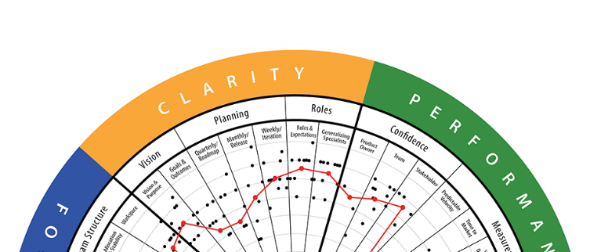
TeamHealth® Strategic Retrospective: What’s Next
Identify 2-3 Team Growth Items and any Organizational Growth Items
Engage in conversation about themes you are seeing
Prioritize – Vote on top items we want to work on & build actionable growth plan (breakout)
Team members
complete the assessment on their phone or laptop
Analyze real-time
radar and textual responses. Have “real” conversations
Build actionable
growth plan for
the team and for
their leaders
STEP 1
STEP 2
STEP 3
Duration: ~ 3 hrs Repeat: Every quarter/release/PI
Notes:
This is what’s happening today…

Slide 15
Jot down the top growth items into Idea board

Slide 16
Breakout & Build Growth Items
Review how to build growth items
Build one growth item as a team
Breakout to build the remaining growth items
Facilitated by a certified AgilityHealth® Facilitator
55 Mins

Slide 17
Team Health Assessment – One Session – Three Hours
Team Members Complete the Assessment as a Group
Introduction | Meeting norms, review agenda, confirm participants have access, (Technical Team confirm Scrum Master is prepared for Quantitative questions) | 10 min
Assessment | The team takes the assessment. Allow the team to ask questions and reflect | 50 min
Part 1
DONE!
Analyze real-time radar and textual responses.
Review the Results | The team members individually review the radar dimension and comments, jot down top growth items into idea board; Compare to previous assessments | 25 min
Prioritize & Discuss | Team members group similar ideas, vote on top topics to address and clarify those items – Open Dialogue about teams Strengths, Opportunities and Impediments. | 35 min
Part 2
DONE!
Build actionable growth plan for the team and for their leaders
Build Growth Plan | Limit team growth items to 2 to 3; Identify top 1 or 2 for leaders (organizational items). Breakout to build out the growth items. | 40 min
Readout | Each group reviews their growth item, others weigh in and identify co-owners | 15 mins
Close the Retro | Appreciation activity, capture next steps, retro of the retro | 5 min
Part 3
Notes:
Slide Purpose: Provide the Agenda and Timebox's for a Individual Team Big Room and Virtual Retrospective. Note this agenda changes if the assessment is sent out and expected to be complete before the team meets for the AHR.
Part 3 - Build 1 org growth item together with the team, then break them out into small groups to build the rest.

Slide 18
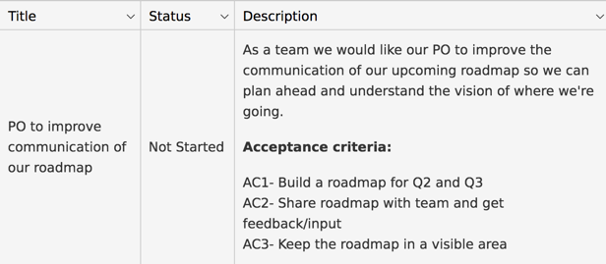
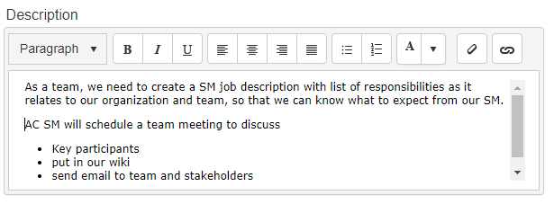
Good Growth Items Are Like Good Stories
S
pecific
M
easurable
A
chievable
R
ealistic
T
ime-Bound
Notes:
.

Slide 19
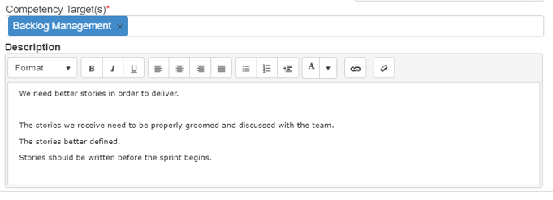
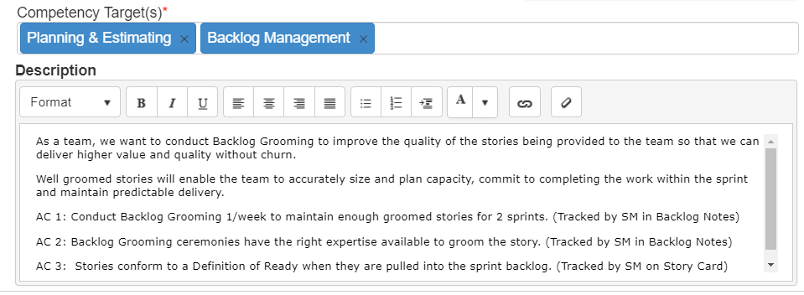
What Makes A Good Growth Item?
Not Good
Good
Written as a good user story
(INVEST or SMART)
Well defined acceptance criteria

Slide 20
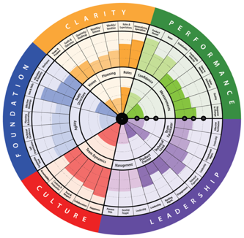
Start Your Growth Journey - Visit Growth Portal
Self Learning by Competency
Learning by competency on Healthy & Unhealthy, Recommendations, Videos, & Resources
https://growthportal.agilityhealthradar.com/

Slide 21
Next Steps
Clarity on Next Steps
Retro of Retro
Feedback is a gift
5 Mins

Slide 22
Next Steps
Scrum-Masters will pull your growth items into your sprint plan/ board
Update your growth items progress in AgilityHealth® during your retrospective
Organizational growth items will be rolled-up & shared with leadership & managers

Slide 23
Retro of Retro
Notes:
Insert Slido Link here or just ask them to give feedback by showing a reaction

Slide 24
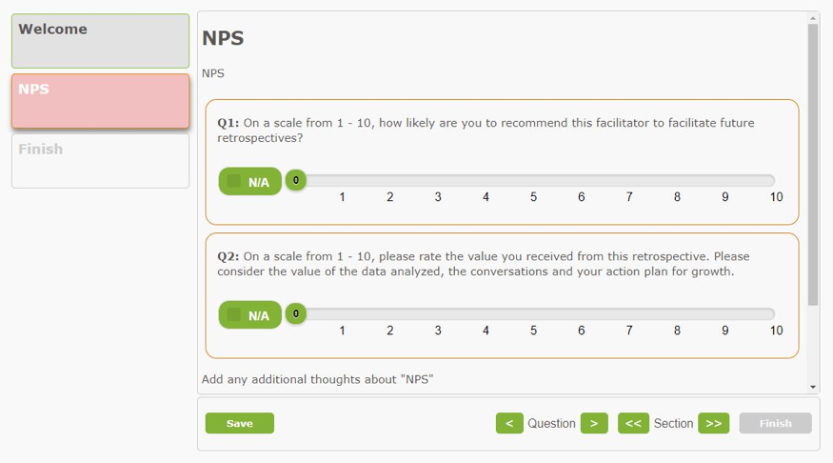
We Value YOUR Feedback!

