Slide 1
AgilityHealth® Facilitator Certification v2.0
Notes:
Objectives:
Start 5 minutes late. Allow stragglers to join.
Talking Points:
While waiting for folks to join in, ask people to post to chat their name, location, title/job function, and something interesting about themselves (or your favorite ice-breaker question)

Slide 2
Instructor Introductions
Intro 2
Notes:
Objectives:
Build credibility with students as a qualified and experienced instructor
Talking points:
Name, Title, Experience coaching/facilitating, History with AgilityHealth

Slide 3
About This Course
We use videos throughout the course to explain key concepts consistently.
Your instructors are experienced coaches and facilitators and will take you deeper into the material and be able to ask any questions you have.
Do not hesitate to ask any question or raise any concern you have.
We want you to leave here feeling capable and confident to lead AgilityHealth® retrospectives through the six-step process.
If you don’t feel this way at the end, please let us know what we can do to help!
Intro 3
Notes:
Objectives:
Help students understand the reason we use videos and the value add of the instructor in the classroom
Talking points:
Speak to slide bullets
Introduce the Parking Lot and tell students that if we need to move on, we will capture the topic there and revisit at the end.

Slide 4
Assumptions About You
Experienced with Agile
Understanding of - and belief in - the value of continuous improvement
Facilitation experience - comfortable leading a group discussion
Self-awareness - role awareness - hold the space for collaboration, stay out of the solution
Good news: if you already facilitate periodic retrospectives, you have most of the skills you’ll need for AH’s strategic retrospectives
Intro 4
Notes:
Objectives:
Explain the assumptions we’re making about the students.
Talking points:
All questions are welcome. Feel free to ask anything during the class.

Slide 5
The Class Overview
Six-step Process
The structure of the class follows the structure of the process itself
Special Section: Facilitation Challenges
Intro 5
Notes:
Objectives:
Explain the flow of the class.
Talking points:
There is no need to go into the six steps in detail here, just name them off and explain that the class will follow the same flow.
We have a special section at the end where students will learn about facilitation challenges and how to overcome them.

Slide 6
Introducing the Six-Step Process
https://vimeo.com/686391388
Intro 6
Notes:
Objectives:
High level overview and introduction to the Six Steps
Talking points:
If any questions come up about the various pros and cons to each launch option, tell students to hold those questions as there is a more detailed explanation coming up shortly.

Slide 7
Step 1: Prepare to Launch
Preparing the People and the Platform
Step One 1

Slide 8
Scrum Master Alignment Meeting
https://vimeo.com/686391603
Step One 2
Notes:
Objectives:
Introduce the idea of having a Scrum Master Alignment meeting
Talking points:
Another thing worth discussing with the Scrum Master at this meeting is discovering any logistical challenges to facilitation such as:
Remote team members: Will zoom be needed? Is chat enabled or disabled at the company? Camera usage norms?
The meeting is optional but recommended
What is learned at this meeting can inform later steps including what to stress during the Team Overview meeting
Questions for Students:
What thoughts or questions do you have about the SM alignment meeting?

Slide 9
Facilitating the Team Overview Meeting
Useful Links
Link to Sally’s Overview Video
Link to Quantitative Questions
https://vimeo.com/686391646
Step One 3
Notes:
Objectives:
Introduce students to the Team Overview meeting and how they might facilitate that meeting.
Talking points:
This meeting is optional but recommended when teams are new to the process.
There is a 10-minute video available that new AHFs can play for teams and then answer questions. Link will be in the handout. They are welcome to run this meeting with or without that video. It’s just there for them to lean on if they wish.
Questions for Students:
What thoughts or questions do you have about the Team Overview meeting?

Slide 10
Sandbox Exercise
Let’s Create a Team and Assessment Together
Note: Please do not click publish at the end of this exercise
Instead, choose Save as Draft
Useful Links
Support Center Article for Work Type
Step One 4
Notes:
Objectives:
Students learn how to create a team and then add an assessment for that team
Instructor Notes:
Type random characters into search to "blank out" team list. This will match what participants will see, since they aren't enterprise admins.
Explain Pendo guide controls
Direct any questions about External ID field to their CSM
Team Creation: Every student creates their own team in the sandbox. You should open the sandbox and share your screen doing it with the students and having them ask any questions along the way.
Tell students to name the team in a way they can find again.
Use required fields only. If questions come up about the others, answer if you have time or put it in the parking lot.
Create at least two team members and one stakeholder. This is a live environment. Make sure students use example.com email addresses (e.g. sam.smith@example.com)
Work Type: Software Delivery. If questions come up around Work Type, refer them to the link on the support center on this slide for detailed help of the various options.
Assessment Creation: Every student adds an assessment for the team they just created. You should do it together with you demonstrating each step.
Type: TeamHealth 3.0
Name: Introduce a naming convention here, (e.g., 2022 Q1 Avengers”)
Facilitator: Anyone
Facilitation Date: Use today’s date. Explain that this is not required here but it will be before we can launch in the next step. This is so the system knows when to send out a post retro survey.
Duration: 2 hours
Location: Leave blank
Select all team members and stakeholders
Choose “Save as Draft”
Debrief is on the next slide.

Slide 11
Debrief
Team and Assessment Creation
Step One 5
Notes:
Talking Points:
Some companies have dedicated people/processes devoted to team and assessment creation
Questions for Students:
What thoughts or questions do you have about adding a team and assessment?
Will you be creating teams and/or assessments at your company, or will that be handled for you?

Slide 12
Check-In
What is your level of comfort with Step 1: Prepare to Launch?
Step One 6

Slide 13
Step 2: Launch the Assessment
Step Two 1

Slide 14
The Movie Theater Analogy
Assessment Start Time = Theater Open
Assessment End Time = Theater Closed
The theater must be open to accept tickets
Team members and stakeholders must have a ”ticket” to take the assessment
You choose when the theater opens & closes and who gets their tickets when you publish the assessment
Step Two 2
Notes:
Objectives:
Introduce students to the Movie Theater analogy to understand assessment start & end as well as who gets invited to take the assessment.
Talking points:
Speak to the bullets on the slide
The next slide has a video that explains the way these dates are used in the three launch scenarios

Slide 15
Sending the “Tickets”
https://vimeo.com/716623760
Step Two 3
Notes:
Talking Points:
We’re going to go into pros and cons for each scenario next so ask students to hold questions until after that.

Slide 16
Approach #1: Split Sessions
Pros
Time for facilitator to prepare for retro and look over data to build an optional “That’s Interesting” list
Time for team to read text comments and look at radar
Can be easier for team to work shorter meetings into their work schedules
Cons
Takes multiple sessions to get through the process
Time span between assessment and retro can cause loss of momentum
Context switching cost
Step Two 4
Notes:
Talking Points:
Speak to bullets on the slide
Tell students that some companies mandate a certain approach but as AHFs, they should be familiar with all of them.
Questions for Students:
Are there any questions or comments about Approach 1, Split Sessions approach?

Slide 17
Approach #2: Single Session
Pros
Team gets through retro in one longer meeting
Context is easier to hold onto from assessment to retro
Cons
Can be difficult to find time for team
Meeting can be long; difficult to hold focus
New facilitators may feel pressured without the break between assessment and retro
Step Two 5
Notes:
Talking Points:
Speak to bullets on the slide
Questions for Students:
Are there any questions or comments about Approach 2, Single Session approach?

Slide 18
Approach #3: Assessment on their own
Pros
Easiest to coordinate schedules as there is a single, shorter meeting for the retro
Team members can work the assessment into their own individual schedules
Good for teams split across multiple time zones
Cons
Team members often show up at retro having not completed the assessment
Scrum Master or Facilitator usually must pester team to take the assessment
Team members may interpret questions differently and won’t ask each other for clarity
Step Two 6
Notes:
Talking Points:
Speak to bullets on the slide
Questions for Students:
Are there any questions or comments about Approach 3, Assessment on Their Own approach?

Slide 19
Sandbox Exercise
Let’s Launch the Assessment You Made Earlier
Step Two 7
Notes:
Objectives:
Practice launching an assessment using the approach they choose
Launch Assessment:
Share your screen and do this with the students
Edit the assessment they created earlier
Assume your assessment start date is today’s date. Pick an approach (1, 2, or 3) and populate the end date appropriately.
Choose the launch option (who gets their tickets at the open date?)
Click publish

Slide 20
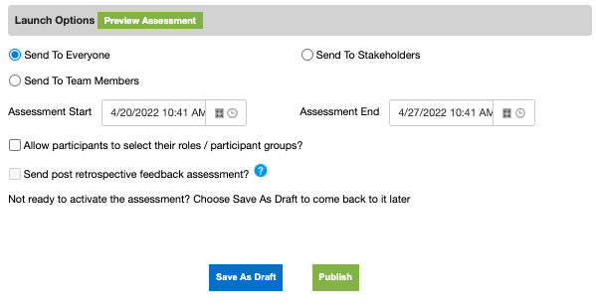
”I Didn’t Get My Ticket”
When you launch the assessment, the platform sends the group you chose their “tickets to the theater”
Happy Path
Everyone receives the email and can log into the platform
Exceptions
Some did not receive (or cannot find) their email
You have 3 options
Verify correct email then resend the email
Chat the link to individual
Group link with code
Step Two 8
Notes:
Objectives:
Help students troubleshoot and resolve people who didn’t get the email invitation and need to take the assessment
Talking points:
Discuss how using a personal email address during team setup can cause problems in a Single-Sign On environment
Demonstrate how to re-send an email to an individual
Demonstrate how to use the individual link icon in the Edit Assessment screen
Demonstrate how to use the Group link with code option in the Edit Assessment screen

Slide 21
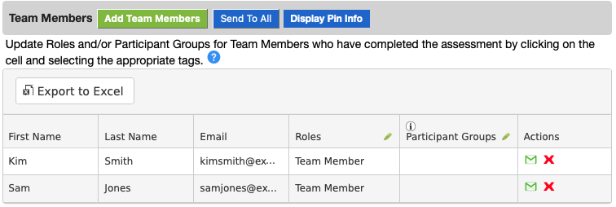
“Off Cycle” Invitation
If you need to send a “ticket” to just an individual (say, they’re going on vacation and want to take it early)
Step Two 9

Slide 22
Debrief
Launching Assessment
Step Two 10
Notes:
Questions for Students:
What thoughts or questions do you have about launching an assessment?
Which approach do you think you’ll use? Are you aware of any mandate at your company?

Slide 23
Check-In
What is your level of comfort with Step 2: Launch Assessment?
Step Two 11

Slide 24
Break (5 minutes)
Step Two 12

Slide 25
Step 3: Complete the Assessment
Step Three 1

Slide 26
Assessment Preamble
These topics have a significant impact on the quality of the data used during the retrospective
Psychological safety & anonymity
Importance of comments
Interpreting the questions
Scoring guidance
Step Three 2
Notes:
Objective:
Introduce the four main points teams need to have stressed to them prior to the assessment.
Talking Points:
The following four videos will cover each point in detail and why it’s important that team members know them.
Let students know that there is a recorded version of this preamble they can use if they choose. The link to it is in the handout.

Slide 27
Psychological Safety & Anonymity
https://vimeo.com/686397692
Step Three 3

Slide 28
Importance of Comments
https://vimeo.com/686397844
Step Three 4

Slide 29
Interpreting Questions
https://vimeo.com/686397884
Step Three 5

Slide 30
Scoring Guidance
https://vimeo.com/686397947
Step Three 6

Slide 31
Check-In
What is your level of comfort with Step 3: Complete Assessment?
Step Three 7

Slide 32
Step 4: Analyze the Data
Step Four 1

Slide 33
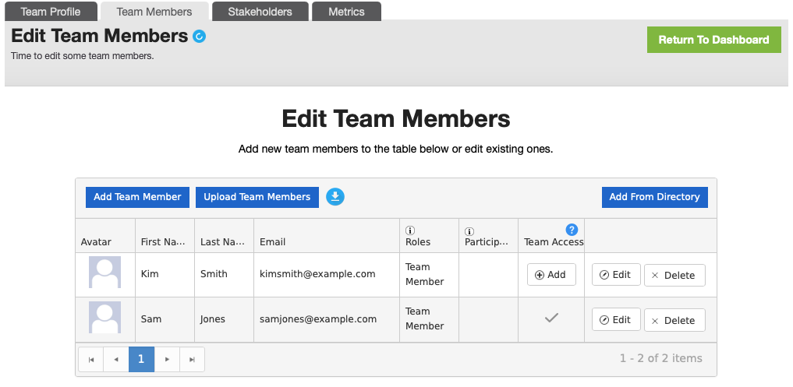
Before the Retrospective Meeting…
Confirm before the meeting that everyone on the team can log into the platform and see the team’s results
When the assessment is in-person, remind people to bring their laptops
Edit team: Verify check mark for access
Stakeholders do not have access to team results
This person would not be able to access team data
Attending to these details before the meeting starts will avoid pressure and wasted time
Step Four 2
Notes:
Objective:
Discuss the things an AHF should do prior to the retro
Talking Points:
Speak to the bullets on the slide

Slide 34
“That’s Interesting” List
If you have time, and you would find it useful, build a “That’s Interesting” list
Items on this list should prompt powerful questions for the team, not statements to them
Keep it to use in case team is quiet or offers no insights
This is not an agenda for the Retro
Use the data patterns we’re about to learn to find things for this list
Step Four 3
Notes:
Objective:
Introduce the “That’s Interesting” list
Talking Points:
Speak to the bullets on the slide
Stress that this is optional. Some AHFs who are learning to spot patterns and other interesting data points benefit from writing them down between the assessment and the retro.
Let students know there is a list of powerful questions available on the support center and the link is in the handout.

Slide 35
Finding Data Patterns
As a facilitator, your job is to recognize the patterns and help the team see them if they are helpful
Do not coach the team on what they should do
Ask everyone to log into the platform and use the Idea Board as a notepad to record their own that’s interesting observations – one per stickie
Step Four 4

Slide 36
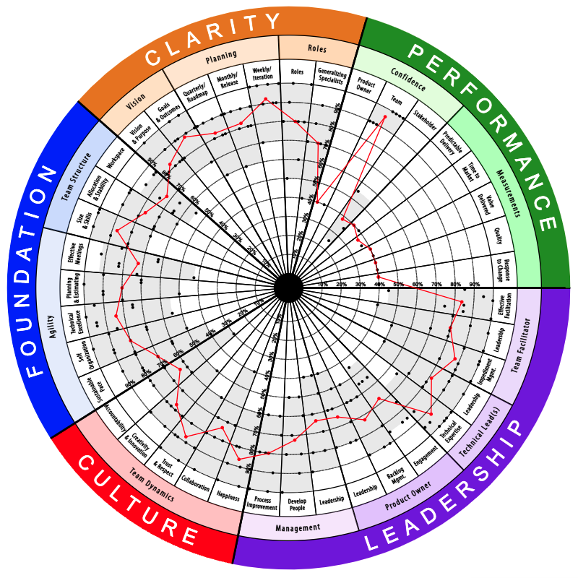
They Say Their Great, But…
Notice:
Low consensus, in this case just one or two votes pulling it wide
High scores except in the Performance dimension
Potential Causes:
Squad or team thinks low scores reflect poorly on themselves or their leader
Squad or team believes low scores are punished or high scores are rewarded
Squad or team misunderstood when to choose what level score
Tips:
Low consensus and the dip in Performance dimension stand out more than the red line
Step Four 5
Notes:
Talking Points:
The first two potential causes could indicate a psychological safety issue on the team
Third potential cause: When explaining team misunderstanding when to choose what level, say, “Teams should choose the lowest score that reflects reality, not the highest score they can justify”
Ask the students:
What’s happening with the performance dimension? What might that mean?
Notice the low consensus. What do you notice about why the bar is so wide? (Let the group answer, then ask: Is someone trying to tell us the truth?)

Slide 37
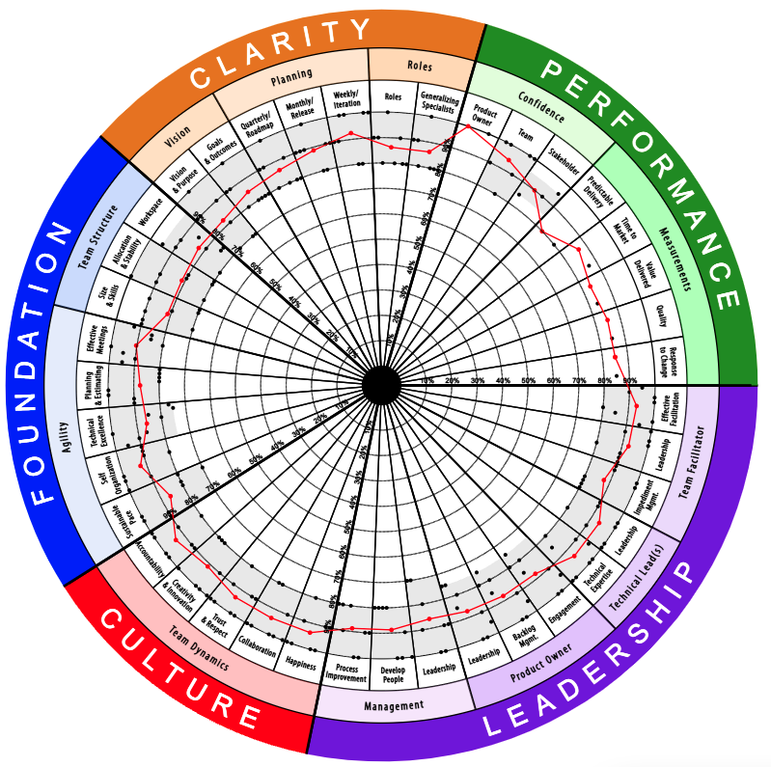
The Elite
Notice
High consensus AND high scores
The performance dimension is now also high
Tips
Ask the Scrum Master if the high scores seem accurate
Growth items for a team like this should focus around helping other teams be this good
Look for inconsistencies with a high performing team in the text comments
Step Four 6
Notes:
Talking Points:
Teams this good are rare. So rare that it’s worth verifying results with the Scrum Master offline
Stress that text comments should back up this team’s high performance. If not, ask powerful questions from the comments that indicate growth may be needed

Slide 38
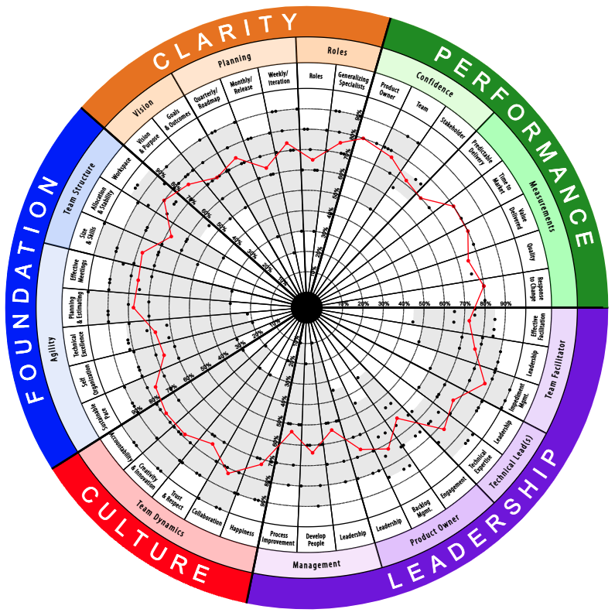
Low Lone Response
Notice
We don’t know for certain that the lone dot in the center is the same person
Someone is having a very different experience being on this team
Possible Causes:
Safety issue for an individual
Inclusion/respect issue for an individual
Tips:
Ask if someone wants to represent the perspective of a low scorer
Read the text comments for insights
Watch for defensiveness from the high scorers. Keep conversations focused on growth, not blame. We’re not trying to be right, we’re trying to get it right
Step Four 7
Notes:
Talking Points:
Talk to the bullets on the slide
Teams that remain comfortable but miserable will never get through their issues. There is a reason that one of the phases in the Tuckman model is “Storming”
Patrick Lencioni says that the most dysfunctional teams he’s ever coached, never argue.
You want to invite the conversation but not push it. If it happens, the AHF needs to create safety from a “them vs me” energy
Ask the students:
Which competencies have the lowest scores? How might those competencies be leading to/complementing the other lower scores?

Slide 39
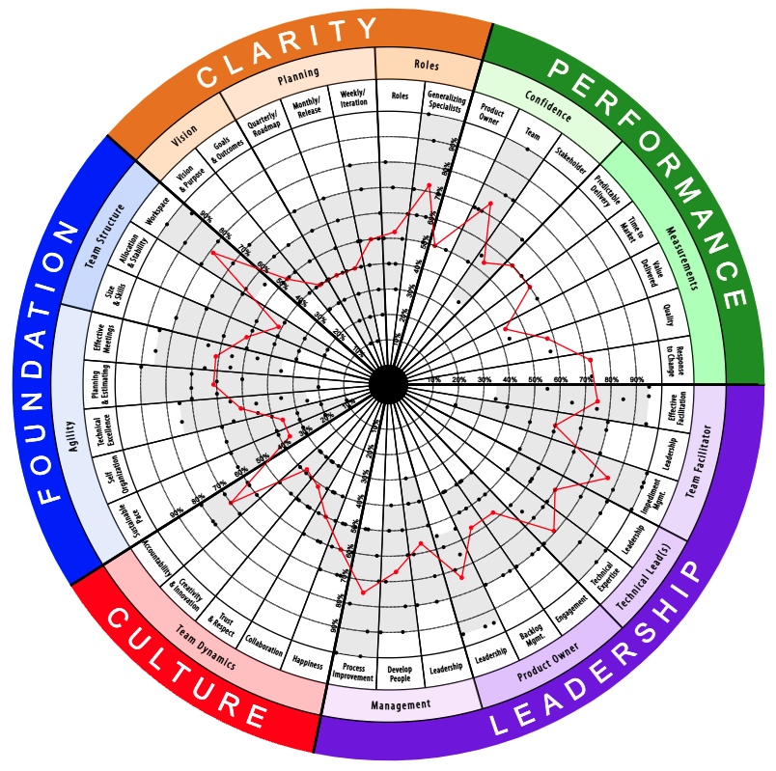
Low Consensus
Notice:
Grey bars are wide
Potential Causes:
The squad or team has a lot of churn
Remote/dispersed team with no in-person time
Facilitation Tips:
Low consensus is at least as important a finding for a team like this as is the red line
Ask someone to represent the higher score in a competency and someone the lower and ask them to discuss those perspectives.
Suggest at least once per quarter in-person work and non-work-related activities
Step Four 8
Notes:
Talking Points:
Don’t fall into the red-line trap. The low consensus (wide grey area) is a very important data point.
This is one time we may suggest a growth item: Team building.
Ask the students:
Why should we look at the red line with caution on competencies with low consensus? (Answer: Because the wide spread of answers with dots dispersed as they are here just show us the mid-score of the opinions on the team rather than provide a useful indicator of actual need for growth).
Why don’t some of the performance dimension competencies have a grey area? (Answer: Only one score)
Are there competencies where the team has higher consensus? Are those scores low or high? What might that mean? (Answer: Low trust and respect, creativity & innovation, and collaboration say that the team members are not connecting – except on the fact that they’re not connecting ☺ )

Slide 40
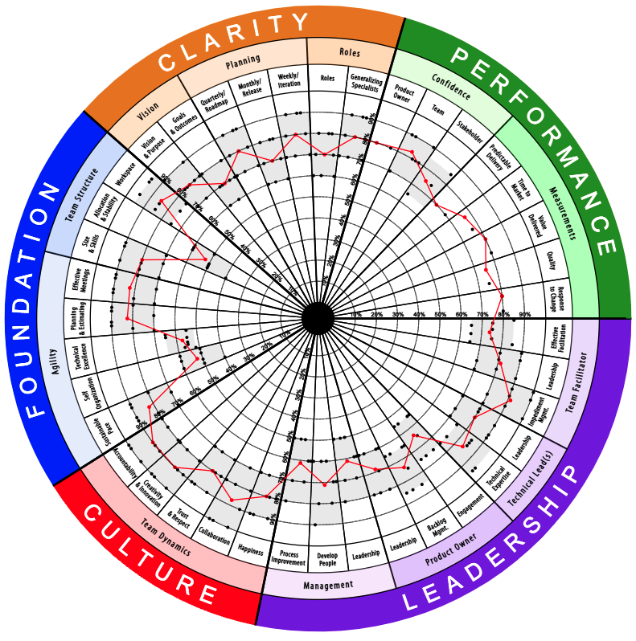
High Consensus
Notice:
Grey areas are narrow all around
Potential Causes:
Often, this is a sign of a squad or team that gets along and respects each other, probably been together for a long time
Facilitation Tips:
Low and narrow scores are great targets for growth items since the squad or team agrees that the competency needs improvement
High and narrow scores indicate a competency that likely doesn’t need improvement
Step Four 9
Notes:
Talking Points:
High consensus is a finding! A good one! Compliment the team when you see this.
You can now trust the red line much more

Slide 41
Activity: Idea Board
Notice the low competencies of Allocation & Stability, Technical Excellence, and Self-Organization
Open the assessment your instructor tells you to.
Using the radar on this slide, invent either a cause for these scores being low or invent an effect/impact of the score being low on the team.
Create stickies on the idea board and record those thoughts.
When facilitating this as an AHF, resist the urge to be a scribe for the team
Step Four 10
Notes:
Talking Points:
Explain that most people leave stickies that either point to a cause “We have too much tech debt” or an effect “We work too many nights and weekends” Both may relate to the same area of growth.
If we were looking at a real radar here, we’d remind the team that text comments are their friends. They can be very helpful to inspire stickies for the idea board.
Instructions:
Students should open the class radar. It will be empty, it’s ok. We’re going to use the idea board on it. They will use the radar on this slide for a visual.
Once you get everyone in the idea board for the same radar, share this slide again. Students can refer to it in zoom while switching to the idea board in their browser to make notes.
Instruct students to invent cause or effect stickies for the three competencies circled in red above.
Instructor Note:
We will be using this populated idea board in the next step so have students leave their browsers pointed at it.

Slide 42
Fist-of-Five Check-ins
What is your level of comfort with Step 4: Analyze Data?
Step Four 11

Slide 43
Break (5 minutes)
Step Four 12

Slide 44
Step 5: Build the Growth Plan
Step Five 1

Slide 45
Class Activity: Voting on the Idea Board
Refine the cards to enable effective voting - eliminating duplicates and combining cards that are related
Look for cause cards and effect cards that point to the same issue
Vote - The number of votes per person will be up to the AHF and based on the number of cards and the need to establish the team’s priorities
Step Five 2
Notes:
Instructions:
De-dupe as a group. Consider adding the word "VOTE:" in front of any stickie that you want team members to vote on and/or delete duplicates so that all that remains are cards to be voted on.
After cards are cleaned up, do a quick vote with 3 votes per person. Time box at 2 minutes.

Slide 46
Growth Plan Basics
https://vimeo.com/686398902
Step Five 3

Slide 47
Using the Growth Portal
https://vimeo.com/686399000
Step Five 4
Notes:
Objective:
Shows students how to use the growth portal to help teams with ideas for improvement as well as moving items from the growth portal directly into the growth plan.
Talking Points:
Mention that the Growth Portal can sometimes become a crutch for the team. It’s best used if the team has run out of improvement ideas of their own. That maximizes ownership because the team came up with the items themselves.

Slide 48
Team Growth Items (TGIs)
Pattern
As the {xyz team}, we need to {improve some aspect of our performance}, so that {state the business rationale}
Acceptance Criteria
AC1: {How we will know that we have been successful}
AC2: {Etc.}
Example
As the Harry Potter team, we need to reduce the amount of technical debt in our codebase so that we can respond faster to additions and changes from the business.
Acceptance Criteria
AC1: We have removed legacy code from the Horcrux module
AC2: We have decommissioned the Quidditch app and migrated everyone over to Cleansweep Seven
Step Five 5
Notes:
Talking Points:
The Acceptance Criteria are not the list of things to do, but what success looks like. Aim for True/False statements.

Slide 49
Organizational Growth Items (OGIs)
Pattern
Problem: {Describe the problem}
Impact: {Describe the impact of the problem on the team; use data if possible}
Example
Problem: Harry Potter team has been unable to reduce or control technical debt because of new feature development timelines. In fact, we are creating more because of how fast we’re being asked to move.
Impact:
We have missed sprint goals every sprint this quarter because the codebase is so brittle that we are forced to react to production issues and escaped defects (we had x escaped defects last quarter)
We have users on a deprecated system. We have no time to help them migrate off so we’re supporting two platforms at once.
How We Will Measure Success:
Technical debt stories are able to be resolved
Our old system is decommissioned
Step Five 6
Notes:
Talking Points:
Leaders typically prefer the Problem/Impact format
Use real data for impact if available. Use a placeholder if you don't have it available during the retro and go back and have Scrum Master fill it in later
We typically don't give acceptance criteria for OGIs because we don’t presume to know what resources the leader has available

Slide 50
Class Activity: Build a Growth Plan
Go to the growth plan for our high consensus radar
Using the top voted items as source material, practice writing at least one TGI and one OGI
Step Five 7
Notes:
Instructions:
Using their class radar, have students collaborate to write a TGI and an OGI from their top voted stickies on the idea board.
If there is a large group, divide the team into two breakout rooms and have one write the TGI and one write the OGI. If you take this approach, make sure there is a readout from each team so both can hear about the other’s work.

Slide 51
Debrief
Writing Growth Items
Step Five 8
Notes:
Questions for Students:
What was it like to write growth items?

Slide 52
Parting words for the team
Team, thank you for your efforts to build this growth plan!
Your organization has made a significant investment for your team to get to this point
What the team does next will determine the return on investment
Will each of you make a pledge to the team to keep your TGIs “front and center” as you do your work?
There are more insights to be gained in the data...as you make progress on the initial TGIs, go back to the data and look for additional improvement opportunities – no need to wait until the next cycle
Step Five 9
Notes:
Talking Points:
This is the standard parting words for the facilitator to the team. Step 6 does not involve the facilitator, so this is the moment that an AHF can leave the team with words of encouragement.

Slide 53
Fist-of-Five Check-ins
What is your level of comfort with Step 5: Build the Growth Plan?
Step Five 10

Slide 54
Step 6: Follow-through
Step Six 1

Slide 55
Assessment Notes & Team Maturity
https://vimeo.com/686399149
Step Six 2
Notes:
Talking Points:
Assessment notes are only visible to people who have edit rights to the team. In most companies this is the scrum master and AHFs only. Leadership and team members do not have this access.
Purpose of these notes is to help future facilitators (even the same facilitator may struggle to remember 3 months ago)
If you change the team maturity from the calculated value, you should notate the change and your thoughts in the assessment notes.

Slide 56
Leadership Follow-Through
Useful Links
Leadership Debrief Template
https://vimeo.com/686399228
Step Six 3
Notes:
Questions for Students:
What is the purpose of the Leadership Debrief? (Answer: Purpose of the debrief is to make sure that leaders are aware of OGI's and have a chance to ask for clarification.)
What can happen if leaders don’t follow through on organizational growth items? (Answer: This could cause disengagement from the team as well as a reduction in value to the organization of the process)
Talking Points:
There is a PPT template for a leader debrief. Link is on the slide and will also be in the handout.

Slide 57
Scrum Master Follow-through
https://vimeo.com/686399266
Step Six 4
Notes:
Questions for Students:
When is the facilitator’s job over? (Answer: When the retrospective is complete. If there are additional details needed for the growth plan, the Scrum Master should work with the team to finish)
True or False, the platform and the process are best suited for feature-level team growth items? (Answer: True. Smaller improvement items are best for the team’s regular retrospectives)
Why is it important for the Scrum Master to update the growth plan? (Answer: Companies often report on growth plan creation vs. closure and other important metrics related to team growth)

Slide 58
Fist-of-Five Check-ins
What is your level of comfort with Step 6: Follow-through?
Step Six 5

Slide 59
Break (5 minutes)
Step Six 6

Slide 60
Facilitation Challenges
FC 1

Slide 61
Zoom Poll: Vote For Your Top 3 Challenges
We will now take a zoom poll. Please vote for the top three challenges that give you the most concern.
FC 2
Notes:
Have the students watch the videos for the top 3 voted challenges that they are most anxious about followed by a debrief with instructors for questions.
• All challenges have a slide with the correct video. You will manually navigate to the slides for the top-voted challenges by the class. • Timeboxes 3 minute video; 8 minutes discussion per challenge you discuss

Slide 62
People are not participating
https://vimeo.com/716627586
FC 3
Notes:
Remember to debrief after each video.

Slide 63
Leaders not addressing OGIs
https://vimeo.com/716627467
FC 4
Notes:
Remember to debrief after each video.

Slide 64
Scoring by or directed at a single person
https://vimeo.com/716627562
FC 5
Notes:
Remember to debrief after each video.

Slide 65
Team member is dominant or disruptive
https://vimeo.com/716627651
FC 6
Notes:
Remember to debrief after each video.

Slide 66
Team member is negative/cynical
https://vimeo.com/716627688
FC 7
Notes:
Remember to debrief after each video.

Slide 67
Team member is toxically positive
https://vimeo.com/716627717
FC 8
Notes:
Remember to debrief after each video.

Slide 68
Something big unacknowledged on team
https://vimeo.com/716627614
FC 9
Notes:
Remember to debrief after each video.

Slide 69
No time or support for improvement
https://vimeo.com/716627632
FC 10
Notes:
Remember to debrief after each video.

Slide 70
Teams are larger than 8-10 people
https://vimeo.com/716627739
FC 11
Notes:
Remember to debrief after each video.

Slide 71
There isn’t enough time to finish retro
https://vimeo.com/716627765
FC 12
Notes:
Remember to debrief after each video.

Slide 72
Few or no text comments
https://vimeo.com/716627440
FC 13
Notes:
Remember to debrief after each video.

Slide 73
Manager shows up at Retrospective
https://vimeo.com/719609227
FC 14
Notes:
Remember to debrief after each video.

Slide 74
Fist-of-Five Check-ins
What is your level of comfort with the facilitation challenges we reviewed?
FC 14

Slide 75
Review Parking Lot
Conclusion 1

Slide 76
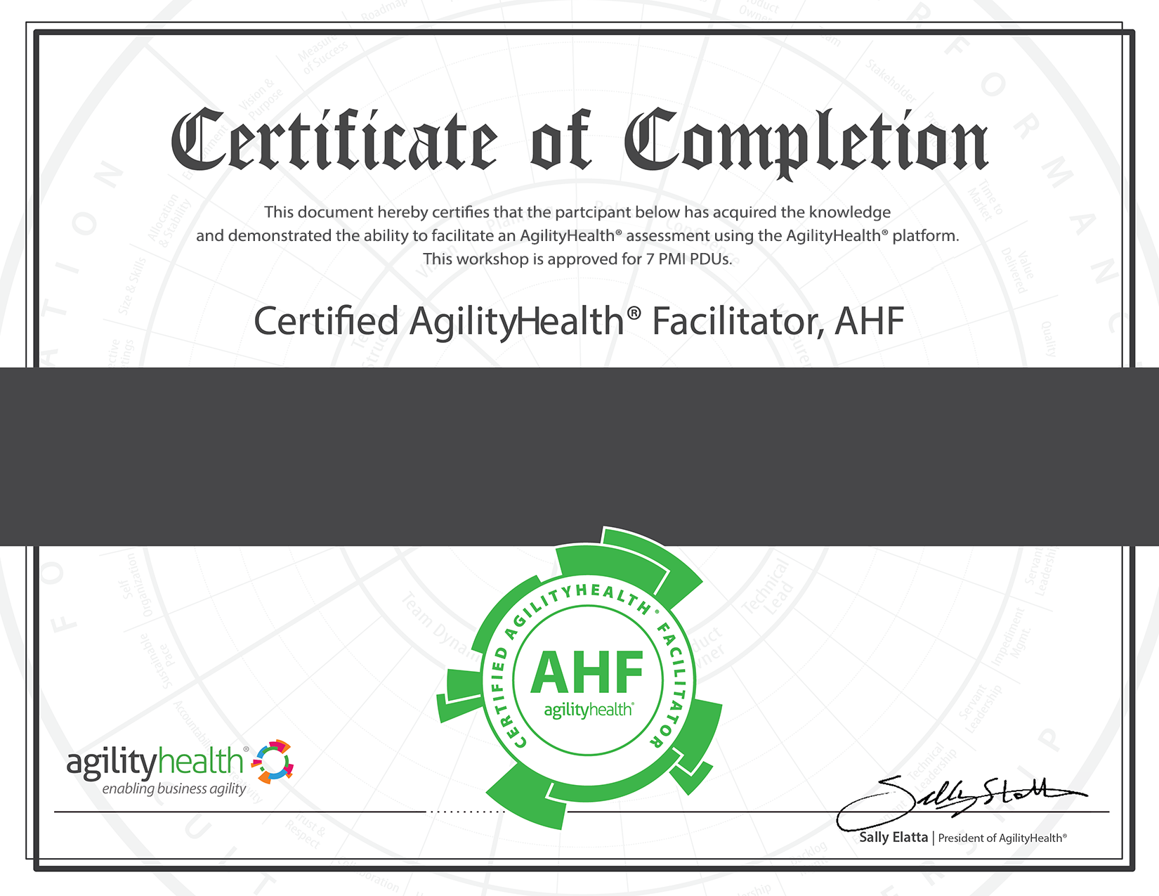
Congratulations & Thank You!
Congratulations on becoming an AHF
AgilityHealth deeply appreciates your commitment to excellence in facilitating these strategic retrospectives
Practice yields proficiency
Facilitate a retrospective as soon as possible
Look for opportunities to facilitate or observe regularly
Use the sandbox as much as you wish
Certification is lifetime, platform is evolving
We will be sending you a follow-up email
Your certificate, reference card, links
Invitation to our periodic CoP virtual meetings
Your Name
Conclusion 3

