Slide 1
TeamHealth® Overview

Slide 2
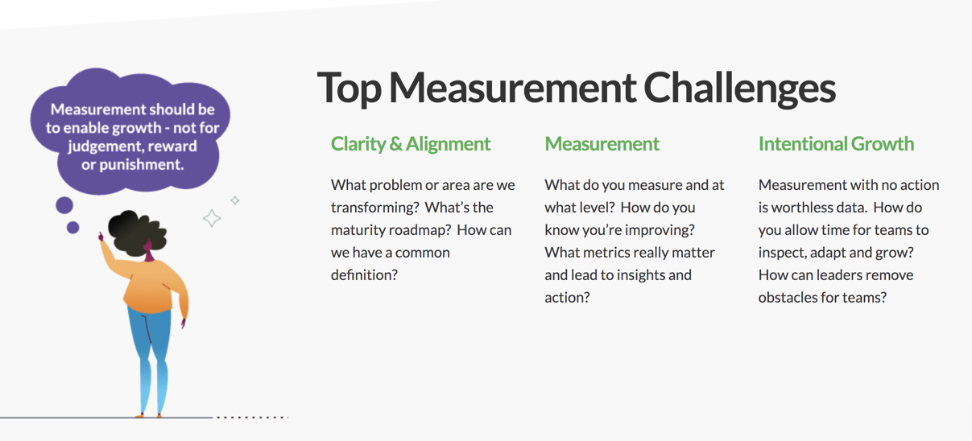
Measurement Challenges

Slide 3



What is the AgilityHealth® Measurement Platform?
AgilityHealth® is the world’s leading
measurement & continuous improvement
platform for accelerating the maturity and productivity of teams and enterprises.
Measure
Grow
Accelerate

Slide 4
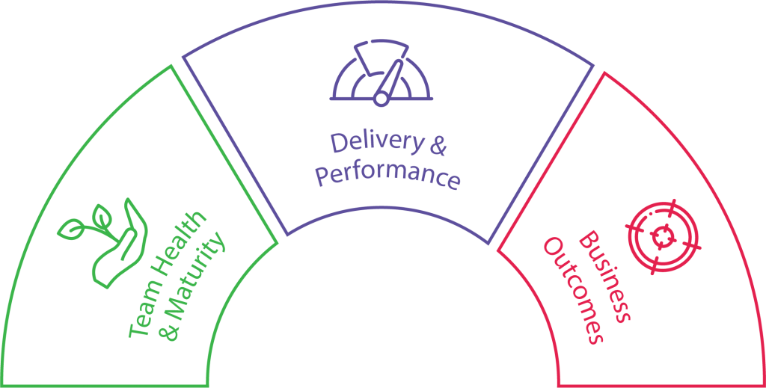
What Should We Measure? The Three Metrics That Matter
Outcomes are THE Metrics that Matter
Maturity and Performance tell us WHY we’re not achieving outcomes.
Performance
Collected via Agile Work Mgmt. Platforms
Maturity
Collected via Team
Assessments/Radars within AgilityHealth
Outcomes
AgilityHealth OKR Dashboard
Notes:
Let’s focus on the “people” – Their health and the maturity of their agile practices and behaviors
Agile work management platforms – Do not forget to mention LeanKit

Slide 5

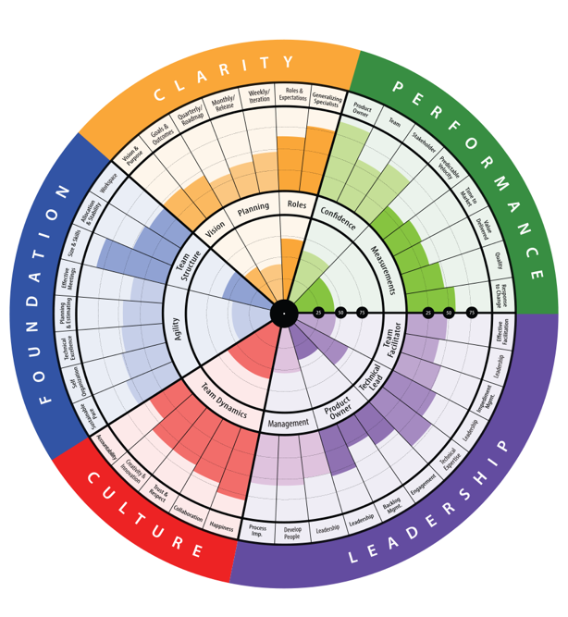

World Class Radars
Team Growth
TeamHealth®
Radar
Technical Health
Radar

Slide 6
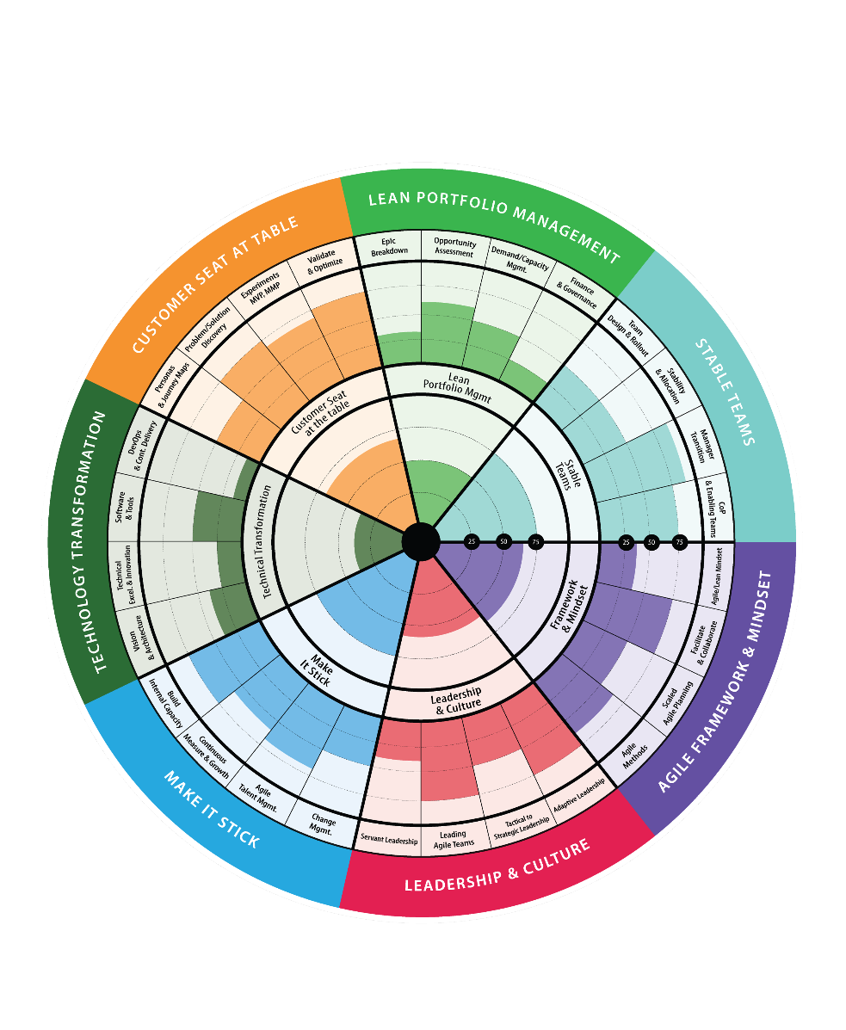
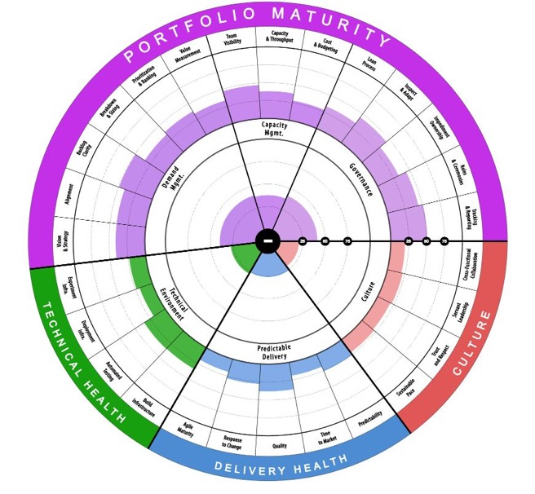

World Class Radars
Enterprise Level
Lean Portfolio
Health Radar
Enterprise Business Agility Health Radar

Slide 7
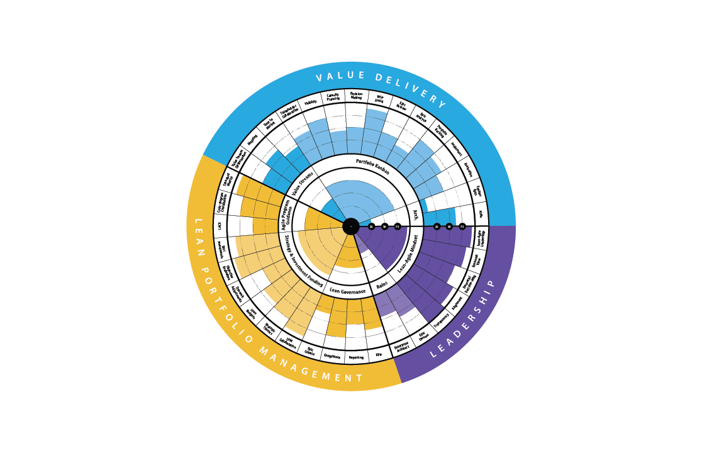
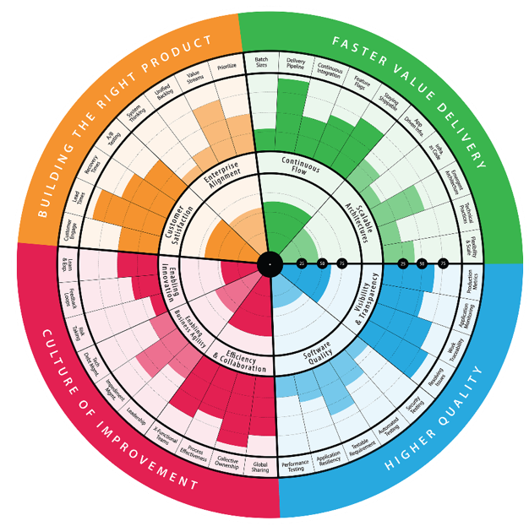
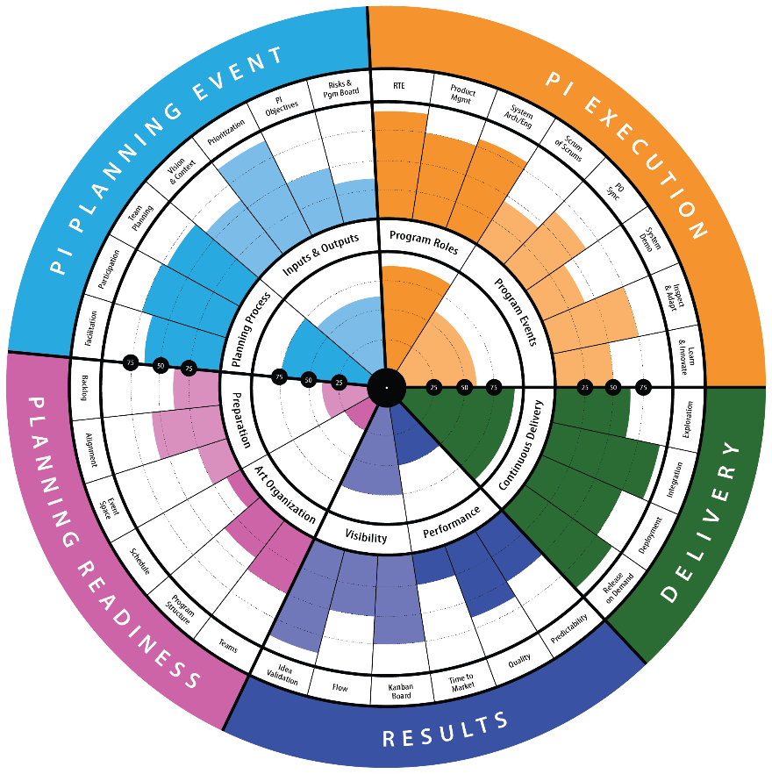

World Class Radars
Team of Teams
DevOps Health
Radar
SAFe® Radars

Slide 8
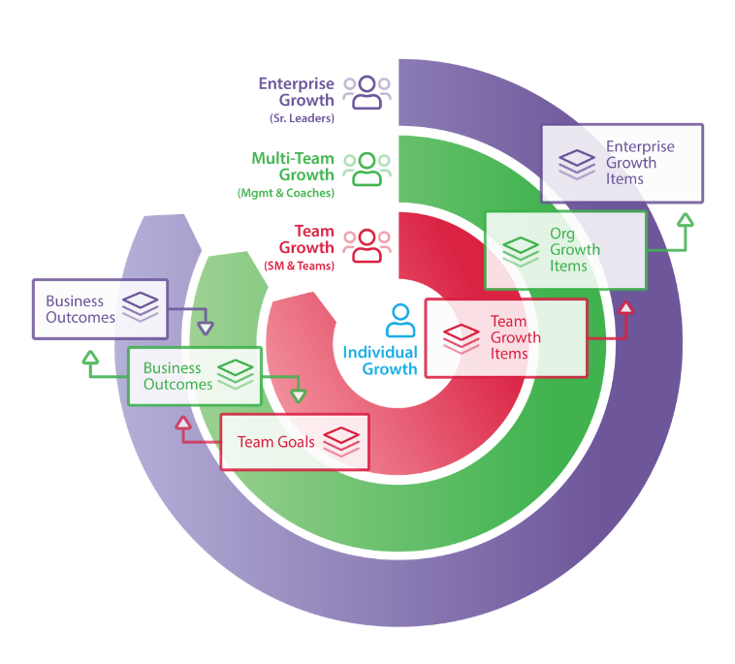
AgilityHealth® Continuous Improvement Model
Org Leaders
Agile Coaches
Managers
‘If you want to teams to align and achieve outcomes, you’ll need to hear their voice and remove obstacles.”
– Sally Elatta
Teams
Scrum Masters
Product Owners

Slide 9





Roles and Jobs To Be Done
Org Leaders
Agile Coaches
Managers
Scrum Masters
The Team
Remove Organizational and/or Enterprise obstacles
Visibility into organization health and performance
Define business outcomes and measure results
Multi-team roll
up analysis
Coaching the
target teams
Measure coaching impact
Identify patterns
Complete
team survey as stakeholder
Own removal of organizational growth items
Measure growth over time
Schedule
and attend retrospectives
Work with team to build and prioritize SMART Growth Items
Manage team growth plan
Be fully present & complete assessments
Analyze results as a team real-time
Build growth plans
Work as a team to prioritize and work on growth items

Slide 10
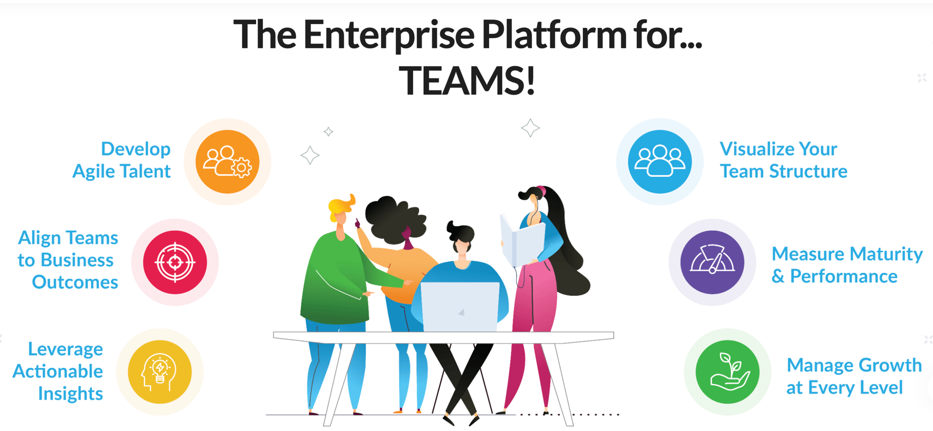
Six Key Capabilities of the AgilityHealth® Platform

Slide 11






The 6 Questions AgilityHealth® Answers
1
2
3
Who are my
teams and how are they organized?
Are we maturing and performing at every level?
Where can leaders help to accelerate growth?
4
What’s the ROI of this transformation? Where should we focus next?
5
6
Are the teams aligned to business outcomes and achieving results?
Are we growing our Agile talent and key roles?

Slide 12
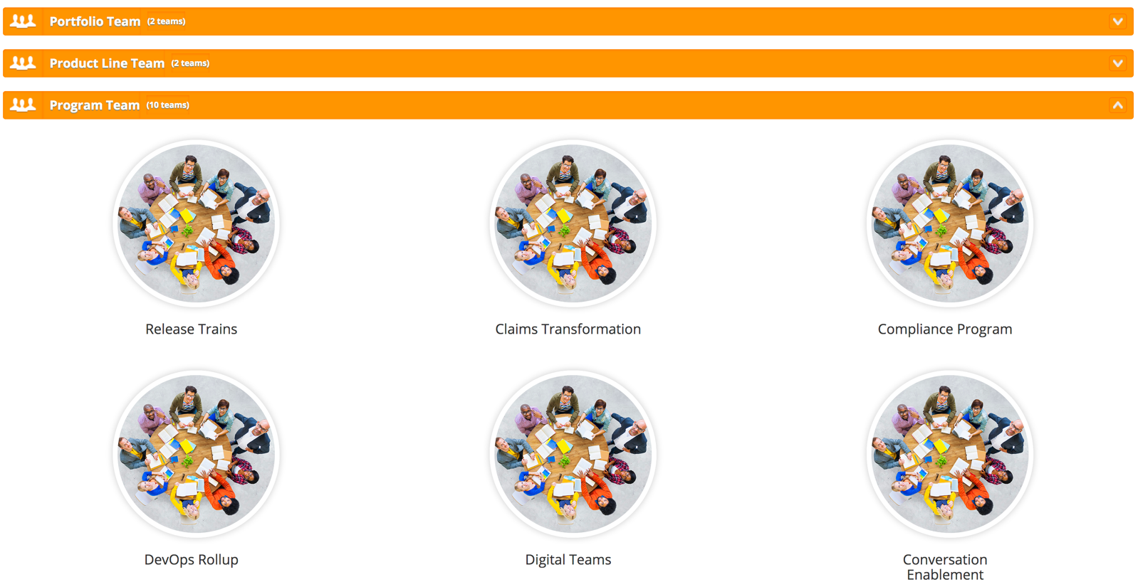
Agile Team View

Slide 13
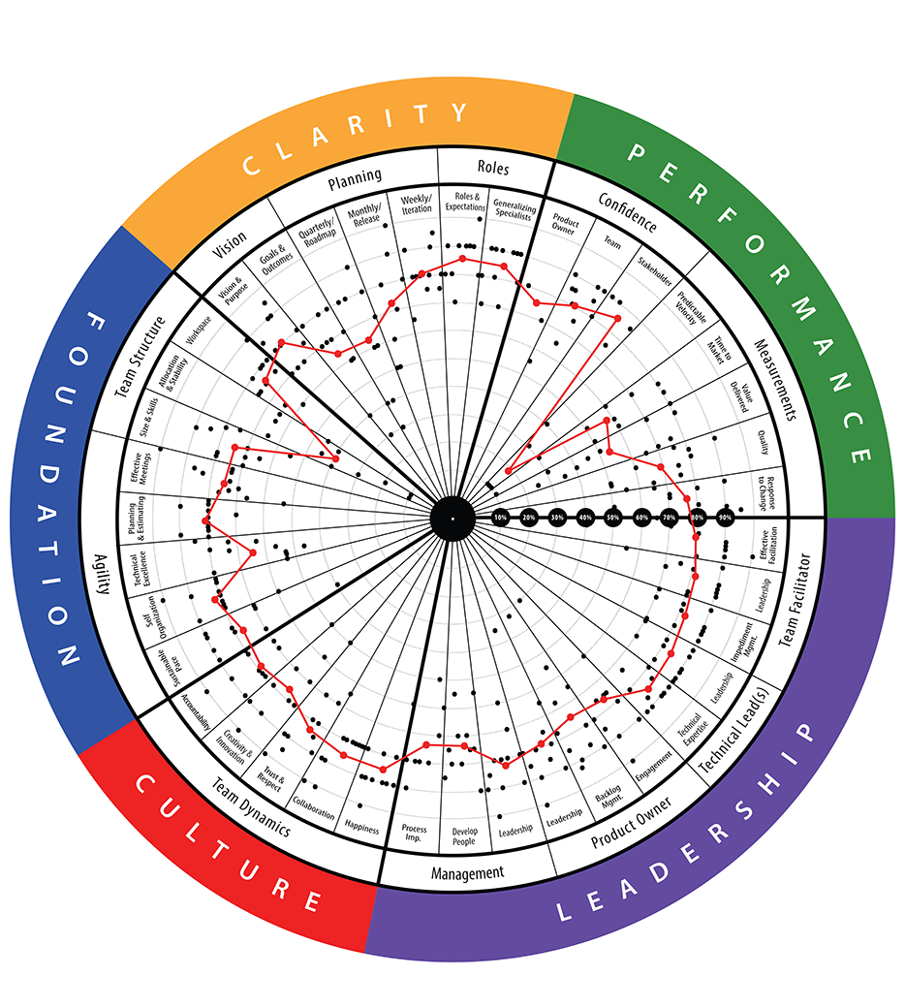
TeamHealth® Radar
Purpose: Our most popular & powerful benchmark for measuring the health of Agile teams across 5 dimensions: Clarity, Performance, Leadership, Culture and Foundation.
Who? Typically completed by the Agile team members: Product Owners, ScrumMasters, Technical Leads, & Team Members.
Pain Points? Team practices not mature or Agile, low predictability and accountability, lack of confidence and value delivered, lack of upfront planning (quarterly, monthly, weekly)...
Preview TeamHealth Qualitative Questions
Preview TeamHealth Quantitative Questions

Slide 14
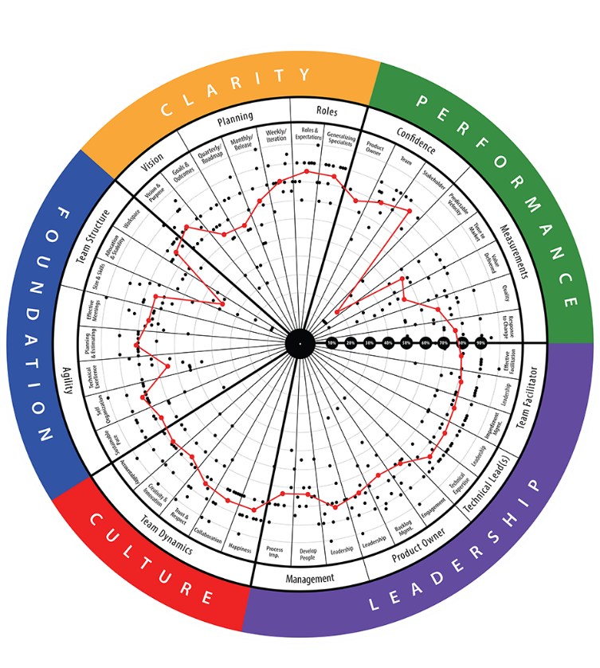
TeamHealth® Retrospective
STRATEGIC RETROSPECTIVE: A retrospective that aims to help teams reflect on their last quarter or release and improve the next one. Facilitated by certified AgilityHealth® Facilitators.
Analyze real-time
radar and textual responses. Have “real” conversations
Team members
complete the assessment on their phone or laptop
STEP 2
Build actionable
growth plan for
the team and for
their leaders
STEP 1
STEP 3
Duration: ~ 2.5 hrs
Repeat: Every quarter/release

Slide 15
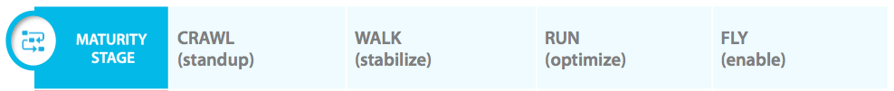
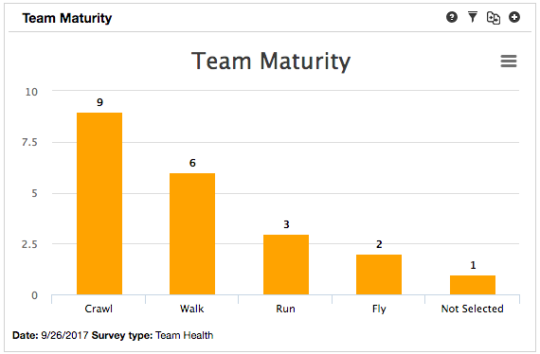
Agile Team Maturity Roadmap
Notes:
Maturity labels can be customized

Slide 16
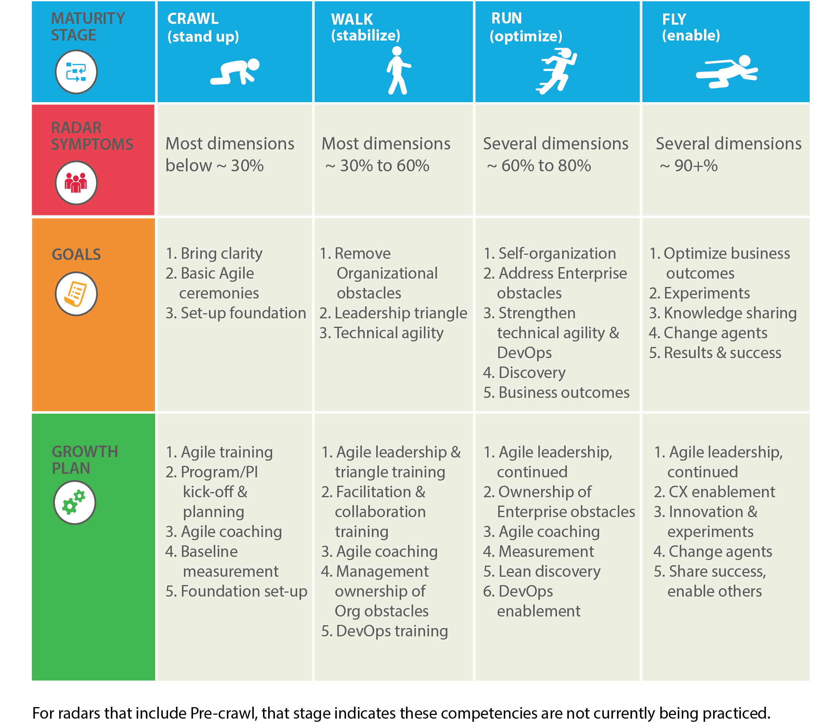
Example: TeamHealth Insights: Maturity
Recommended goals for teams at Walk and Run maturity levels

Slide 17
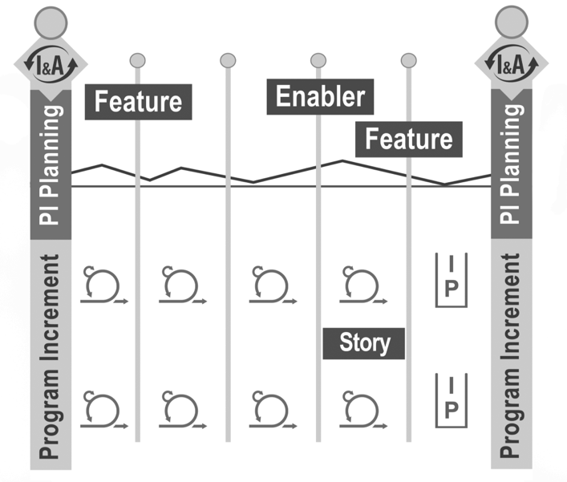
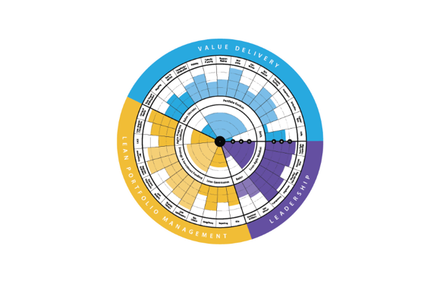
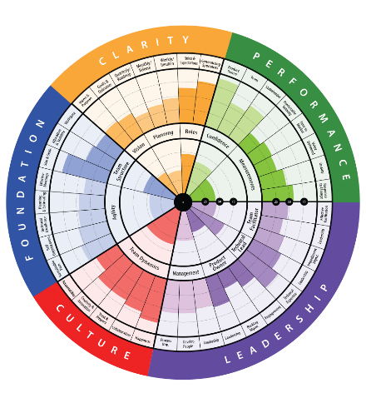
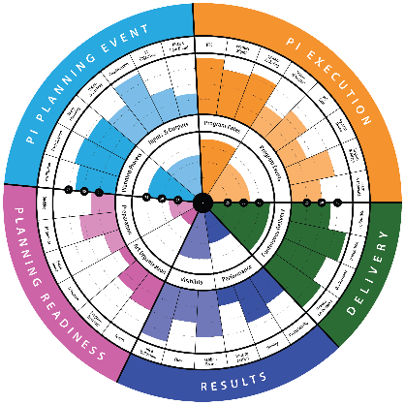
When to Run the Assessments
Portfolio/Organization
Retrospective
Train/Program
Health
Portfolio
Health
Team Health

Slide 18
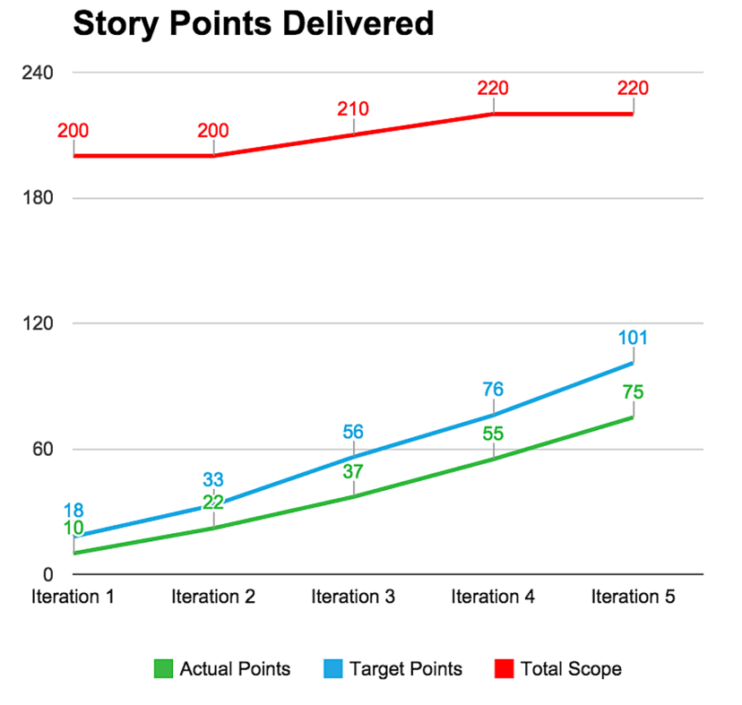
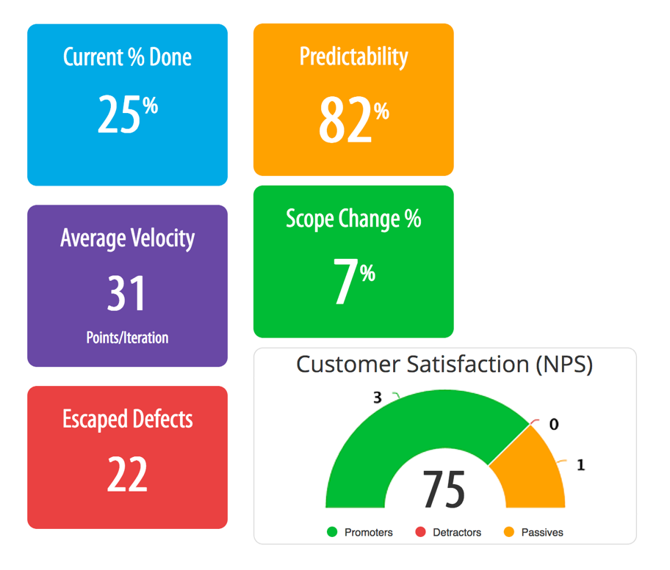
Team Performance Metrics

Slide 19
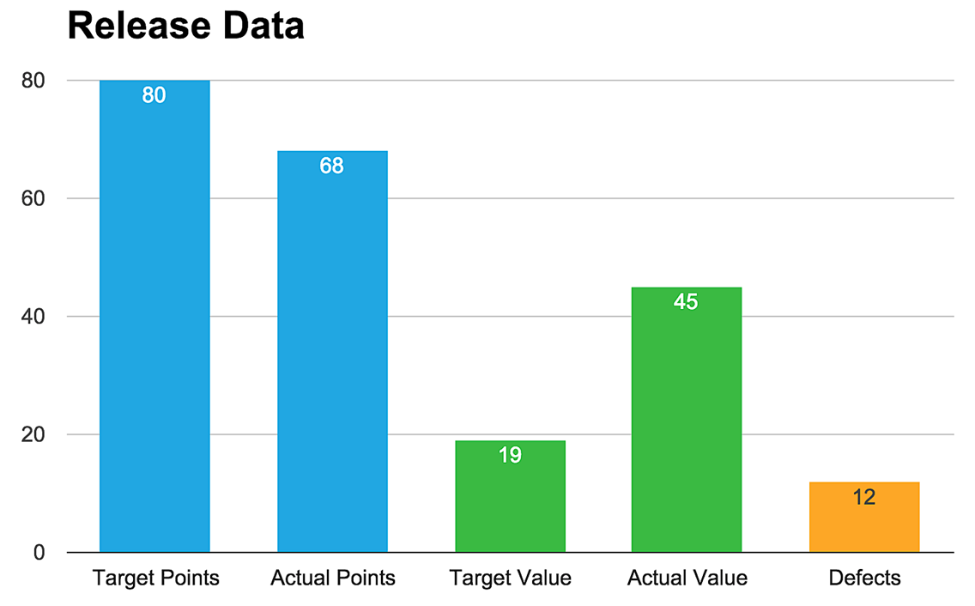
Release Health Metrics
Features
Delivered
85%
Value
Delivered
237%
Escaped
Defects
12
Target Date
6/09/2015
Actual Date
6/19/2015

Slide 20
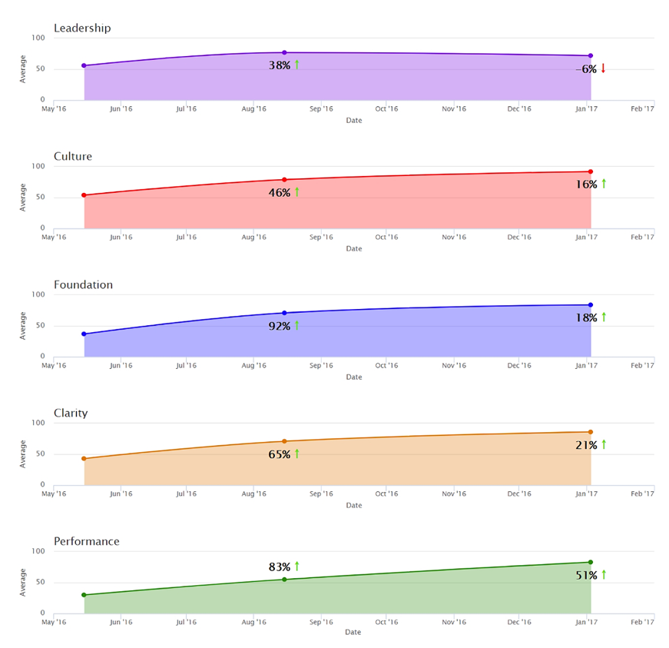
Program Improvements - Quarterly
Leadership Decreased by 32%
Culture Improved by 62%
Foundation Improved by 110%
Clarity Improved by 86%
Performance Improved by 134%

Slide 21
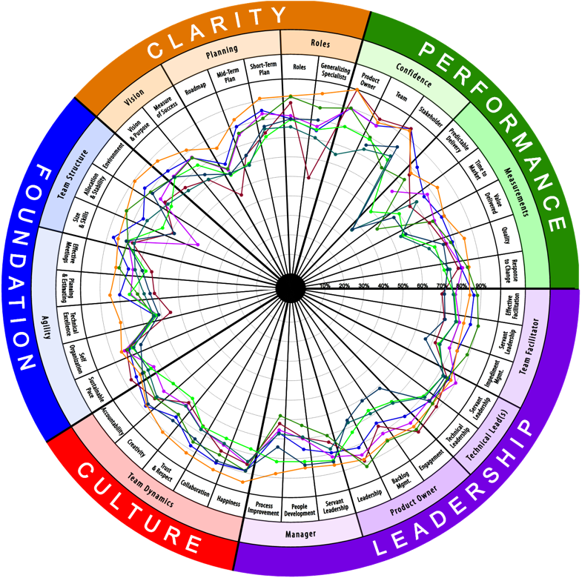
Multi-Team Rollup Radar

Slide 22
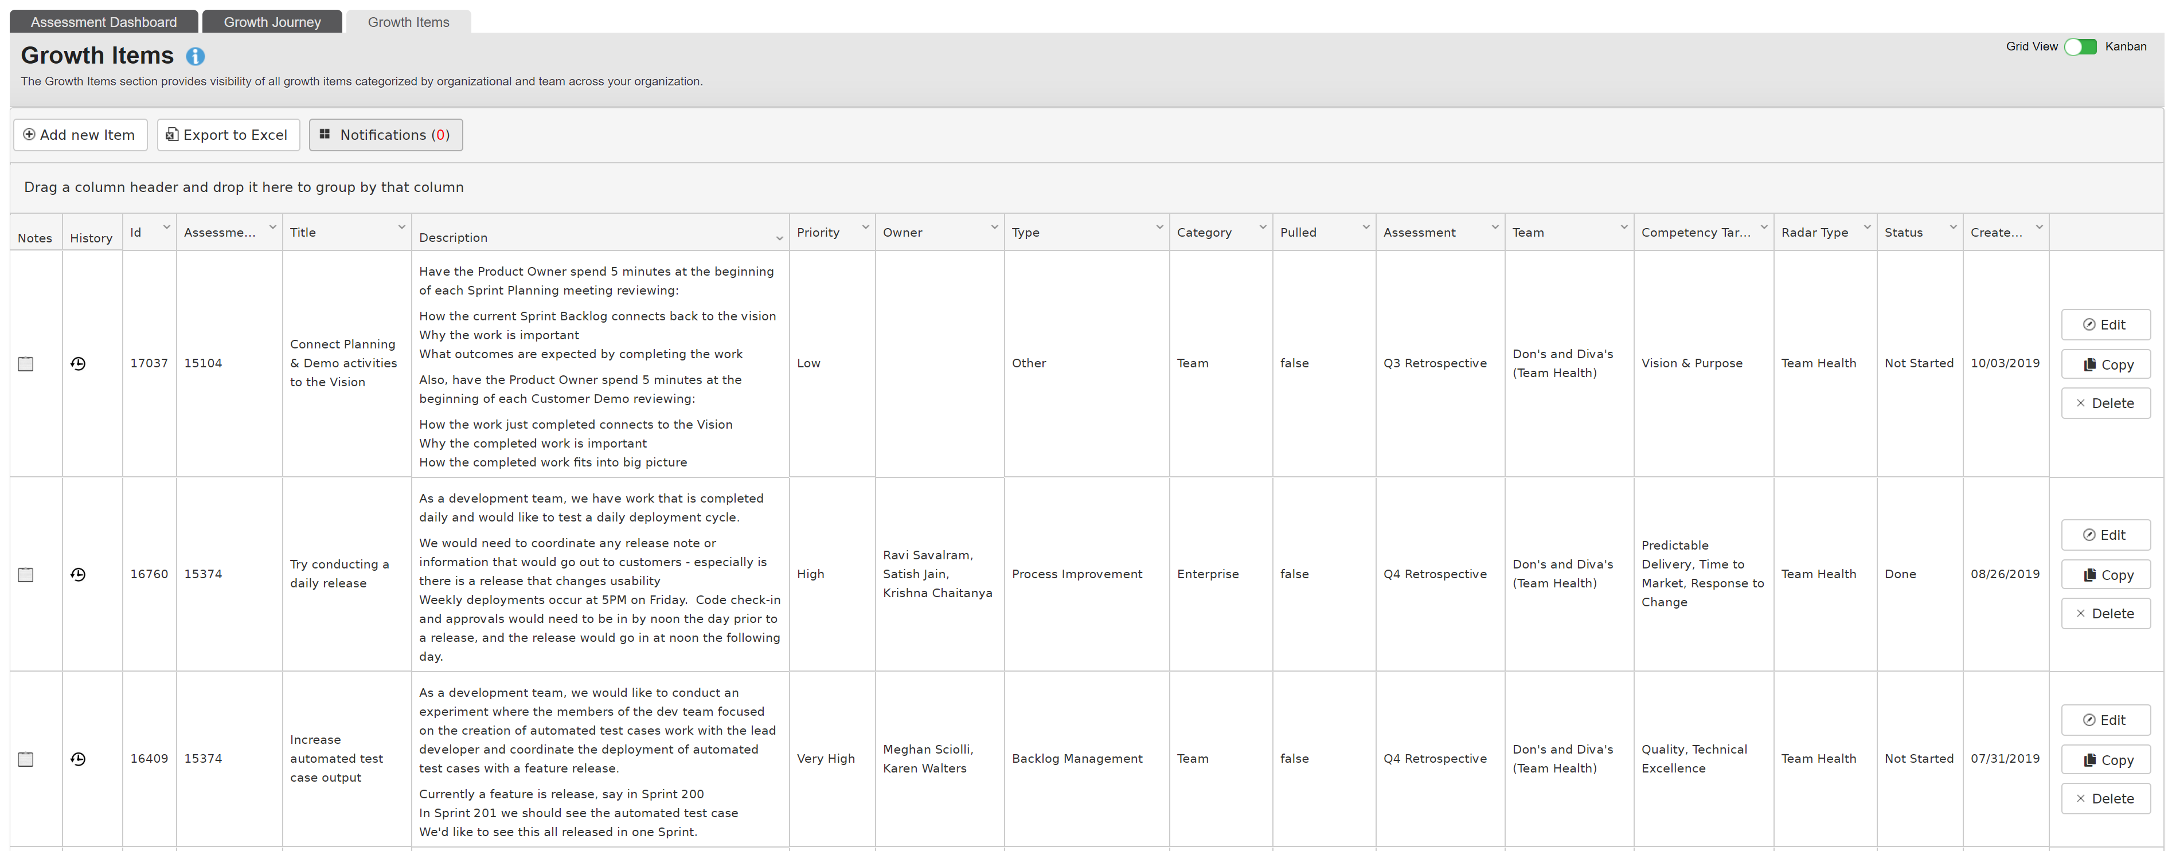
Actionable Growth Items

Slide 23
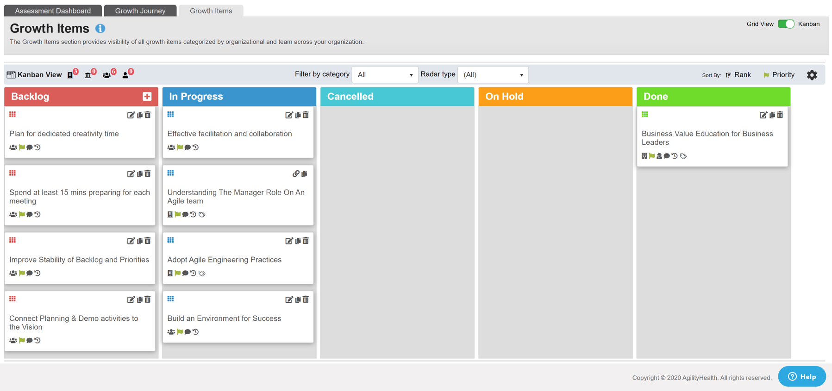
Manage Growth at Every Level

Slide 24
Leadership Owns Organizational Growth Items
Challenges outside the control of the team are addressed through Organizational Growth Items owned by Leadership.
Agile Enablement
Tech Agility & Tools
Culture & Leadership
Product & Program
The CI Leadership Team
focuses on an improvement plan for removing obstacles, coaching, and helping the teams to become high performing.
Role clarity
Estimating & Planning
Story writing
Effective meetings
…
Tooling issues
Test automation
Dev Ops
Access Issues Environment Issues
…
Talent & skill gaps
Capacity challenges
People, Culture
Change management
…
Conflicting priorities
Clarity on requirements
Dependencies
Value alignment
….
Agile Coaches / SM
Technical Leads, DevOps Leads
Managers, Directors
Product / Program Mgrs

Slide 25
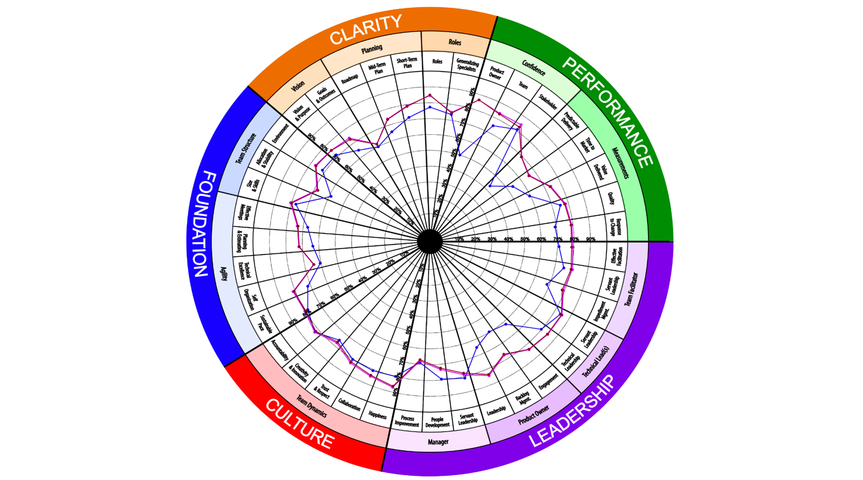
Enable Growth & Scaling of Coaching Capacity

Slide 26
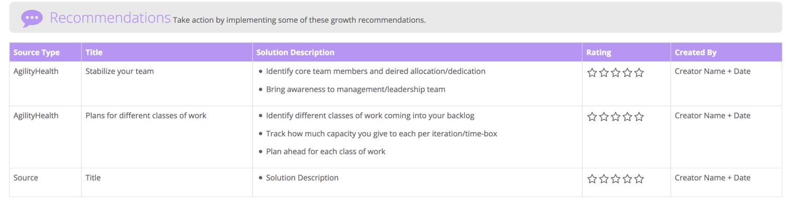
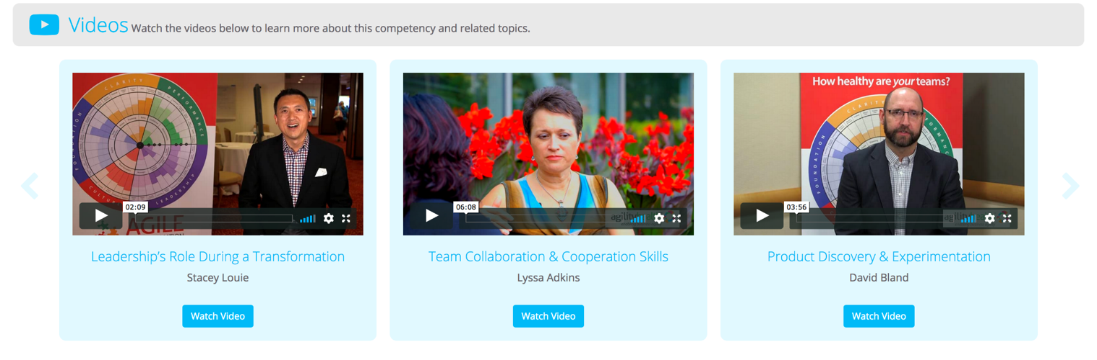
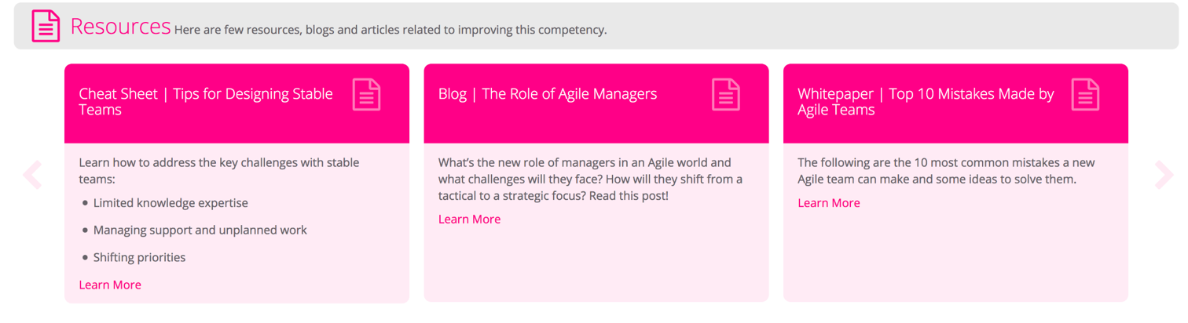
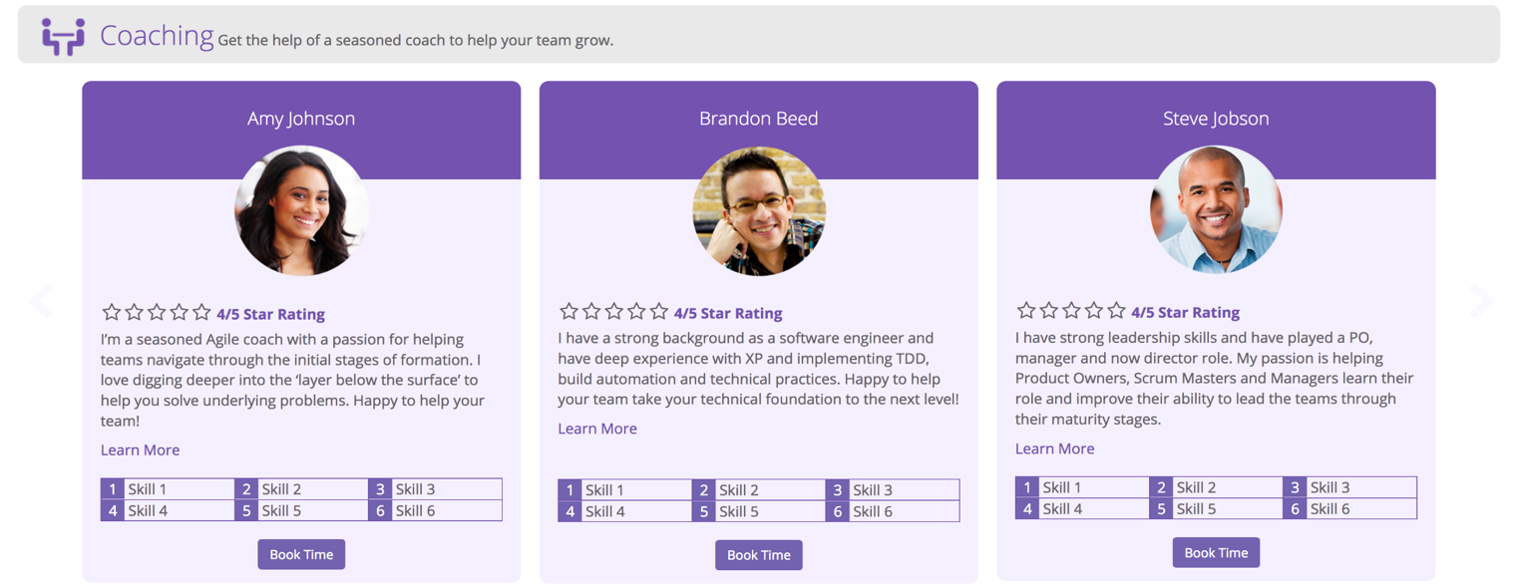
Enable Growth & Scaling of Coaching Capacity

Slide 27
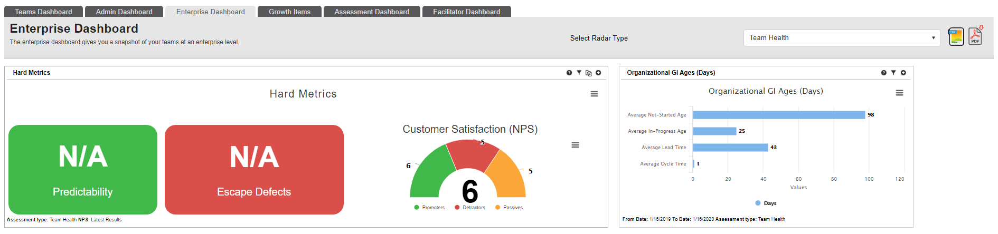
Insights by Line of Business

Slide 28
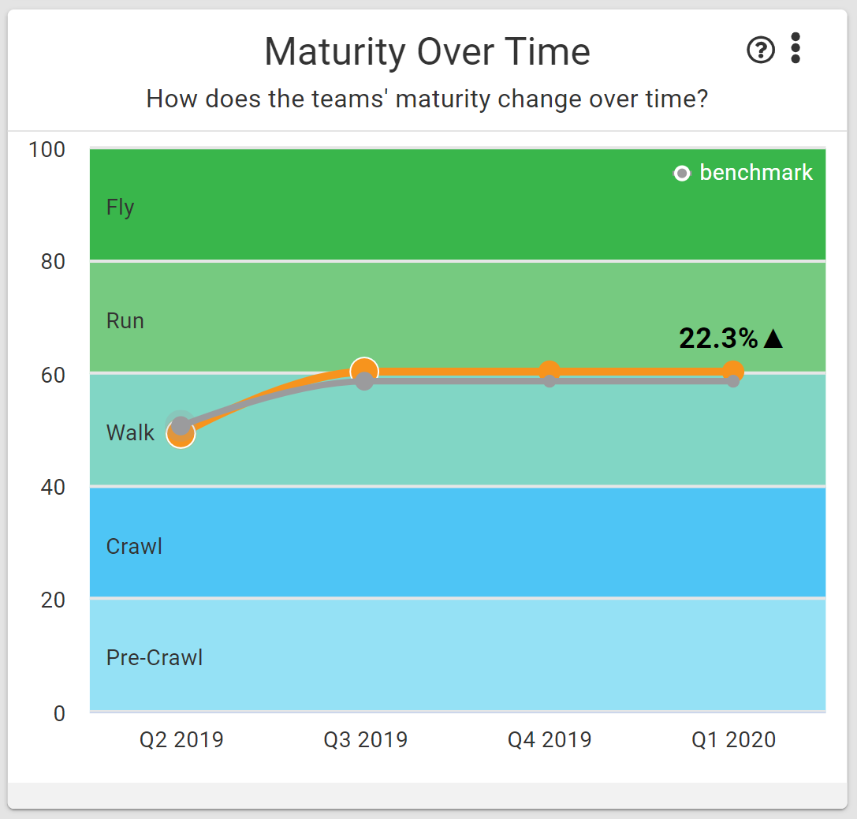
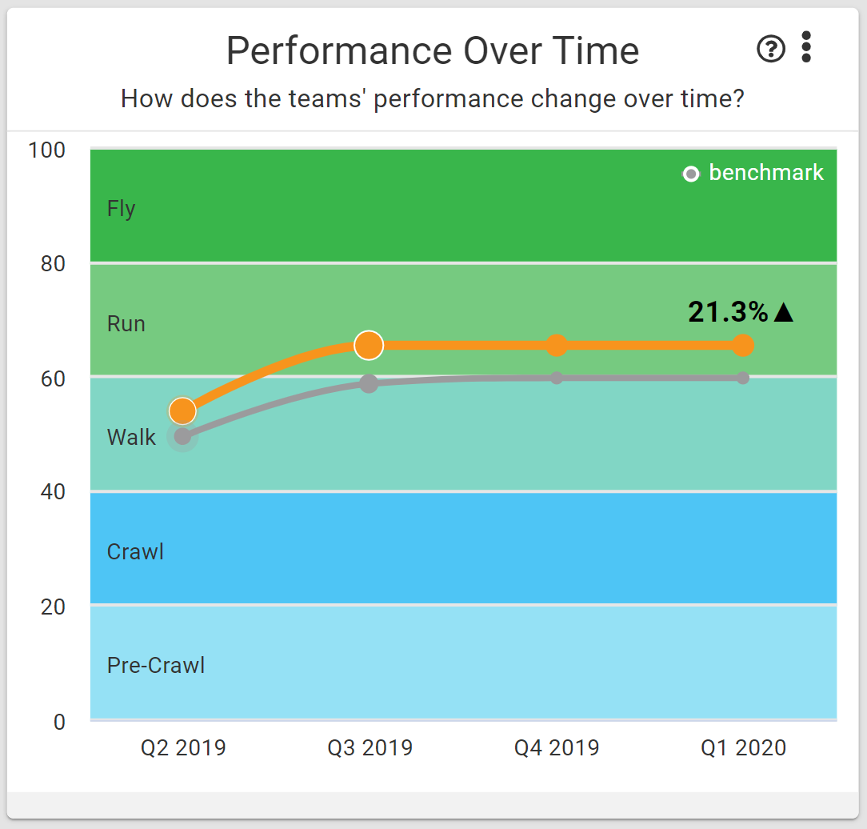

Team Agility Measurement
** Example **
Assess both the maturity (qualitative) and performance (quantitative) metrics to assess Team Agility Index. Benchmark against other companies or internally.
Notes:
To calculate Team Agility, we take the average of the Team Maturity measures (Clarity, Leadership, Culture, Foundation) plus the average of the Team Performance measures (Throughput, Predictability, Change Fail Rate, Deployment Frequency, Mean Time to Deploy, Story Lead-Time), divide by 2 to understand where the Team Agility score lies. Both Team Maturity and Team Performance carry equal weighting.
We have seen over time the average efficiency gains listed as teams mature.

Slide 29
Focus on Outcomes | Annual Outcome Card Sample
Title:
New & Compelling Non-medical SMB products
Overall Progress:
Hypothesis:
We believe that by launching new SMB non-medical benefits insurance products to the market we will increase our market share for small business members.
Key Results / Metrics:
Title | Progress | Metric | Now | Target | Team of Teams
Increase SMB membership |  | Active Members | 30K | 60k | SMB Sales
Maintain Conversion Rate |  | Activation | 72% | 72% | SMB Delivery
Quote applications for new products |  | Quotes | 0 | 45K | SMB Marketing
Customer/org Impact metric

Slide 30
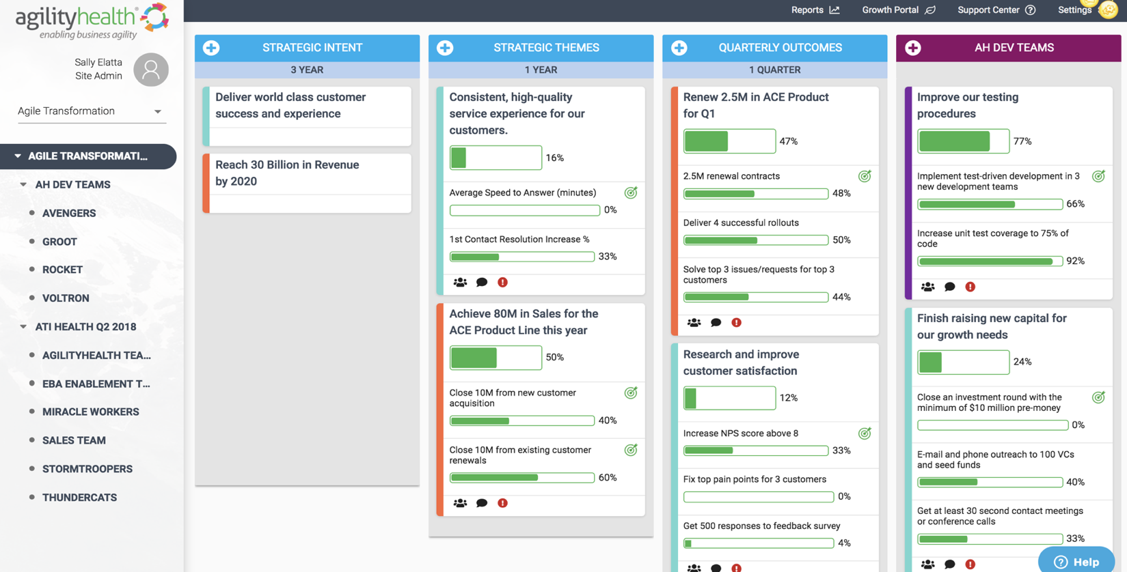
AgilityHealth® Outcome Alignment Dashboard
Align all teams at all levels to outcomes (OKRs)
The blue columns represent ‘Demand’ the purple are ‘Capacity’. You can click on any level of the org to gain visibility and alignment on outcomes.

Slide 31
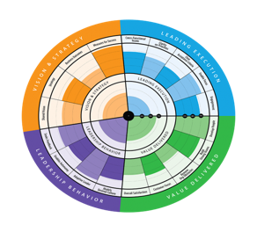
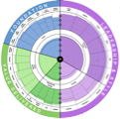









Agile Roles & Talent Development
LEARN
Build Role Specific
Learning Roadmap
MEASURE
Role Health Radar +
Crawl, Walk, Run, Fly Maturity
AgilityHealth Growth Portal
Standup or Stabilize
Community of Practice
MENTOR
GROW
Show me| Pair with Me | Enable me
Enable Self-Learning

Slide 32






Agile Roles & Talent Development (5x4)
5 Roles, 4 Quadrants
Leadership
Senior Leaders
Program Managers/RTEs
ScrumMasters
Managers
Agile Coaches
Products Owners

Slide 33

Agile Leaders and Managers Learning Roadmap
One workshop every ~3-4 months
Leadership Agility
1 Day
Leading SAFe®
2 Days
Enabling Business Agility
2 hr. Seminar + Workshop
Tactical to Strategic Leadership
Senior Leaders
Agile
Leadership
2 Days
Leading SAFe®
2 Days
Effective Facilitation & Collaboration
2 Days
Tactical to Strategic Leadership
2 Days
Managers

Slide 34
RTEs and Agile Coaches Learning Roadmap
One workshop every ~3-4 months
Leading SAFe®
2 Days
SAFe® Release Train Engineer
3 Days
AgilityHealth® Facilitator Certification
(AHF)
1 Day
Effective Facilitation & Collaboration
2 Days
Program Managers/RTEs
AgilityHealth® Facilitator Certification (AHF)
1 Day
Scaling Measurement and Growth
1 Day
AgilityHealth® Coach Certification (AHF)
(3 Days)
Enterprise Business Agility Strategist (EBAS)
3 Days
Agile Coaches

Slide 35
SMs and POs Learning Roadmap
One workshop every ~3-4 months
SAFe® for Teams
2 Days
SAFe® Scrum Master
2 Days
Effective Facilitation & Collaboration
2 Days
SAFe® Advanced Scrum Master
2 Days
ScrumMasters
Leading SAFe®
2 Days
SAFe® for Product Owners
2 Days
Agile
Leadership
2 Days
Lean Product Development
2 Days
Products Owners

Slide 36




AgilityHealth® Capabilities by Level
Teams
Team of Teams
Portfolios/Enterprise
Individual Roles
The goal of measurement should be to enable growth,
not for judgment, reward or punishment.
Assess team maturity and performance
Build actionable growth & improvement plans
Visualize growth each quarter
Enable self-learning through the Growth Portal
Build organizational growth areas for leaders to own
Align teams to business outcomes
Assess the maturity of programs (DevOps, SAFe, Lean Product Maturity)
Build actionable growth & improvement plans
Rollup data and identify patterns and target areas for growth
Remove organizational obstacles
Align product/programs to business outcomes
Assess the Enterprise Business Agility maturity
Measure transformation progress and next areas for improvement
Rollup enterprise data and gain actionable insights
Remove enterprise obstacles
Align the org to business outcomes
Define clear role based competencies
Enable self-assessment and 360 feedback
Build individual growth plans
Rollup data and develop targeted growth plans across roles
Enable self learning through the growth portal
Strengthen communities of practice

