Slide 1
AgilityHealth® Overview for Stakeholders

Slide 2







Enterprise Business Agility Journey
Team Agility
- Measure TeamHealth
- Enable Self-learning
- Develop Talent
Org Agility
- Lean Portfolio Mgmt.
- Value Stream Structure
- Lean Product Maturity
Enterprise Business Agility
- Anticipate Customer Needs
- Disrupt Before Being Disrupted
- Relentless Improvement
Team of Teams Agility
- Scaling Agile
- DevOps Maturity
- Leadership & Culture
Operational Agility
- Customer Seat at the Table
- Talent Development, HR Transformation
- Ops, Finance, Legal, Audit, Sales/Mktg
Measure What Matters | Team Agility (Outcomes, Maturity & Performance) | Enterprise Agility (Flow, Value, Quality)

Slide 3
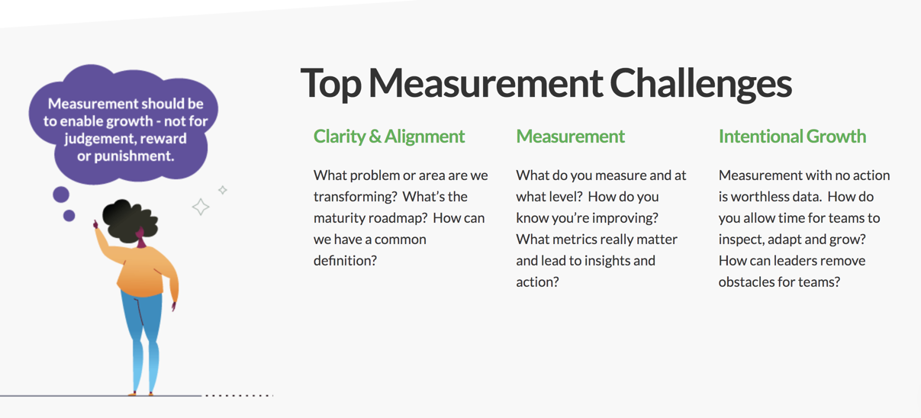
Measurement Challenges

Slide 4
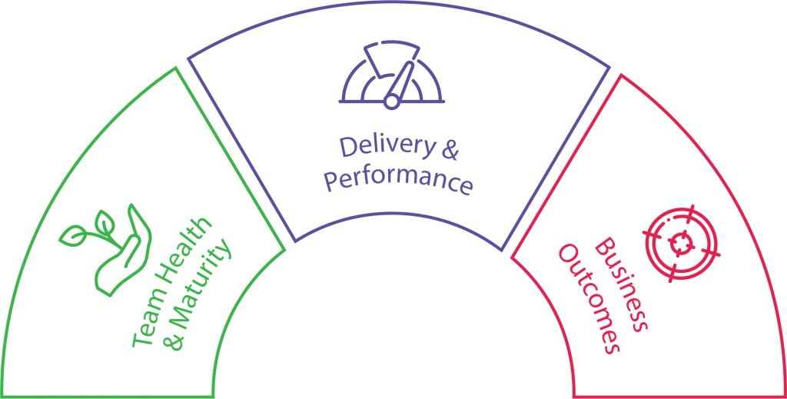
What Should We Measure? The Three Metrics That Matter
Outcomes are THE Metrics that Matter
Maturity and Performance tell us WHY we’re not achieving outcomes.
Performance
Collected via Agile Work Mgmt. Platforms
Maturity
Collected via Team
Assessments/Radars within AgilityHealth
Outcomes
AgilityHealth OKR Dashboard
Notes:
Let’s focus on the “people” – Their health and the maturity of their agile practices and behaviors
Agile work management platforms – Do not forget to mention LeanKit

Slide 5



What is the AgilityHealth® Measurement Platform?
AgilityHealth® is the world’s leading
measurement & continuous improvement
platform for accelerating the maturity and productivity of teams and enterprises.
Measure
Grow
Accelerate

Slide 6
4 Levels of Metrics
Team Agility = Rollup of Team Maturity & Performance
Enterprise
Portfolio/ LOB
Team of Teams
Team
Org Agility = EBA Rollup
Enterprise Business Agility
DevOps, Product Mgmt. & ART Health
Team Health & Performance

Slide 7
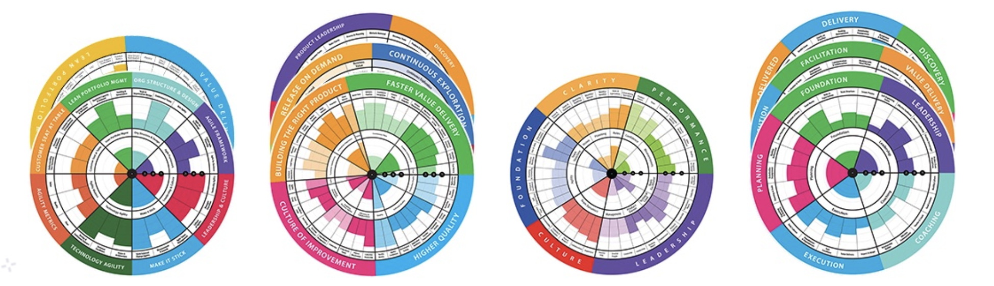
Measure & Grow at Every Level
Portfolio / Enterprise
- Enterprise Business Agility
- Lean Portfolio Mgmt.
- Digital Transformation*
Team of Teams / Product
- Lean Product Health
- DevOps Health
- Scaling Agile
Team Level
- Team Health
- Technical Agility
- Remote Work Health
Role/Talent Dev
- Scrum Master, Product Owner
- Agile Leader
- Agile Coach, RTE, others*
8 new SAFe® Radars have just been launched!
Notes:
Team Radars for all teams including leadership teams.
TeamHealth for all teams – our most popular and where most of our customers begin.
Team of Teams – The leadership teams (and key team members) for DevOps and Programs
Portfolio – The portfolio leadership teams, or multiple portfolio teams can be rollup/combined for a cross-enterprise view.
Individual Roles (talent). Such as agile coach, scrum master, manager, leader, etc.
For your customers using the SAFe scaling framework we have SAFe specific radars too.

Slide 8
Large Financial Co. AgilityHealth® Case Study
Objective: Accelerate transformation and team maturity/adoption of Agile and DevOps to enable business agility
1500 Technology Teams
21K Team Members
Agile and
Non-Agile
Customer Needs | Solutions Delivered
Baseline assessment across all teams Measure and quantify maturity and performance Build actionable growth plans for next quarter Engage leaders at all levels in removing obstacles Re-assess and quantify growth | Agile/DevOps team assessment launched in Jan across 21k Trained 400+ facilitators within 2 weeks Facilitators completed 1500 retrospectives within 3 weeks Growth plans created 200+ managers trained on removing obstacles

Slide 9
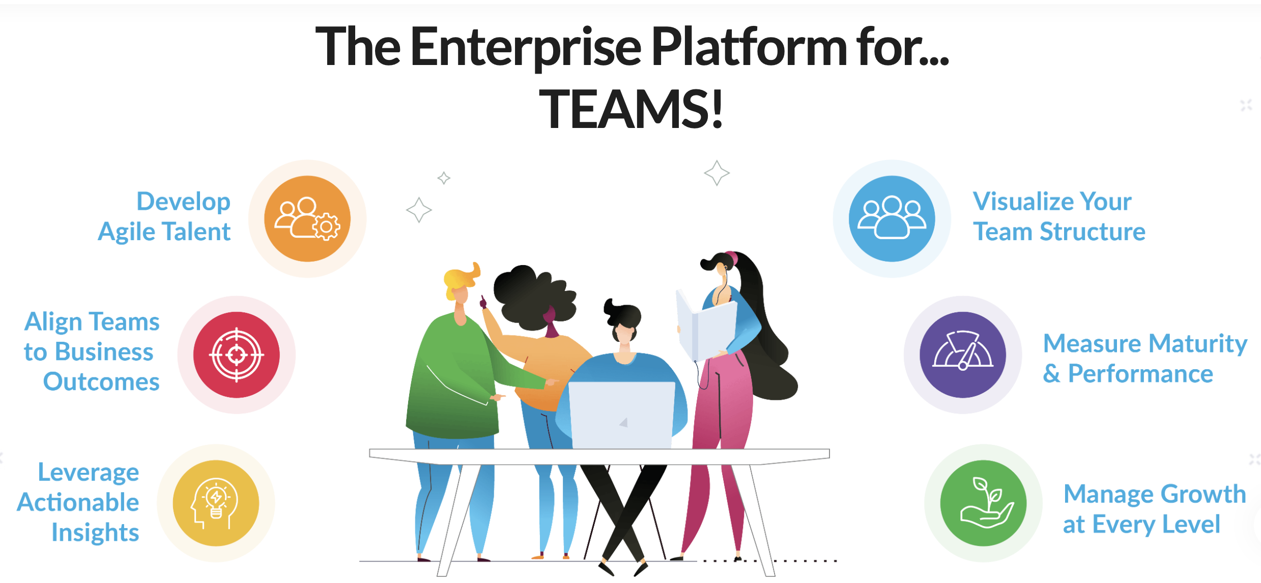
Six Key Capabilities of the AgilityHealth® Platform

Slide 10






The 6 Questions AgilityHealth® Answers
1
2
3
Who are my
teams and how are they organized?
Are we maturing and performing at every level?
Where can leaders help to accelerate growth?
4
What’s the ROI of this transformation? Where should we focus next?
5
6
Are the teams aligned to business outcomes and achieving results?
Are we growing our Agile talent and key roles?

Slide 11





Roles and Jobs To Be Done
Org Leaders
Agile Coaches
Managers
Scrum Masters
The Team
Remove Organizational and/or Enterprise obstacles
Visibility into organization health and performance
Define business outcomes and measure results
Multi-team roll
up analysis
Coaching the
target teams
Measure coaching impact
Identify patterns
Complete
team survey as stakeholder
Own removal of organizational growth items
Measure growth over time
Schedule
and attend retrospectives
Work with team to build and prioritize SMART Growth Items
Manage team growth plan
Be fully present & complete assessments
Analyze results as a team real-time
Build growth plans
Work as a team to prioritize and work on growth items

Slide 12
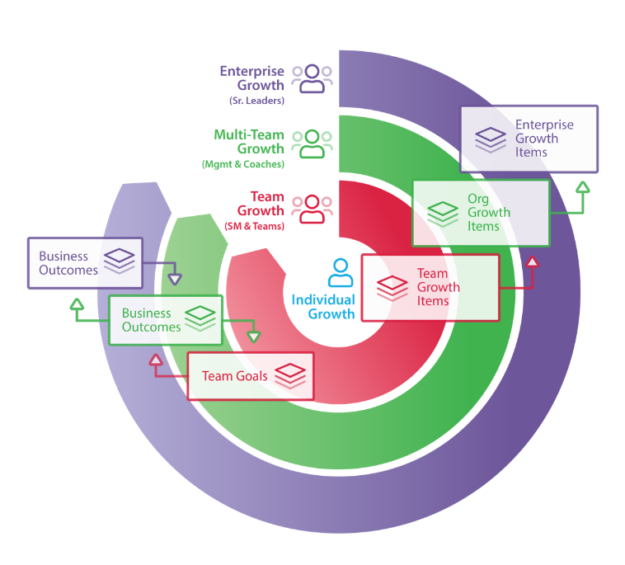
AgilityHealth® Continuous Improvement Model
Org Leaders
Agile Coaches
Managers
‘If you want to teams to align and achieve outcomes, you’ll need to hear their voice and remove obstacles.”
– Sally Elatta
Teams
Scrum Masters
Product Owners

Slide 13
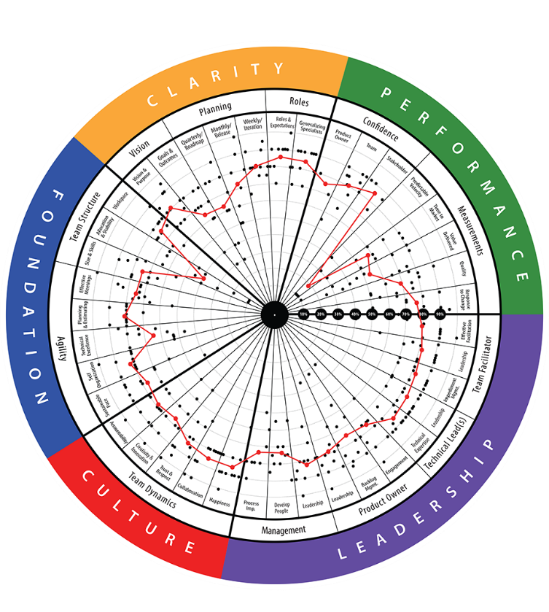
TeamHealth® Retrospective
STRATEGIC RETROSPECTIVE: A retrospective that aims to help teams reflect on their last quarter or release and improve the next one. Facilitated by certified AgilityHealth® Facilitators.
Analyze real-time
radar and textual responses. Have “real” conversations
Team members
complete the assessment on their phone or laptop
STEP 2
Build actionable
growth plan for
the team and for
their leaders
STEP 1
STEP 3
Duration: ~ 2.5 hrs
Repeat: Every quarter/release

Slide 14
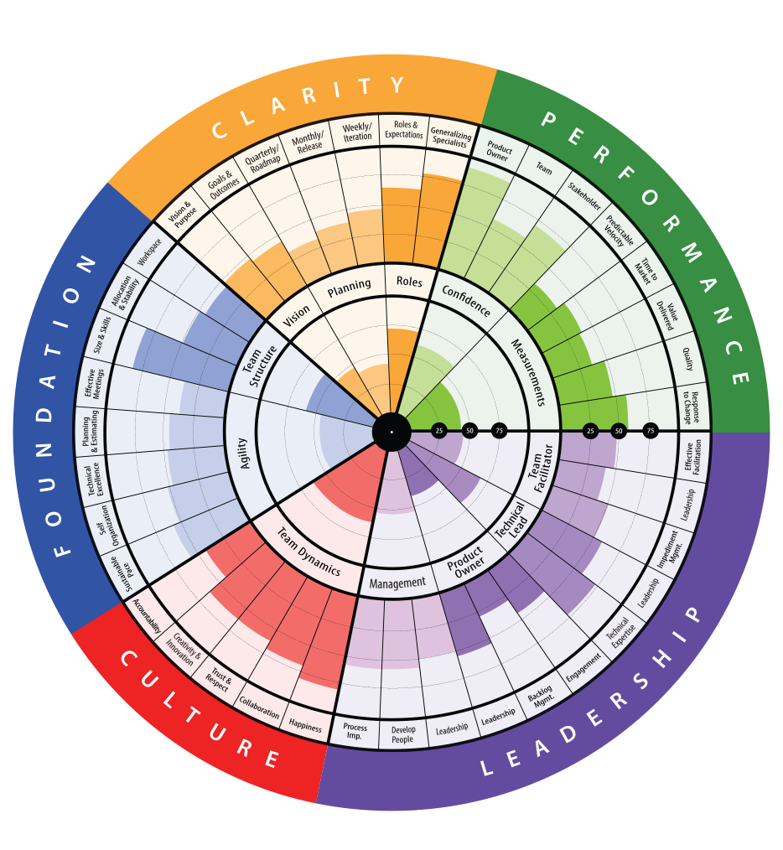
Tactical vs Strategic Retrospectives
Sprint
Tactical
Sprint
Tactical
Sprint
Tactical
Quarterly or Release Planning
Quarterly or Release Demo
Extend Sprint Retrospective for Strategic Retrospective
Sprint Planning
Sprint Demo
Sprint Retrospective
Sprint Planning
Sprint Demo
Sprint Planning
Sprint Demo
Sprint Retrospective
Tactical
Strategic

Slide 15

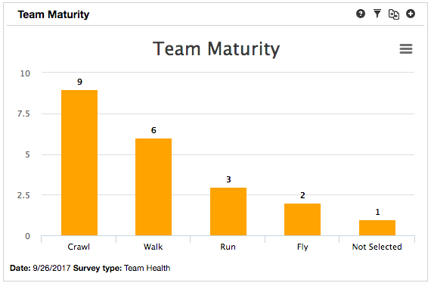
Agile Team Maturity Roadmap

Slide 16
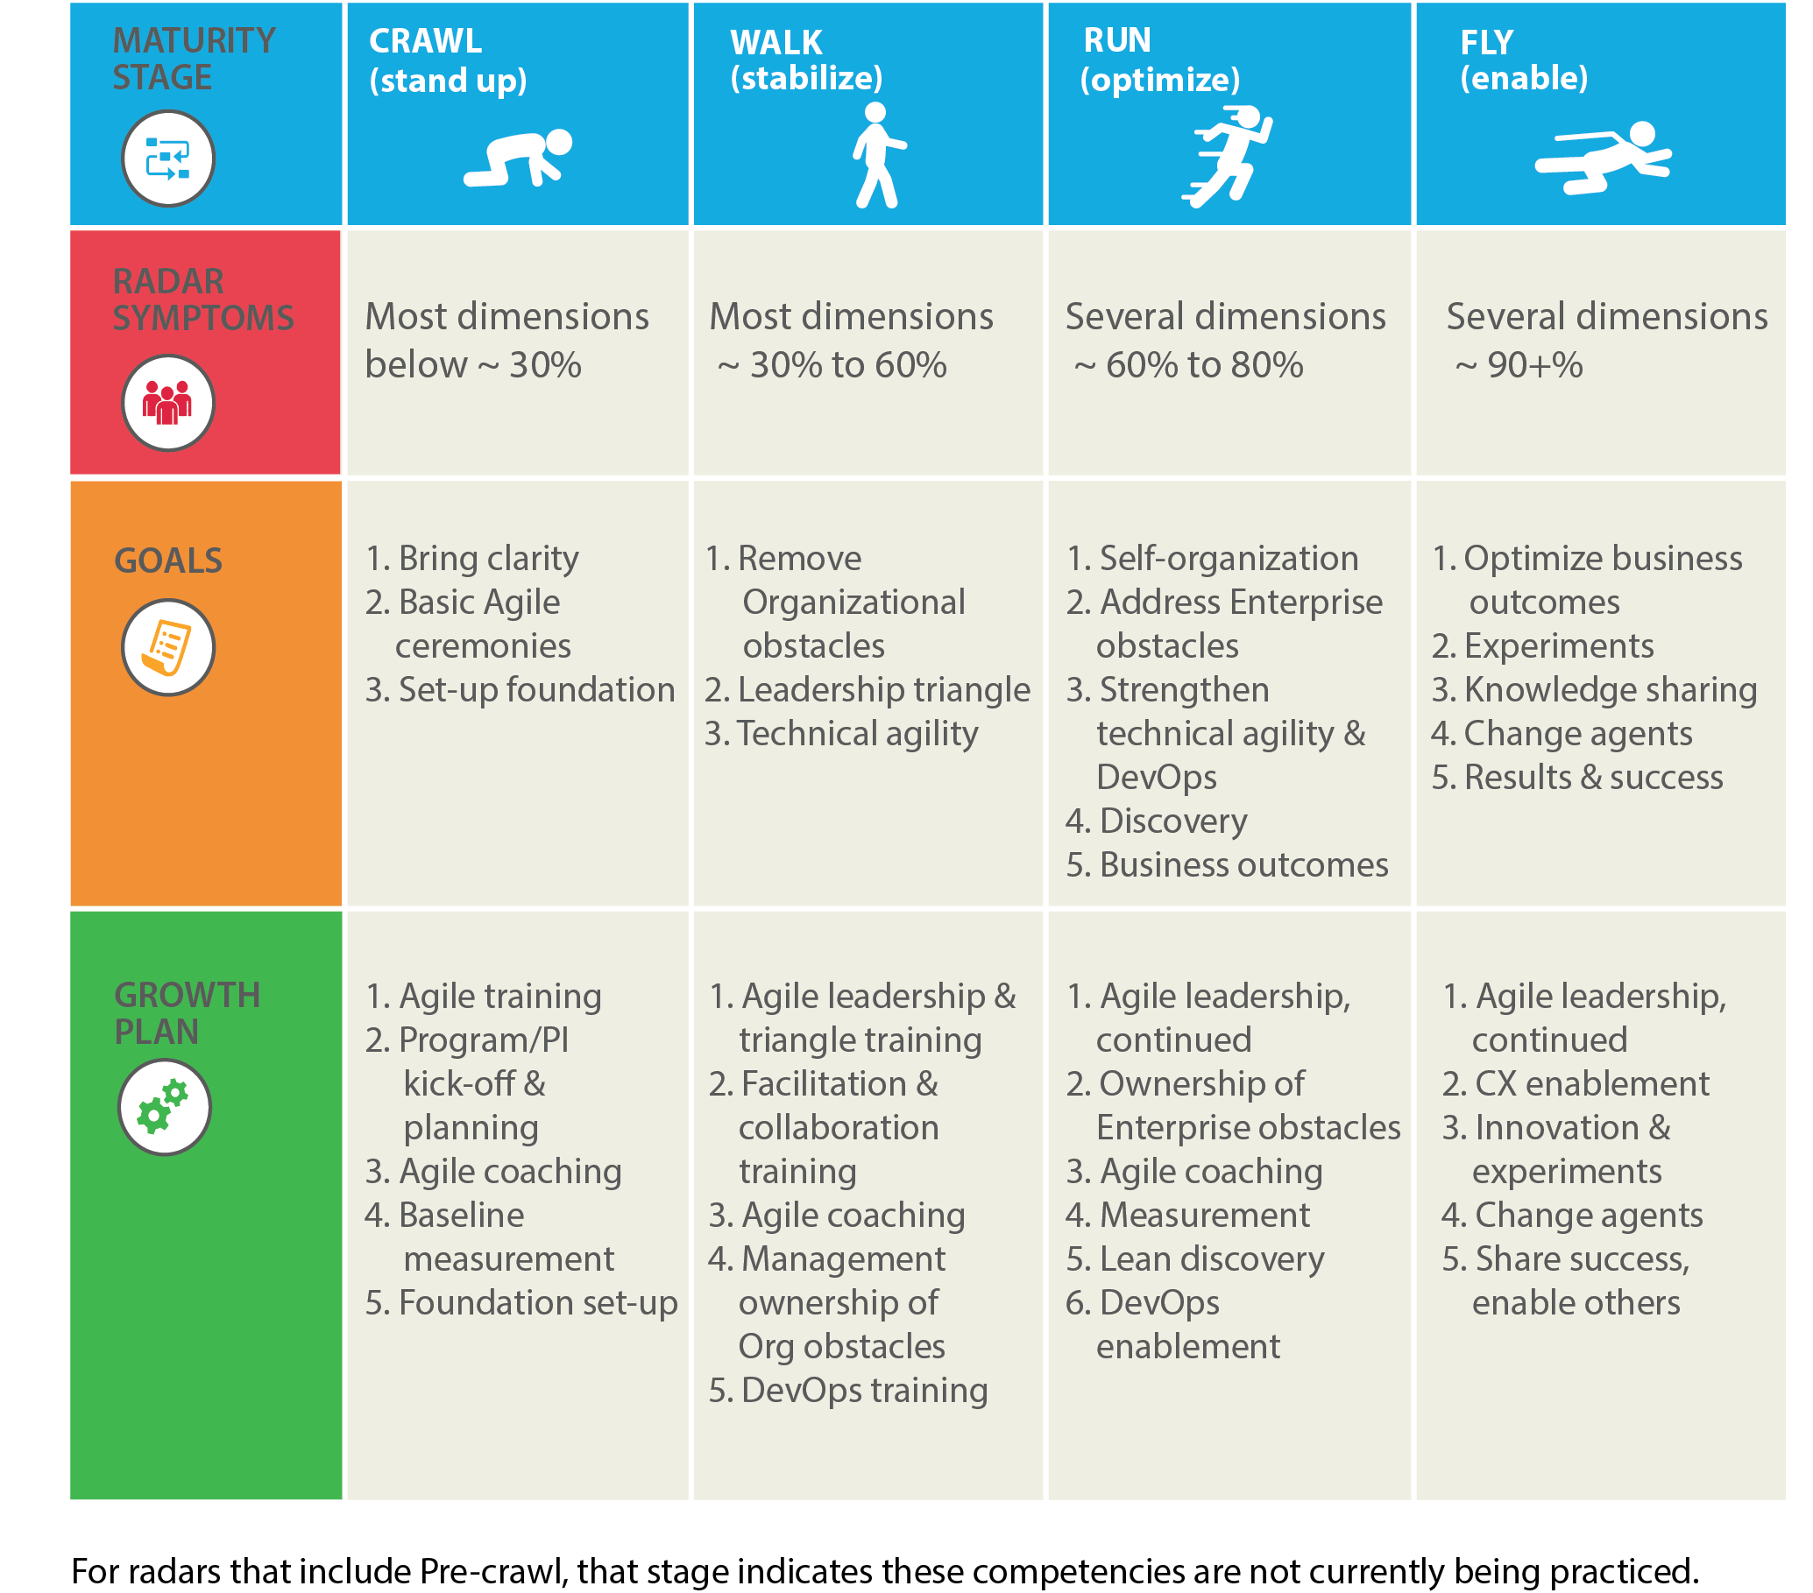
Example: TeamHealth® Insights: Maturity
Recommended goals for teams at Walk and Run maturity levels

Slide 17
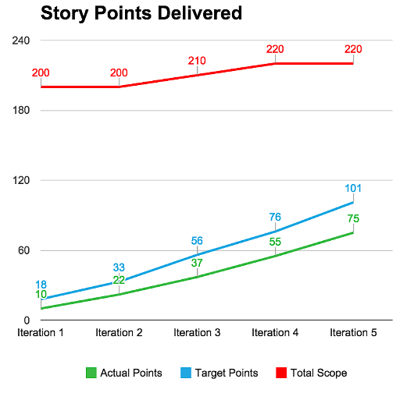
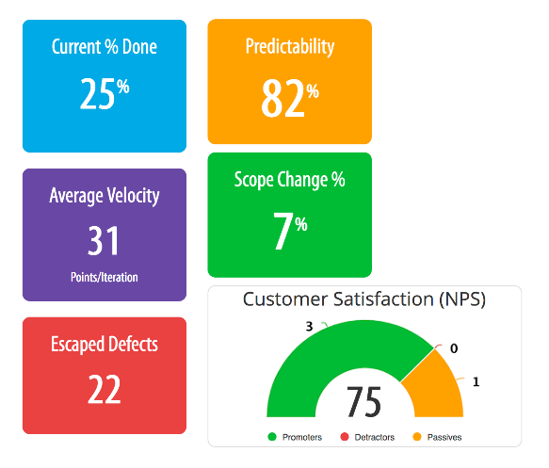
Team Performance Metrics

Slide 18
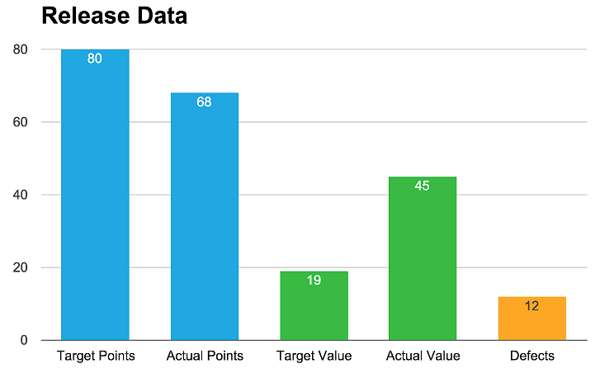
Release Health Metrics
Features
Delivered
85%
Value
Delivered
237%
Escaped
Defects
12
Target Date
6/09/2015
Actual Date
6/19/2015

Slide 19
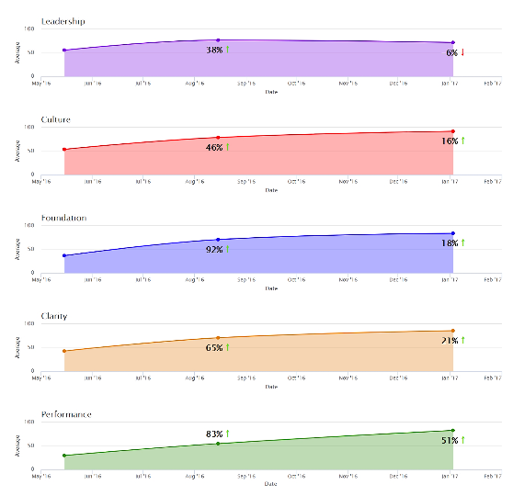
Program Improvements - Quarterly
Leadership Increased by 32%
Culture Improved by 62%
Foundation Improved by 110%
Clarity Improved by 86%
Performance Improved by 134%

Slide 20
Multi-Team Rollup Radar
Analyze common patterns

Slide 21
Multi-Team Rollout Process
TeamHealth® Week
Schedule TeamHealth® assessments for all the teams in a Business Unit, target a specific week or two
Multi-Team Growth Planning Week
Following the assessments, schedule multi-team analysis meeting to analyze the common patters across teams and review results
Consolidate and rank the organizational items. Develop recommendations
Continuous Improvement Planning
Invite leaders and stakeholders to a continuous improvement planning session
Execute
Execute organizational growth plan
Demo, Retrospective
Teams execute team growth plan
Leaders demo to teams what they completed from the org items
Retrospective on the last quarter of growth, re-assess teams to measure TeamHealth® before/after
Review assessment summary results and organizational items
Define goals for the quarter and select key org items to tackle

Slide 22
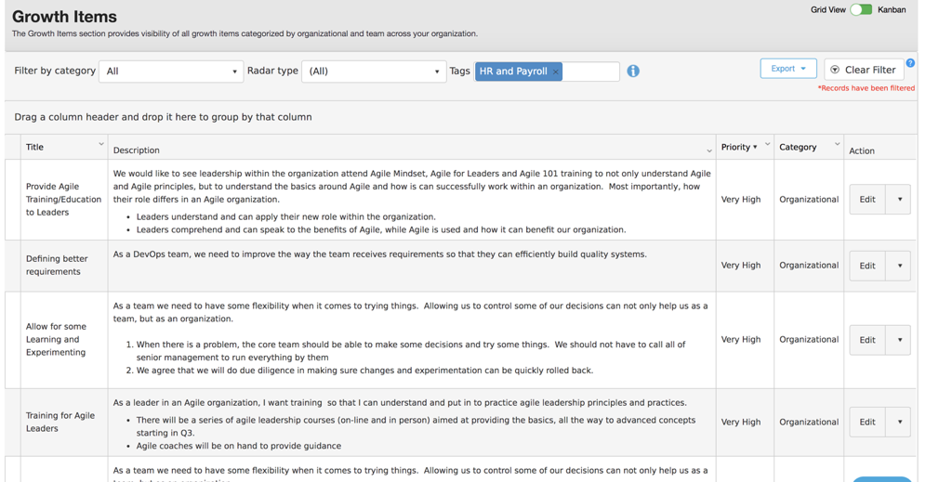
Improvement Plans at Each Level
Make improvement plans actionable. Think Story and acceptance criteria NOT EPIC.

Slide 23
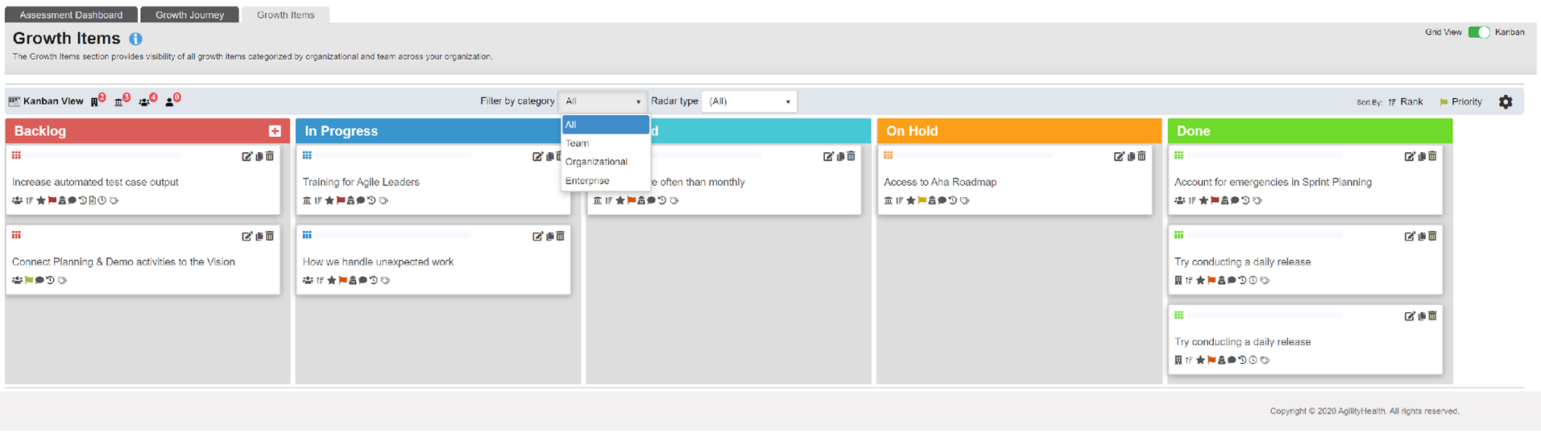
Managing Growth Items with AgilityHealth

Slide 24
Leadership Owns Organizational Growth Items
Challenges outside the control of the team are addressed through Organizational Growth Items owned by Leadership.
Agile Enablement
Tech Agility & Tools
Culture & Leadership
Product & Program
The CI Leadership Team
focuses on an improvement plan for removing obstacles, coaching, and helping the teams to become high performing.
Role clarity
Estimating & Planning
Story writing
Effective meetings
…
Tooling issues
Test automation
Dev Ops
Access Issues Environment Issues
…
Talent & skill gaps
Capacity challenges
People, Culture
Change management
…
Conflicting priorities
Clarity on requirements
Dependencies
Value alignment
….
Agile Coaches / SM
Technical Leads, DevOps Leads
Managers, Directors
Product / Program Mgrs

Slide 25
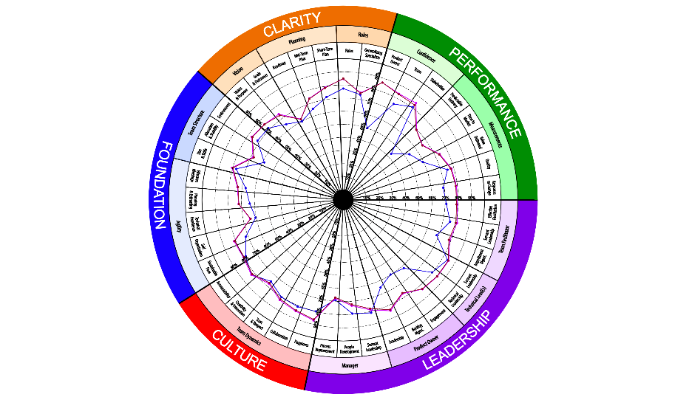
Enable Growth & Scaling of Coaching Capacity

Slide 26
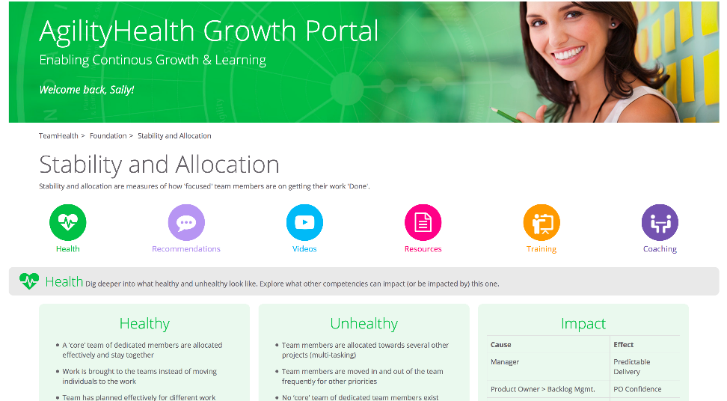
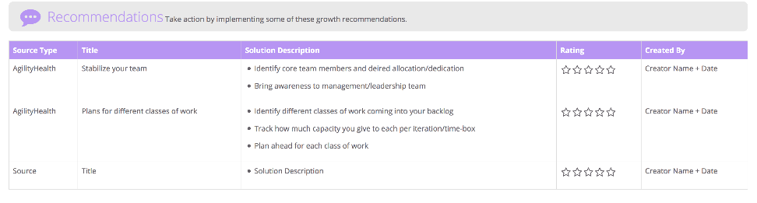
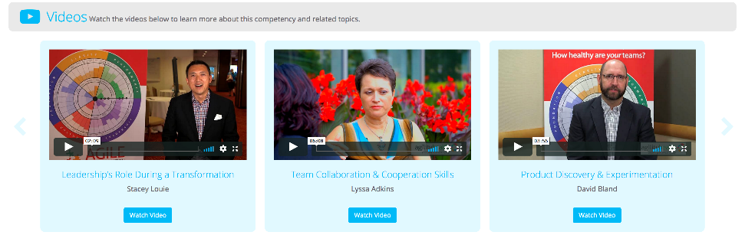
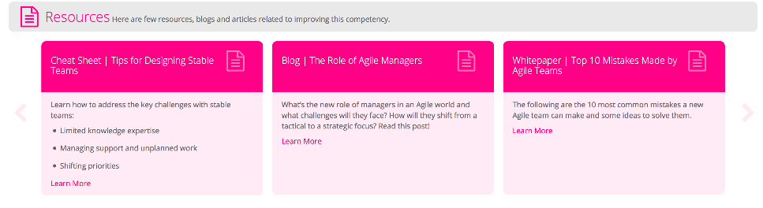
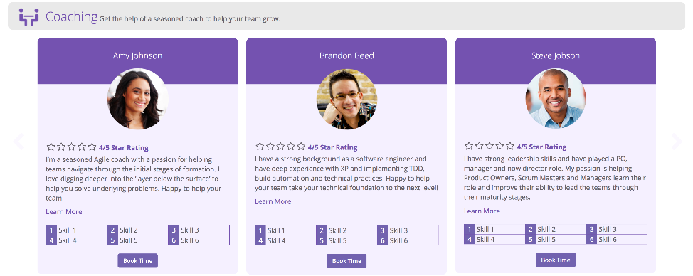
Enable Growth & Scaling of Coaching Capacity

Slide 27
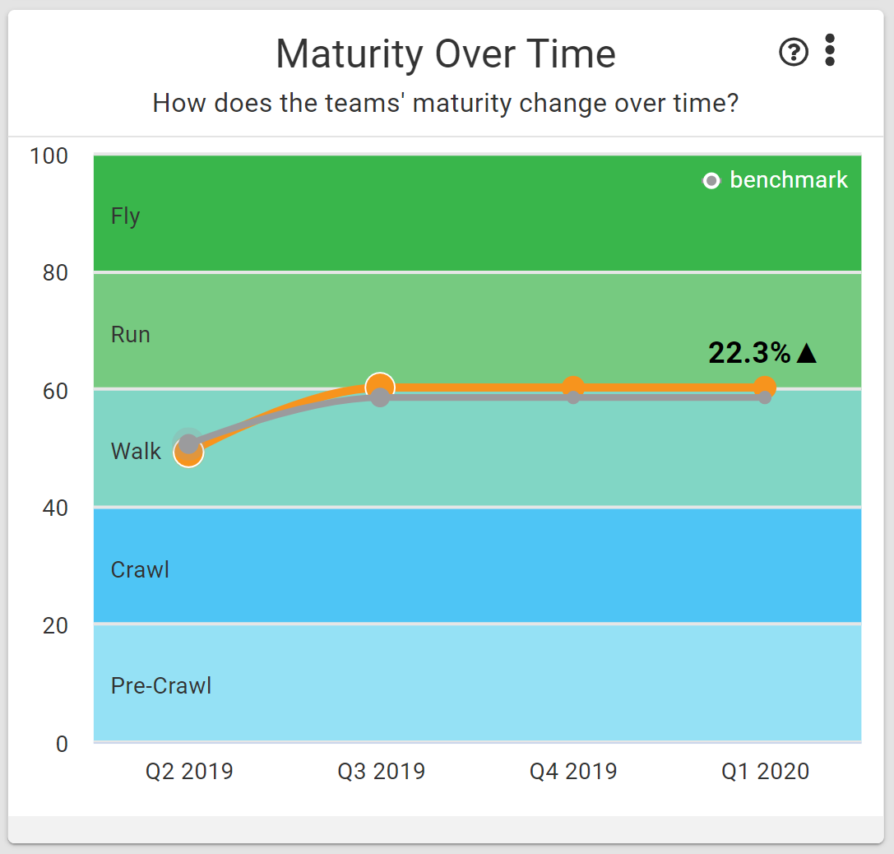
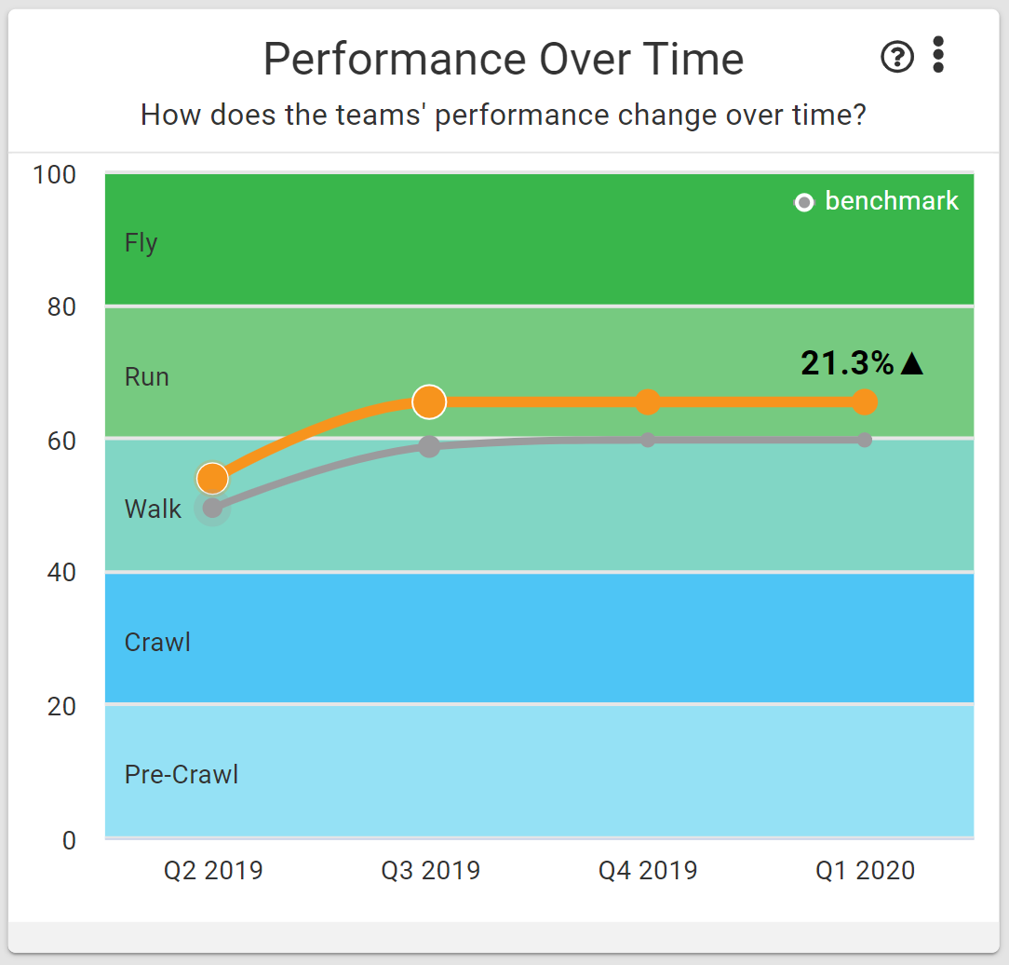

Insights: Team Agility Dashboard
Visualize Growth & Maturity Across All Teams
Improvements over the last quarter

Slide 28




AgilityHealth® Capabilities by Level
Teams
Team of Teams
Portfolios/Enterprise
Individual Roles
The goal of measurement should be to enable growth,
not for judgment, reward or punishment.
Assess team maturity and performance
Build actionable growth & improvement plans
Visualize growth each quarter
Enable self-learning through the Growth Portal
Build organizational growth areas for leaders to own
Align teams to business outcomes
Assess the maturity of programs (DevOps, SAFe, Lean Product Maturity)
Build actionable growth & improvement plans
Rollup data and identify patterns and target areas for growth
Remove organizational obstacles
Align product/programs to business outcomes
Assess the Enterprise Business Agility maturity
Measure transformation progress and next areas for improvement
Rollup enterprise data and gain actionable insights
Remove enterprise obstacles
Align the org to business outcomes
Define clear role based competencies
Enable self-assessment and 360 feedback
Build individual growth plans
Rollup data and develop targeted growth plans across roles
Enable self learning through the growth portal
Strengthen communities of practice

Slide 29
Thank You!
Getting in touch:
success@agilityhealthradar.com

