Slide 1
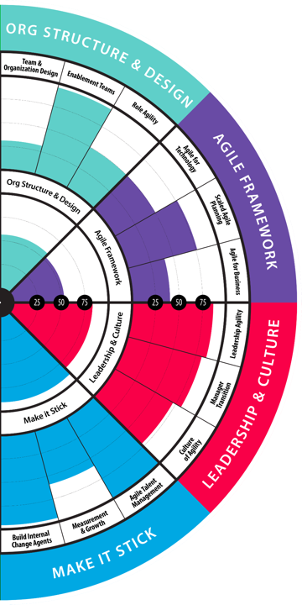
AgilityHealth Overview for Leaders

Slide 2
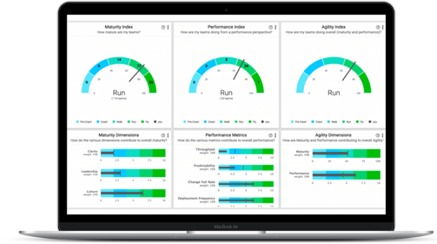
Purpose: Introduce AgilityHealth with a deeper look into the TeamHealth retrospective, which your teams will soon participate in, and provide clarity on YOUR role as an Agile leader
Agenda:
What is AgilityHealth? Business Agility Explainer Video
Three Metrics that Matter + Platform Demo
Overview of the TeamHealth Radar Process
Your Role as Leaders
Next Steps & Questions

Slide 3
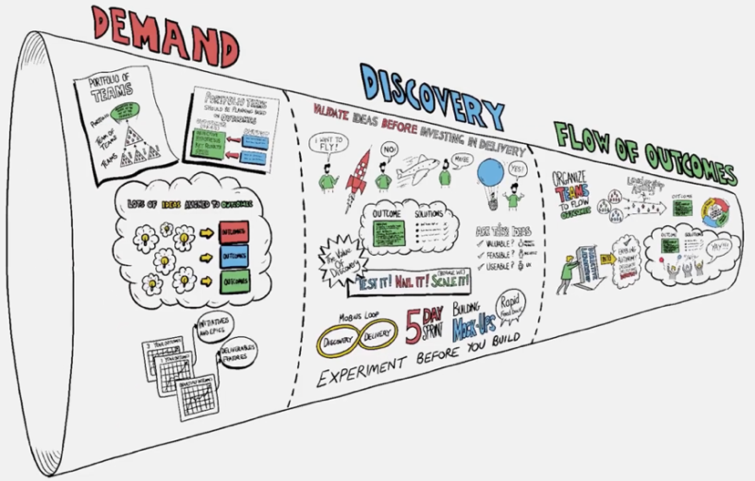
Enterprise Business Agility Explainer Video
https://agilityhealthradar.com/videos/business-agility/

Slide 4
An organization is only as ‘Agile’ as its least agile part.
Evan’s Theory of Agile Constraints
Source: Evan Leybourn, Business Agility Institute

Slide 5
What is the AgilityHealth®?
AgilityHealth® is the leading enterprise team management platform for building high performing teams
by measuring and improving maturity, performance and outcomes at ALL levels.
Measure
Grow
Accelerate

Slide 6
Measurement Challenges

Slide 7
AgilityHealth’s Secret Sauce
Common Language create common language for areas to develop and grow
Facilitated measure and grow workshops (not just surveys)
Consistent way to measure team maturity against best practices
Teams prioritize their opportunities for improvement
Measure
Teams and leaders commit to “growth” items (TGIs, OGIs)
Integrate growth items into existing team board, demos and planning
Build internal Continuous Improvement Champions
Help teams help themselves through the growth portal
Grow
Improve the key metrics that matter, including:
Flow: Time-to-Market | Flow: Predictable Delivery
Quality | Value (Outcomes)
Customer Satisfaction | Happiness: Team
Accelerate
Notes:
When teams are supported and invested in continuous improvement and have the ability to reflect on how they work by inspecting and adapting and
The leadership team focuses on removing obstacles, coaching, and helping mature teams to optimize their performance.
How we approach and enable continuous improvement in your org
Once you hsve a clear understanding of where your teams
Reduced time
Show that companies which invest in continuous improvement, mature their teams faster, which results in higher productivity and outcomes.
Show that teams that have used AH have grown and matured by 12-15% following their first assessment (baseline)

Slide 8
Goal: Measurable Growth
643 Teams
32 Teams
29 Teams
6 Teams
Insurance
Insurance
Financial Services
Financial Services
( Enterprise )
( Portfolio )
( Portfolio )
( Program )
▲ 11% - Agility
▲ 17.6% - Maturity
▲ 4.8% - Performance
+274 Org Growth Items
( Realized Over 1 Yr )
▲ 20.4% - Agility
▲ 33.6% - Maturity
▲ 9% - Performance
+54 Org Growth Items
( Realized Over 1 Yr )
▲ 11.3% - Agility
▲ 11.7% - Maturity
▲ 10.8% - Performance
+145 Org Growth Items
( Realized Over 1 Yr )
▲ 17.1% - Agility
▲ 15.9% - Maturity
▲ 18.2% - Performance
+25 Org Growth Items
( Realized Over 1 Yr )
95 Teams
2,300 Teams
( Enterprise )
Financial Services
Financial Services
( Enterprise )
* Results over 1 Year. Refer to Sample AH Use Cases from Actual Clients: https://agilityhealthradar.com/roi-calculator/#customer4
▲ 15.4% - Agility
▲ 10% - Maturity
▲ 21.9% - Performance
+391 Org Growth Items
( Realized Over 1 Yr )
▲ 26% - Agility
▲ 33% - Maturity
▲ 37% - Performance
Scaled from 1500 Teams
( Realized Over 2.5 Yrs )

Slide 9
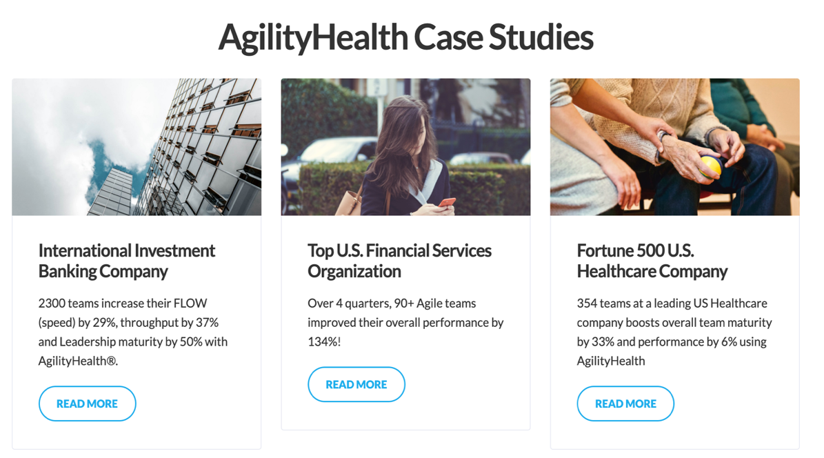
Case Studies
https://agilityhealthradar.com/case-studies
Notes:
Just let them know this is available

Slide 10
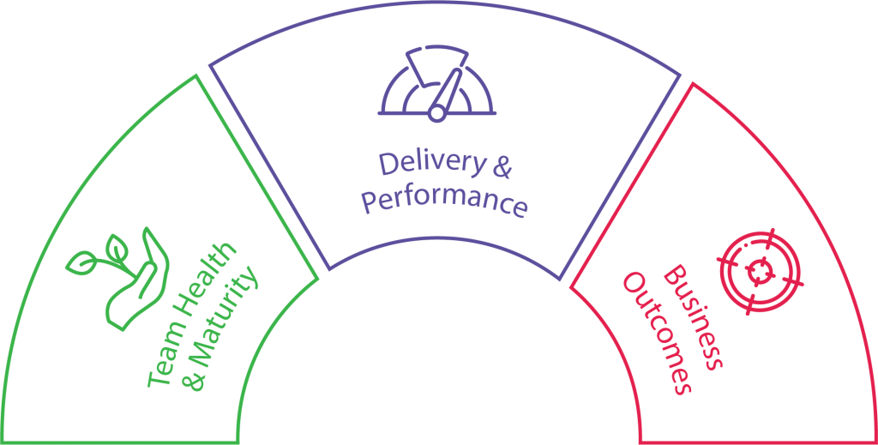
The Platform: Measuring What Matters
AgilityHealth is the ONLY global platform that combines Maturity, Performance and Outcomes so you make informed decisions
Performance
Outputs (flow, quality, predictability)
How are they performing?
Maturity
Practices & Behaviors
Outcomes/OKRs
Strategy & Results Measurement
Are they delivering measurable VALUE?
What is their maturity and where do they need help?
Team Structure
Who are my teams? How are they structured?

Slide 11
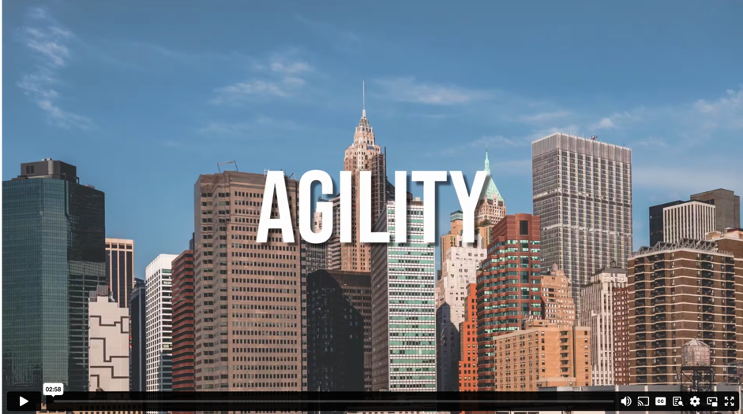
AgilityHealth Explainer Video

Slide 12
Measure & Grow at Every Level | Explore Radars
Portfolio / Enterprise - Enterprise Business Agility - Lean Portfolio Mgmt. - Digital Transformation
Team of Teams / Product - Lean Product Health
- DevOps Health
- Scaling Agile
Team Level - TeamHealth
- Technical Agility
- Team Agility
Role/Talent Dev - Scrum Master
- Product Mgr, Product Owner
- Agile Leader
- Agile Coach, RTE, others*
8 SAFe® Radars
Notes:
Team Radars for all teams including leadership teams.
TeamHealth for all teams – our most popular and where most of our customers begin.
Team of Teams – The leadership teams (and key team members) for DevOps and Programs
Portfolio – The portfolio leadership teams, or multiple portfolio teams can be rollup/combined for a cross-enterprise view.
Individual Roles (talent). Such as agile coach, scrum master, manager, leader, etc.
For your customers using the SAFe scaling framework we have SAFe specific radars too.

Slide 13
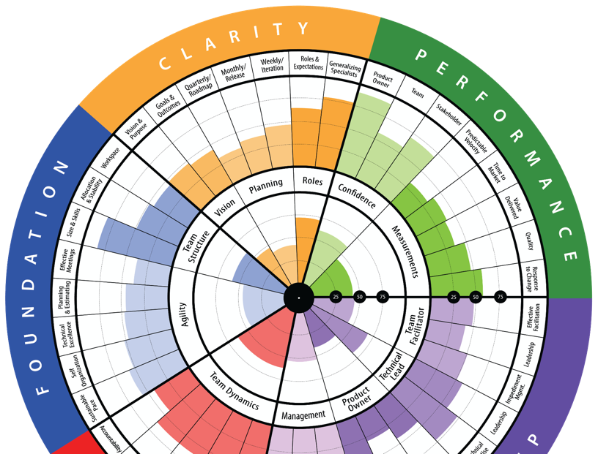
TeamHealth® Demo
View Radar
Preview TeamHealth Questions

Slide 14
3 Minute TeamHealth® Overview Video
Watch the TeamHealth® Overview Video

Slide 15
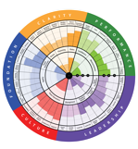
Tactical vs Strategic Retrospectives
Sprint
Tactical
Sprint
Tactical
Sprint
Tactical
PI Planning
PI Demo & I&A
TeamHealth Retrospective & Growth Plan
Sprint Planning
Sprint Demo
Sprint Retrospective
Sprint Planning
Sprint Demo
Sprint Planning
Sprint Demo
Sprint Retrospective
Tactical
Strategic

Slide 16
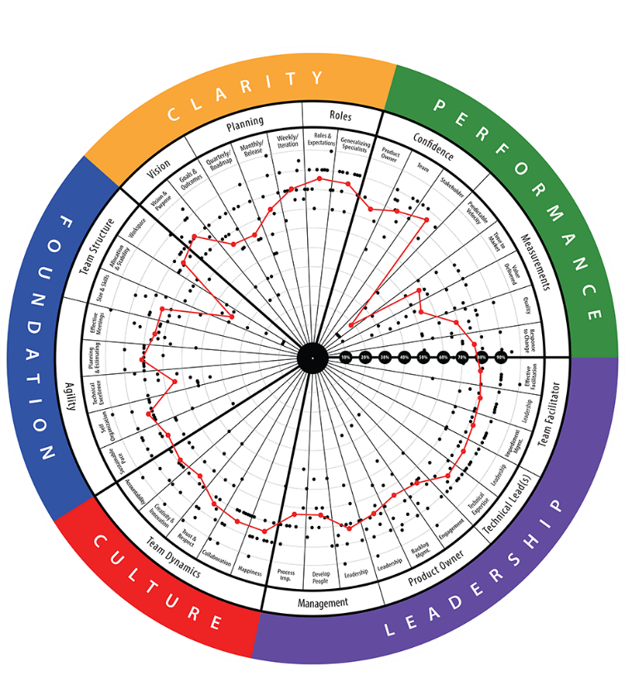
TeamHealth® Retrospective
STRATEGIC RETROSPECTIVE: A retrospective that aims to help teams reflect on their last quarter or release and improve the next one. Facilitated by trained facilitators (AHFs).
Analyze real-time
radar and textual responses. Have “real” conversations - 1 hr
Team members
complete the assessment on their phone or laptop 30 - 45 min
STEP 2
Build actionable
growth plan for
the team and for
their leaders - 30 min
STEP 1
STEP 3
Duration: ~ 2.5 hrs Repeat: Every quarter

Slide 17
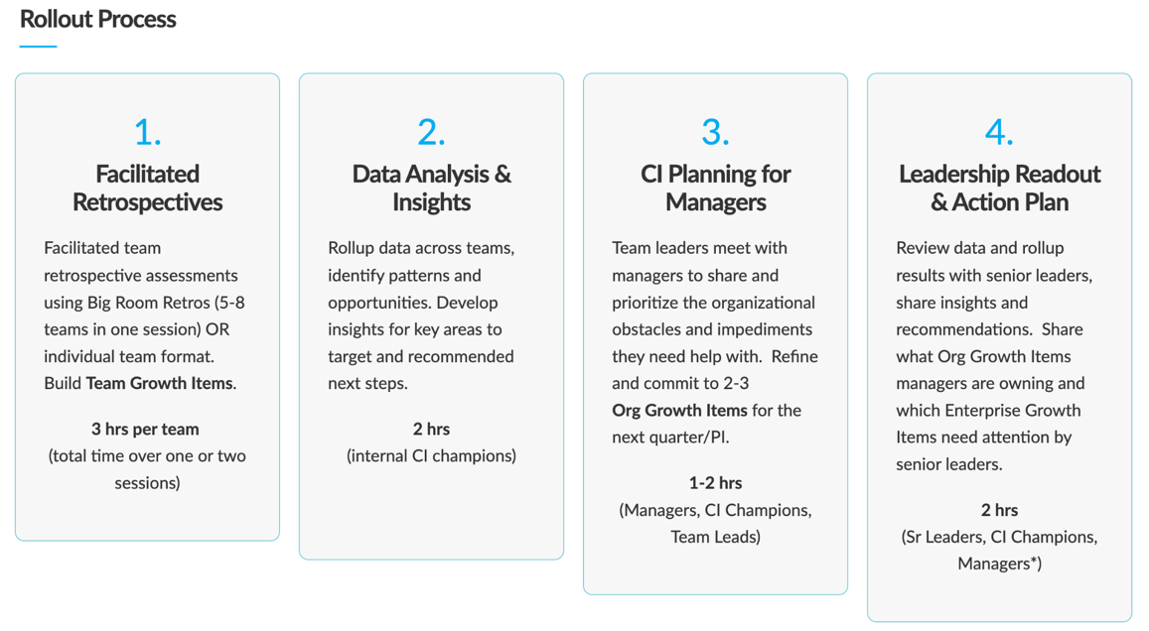

Slide 18
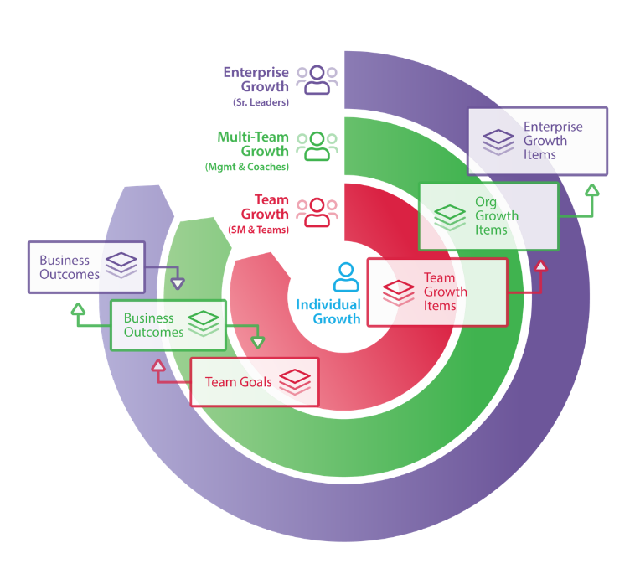
AgilityHealth® Continuous Improvement Model
Sr Leaders
Agile Coaches
Managers
‘If you want to teams to align and achieve outcomes, you’ll need to hear their voice and remove obstacles.” – Sally Elatta

Slide 19
What’s the role of Managers/Leaders in the Continuous Improvement Process?

Slide 20
What Is A Continuous Improvement Leadership Team (CILT)?
Leadership team focuses on removing obstacles and helping mature teams to optimize their performance*
Who is involved?
What do they do?
How do they operate?
Managers
Agile Coaches
DevOps Coaches
Program Mgrs/RTE
Product Managers
Review OGIs from TeamHealth® results
Prioritize top 2 or 3 obstacles to remove
Work as a team to manage the org level growth backlog
They manage the OGIs backlog in AgilityHealth®
They meet on a regular cadence
They demo their progress to the teams monthly or quarterly
*This could be an existing transformation team, train, product leadership group. Specific Members may engage at different times based on the Growth Items in play.

Slide 21
Demonstrate Progress on Organizational Growth Items
Once a month or quarter demonstrate your progress to the teams and celebrate growth!
Demo at the end of the quarter or release
Get feedback from the teams on what you have completed
Ask teams for where they need help for the next PI/Quarter
With your support, teams can accelerate their maturity growth and performance!

Slide 22
The Organization Growth Cycle
Responding well means
Echoing back what you heard from the teams
Providing an opportunity for teams to elaborate and/or clarify
Communicating what you will work on and what you will not or cannot work on and why
More willing to provide better feedback
Teams provide OGIs
Feel like their opinion matters
Leaders Respond well
Engagement Builds

Slide 23
The Organization Growth Cycle
What not to do with the data
Judge, reward, or punish teams for results or for their OGI feedback
Push/pressure teams to increase their scores
Compare one team to another
Incentivize scores (incentivizing participation is ok)
Less willing to provide feedback
Teams provide OGIs
Leaders don’t respond or respond poorly
Feel like their opinion doesn’t matter
Disengagement builds

Slide 24
State of Agility Annual Report end of year report on overall progress
Executive Summary
Top Growth Areas + Benchmark
Current Maturity & Performance
Top Predictors for Growth
Analysis by Value Stream
Voice of the Teams Videos & Enterprise Recommendations

Slide 25
Keys To Success
NEVER Punish or Reward Teams or Leaders Based on their Assessment Results
Communication is KEY – If you’re not able to address certain Organization items (OGIs), explain why
Leaders Owning OGIs for the Quarter – demo as you make progress, email is fine. Use existing meetings if you have them
Be Intentional About Growth – Make Time

Slide 26
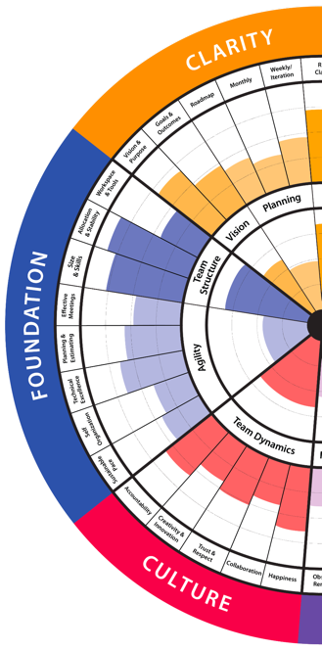
Why AgilityHealth® www.AgilityHealthRadar.com
Achieve 10-20% productivity increase within 12 months (~$100k per team efficiency gain per year)
Enable teams to help themselves grow with the Growth Portal, build internal change champions (30% cost savings)
Provides a consistent and sustainable way to measure the health of your teams and org
Use Data to make actionable decisions for where to invest
Creates real-time visibility into where teams and leaders need to focus
Create a culture of continuous improvement at every level

