Slide 1
AgilityHealth® Business Line Admins

Slide 2
Business Line Admin Responsibilities
Refer to the Business Line Admin Role Guide for all the details on your role!
1
Serve as a proxy for Company Admin
2
Manage Teams Admin and Team Member users
3
Manage assigned teams (Add/Update/Archive)
View Teams at Enterprise, Portfolio/Program & Team Levels
4
5
View AgilityHealth® Dashboards, Analyze Data & Run Reports for assigned teams

Slide 3
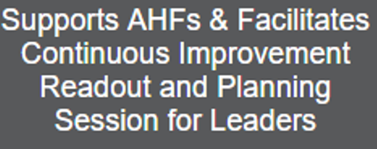
1) Manage Users
A Business Line Admin can add/edit AgilityHealth® Users in Settings, under Manager Users. To access this section, click on the Settings icon in the upper right corner of AgilityHealth®, once you are logged in. Then, click on the View Users button under Manage Users.
Here you can add, edit, or delete team users and add teams or program portfolio tags to their accounts. To learn more about how to add users, visit our What User Roles are Available and How to Manage Them article.
®
Check out the AgilityHealth® Strategic Roadmap, which breaks down each role in AgilityHealth® with details, responsibilities and available training/support!

Slide 4
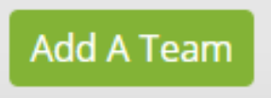
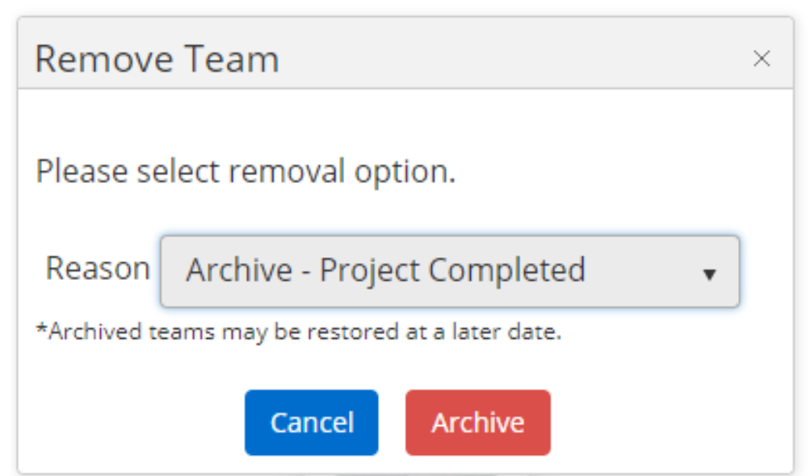
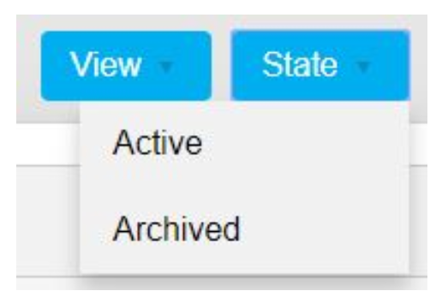
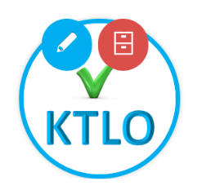
2) Manage Team Data
A Business Line Admin can add, update, archive and restore teams, as well as edit a team’s members and stakeholders.
To set up or create a team, visit our Set up and Manage Teams article.
To edit an existing team’s members or stakeholders, visit the Edit an Existing Team Profile article.
To Edit, Delete, Archive or Restore a team, visit this article.

Slide 5
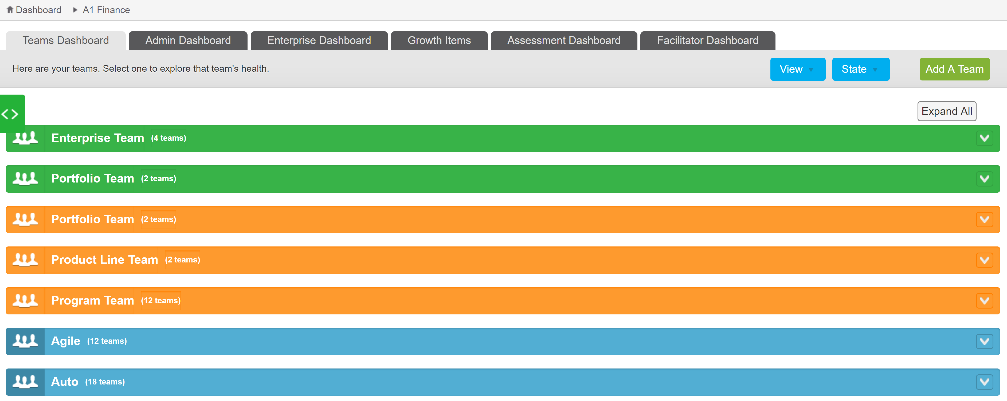
3) View Line of Business Team Data
Teams are organized in AgilityHealth® in a hierarchy that includes Individual Teams, Multi-Teams and Enterprise Teams. A Business Line Admin can view all three levels on the Team Dashboard for their line of business.
There are two views available: Swim Lane or Grid View. Change the view by selecting the appropriate option in the upper right corner on the Team Dashboard.
In the Swim Lanes view, the teams are organized by colored swim lanes. Enterprise Teams are green, Multi-Teams are orange and Individual Teams are blue.

Slide 6
4) View Teams at all Levels Continued…
The Grid View is a tabular view of all teams with additional information such as the number of assessments this team completed, date of their last assessment and how the team is tagged. You can quickly search by the name of the team, program, product line or portfolio and generate a report in Excel or PDF.
If you'd like to learn more about the different types of teams, please see the Understanding Teams, Multi-Teams and Enterprise Teams article.

Slide 7
5) Utilize Dashboards & Reports
A Business Line Admin has access to AgilityHealth® Dashboards and Reports, where you can view line of business data.
Understanding the Team Dashboard
Understanding the Admin Dashboard
Understanding the Enterprise Dashboard
Understanding the Growth Item Dashboard
Understanding the Assessment Dashboard
Understanding the Facilitator Dashboard
Insights Dashboard
Understanding the Reports Dashboard

Slide 8
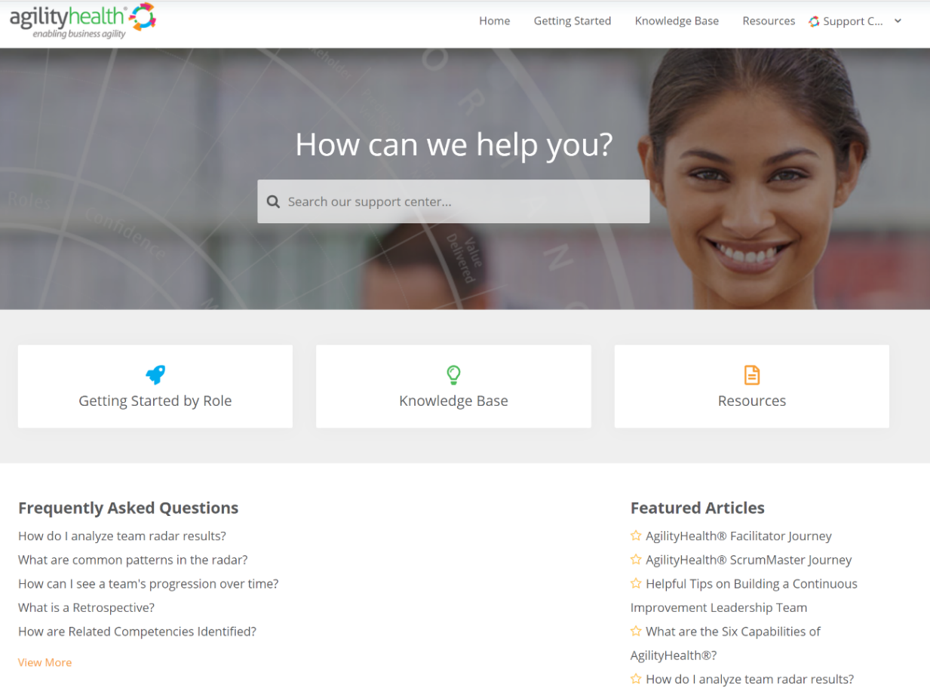
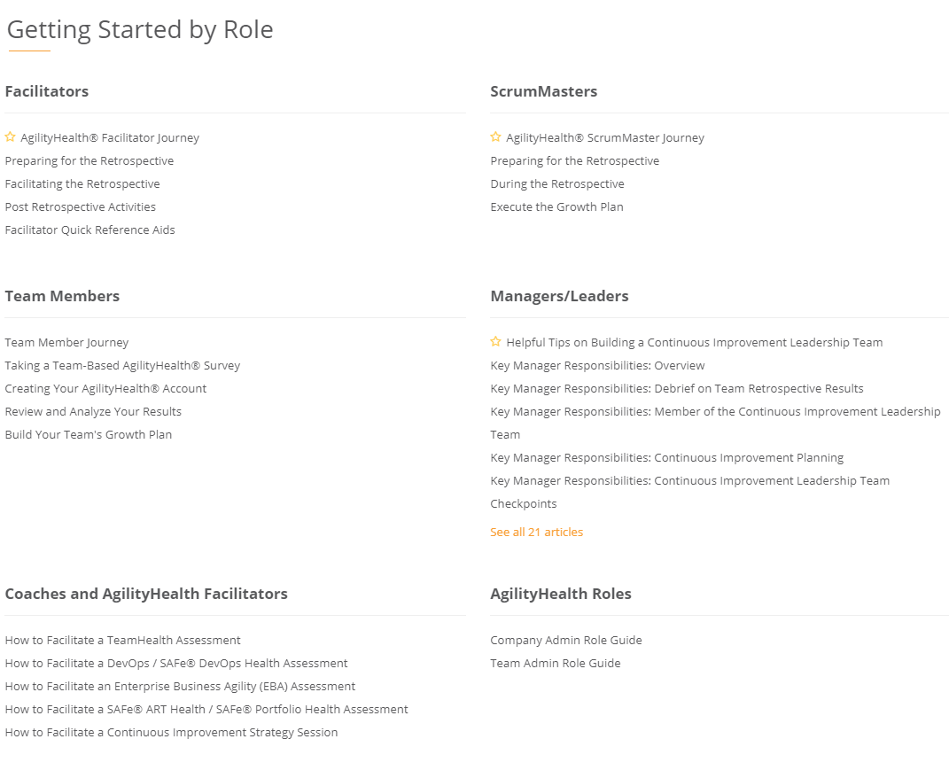
Questions? Check Out Our Customer Support Center
https://support.agilityhealthradar.com
Role based guides, page by page tutorials, FAQ’s, downloadable resources and more!

Slide 9
Thank You!
Getting in touch:
success@agilityhealthradar.com

