Slide 1
AgilityHealth Company Admin Training

Slide 2
Company Admin Responsibilities
Refer to the Company Admin Role Guide for all the details on your role!
1
Manage All Users (Add/Edit/Delete)
2
Manage All Tags (Add Roles, Participant Groups, Business Units, etc.)
3
Manage All Teams (Add/Update/Archive)
View Teams at Enterprise, Portfolio/Program & Team Levels
4
5
View All AgilityHealth® Dashboards, Analyze Data & Run Reports

Slide 3
1) Manage All Users
A Company Admin can add/edit AgilityHealth® Users in Settings, under Manager Users. To access this section, click on the Settings icon in the upper right corner of AgilityHealth®, once you are logged in. Then, click on the View Users button under Manage Users.
Here you can add, edit, or delete team users and add teams or program portfolio tags to their accounts. To learn more about how to add users, visit our What User Roles are Available and How to Manage Them article.
®
Check out the AgilityHealth® Strategic Roadmap, which breaks down each role in AgilityHealth® with details, responsibilities and available training/support!

Slide 4
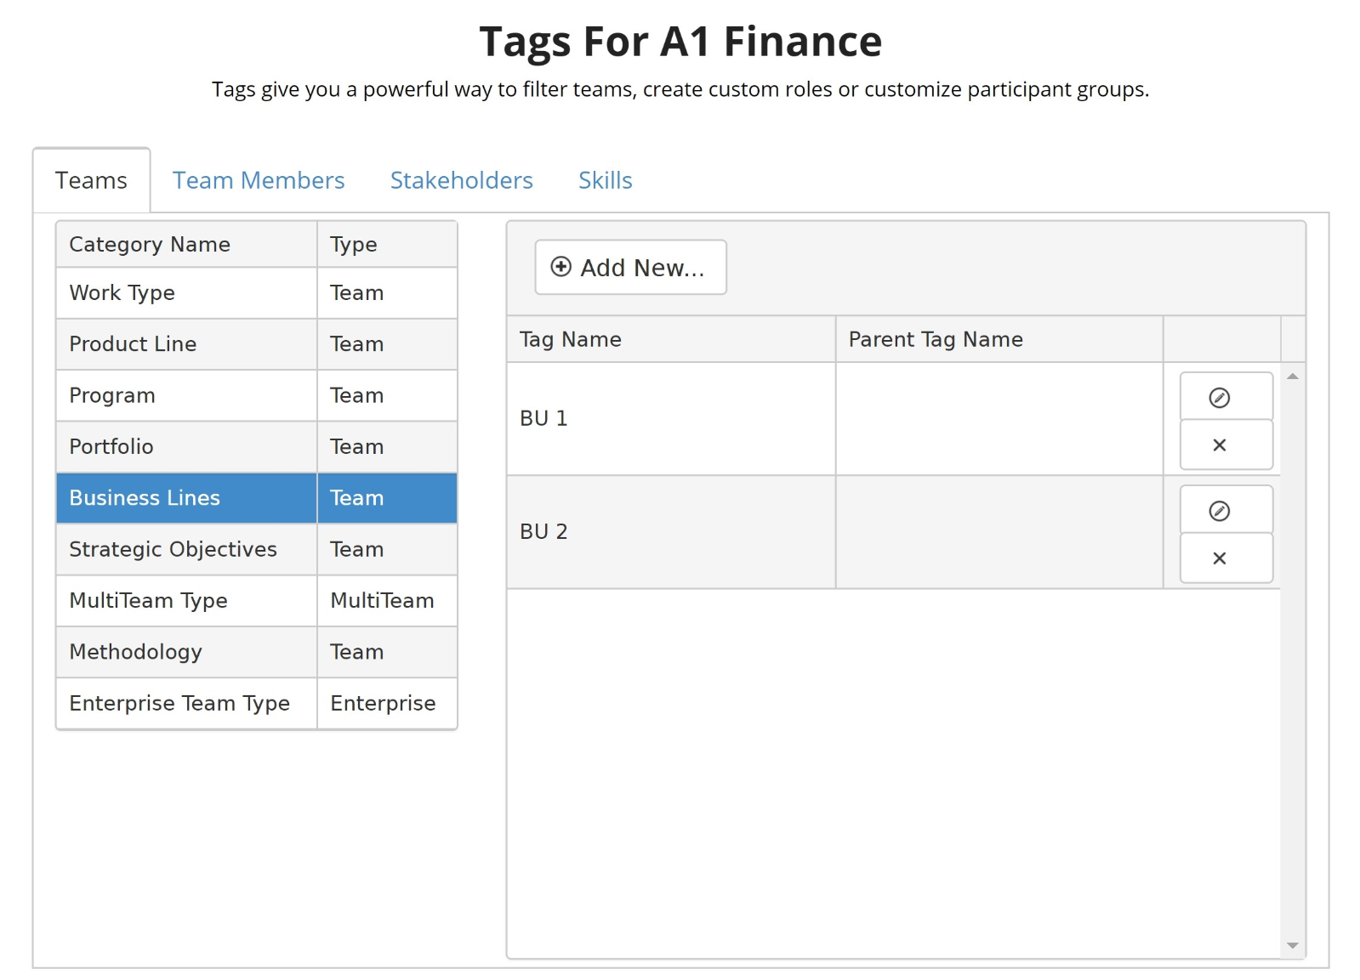
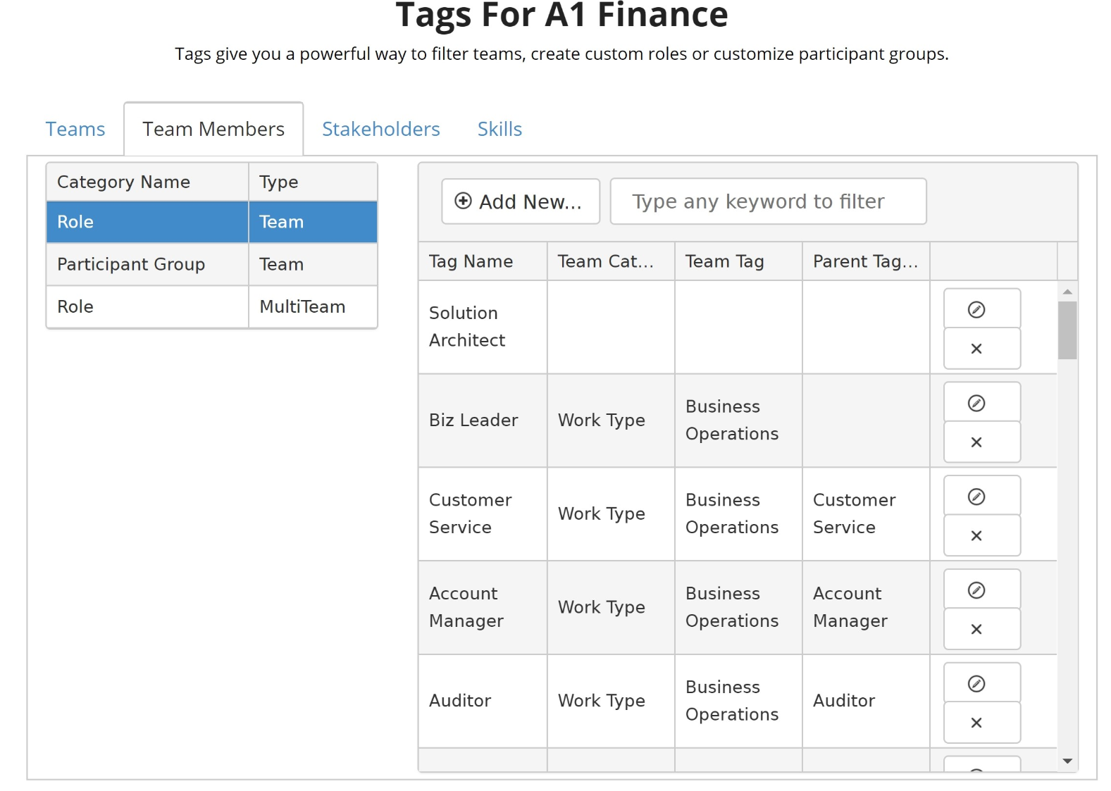
2) Manage All Tags
Tags are customizable attributes that can be used to organize your company within AgilityHealth®. To access the Manage Tags function, click on the Settings icon in the upper right corner of AgilityHealth®, once you are logged in. Then, click on the View Tags button under the Manage Tags section.
You can create or set up tags to add new roles or new lines of business to link teams together, in order to roll their assessment results up into a multi-team or enterprise-team view. Check out our Set Up and Manage Tags article.

Slide 5
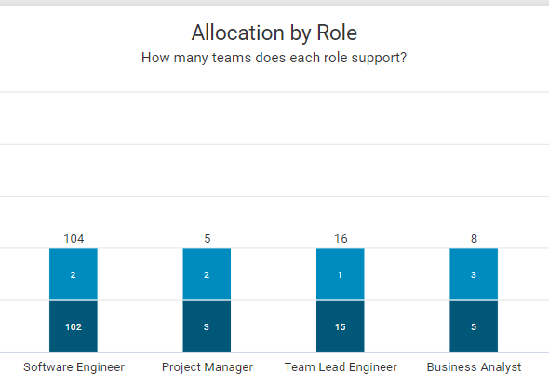
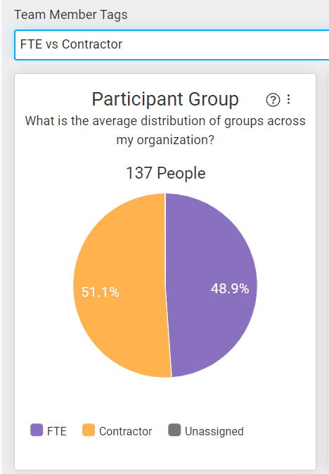
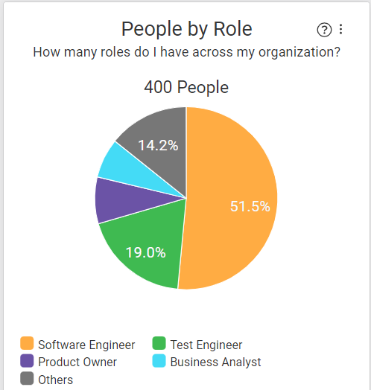
2) Manage All Tags Continued
Important Considerations when Managing Tags
Team Tags | Work Type – drives the assessment questions, Structural Agility also offers widgets that can be filtered by work type
 | Agile Adoption – Structural Agility offers a widget that can be filtered by this team tag
 | Team Formation - Structural Agility offers a widget that can be filtered by this team tag
Team Member Tags | Roles– A few widgets within Structural Agility relate to team member role tags. Allocation by Role, Allocation per Team, People by Role, and People Distribution are driven by the roles tags and allocations set within Structural Agility
 | Participant Groups – Structural Agility offers a widget that can be filtered by two different Participant Groups, FTE vs. Contractor and Distributed vs. Collocated

Slide 6
D3) Manage All Teams - 3 Formats for Loading Teamsata Configuration | 3 Formats to Load
Decisions Needed Prior to Data Setup:
Left navigation design. How do you want to see your teams? (Value Stream, Portfolio, Program, Chapter, Tribe, Product Area, etc.)
Which roles are defined for Software Teams, Service and Support, Business Ops, Product/Program, Portfolio Team
What gearing ratios do you want to set at the team level? Each role can be on x teams (1:2)
Which tags do you want to apply to Teams and to Members
What are the main views/reports you will need immediately from this data?
Which internal system do you want to sync this data with?
Bulk Upload File for Company Admin
Points of Contact to Enter Data
Invite Team Members Via Link
Effort involves completing the excel template provided by AgilityHealth with the Team information and users of the platform.
*Select this if you have an existing source for most of the data, otherwise this will be a heavy lift
Effort involves identifying the right roles who can enter team information (such as Scrum Masters), adding them as users, inviting them to a 30-40 min training OR sending them a video.
*Select this if you have no existing data source but are confident a member of the team will enter the correct information
Effort involves creating all the teams in AHR and generating a unique invitation link for each. The team Point of Contact shares the link with all team members who add themselves to the team.
*Select this if you have no existing data source and you are confident the right members will be invited via the link

Slide 7
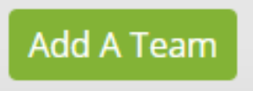
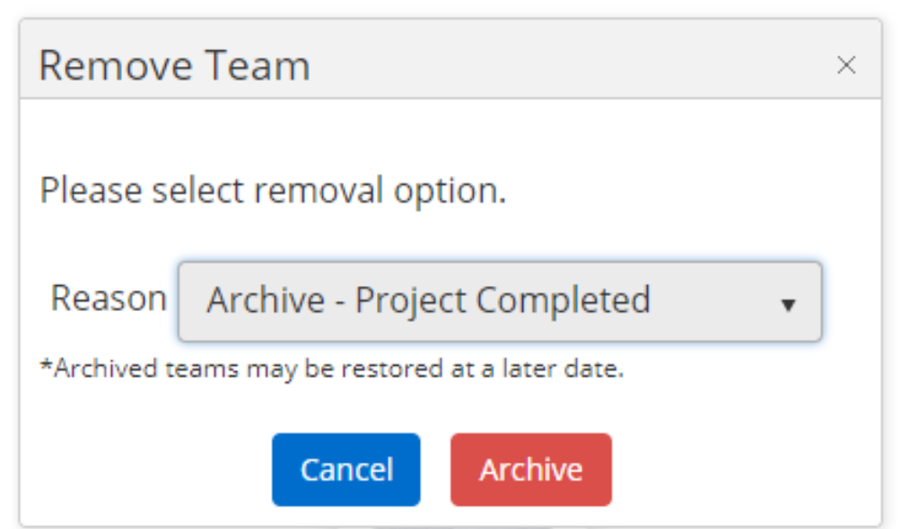
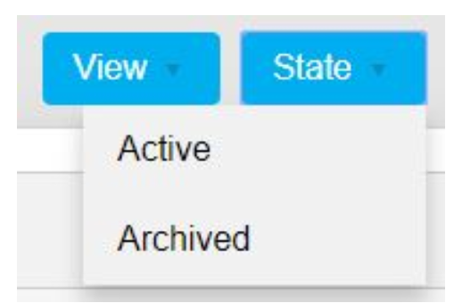
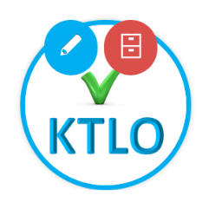
3) Manage All Teams - Manually Add, Edit & Archive
A Company Admin can add, update, archive and restore teams, as well as edit a team’s members and stakeholders.
To set up or create a team, visit our Set up and Manage Teams article.
To edit an existing team’s members or stakeholders, visit the Edit an Existing Team Profile article.
To Edit, Delete, Archive or Restore a team, visit this article.

Slide 8
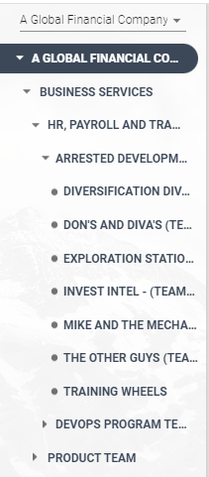
3) Manage All Teams Continued
The Left Navigation
Design should be based on how you would like to see your teams’ hierarchy (Value Stream, Portfolio, Program, Chapter, Tribe, Product Area, etc.)
A reflection of the team structure, based on how the teams, multi-teams, and enterprise teams are rolled up to reflect the company structure
The Left Nav allows you to set the focus for the Insights Dashboards and drill in or out of the various parts of your organization
As you assign teams as sub-teams of another level, they will be removed from the Unassigned data and will populate in the left nav under the parent team
N-Tier functionality in AgilityHealth is the method to expand beyond our standard levels of team hierarchy: Team > Multi-Team > Enterprise Team. Learn more about N-Tier
N-Tier
Enterprise
Multi-Team
Teams
Multi-Team
Enterprise

Slide 9
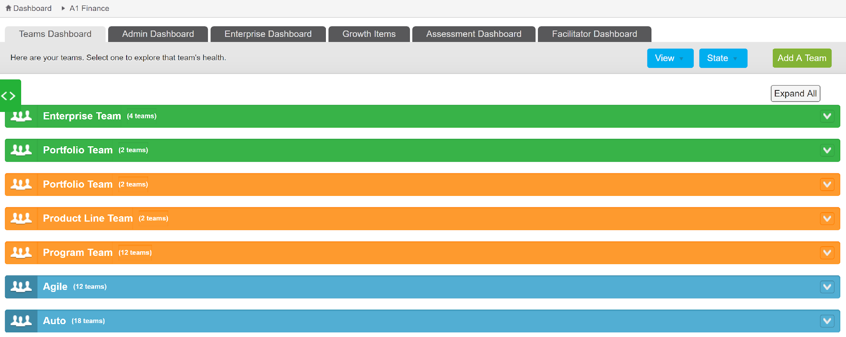
4) View Teams at All Levels
Teams are organized in AgilityHealth® in a hierarchy that includes Individual Teams, Multi-Teams and Enterprise Teams. A Company Admin can view all three levels on the Team Dashboard.
There are two views available: Swim Lane or Grid View. Change the view by selecting the appropriate option in the upper right corner on the Team Dashboard.
In the Swim Lanes view, the teams are organized by colored swim lanes. Enterprise Teams are green, Multi-Teams are orange and Individual Teams are blue.

Slide 10
4) View Teams at all Levels Continued
The Grid View is a tabular view of all teams with additional information such as the number of assessments this team completed, date of their last assessment and how the team is tagged. You can quickly search by the name of the team, program, product line or portfolio and generate a report in Excel or PDF.
If you'd like to learn more about the different types of teams, please see the Understanding Teams, Multi-Teams and Enterprise Teams article.

Slide 11
5) Utilize Dashboards & Reports
A Company Admin has access to all of the AgilityHealth® Dashboards and Reports, where you can view your company’s data.
Understanding the Team Dashboard
Understanding the Growth Item Dashboard
Understanding the Assessment Dashboard
Understanding the Facilitator Dashboard
Team Agility Dashboard
Structural Agility Dashboard
Enterprise Agility Dashboard
Business Outcomes
Understanding the Reports Dashboard

Slide 12
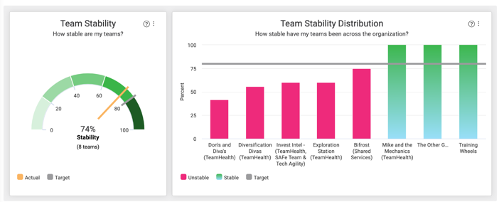
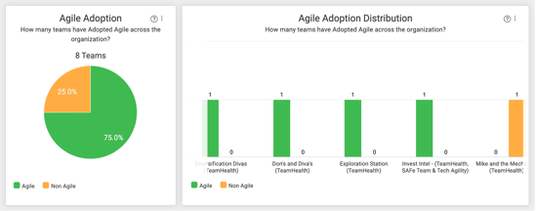
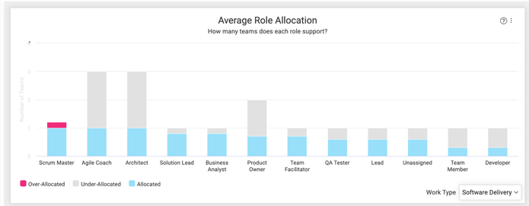
Structural Agility Dashboard | Support Page
Manage all your teams in one place. Visualize their stability, allocation by role, agile adoption rate and more.

Slide 13
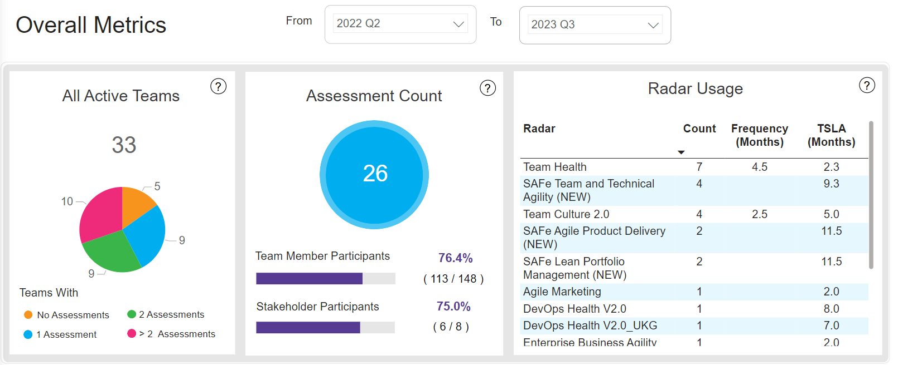
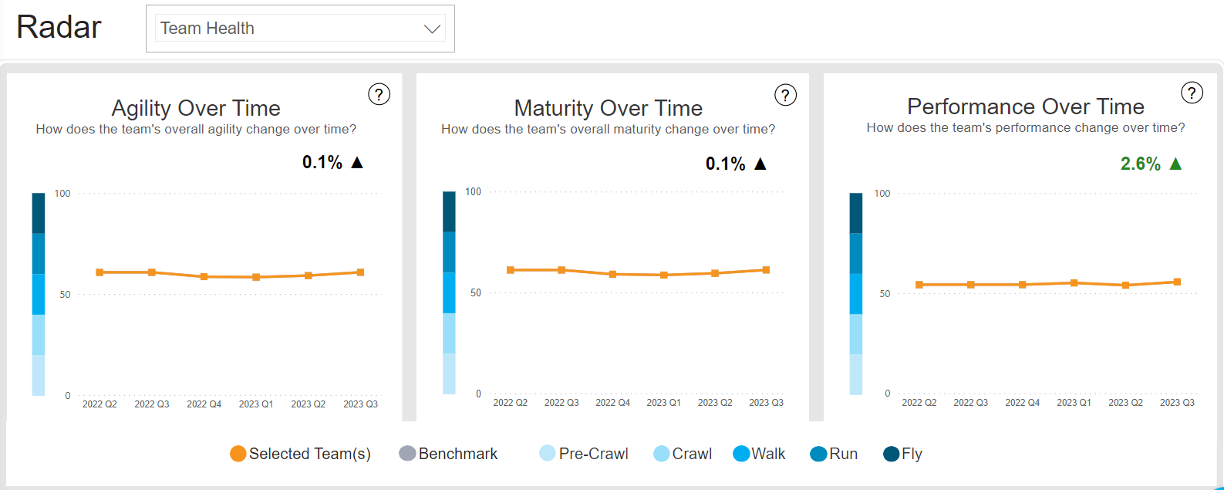
Enterprise Agility Dashboard | Support Page
Make underlying data visible, focusing on team maturity, performance, and agility, at any level

Slide 14
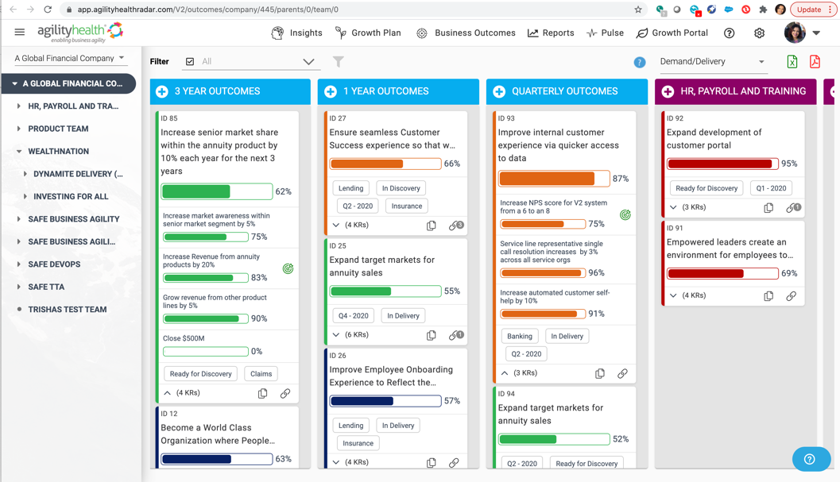
Outcomes/OKR Dashboard |Support Page
Define and align strategic outcomes to portfolios, products and teams to them. Track progress and capture learnings.

Slide 15
AgilityHealth Roadmap | Visit Page
Check out our exciting new capabilities and roadmap! If you are looking for updates on smaller weekly level enhancements, visit the release notes.

Slide 16
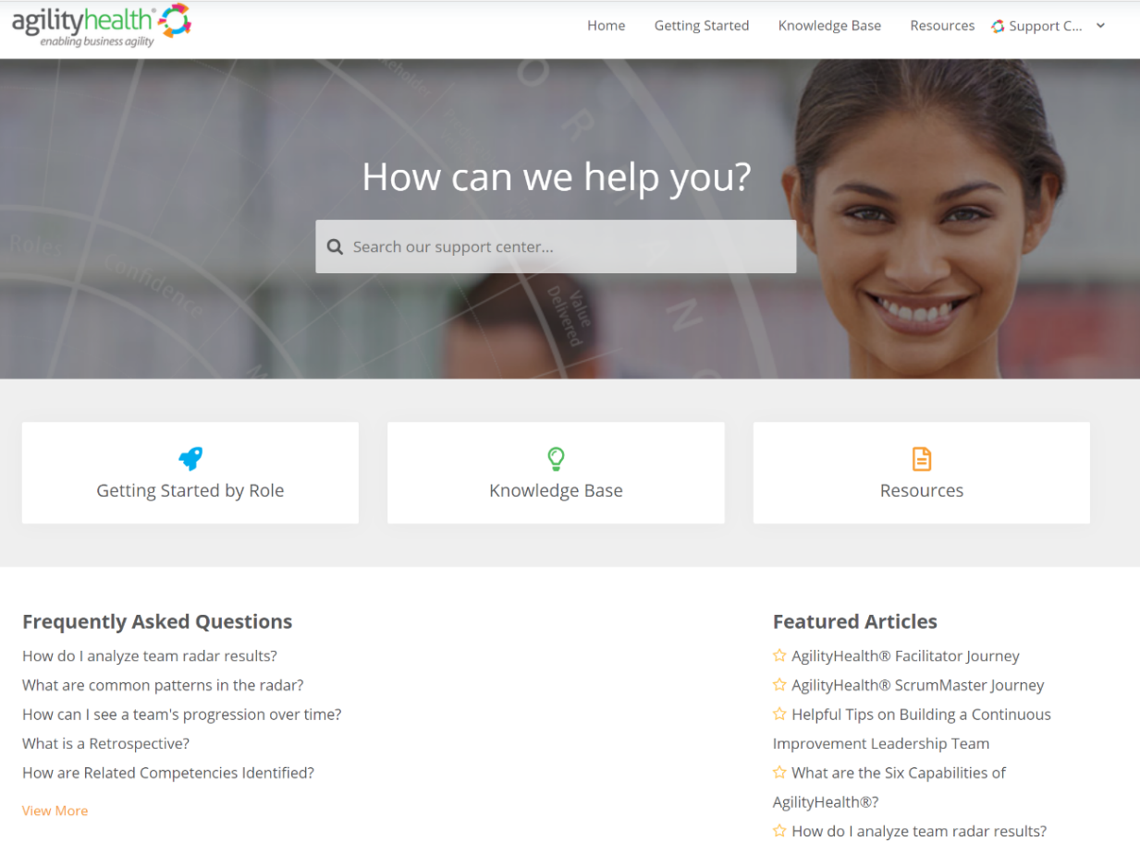
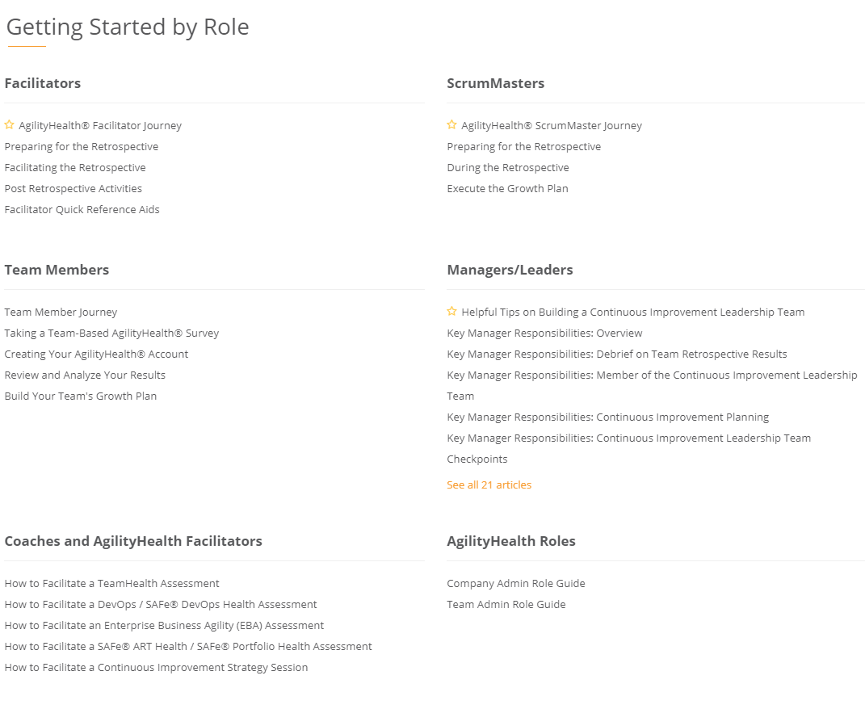
Questions? Check Out Our Customer Support Center
https://support.agilityhealthradar.com
Role based guides, page by page tutorials, FAQ’s, downloadable resources and more!

Slide 17
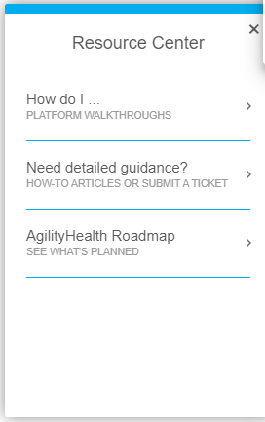
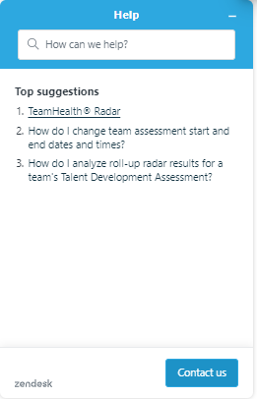
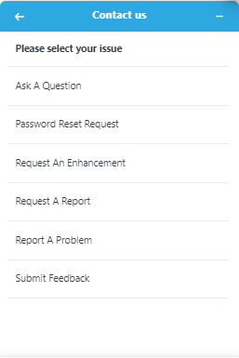
How to Submit Ticket | Support Page
From the page the enhancement is needed, or issue is experienced, select the blue “?” button in the bottom right corner

Slide 18
Thank You!
Getting in touch:
success@agilityhealthradar.com

