Slide 1
Continuous Improvement Readout and Planning Session for Leaders FACILITATION TEMPLATE

Slide 2
Organizing Tools
Our Team Norms
Start / Finish / Breaks
Assumptions
2
2
Notes:
2
2

Slide 3
Workshop Purpose & Deliverables
As Agile Leaders, gain visibility into the health across your teams and create a plan to accelerate their performance and growth.
Purpose
Growth Plan for the Quarter
Owners for Each Item
Plan for Leadership Check-points
Agreement on Next Steps
Deliverables

Slide 4
About Me…

Slide 5
About YOU!
Name
Role
Something Fun/Interesting

Slide 6
Agenda
Introduction and Summary of Observations
Analysis and Discussion
Multi-Team Data & Organizational Growth Items
Growth Plan and Next Steps

Slide 7
Moving Towards A Growth Mindset
We’re doing the best we can and have no time for growth
We can continuously improve our way of working
Strategic Retrospectives help a team adopt a Growth Mindset.
In order to have a Growth Mindset, the team must make time and space for Intentional Growth.

Slide 8
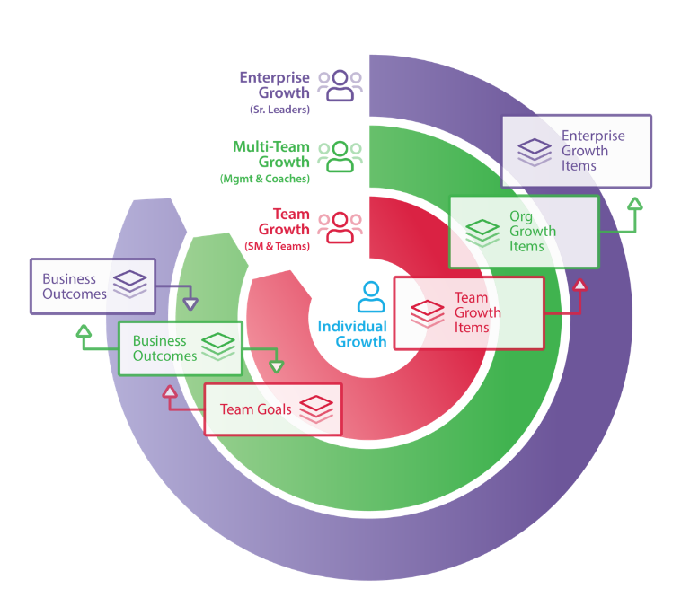
AgilityHealth® Continuous Improvement Model
Org Leaders
Agile Coaches
Managers
‘If you want to teams to align and achieve outcomes, you’ll need to hear their voice and remove obstacles.” – Sally Elatta
Teams
Scrum Masters
Product Owners

Slide 9
Inspect & Adapt Leads to Growth
Measure
Collect Team Health & Maturity Data
Understand
Analyze Radar, Gain Insights
Inspect
&
Adapt
Plan
Gain Consensus & Build Growth Plan
(for team & leaders)
Grow
Validate the Growth & Iterate

Slide 10
Summary of Observations

Slide 11
Multi-Team Analysis Teams & Assessments Completed

Slide 12
Multi-Team Analysis Rollup Radar & Filtering

Slide 13
Multi-Team Analysis Analytics Table

Slide 14
Multi-Team Analysis Maturity

Slide 15
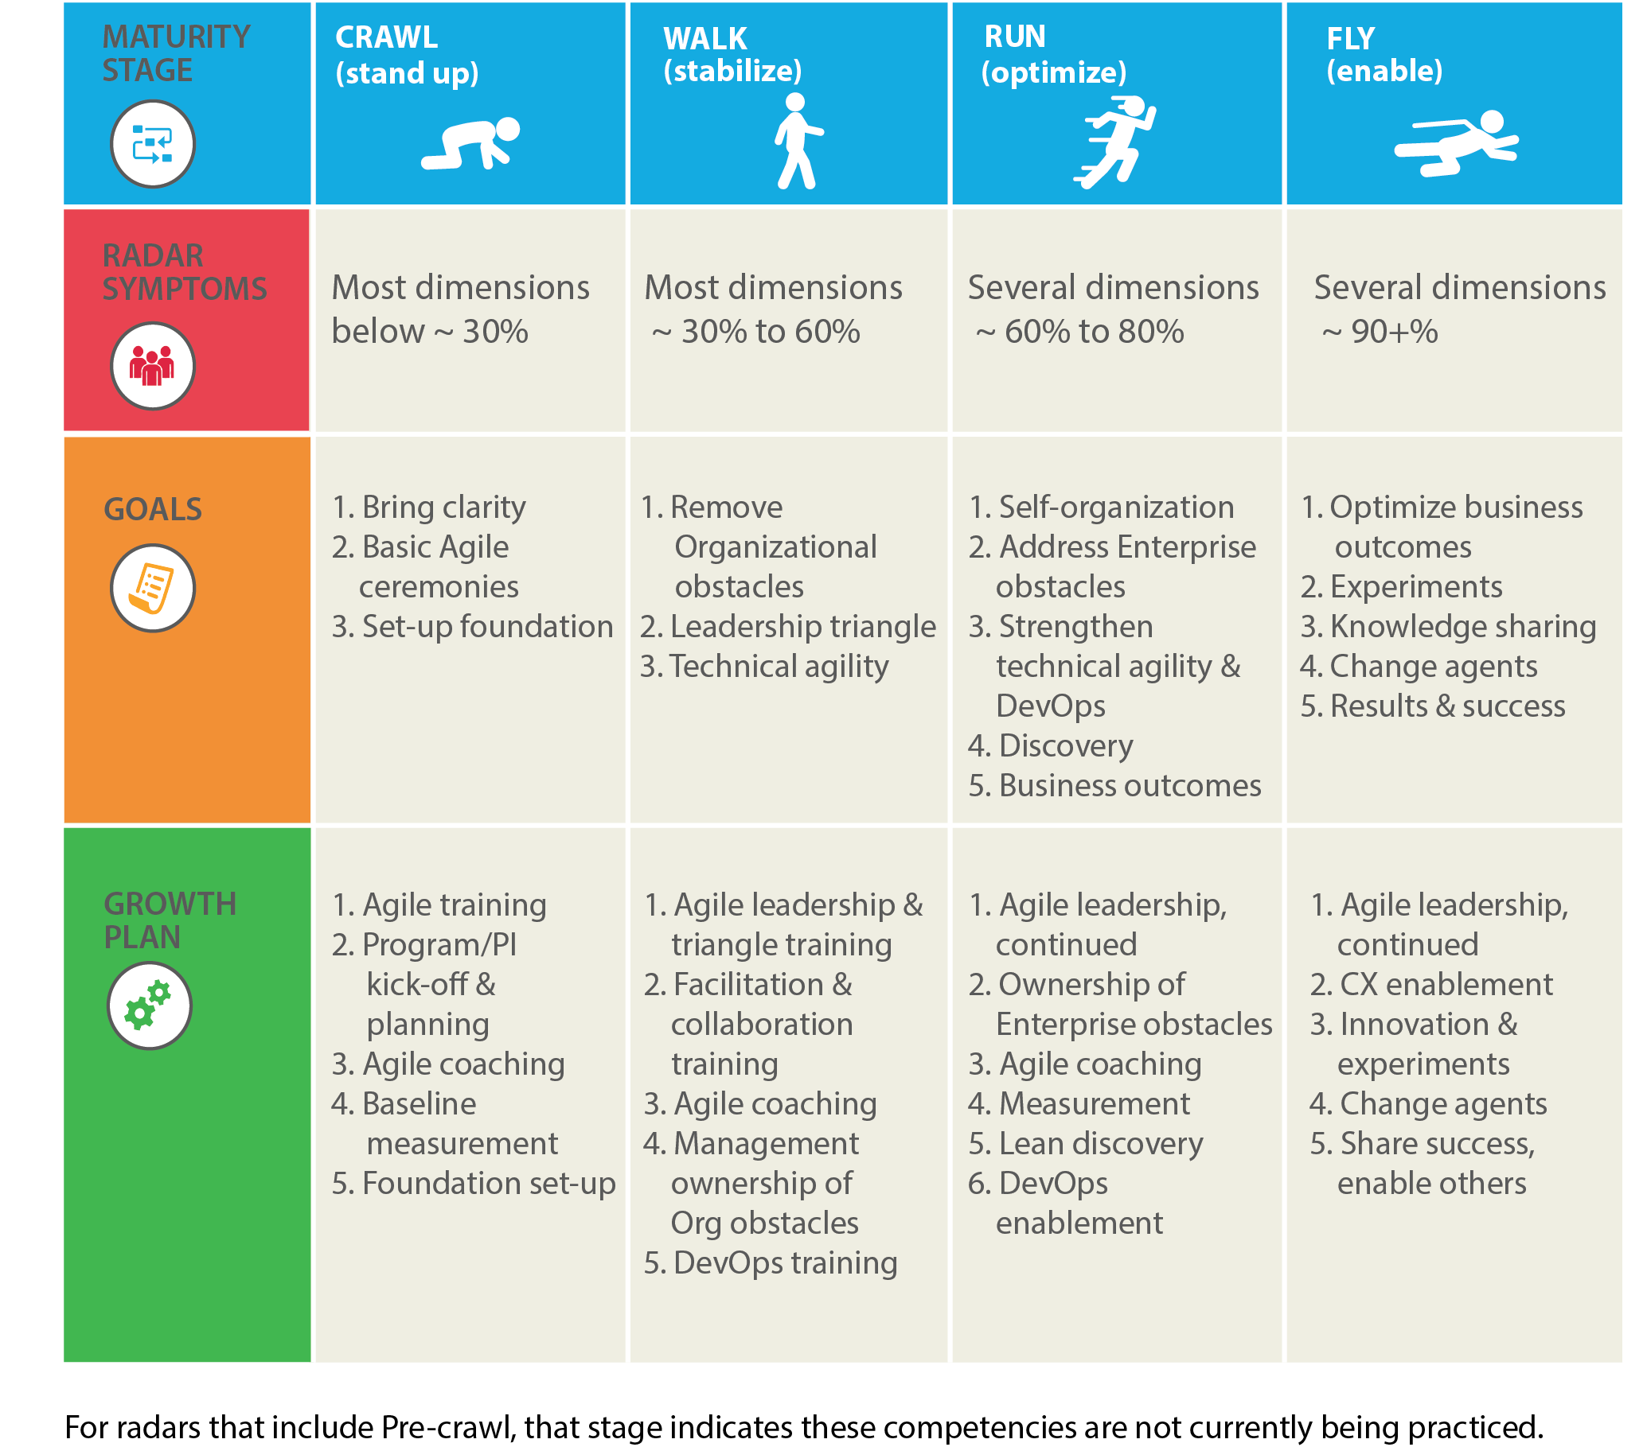
Example: TeamHealth Insights: Maturity
Recommended goals for teams at Walk and Run maturity levels

Slide 16
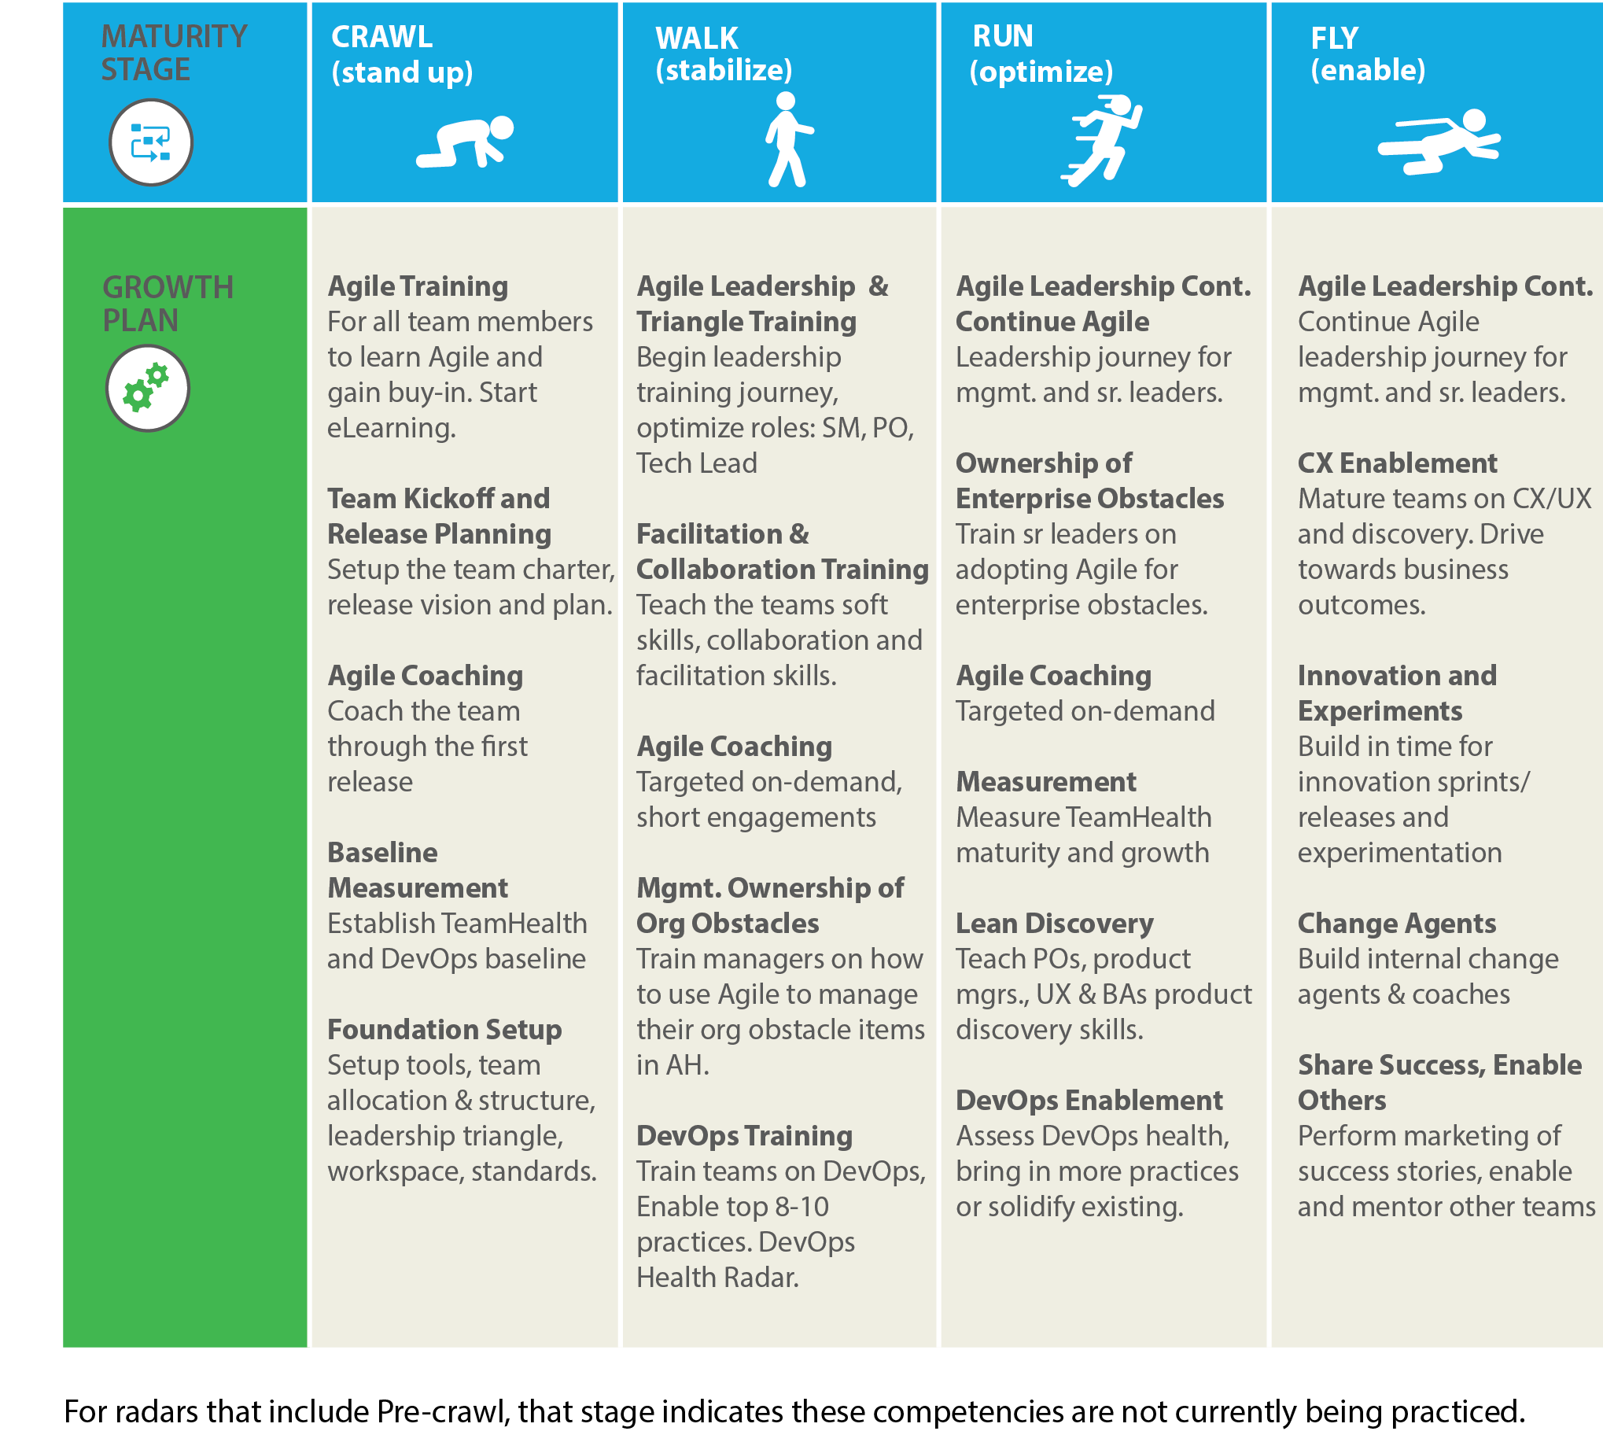
Example: Maturity Roadmap – Recommended Plan
Recommended activities for teams at Walk and Run maturity levels

Slide 17
Multi-Team Analysis Quantitative Delivery Metrics

Slide 18
Multi-Team Analysis Growth Journey

Slide 19
Multi-Team Analysis OGI Themes

Slide 20
Analysis & Discussion

Slide 21
Analyze Data and Share your Insights
Multi-team Rollup & Filter by Roles, Participants
Analytics Table
Growth Journey
Quantitative Metrics
Maturity Level and Roadmap

Slide 22
Activity: Radar Analysis
Break into small groups
Analyze one of the data sets in AgilityHealth
Share your insights with the larger group

Slide 23
What are the teams asking for? Analyze the OGIs
Identify Themes
Review Each Growth Item
Add New Items if Needed
Clarify the Description & Add Acceptance Criteria
Group Closely Related Items & Identify Affected Teams

Slide 24
Activity: What are the teams asking for? OGI Analysis
Break into small groups
Review, analyze and update the Organizational Growth Items
Share your work with the larger group

Slide 25
Growth Plan & Next Steps

Slide 26
Activity: Prioritize Top Issues
Prioritize the list of Organizational Growth Items
Identify the top 1-3 issues to focus on this quarter
Gain consensus from the team

Slide 27
Refining the Top Issues
Is this an Epic or a Story?
Do we Agree on the Acceptance Criteria?
Who will Take Ownership?
How will we Measure Results?

Slide 28
Activity: Refine the Top Issues
For each OGI the team has selected for the quarter:
Understand the size (epic or story)
Confirm agreement on acceptance criteria (update if needed)
Define measurable results
Identify an owner/paired owners

Slide 29
Leadership Checkpoints
Quarterly planning
Weekly Standups
Monthly Reviews
Quarterly Demos
Meetings scheduled and facilitated by role: Facilitator/Agile Coach, Manager, Team Lead/ScrumMaster

Slide 30
Activity: Design your Agile Ceremonies
Agile Teams have the following ceremonies to keep work visible and healthy:
Planning
Daily Standup
Demo
Retrospective
Which ceremonies will your team adopt?

Slide 31
Activity: Plan for Next Steps
What do we need to do next?
Use the WWWF Format (Who/What/When and Follow-up) to capture the plan for next steps

Slide 32
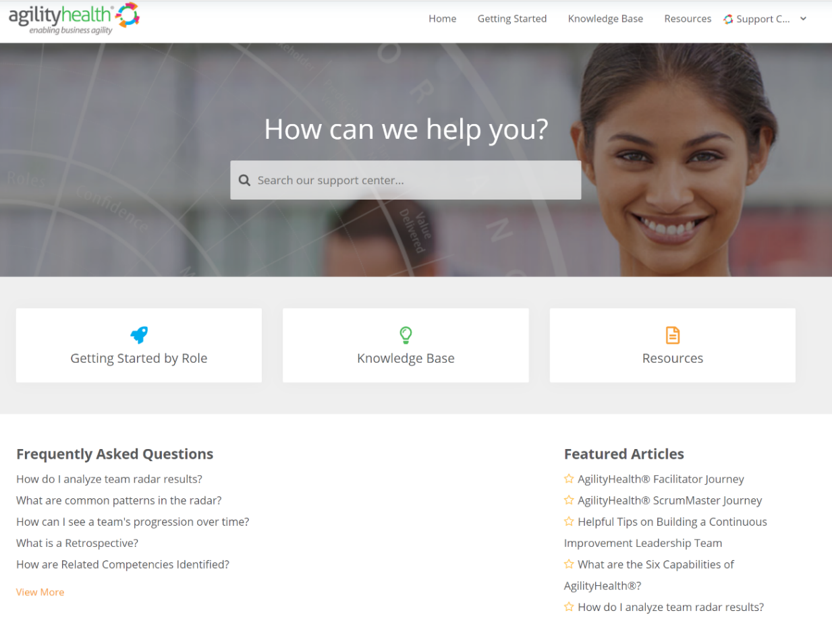
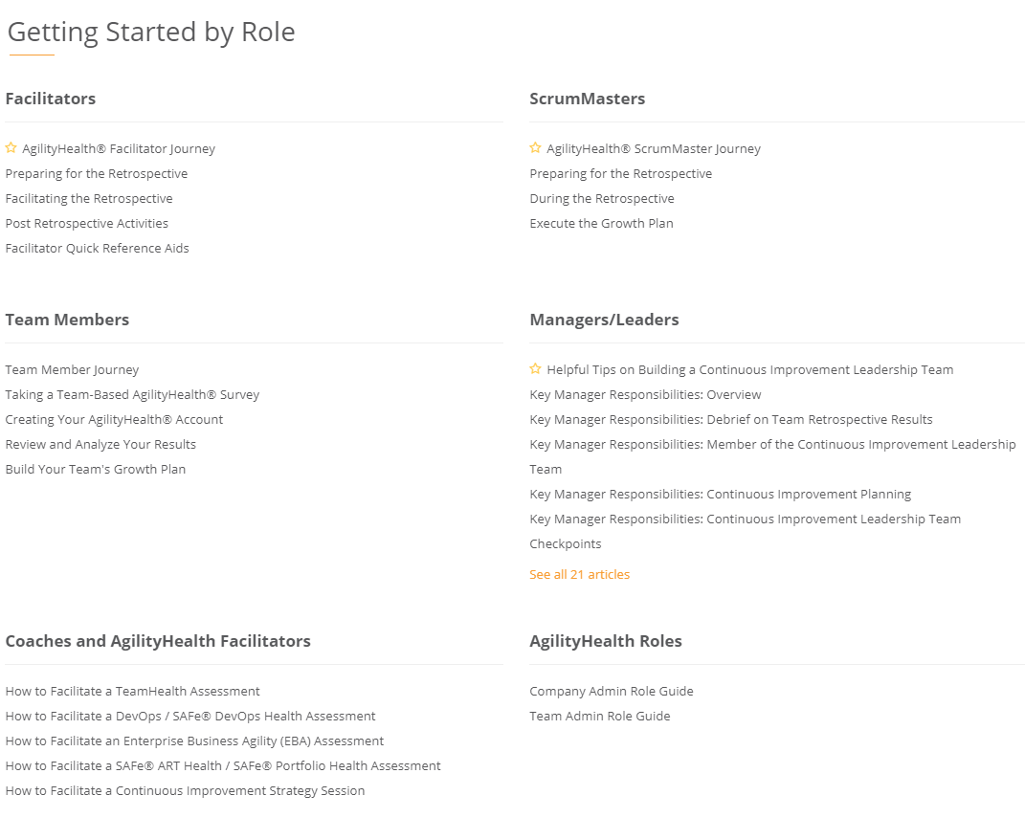
Questions? Check Out Our Customer Support Center
https://support.agilityhealthradar.com
Role based guides, page by page tutorials, FAQ’s, downloadable resources and more!

