Slide 1
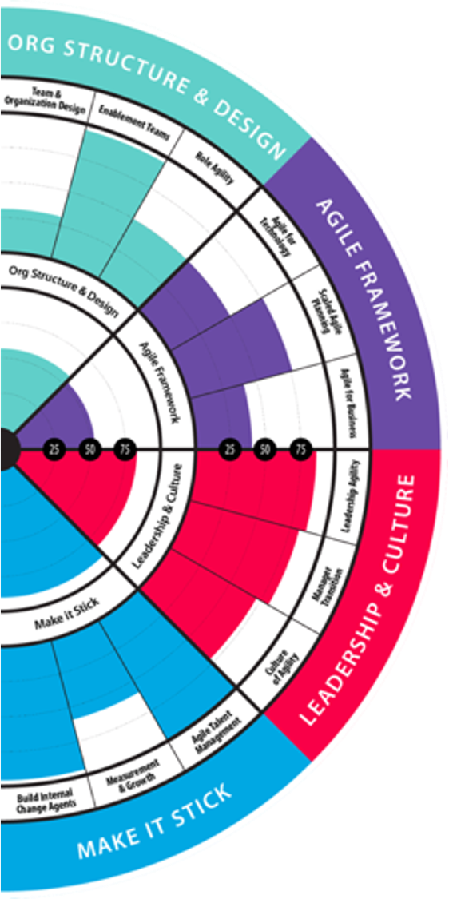
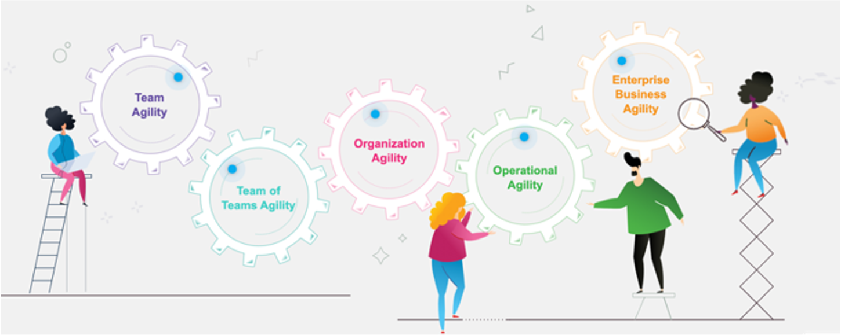
Unified Calculations

Slide 2
Unified Calculation
Objective is to unify how we calculate maturity and performance metrics across the full platform to address variations we had before between pages. This new engine will also improve the accuracy of the calculations.
What's New?
Competency Calculation: We now calculate the competency by averaging all the answers to the questions within that competency. Before we averaged the sum of what each participant answered.
Dimension Calculation: We now calculate the dimension by averaging all the competencies within that dimension. Before we averaged the sub-dimensions.
Enterprise Rollup Calculation: We now calculate the enterprise rollup by averaging all the team scores within that portfolio or enterprise. Before we averaged the team of teams.
Pages updated: The growth journey, multi-team radar pages and radar page have been updated to reflect the new calculations. Enterprise agility and team agility are already using this method.
Performance Growth Journey: TeamHealth Performance on growth journey is now calculated only using the quantitative questions and will be separated from Confidence and any ‘qualitative’ questions.
Benchmark: You will see a larger set of benchmark data to analyze your teams against
APIs: APIs have been updated to use this new unified calculation engine. See new v2 end points here.
High Variance Treatment: You now have the option to turn on this feature (ask your CSM) which will reduce the overall scores of team where the assessment has high variance - 50% or more of the competencies have 50% or more variance (gray shading between highest and lowest score).

Slide 3
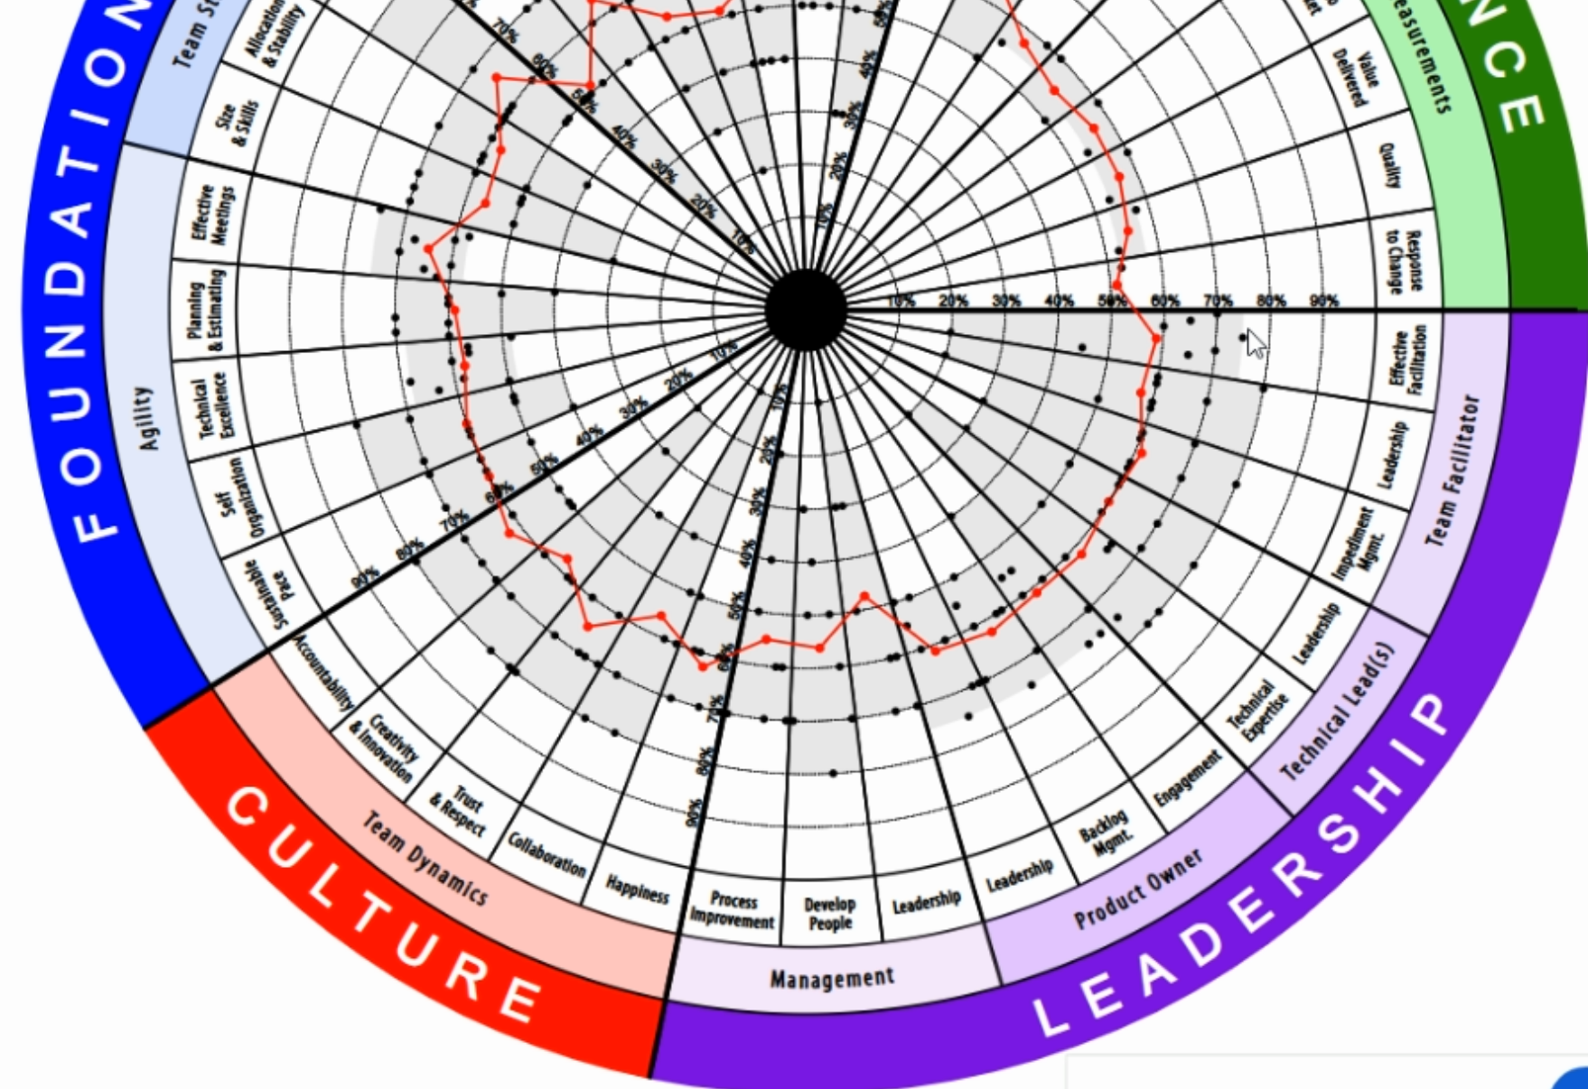
What’s Changed? Competency Calculation
Before the red dot was the average of the other black dots (which are an average of how one team member responded to all the questions).
Now, the red dot is the average of all the questions within that competency.

Slide 4
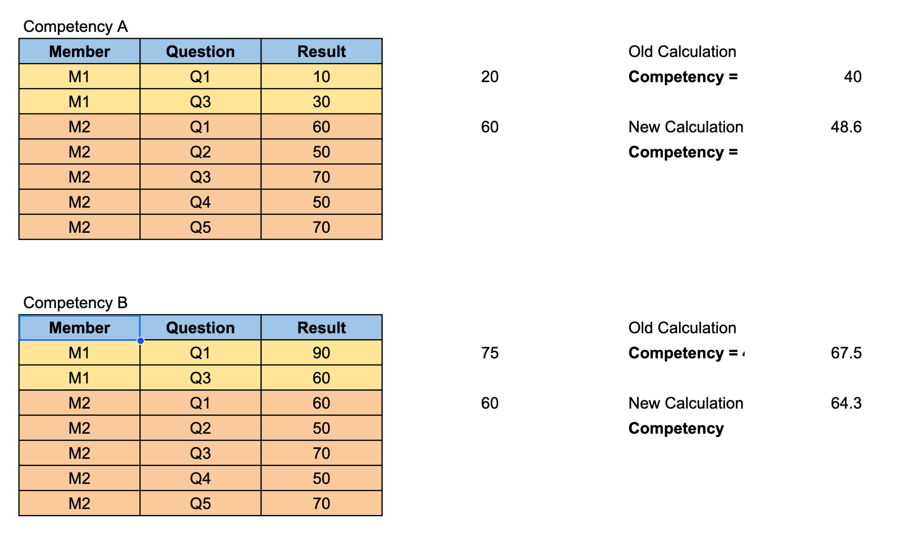
New Competency Calculation Example
OLD Way: average team member 1 + average team member 2 then average these together
New Way: average the results of all the answers of the team members
The impact is a small increase or decrease. It will mostly impact competencies that have multiple questions. Almost 90% of the TeamHealth competencies have 1 question.

Slide 5
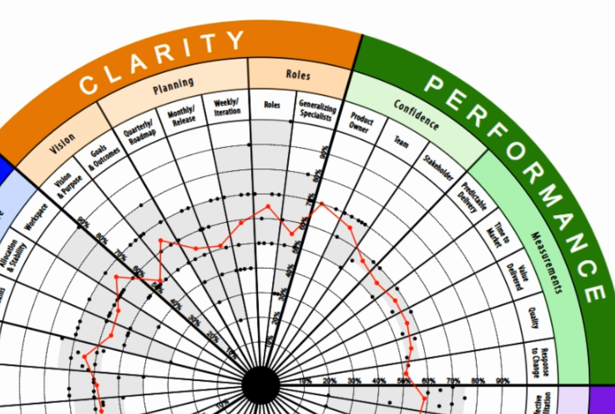
What’s Changed? Dimension Calculation
Before the dimension CLARITY would be calculated as an average of Vision, Planning, Roles.
Now, the dimension CLARITY is calculated as an average of the 7 competencies inside it.

Slide 6
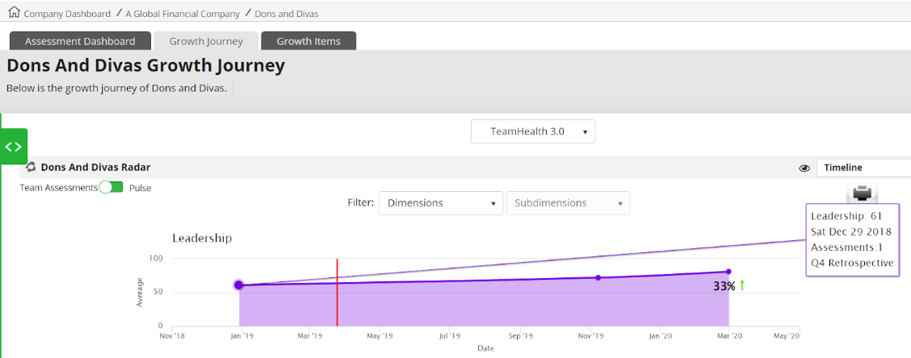
Where will I see the change?

