Slide 1
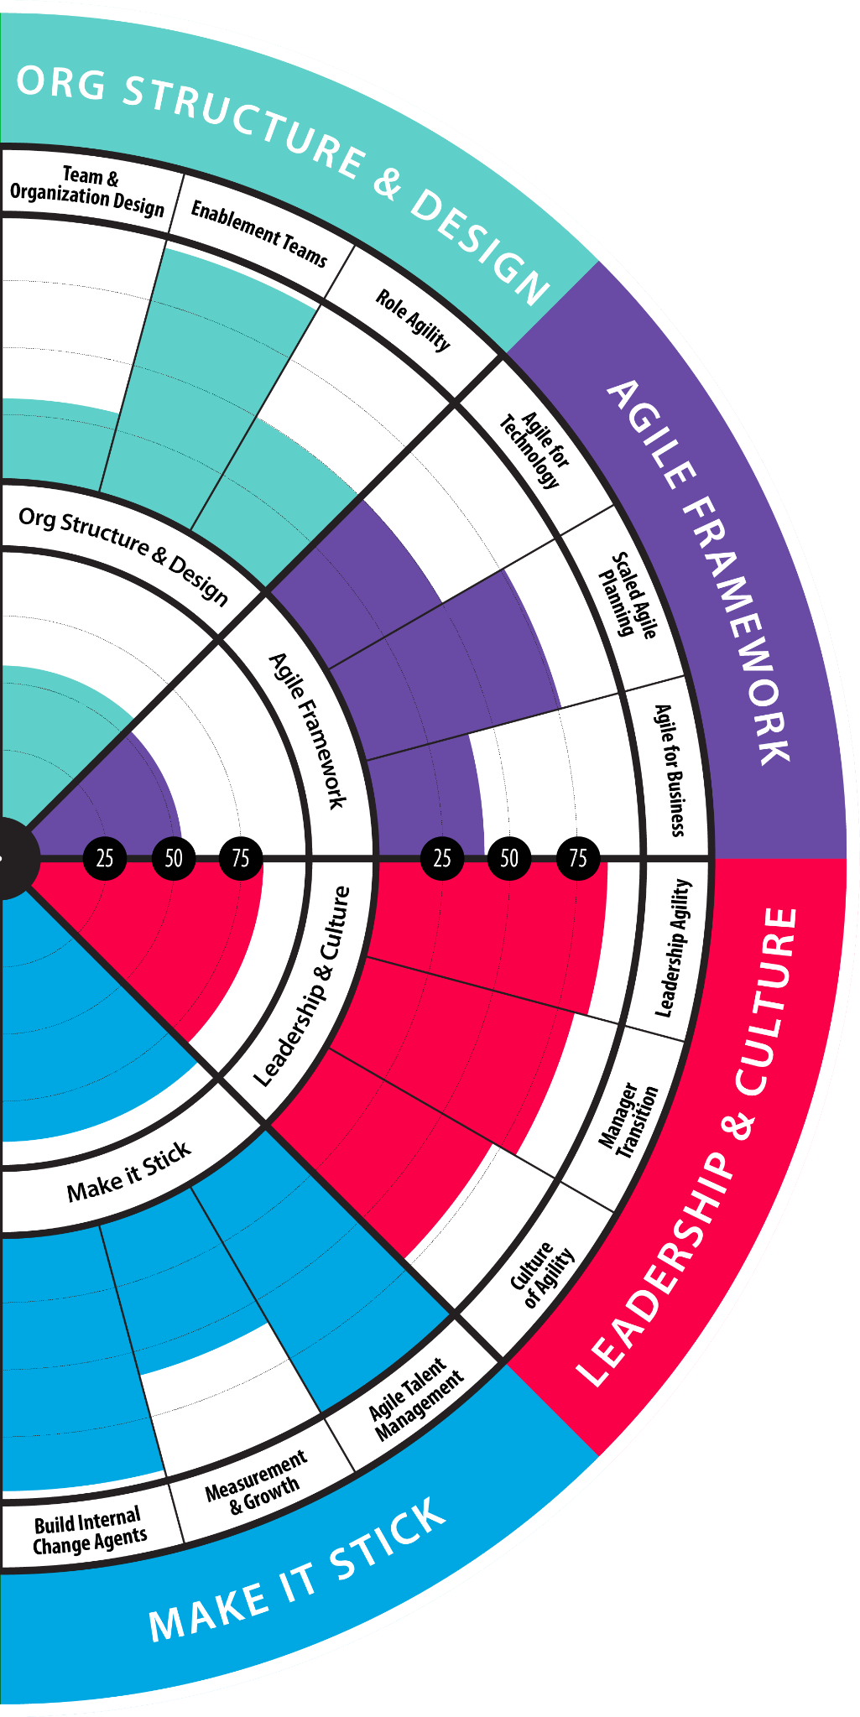
AgilityHealth Overview for Teams

Slide 2
Purpose & Agenda
Purpose
To provide an introduction to the AgilityHealth® TeamHealth program so that you understand your role during and after the TeamHealth® Retrospective.
Agenda
What is AgilityHealth®
The Strategic Retrospective Process for Teams
Demo of the AgilityHealth® TeamHealth® Radar
AgilityHealth®: What do I do now that the strategic retro is done?
Creating and Managing Growth Items
Leveraging the Growth Portal

Slide 3
Activity: Your Top Challenges?
What are the top challenges getting work done? What gets in your way?
Notes:
What do you expect of your teams and their leaders?
Be your whole person
alignment
communications - 360
vulnerable to elevate issues
Enteprise - team - self
high standards, have fun
supported teams
commit to work in a healthy way
transparency
having fun - team is working on thing they are passionate about and enjoying their work
safe environment
environment of trust
need to win as an organization - kick the grass’s ass not each others
productivity
wants team to grow
value add work
choosing the greater good
understanding strategy
intentionality
diversity
competency
open to change
What is working well/not?

Slide 4
Measurement Challenges

Slide 5
What is the AgilityHealth®?
AgilityHealth® is the leading enterprise team management platform for building high performing teams
by measuring and improving maturity, performance and outcomes at ALL levels.
Measure
Grow
Accelerate

Slide 6
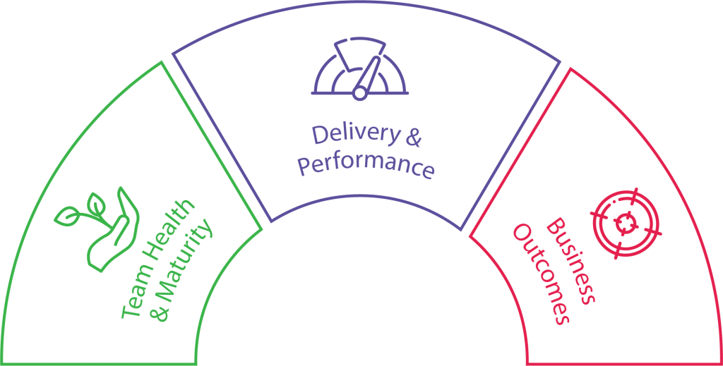
The Platform: Measuring What Matters
AgilityHealth is the ONLY global platform that combines Maturity, Performance and Outcomes so you make informed decisions
Performance
Outputs (flow, quality, predictability)
How are they performing?
Maturity
Practices & Behaviors
Outcomes/OKRs
Strategy & Results Measurement
Are they delivering measurable VALUE?
What is their maturity and where do they need help?
Team Structure
Who are my teams? How are they structured?

Slide 7
Goal: Measurable Growth
643 Teams
32 Teams
29 Teams
6 Teams
Insurance
Insurance
Financial Services
Financial Services
( Enterprise )
( Portfolio )
( Portfolio )
( Program )
▲ 11% - Agility
▲ 17.6% - Maturity
▲ 4.8% - Performance
+274 Org Growth Items
( Realized Over 1 Yr )
▲ 20.4% - Agility
▲ 33.6% - Maturity
▲ 9% - Performance
+54 Org Growth Items
( Realized Over 1 Yr )
▲ 11.3% - Agility
▲ 11.7% - Maturity
▲ 10.8% - Performance
+145 Org Growth Items
( Realized Over 1 Yr )
▲ 17.1% - Agility
▲ 15.9% - Maturity
▲ 18.2% - Performance
+25 Org Growth Items
( Realized Over 1 Yr )
95 Teams
2,300 Teams
( Enterprise )
Financial Services
Financial Services
( Enterprise )
* Results over 1 Year. Refer to Sample AH Use Cases from Actual FS Clients: https://agilityhealthradar.com/roi-calculator/#customer4
▲ 15.4% - Agility
▲ 10% - Maturity
▲ 21.9% - Performance
+391 Org Growth Items
( Realized Over 1 Yr )
▲ 26% - Agility
▲ 33% - Maturity
▲ 37% - Performance
Scaled from 1500 Teams
( Realized Over 2.5 Yrs )

Slide 8
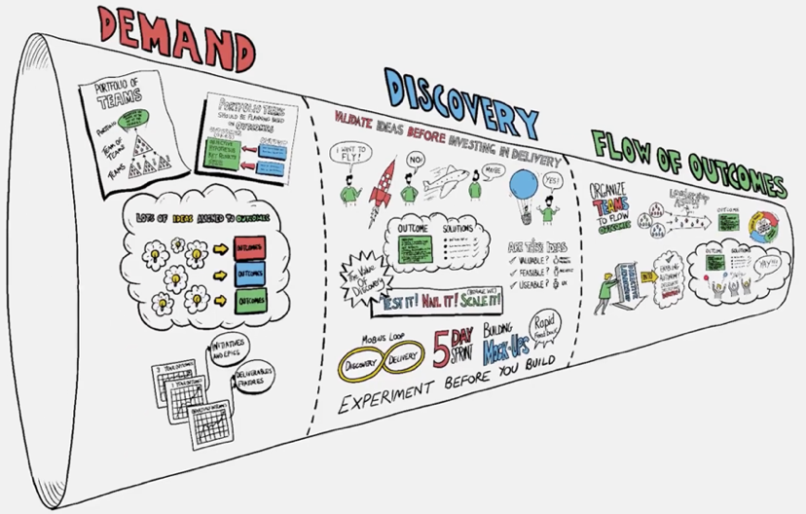
Enterprise Business Agility Explainer Video
https://agilityhealthradar.com/videos/business-agility/

Slide 9
An organization is only as ‘Agile’ as its least agile part.
Evan’s Theory of Agile Constraints
Source: Evan Leybourn, Business Agility Institute

Slide 10
Optimize the Enterprise FLOW of Value
Strategic Outcomes
Operations & Support
Grow
Transform/Innovate
Run
Grow
Transform
Demand
Delivery
Opportunity Assessment
Solution Discovery
Agile Delivery
Portfolio Team
Product Team
Delivery Teams
Who are the customers?
Is this the right opportunity?
What outcomes do we want to achieve?
At what cost? “Definition of Outcomes” Outcomes <> EPICs
What problem are we solving for whom? How can we validate our hypothesis? What should the teams focus on for the next quarter? “Definition of ready” EPICs <> Features
What are the minimum features with highest value we need to build?
Who should we engage for feedback? How can we iterate quickly & get feedback? How will we measure results? “Definition of DONE” Features <> Stories
F L O W o f V A L U E
Notes:
Speed is important, but doing the right thing (moving in the right direction) is paramount.
Example: name change from Agile Transformation (focus on team delivery) to Agility Health (focus on the whole company /demand - doing the most important things)
Some people have more acumen for strategy and some for execution
jumpstart the discovery before your jumpstart the delivery

Slide 11
BIG PICTURE | Cadence
Annual Portfolio Planning
Annual Outcomes > Initiatives & EPICs
Portfolio Leaders
Quarterly / PI Planning
Q1
Q2
Q3
Q4
Quarterly Outcomes > Deliverables/Features
Team of Teams
APR
MAY
JUN
Team Goals > Stories
Delivery Teams
Sprint 1
Sprint 2
Sprint 3
Sprint 4
Sprint 5
I & P Sprint
Notes:
Erie could use support for this type of annual planning
Taks Froce provides ‘customer’ feedbac/demand via agents

Slide 12
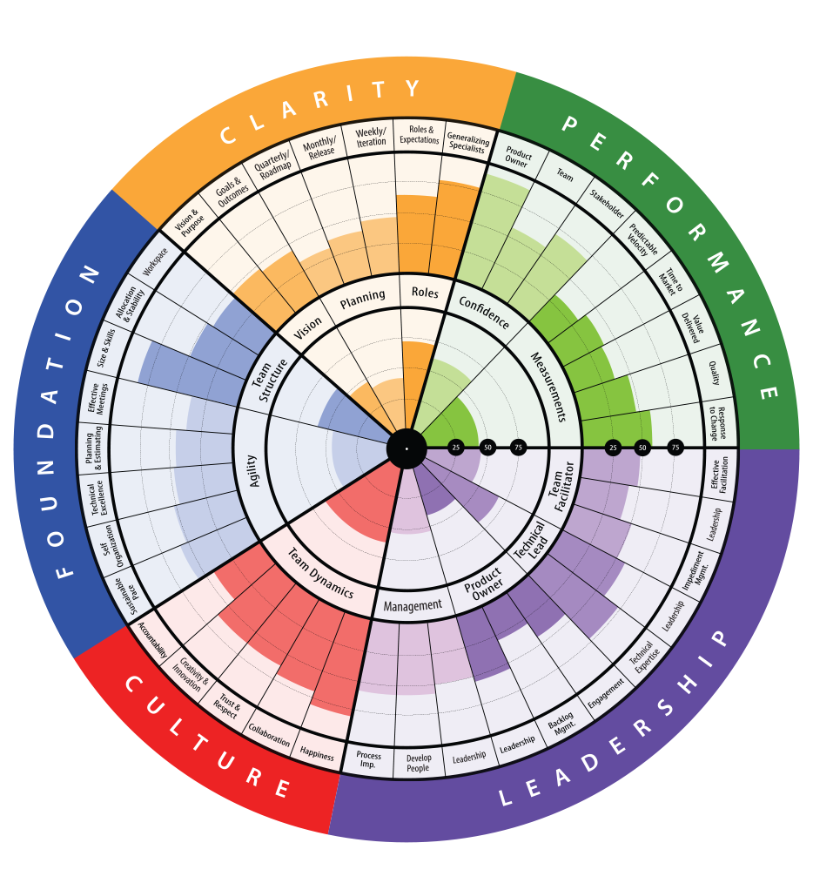
Tactical vs Strategic Retrospectives
Sprint
Tactical
Sprint
Tactical
Sprint
Tactical
PI Planning
PI Demo & I&A
TeamHealth Retrospective & Growth Plan
Sprint Planning
Sprint Demo
Sprint Retrospective
Sprint Planning
Sprint Demo
Sprint Planning
Sprint Demo
Sprint Retrospective
Tactical
Strategic

Slide 13
3 Minute TeamHealth® Overview Video
Watch the TeamHealth® Overview Video

Slide 14
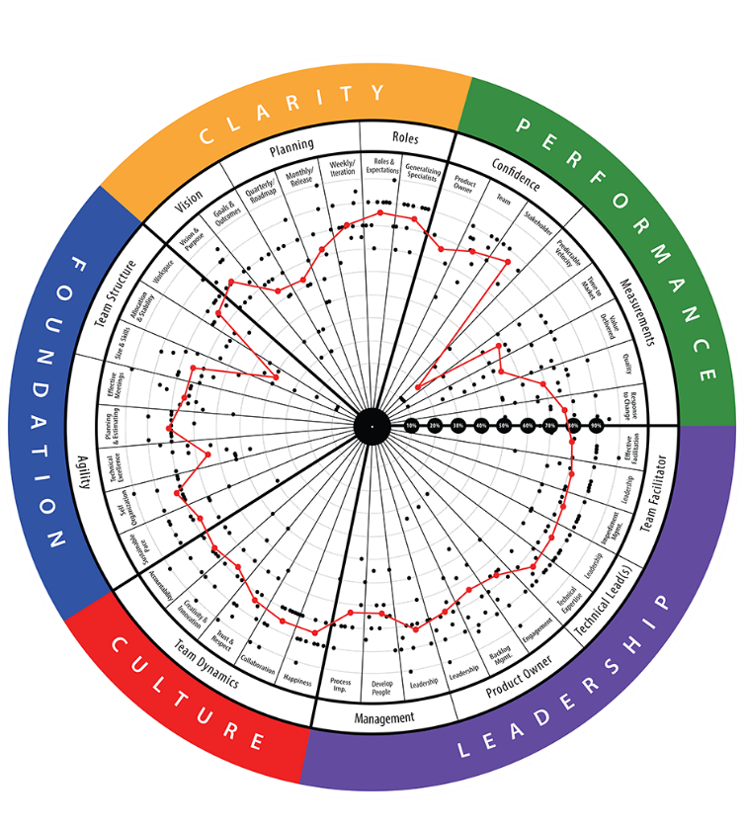
TeamHealth® Retrospective
STRATEGIC RETROSPECTIVE: A retrospective that aims to help teams reflect on their last quarter or release and improve the next one. Facilitated by trained facilitators (AHFs).
Analyze real-time
radar and textual responses. Have “real” conversations - 1 hr
Team members
complete the assessment on their phone or laptop 30 - 45 min
STEP 2
Build actionable
growth plan for
the team and for
their leaders - 30 min
STEP 1
STEP 3
Duration: ~ 2.5 hrs Repeat: Every quarter

Slide 15
Team Member Responsibilities
1
Show-up and be fully present and engaged during your teams’ TeamHealth® Strategic Retrospective
2
Answer all the questions and provide comments throughout – ask questions of your AgilityHealth® Facilitator
3
Be sure to hit “submit” when you complete all the questions and create your login to access the results
Analyze the results as a team and help capture/refine Growth items during the Retrospective session
4
5
Collaborate as a team to review, prioritize and manage the growth backlog each sprint

Slide 16
Moving Towards A Growth Mindset
We’re doing the best we can and have no time for growth
We can continuously improve our way of working
Strategic Retrospectives help a team adopt a Growth Mindset.
In order to have a Growth Mindset, the team must make time and space for Intentional Growth.

Slide 17
TeamHealth® Radar Demo
Team Members will take together as a team
All responses are anonymous
Facilitated by a certified AgilityHealth® Facilitator

Slide 18
TeamHealth® Radar
Purpose: Our most popular & powerful benchmark for measuring the health of Agile teams across 5 dimensions: Clarity, Performance, Leadership, Culture and Foundation.
Who? Typically completed by the Agile team members: Product Owners, ScrumMasters, Technical Leads, & Team Members.
Pain Points? Team practices not mature or Agile, low predictability and accountability, lack of confidence and value delivered, lack of upfront planning (quarterly, monthly, weekly)...
Preview TeamHealth 2.5 Qualitative Questions
Preview TeamHealth 2.5 Quantitative Questions

Slide 19
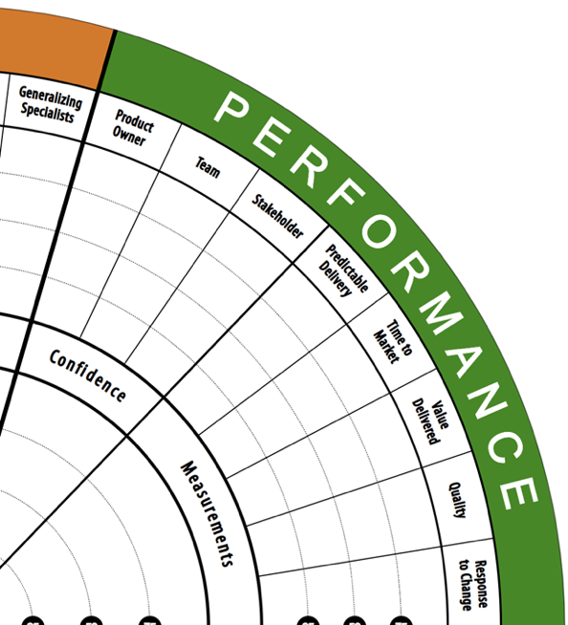
TeamHealth® | Performance Dimension
Performance metrics are both qualitative and quantitative – the quantitative questions are answered by the ScrumMaster and/or Product Owner.
Confidence - Qualitative:
Product Owner’s confidence level that the team has the right knowledge, skills, motivation, and tools to meet the current goals.
Team Member’s confidence level that the team has the right knowledge, skills, motivation, and tools to meet the current goals.
Stakeholders confidence level, they will receive a 2 question survey the week leading up to your team strategic retrospective that asks:
What is confidence level that the team will meet or exceed the current goals.
Likelihood to recommend team on a scale of 1 to 10.
Measurements - Quantitative:
Predictable Delivery
Time To Market
Value Delivery
Quality
Response To Change

Slide 20
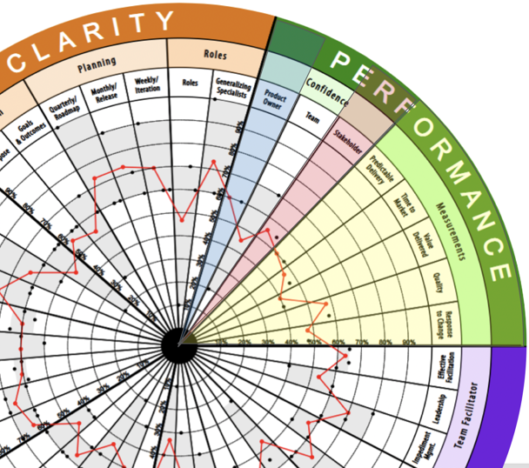
Which Roles Receive Which Performance Questions*?
Product Owner Confidence
Only the Product Owner receives the Product Owner confidence question.
Stakeholder Confidence
Only the Stakeholder(s) receive the Stakeholder confidence questions.
Performance Quantitative Questions Only ScrumMaster and/or Product Owners answer the 9 quantitative questions for Performance.

Slide 21
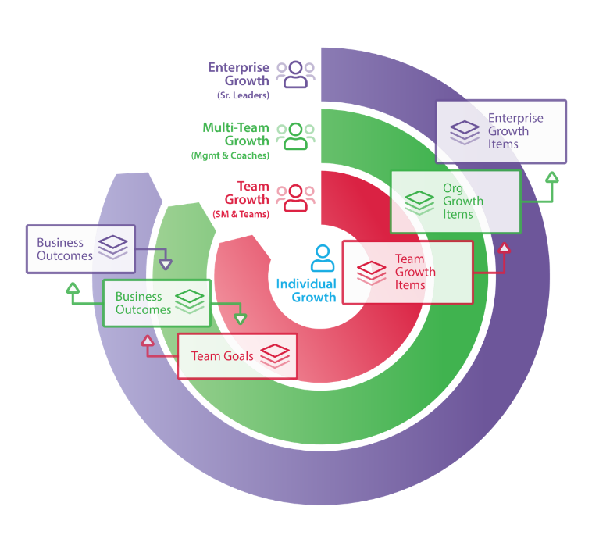
AgilityHealth® Continuous Improvement Model
Org Leaders
Agile Coaches
Managers
‘If you want to teams to align and achieve outcomes, you’ll need to hear their voice and remove obstacles.” – Sally Elatta
Teams
Scrum Masters
Product Owners

Slide 22
Roles and Jobs To Be Done
Org Leaders
Agile Coaches
Managers
Scrum Masters
The Team
Remove Organizational and/or Enterprise obstacles
Visibility into organization health and performance
Define business outcomes and measure results
Multi-team roll up analysis
Coaching the target teams
Measure coaching impact
Identify patterns
Complete team survey as stakeholder
Own removal of organizational growth items
Measure growth over time
Schedule and attend retrospectives
Work with team to build and prioritize SMART Growth Items
Manage team growth plan
Be fully present & complete assessments
Analyze results as a team real-time
Build growth plans
Work as a team to prioritize and work on growth items

Slide 23
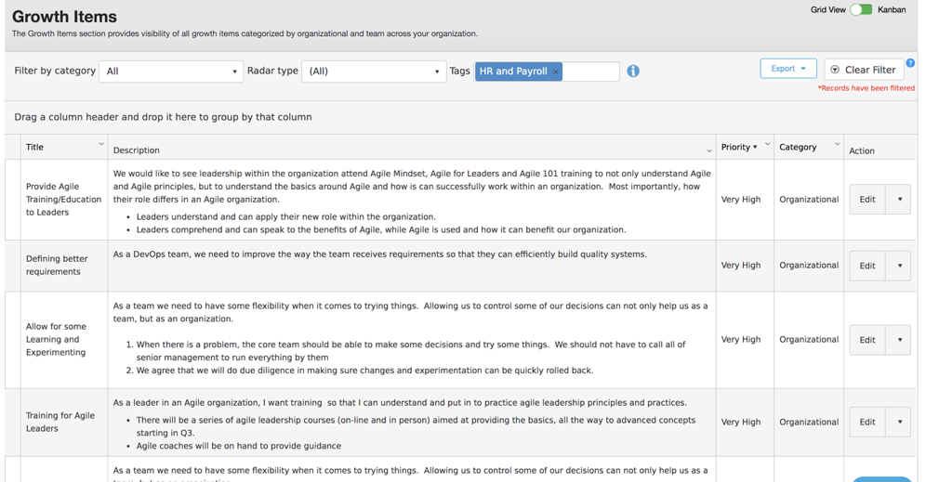
Improvement Plans at Each Level
Make improvement plans actionable. Think Story and acceptance criteria NOT EPIC.

Slide 24
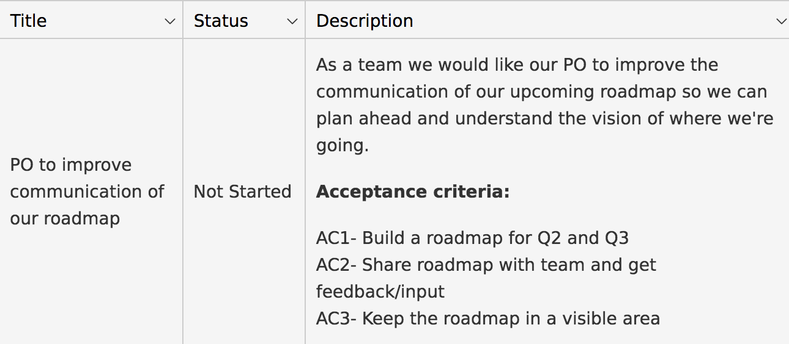
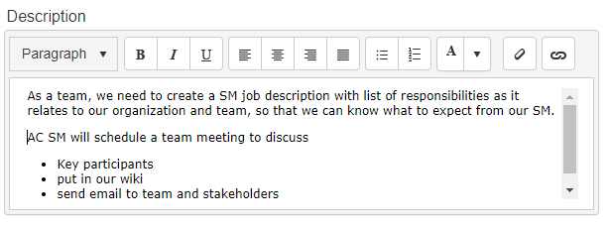
Good Growth Items Are Like Good Stories
S
pecific
M
easurable
A
chievable
R
ealistic
T
ime-Bound
Notes:
.

Slide 25
Managing Growth Items with AgilityHealth

Slide 26
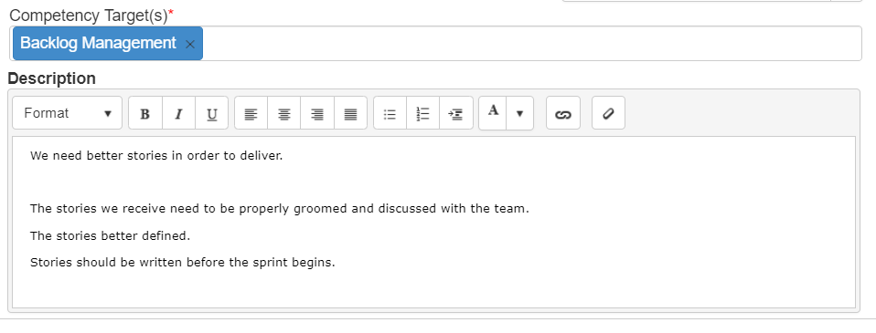
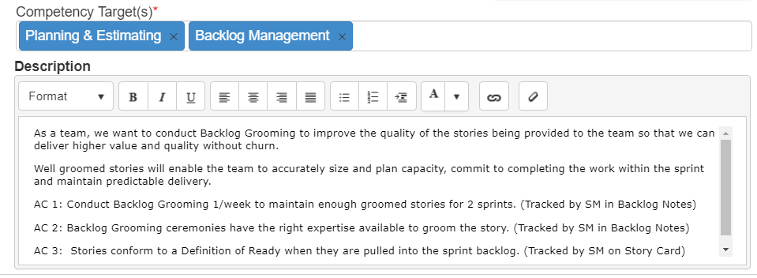
What Makes A Good Growth Item?
Not Good
Good
Written as a good user story
(INVEST or SMART)
Well defined acceptance criteria

Slide 27
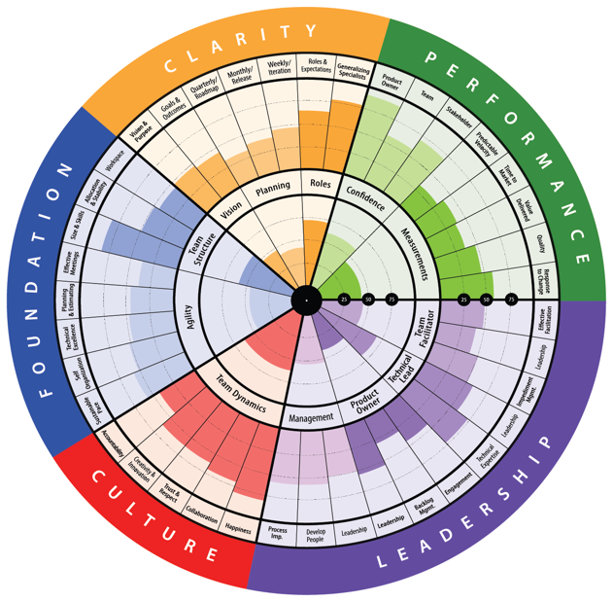
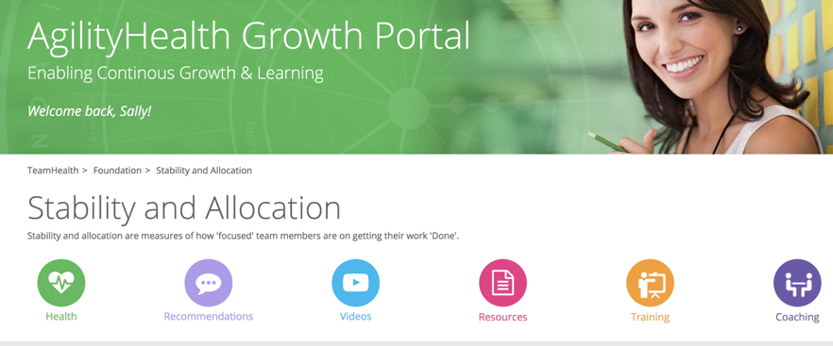
Access Recommendations by Competency
Self Learning by Competency
View Sample: https://growthportal.agilityhealthradar.com/

Slide 28
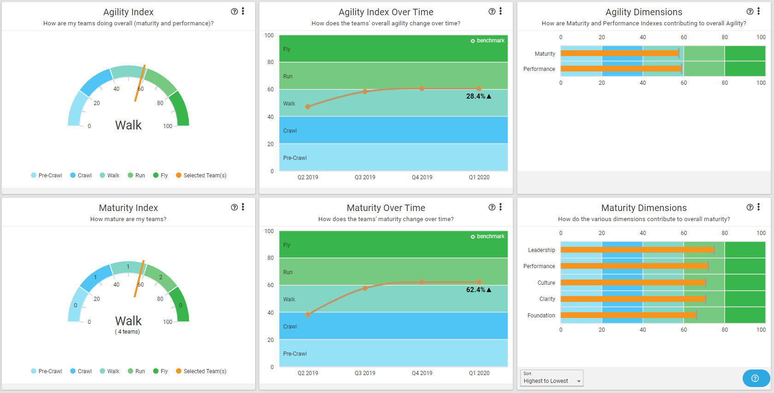
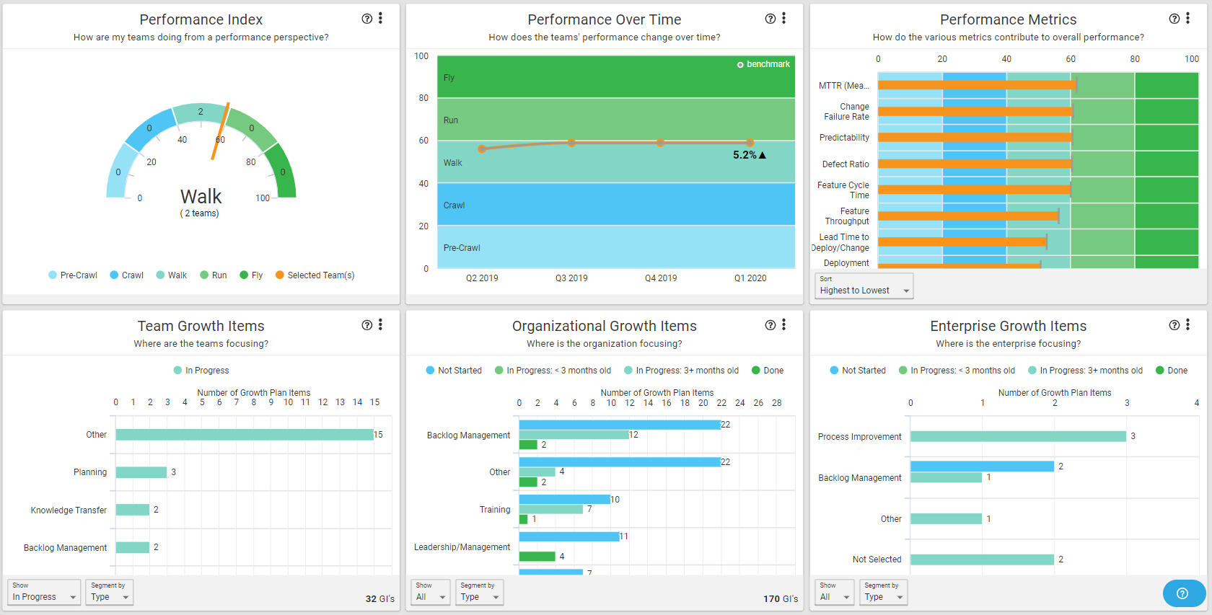
Insights: Team Agility Dashboard

Slide 29
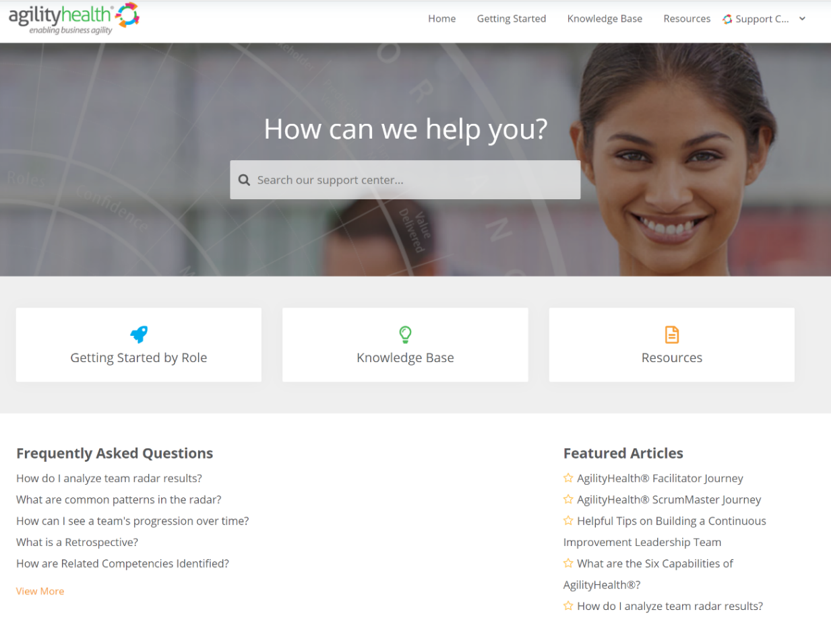
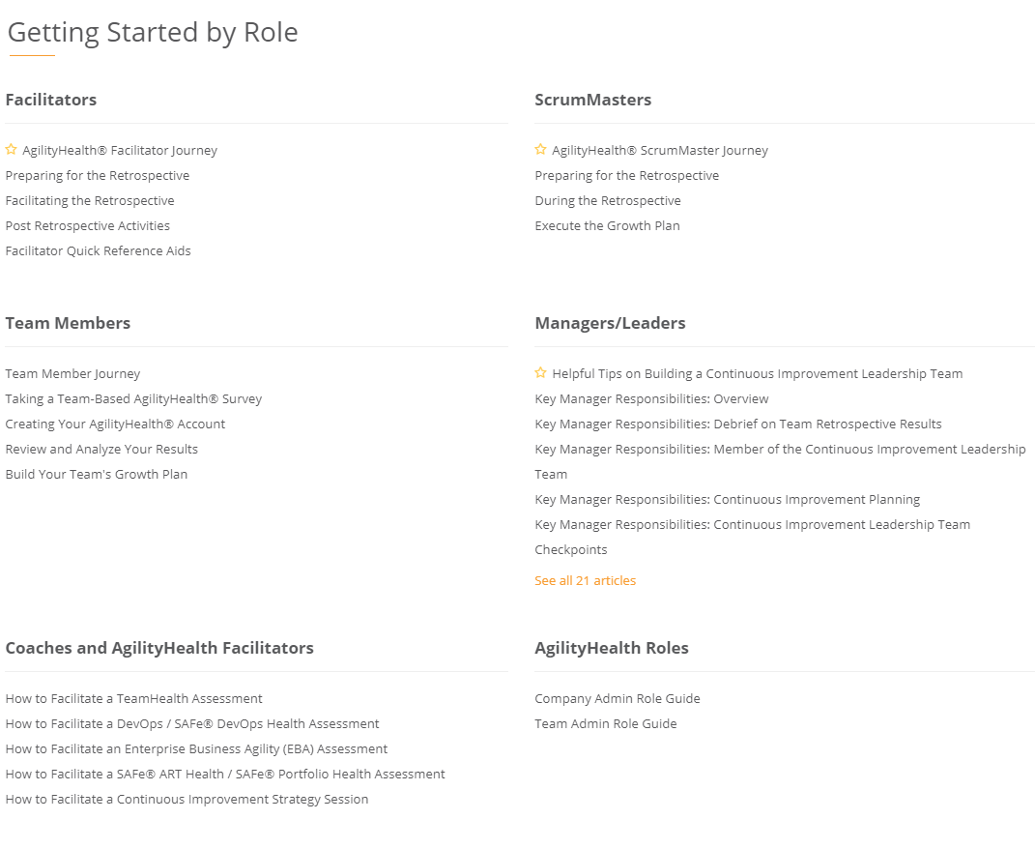
Questions? Check Out Our Customer Support Center
https://support.agilityhealthradar.com
Role based guides, page by page tutorials, FAQ’s, downloadable resources and more!

Slide 30
Thank You!
Getting in touch:
success@agilityhealthradar.com

