Slide 1
AgilityHealth® Facilitator
Certification Refresher

Slide 2
Purpose & Agenda
Purpose:
Provide certified AgilityHealth® Facilitators a refresher course reviewing their key responsibilities in preparing for and conducting a TeamHealth® Retrospective.
Agenda:
  Quick Review of the AgilityHealth® Purpose & Roles
  Preparing for a TeamHealth® Retrospective
  Facilitating the Retrospective
  Post Retrospective Activities
  Q & A
Notes:
2
2

Slide 3
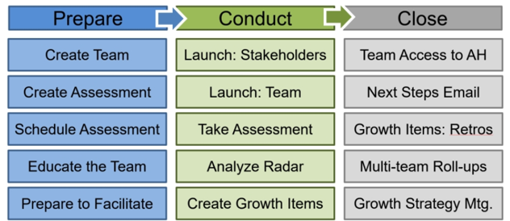
AgilityHealth® Facilitator Journey
Goals
Provide retrospective experience
Create a solid growth plan
Obtain valuable feedback for team growth
Visit our Support Center to download your
Getting Started by Role guide for Facilitators

Slide 4
AgilityHealth® Purpose & Roles
Review of the AgilityHealth® Purpose & Roles
Preparing for a TeamHealth® Retrospective
Q & A
Post Retrospective Activities
Facilitating the Retrospective

Slide 5



What is the AgilityHealth® Measurement Platform?
AgilityHealth® is the world’s leading
measurement & continuous improvement
platform for accelerating the maturity and productivity of teams and enterprises.
Measure
Grow
Accelerate

Slide 6

3 Minute TeamHealth® Overview Video
Watch the TeamHealth® Overview Video

Slide 7
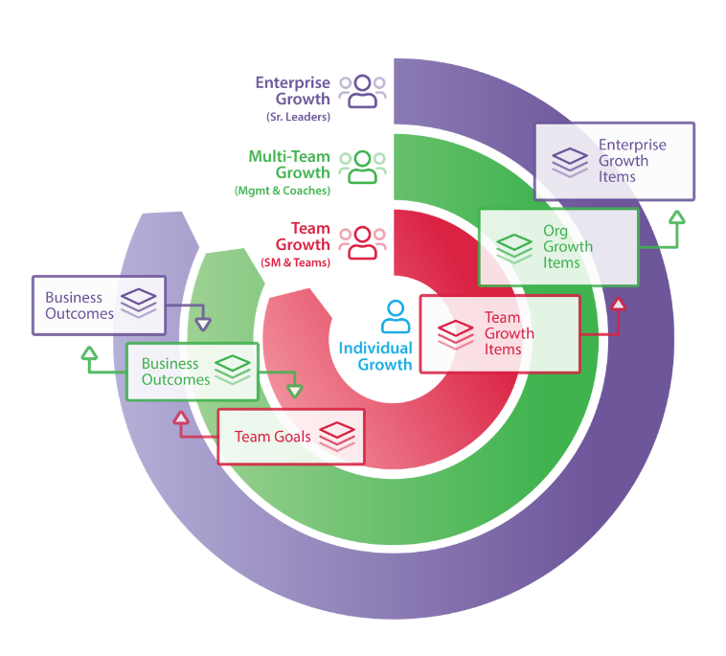
AgilityHealth® Continuous Improvement Model
Org Leaders
Agile Coaches
Managers
‘If you want to teams to align and achieve outcomes, you’ll need to hear their voice and remove obstacles.”
– Sally Elatta
Teams
Scrum Masters
Product Owners

Slide 8




Inspect & Adapt Leads to Growth
Measure
Collect Team Health
& Maturity Data
Understand
Analyze Radar,
Gain Insights
Inspect
&
Adapt
Plan
Gain Consensus &
Build Growth Plan
(for team & leaders)
Grow
Validate the Growth
& Iterate

Slide 9
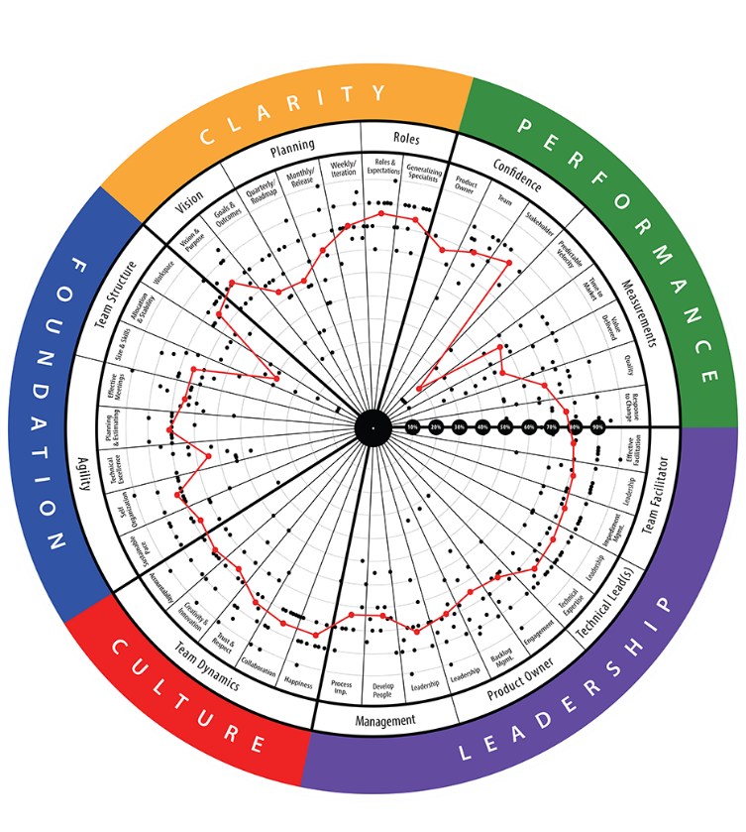
TeamHealth® Retrospective
STRATEGIC RETROSPECTIVE: A retrospective that aims to help teams reflect on their last quarter or release and improve the next one. Facilitated by certified AgilityHealth® Facilitators.
Analyze real-time
radar and textual responses. Have “real” conversations
Team members
complete the assessment on their phone or laptop
STEP 2
Build actionable
growth plan for
the team and for
their leaders
STEP 1
STEP 3
Duration: ~ 2.5 hrs
Repeat: Every quarter/release

Slide 10






Roles & Jobs to Be Done
Org Leaders
Agile Coaches
Managers
Remove Organizational and/or Enterprise obstacles
Visibility into organization health and performance
Define business outcomes and measure results
Multi-team roll
up analysis
Coaching the
target teams
Measure coaching impact
Identify patterns
Complete
team survey as stakeholder
Own removal of organizational growth items
Measure growth over time
Scrum Masters
AgilityHealth® Facilitator
The Team
Schedule
and attend retrospectives
Work with team to build and prioritize SMART Growth Items
Manage team growth plan
Facilitator and Scrum Master Prep, Conduct and Close Assessment
Engages with Scrum Master to Manage Teams
Be fully present & complete assessments
Analyze results as a team real-time
Build growth plans
Work as a team to prioritize and work on growth items

Slide 11
TeamHealth® Retro Prep
Review of the AgilityHealth® Purpose & Roles
Preparing for a TeamHealth® Retrospective
Q & A
Post Retrospective Activities
Facilitating the Retrospective

Slide 12

Pre-Retrospective Activities
Support Center Article
Setup the team, team members and stakeholders (or setup ScrumMaster as Team Admin to do this)
Schedule session and provide purpose, agenda and reminder to bring laptop
Create and launch assessment for stakeholders several days before the team retrospective session
Prep for retrospective by getting background or general updates about the team (from ScrumMaster/PO)
Enter hard metrics for the team (manually or ALM integration) – usually the ScrumMaster does this. Prep the ScrumMaster and/or Product Owner to answer Metrics questions.
1
2
3
4
5

Slide 13
Sample Email/Calendar Invitation
Subject Line: AgilityHealth® Team Retrospectives
Dear Team Member:
As a reminder, your team has been selected to participate in an AgilityHealth® Retrospective. Please attend your retrospective session at [DATE] and [TIME]. The final output of this session is a Team Growth Plan with actionable items you want to achieve within the next quarter and Organizational Growth Items you want Leadership to address.
Desired Outcomes:
  Analyze your radar results and engage in an open/honest conversation about your strengths and growth opportunities.
  Develop an actionable growth plan for your team for the next quarter/release.
  Let Leadership know where they can help you.
  Have FUN!
Post Retrospective:
  We'll ask for your feedback on the session.
  We'll share your Organizational Growth Items with Leadership so they can take action.
  Your ScrumMaster will help pull any improvements you identified into your next retrospective.
Thank you for participating in the AgilityHealth® Retrospectives!

Slide 14
Product Demo
Add/Edit Teams
Set up the Assessments

Slide 15
TeamHealth® Retro Facilitation
Review of the AgilityHealth® Purpose & Roles
Preparing for a TeamHealth® Retrospective
Q & A
Post Retrospective Activities
Facilitating the Retrospective
Support Center Article

Slide 16
TeamHealth® Meeting Agenda (includes taking assessment during retro)
Introduction (15 minutes)
Meeting Norms, Review Agenda, Introduce the Assessment
Take the Assessment (50 minutes) and Break (10 minutes for break)
Walk the Radar (5 minutes)
Demonstrate how to read the radar
Break into small groups to review each dimension (10 minutes)
Read the radar dimension and comments, jot down observations on Post-It Notes.
Group Discussion (60 minutes)
Each team then presents their dimension and have a conversation with the whole group.
Review strengths, improvements and impediments
As a team, identify top issues (use dot/straw voting)
Create Growth Backlog (15 minutes)
Select the top few issues and create growth items, with clear user stories and well-defined acceptance criteria
Closing Activities (10-15 minutes)
Appreciation Game (or any other fun game), Capture Next Steps (What, When and Who), Retro of the Retro
~3 hour timebox, once a quarter

Slide 17
TeamHealth® Meeting Agenda (Assessment is taken prior to retro)
Introduction (10 minutes)
Meeting Norms, Review Agenda
Walk the Radar (5 minutes)
Demonstrate how to read the radar
Break into small groups to review each dimension (10 minutes)
Read the radar dimension and comments, jot down observations on Post-It Notes.
Group Discussion (60 minutes)
Each team then presents their dimension and have a conversation with the whole group.
Review strengths, improvements and impediments
As a team, identify top issues (use dot/straw voting)
Create Growth Backlog (15-30 minutes)
Select the top few issues and create growth items, with clear user stories and well-defined acceptance criteria
Closing Activities (15 minutes)
Appreciation Game (or any other fun game), Capture Next Steps (What, When and Who), Retro of the Retro
~2-2.5 hour timebox, once a quarter

Slide 18
TeamHealth® Introduction Talking Points
Introduce yourself as their neutral AgilityHealth® Facilitator
Tactical vs. Strategic Retrospectives
Outcomes are the radar and actionable growth plan
Quick Radar Dimensions overview
Responses are anonymous
Emphasize entry of detailed textual responses to provide context
Let’s set up our team norms! (Be open, honest, Vegas rule, etc.)
Ratings follow the CRAWL(1-2), WALK(3-5), RUN(6-8), FLY(9-10) | Additive
Use upper/lower range when question has two parts/acceptance criteria

Slide 19
TeamHealth®
Detailed View
Qualitative Metrics

Slide 20
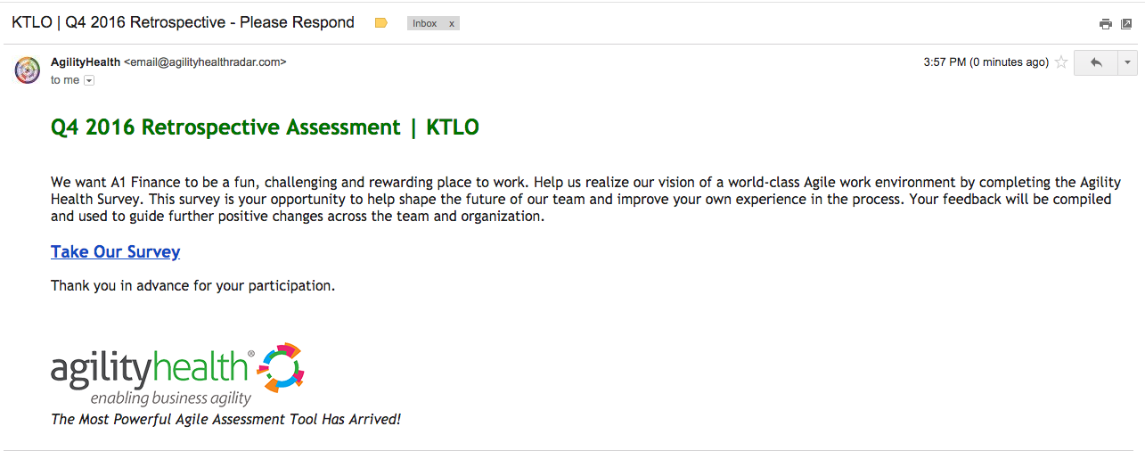
Email with Assessment Invitation
Important: Since each assessment link is unique to the user that receives the email, no one should forward the assessment email they receive. If someone takes the assessment in their place, the system will not allow them to take it.

Slide 21
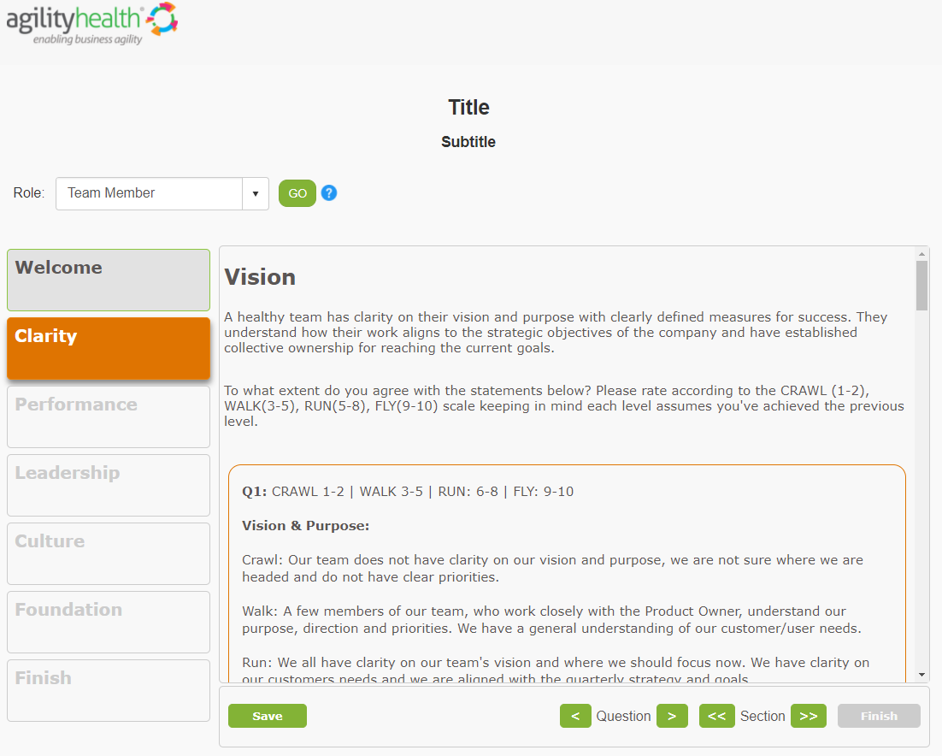
Assessment Guidance

Slide 22
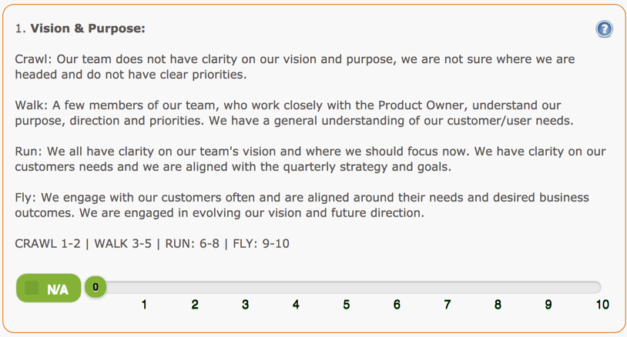
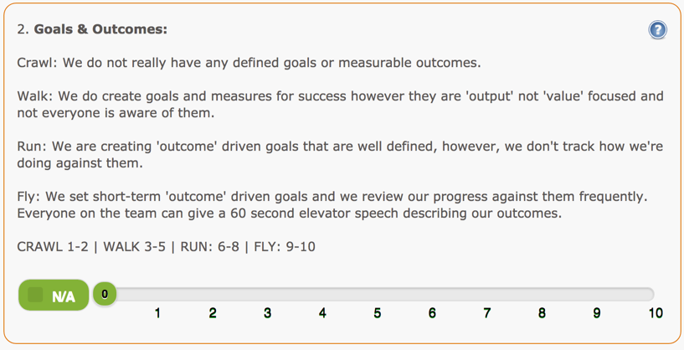
Assessment Guidance

Slide 23
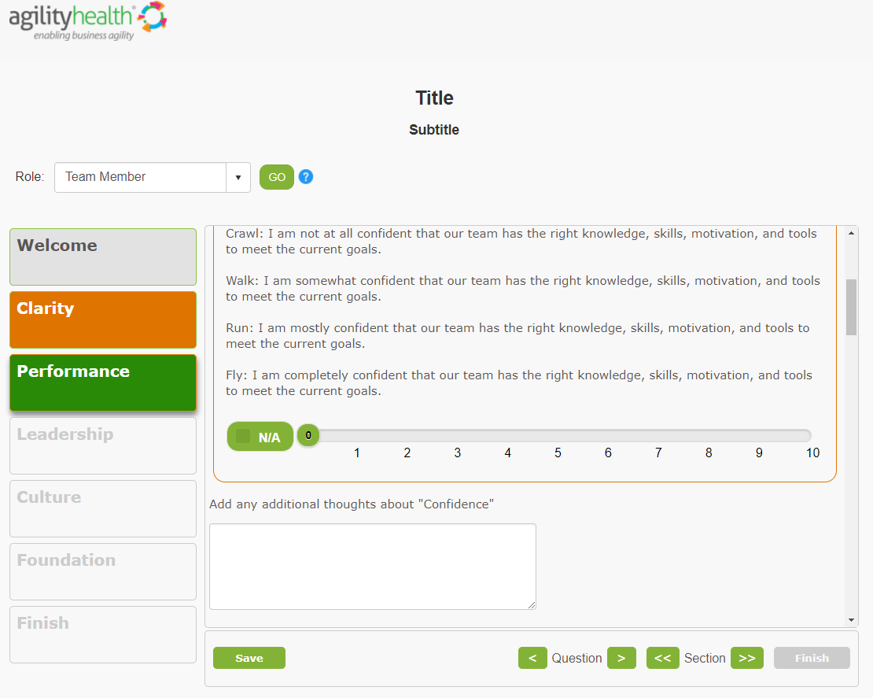
Assessment Guidance

Slide 24
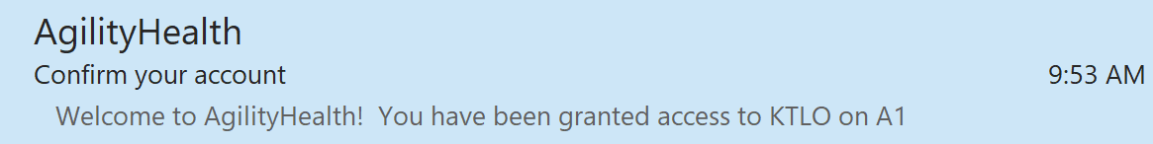
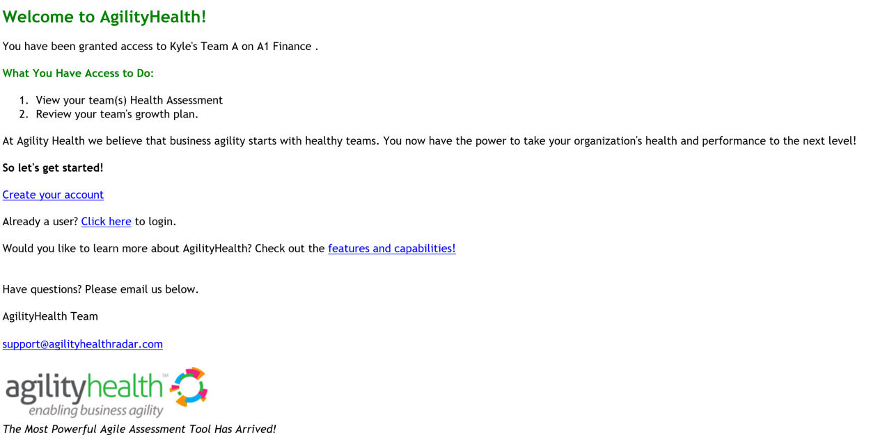
Email for Participants to Login
From
Subject

Slide 25
Product Demo
Assessment Links & Completion
Review Results
Growth Portal

Slide 26
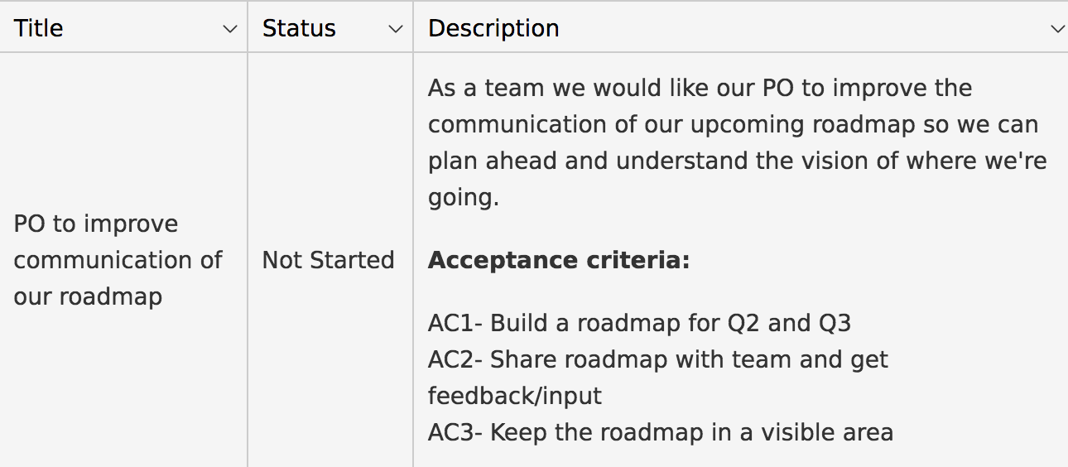
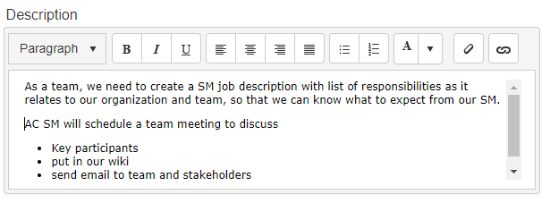
Good Growth Items Are Like Good Stories
Specific
Measurable
Achievable
Realistic
Time-Bound
Notes:
.

Slide 27
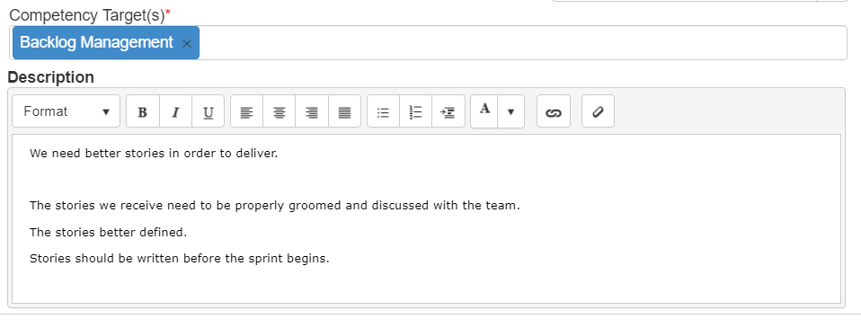
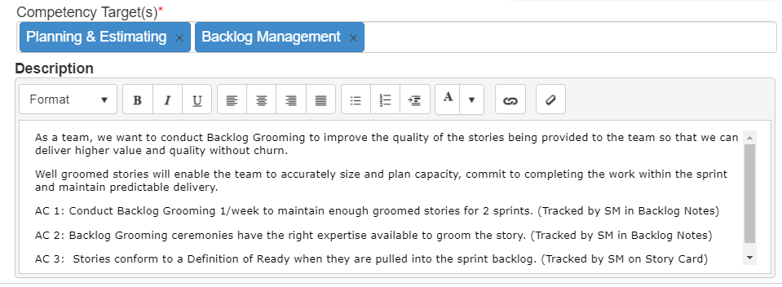
What Makes A Good Growth Item?
Not Good
Good
Written as a good user story
(INVEST or SMART)
Well defined acceptance criteria

Slide 28
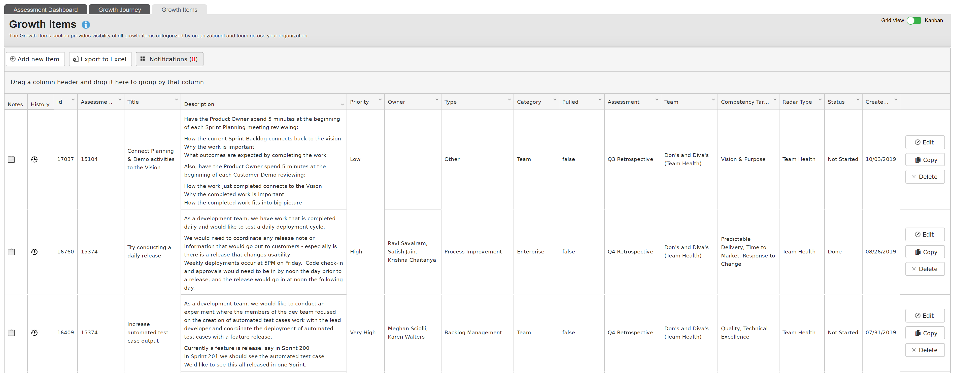
Growth Items Backlog

Slide 29
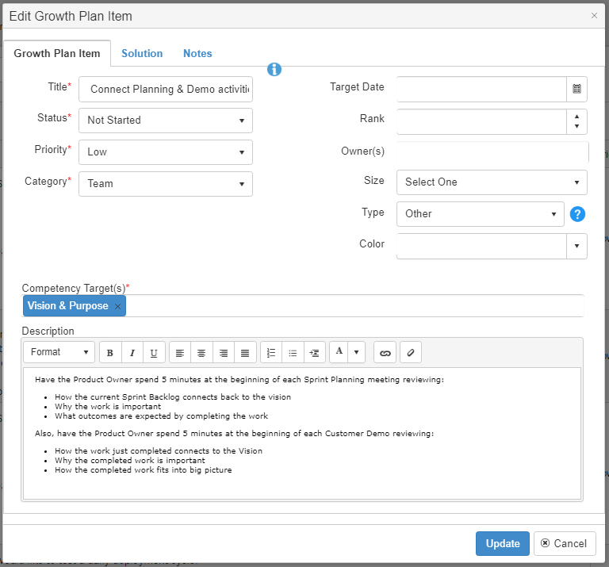
Growth Items - Objectives
Growth Plan Items are added to the backlog and worked by the Team
The self-organizing team functions as a their own P.O. for growth items
Growth Plan Items, like good stories, need to be well-defined with acceptance criteria.
Growth Plan Items are tied to Competency Targets

Slide 30
AgilityHealth® Facilitation Tips
Remind participants to select N/A when unsure
Prepare the team for a healthy open retrospective through team norms
Dig deeper into team dynamics (elephant in the room conversations)
Celebrate success, try the appreciation game
Keep growth plan to a manageable size. i.e. Only select top 3 to 4 things to improve
Review textual responses in case any are out of ordinary

Slide 31
AgilityHealth® Facilitation Tips
Frame the retrospective as a Health Check designed to address real issues.
Keep in mind what it takes to be a High Performing Team. Push teams to think about “how they may not know what they don’t know
Before reviewing with the team: Discuss low responses about Leadership Roles with the Triangle Leads.
Before reviewing with the team: Review comments for improper language, inflammatory comments or personal attacks
Before reviewing with the team: Determine who should be paired up together for the group breakouts.
If Managers are on the team, discuss ahead of time if their presence will impact how the team scores.

Slide 32
Post Retrospective Activities
Review of the AgilityHealth® Purpose & Roles
Preparing for a TeamHealth® Retrospective
Q & A
Post Retrospective Activities
Facilitating the Retrospective
Support Center Article

Slide 33
Post-Retrospective Activities
Communicate to ScrumMaster their role in keeping the radar and growth items visible during each iteration and retrospectives.
Add your assessment notes/observations and team maturity rating in the “Edit Assessment” page.
Follow through with making sure organizational growth items are brought to leadership attention.
Ensure all team members have access.
Managers should be debriefed on assessment results and where they can help
1
2
3
4
5

Slide 34
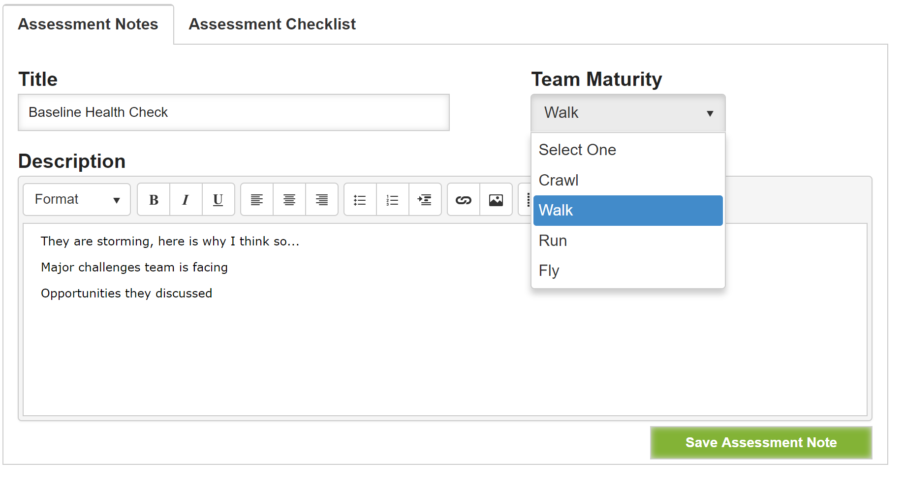
Assessment Notes
Making notes after the assessment is a very important step.

Slide 35
Manager Debrief – Post Retrospective
Review outcomes of the retrospective(s)
Training (or reminder) on how to use and not use AgilityHealth®. Review themes around strengths, growth opportunities and impediments
Call out specific organizational items leadership should own
Do multi-team analysis highlighting trends and patterns
If not done already, establish Continuous Improvement Leadership Team and build internal cadence for reviewing and executing organizational growth items
*Check out the Manager Debrief deck on the Support Center that we created to provide guidance on what slides to put together for your presentation!

Slide 36
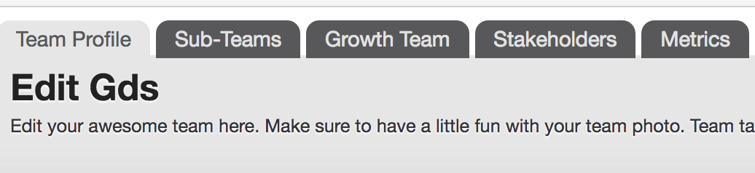
Multi-Teams
“Multi-Team” is a term referencing a rollup of sub teams + a definition of a Continuous Improvement Leadership Team
Programs
Release Trains
Product Lines

Slide 37
Multi- Team Rollup Radar
Analyze common patterns
Filter by Participant Groups

Slide 38

Keys to Success
Educate Executives and Leaders on AgilityHealth® Continuous Growth Program
Create Energy and Excitement, ‘Pull’ vs. ‘Push’
Communication and Marketing
Leaders Use Agile by Committing to Organizational Growth Stories for the Quarter
NEVER Punish or Reward Teams or Leaders Based on their Assessment Results

Slide 39
Q & A
Review of the AgilityHealth® Purpose & Roles
Preparing for a TeamHealth® Retrospective
Q & A
Post Retrospective Activities
Facilitating the Retrospective

Slide 40
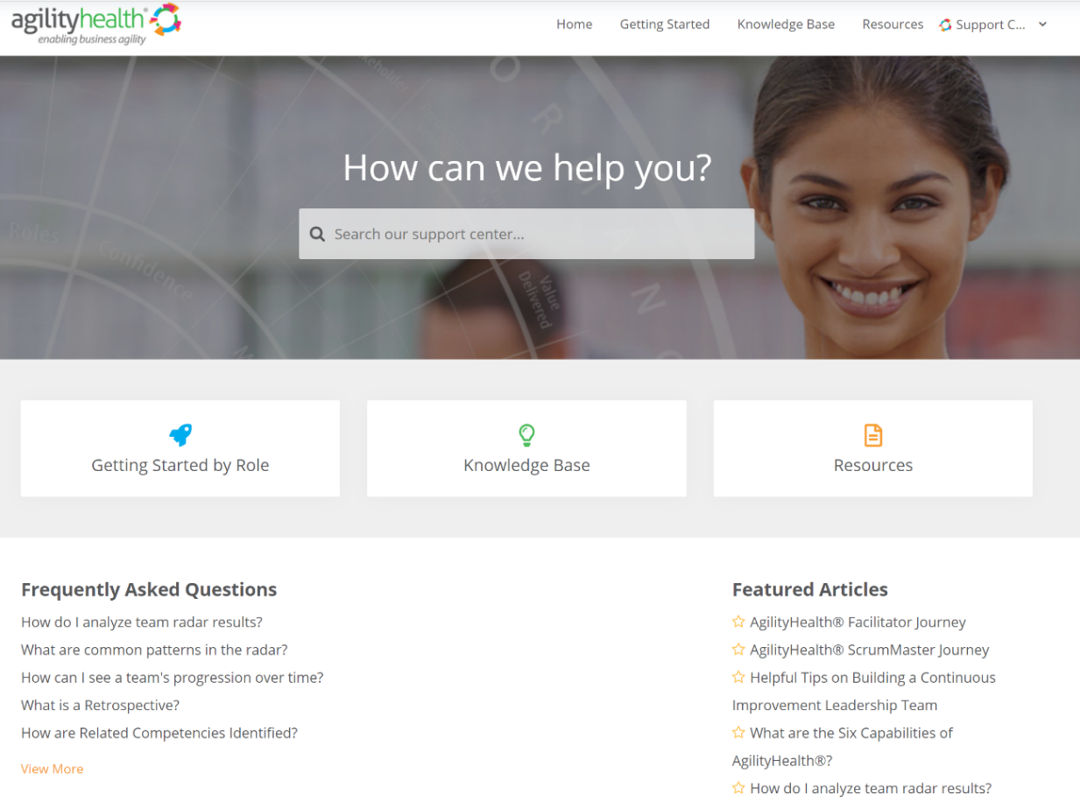
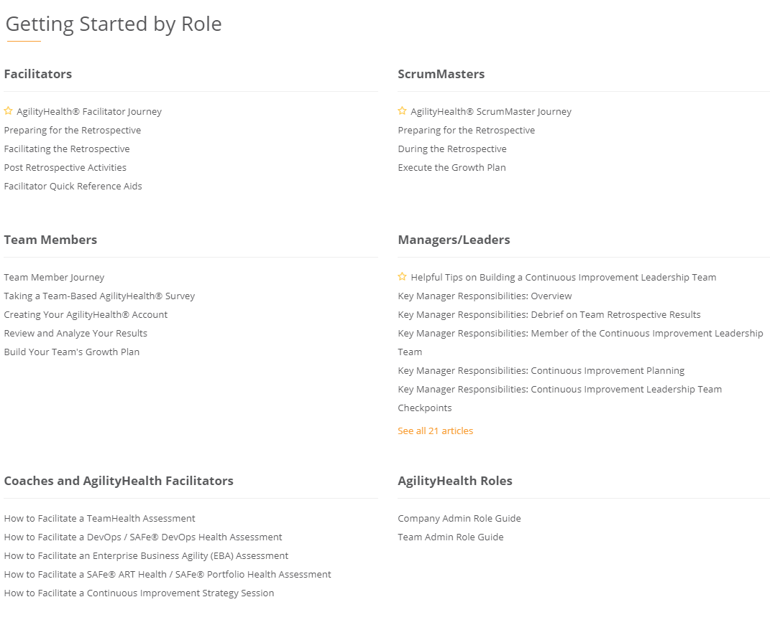
Questions? Check Out Our Customer Support Center
https://support.agilityhealthradar.com
Role based guides, page by page tutorials, FAQ’s, downloadable resources and more!

Slide 41
Thank You!
Getting in touch:
success@agilityhealthradar.com

