Slide 1
AgilityHealth® Manager Debrief

Slide 2
Manager Debrief Agenda
Welcome and Introductions
Review accomplishments of engagement (see example)
Walk through a quick overview of the process the teams went through
Training (or reminder) on how to use and not use AgilityHealth® (Keys to Success)
Review themes around Strengths, Growth Opportunities and Impediments
Call out specific Organizational items leadership should own
Do Multi-team analysis highlighting trends and patterns
  Analyze tags, roles and participant groups, as appropriate
If not done already, establish Continuous Improvement Leadership Team and build internal cadence for reviewing and executing OGIs
If not done already, train Continuous Improvement Leadership facilitator (often Program Manager or similar role) to use AgilityHealth® and manage the Continuous Improvement Leadership Team backlog

Slide 3
TeamHealth® Retrospective
Strategic deep dive retrospective
Takes 3 hours to complete the first time, 1.5-2 hours each quarter thereafter
Facilitated by a certified AgilityHealth® Facilitator
Members complete an assessment and see the detailed radar immediately
Team analyzes results, builds team growth plan and identifies organizational growth items

Slide 4
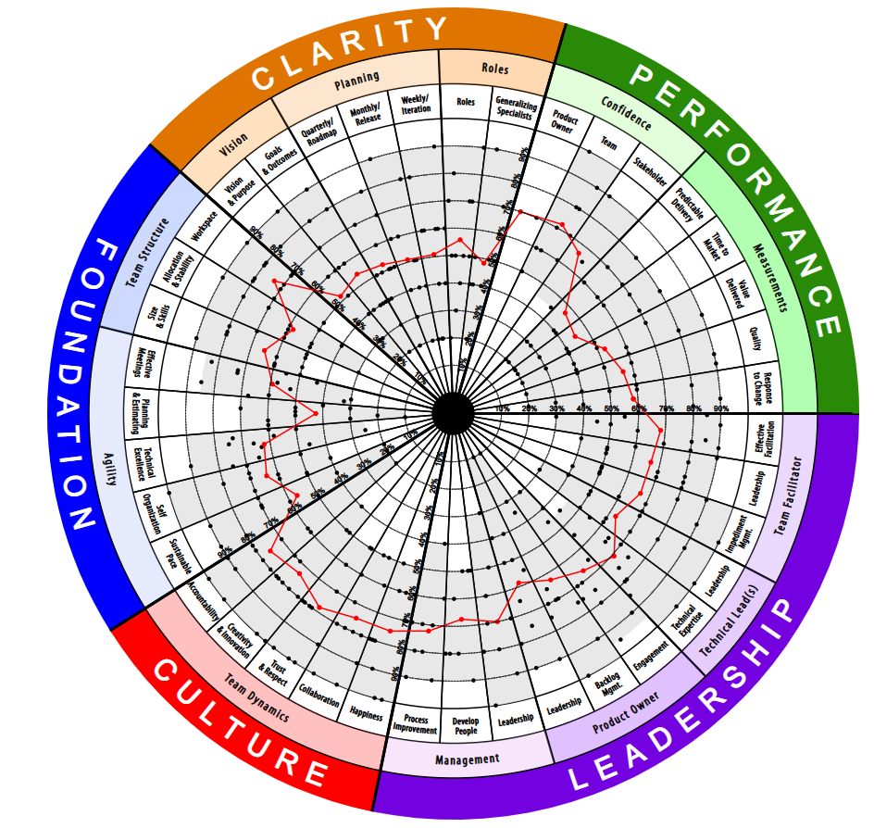
Sample Radar

Slide 5
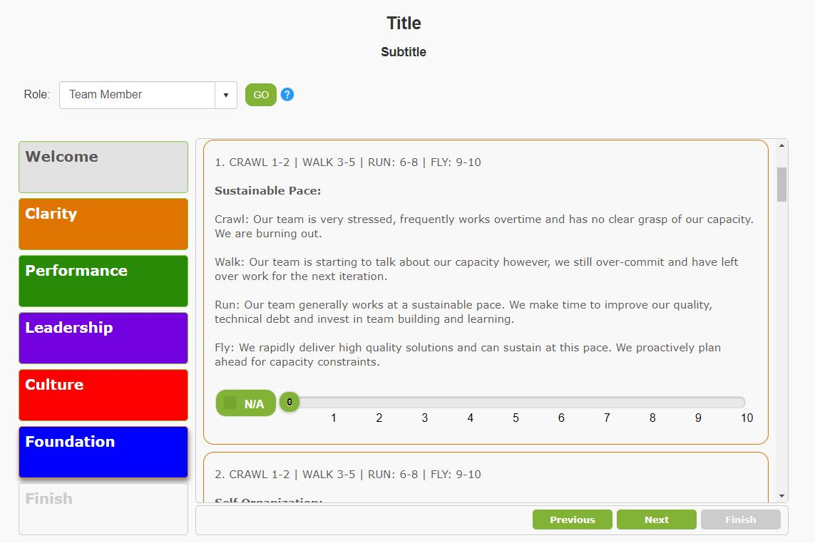
Sample Assessment Questions

Slide 6
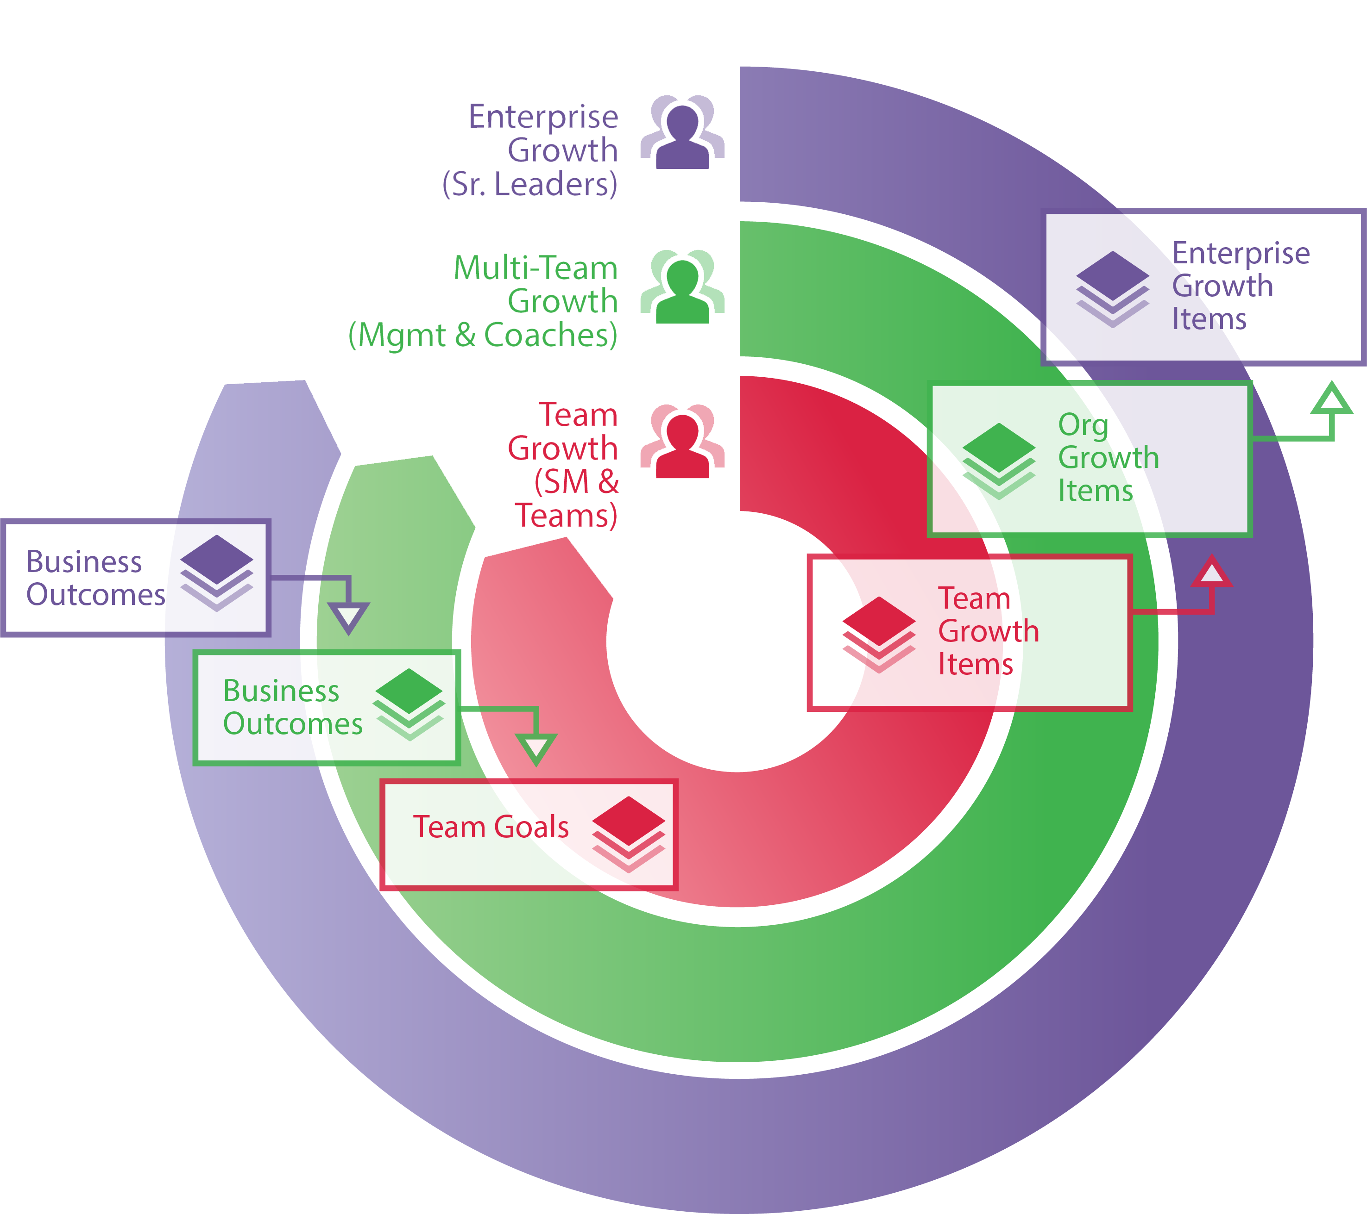
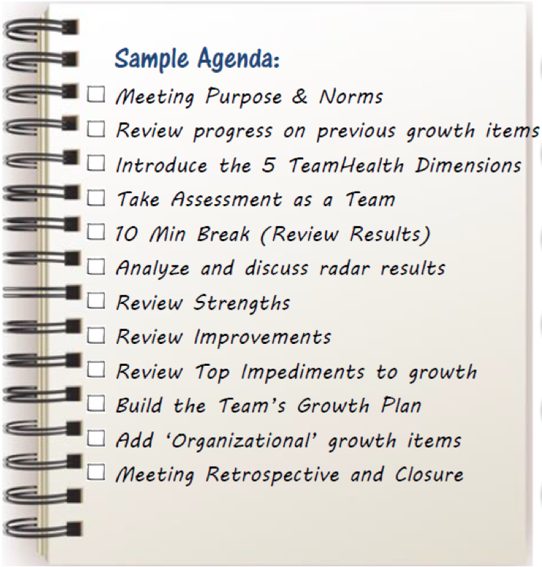
AH Strategic Retrospective Process
Escaped Defects
25

Slide 7
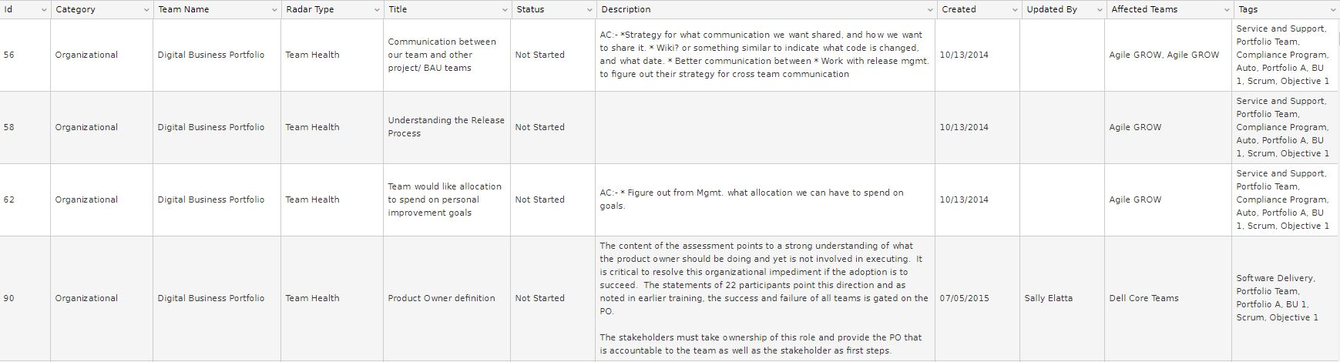
Accomplishments
4 teams assessed in 3 days
60 team members and 4 stakeholders participated
Trained SMs to administer their team’s Growth Plan
Each team has several Growth Items
A few Organizational Growth Items were identified
** Example **

Slide 8
Team Strengths – Team A
Good collaboration from all team members
High level of experience and expertise
Everyone is willing to pitch in, learn where needed and get the job done
Willingness to help each other out, especially those new to the team
High motivation and drive to succeed
Open communication, willing to giving and receive feedback
Engaged and responsive PO
** Example **

Slide 9
Gaps & Opportunities – Team A
Vision and clarity on project direction
Become more comfortable with ambiguity and realize that we won’t have all the answers up front
Product knowledge is siloed, need specific time for knowledge sharing (Lisa to spend entire sprint pairing, transferring knowledge on DIF)
Better ownership of stories, ask for help as needed, look for opportunities to pair
Become more innovative, research possibilities and pitch new ideas
Need a Rolling Work Plan to understand the stories coming up in future sprints, show visibly on board
** Example **

Slide 10
Impediments – Team A
Reliance on external teams is slowing the team down (privacy, security, compliance)
Working with Brand and integrating them into the team’s rapid process
Collaboration space for the team
Skill gap with ACORD (solution is in place)
Lead BA leaving, will cause some storming until replacement gets up to speed
** Example **

Slide 11
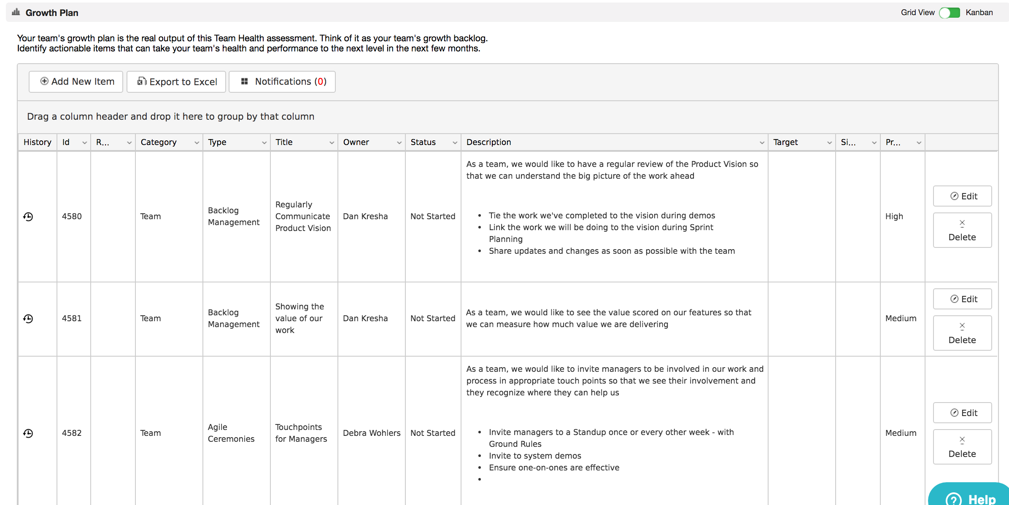
Growth Plan – Team A
** Example **

Slide 12
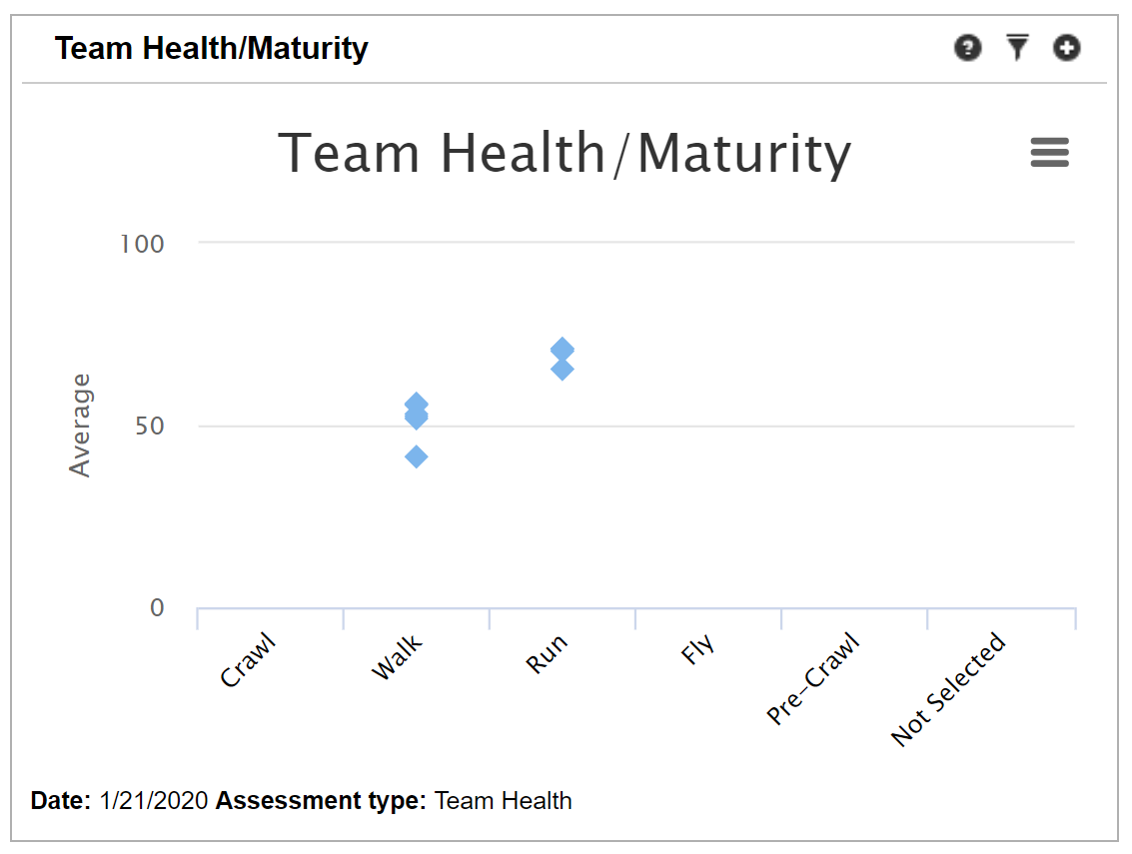
Team Maturity Stages
** Example **

Slide 13
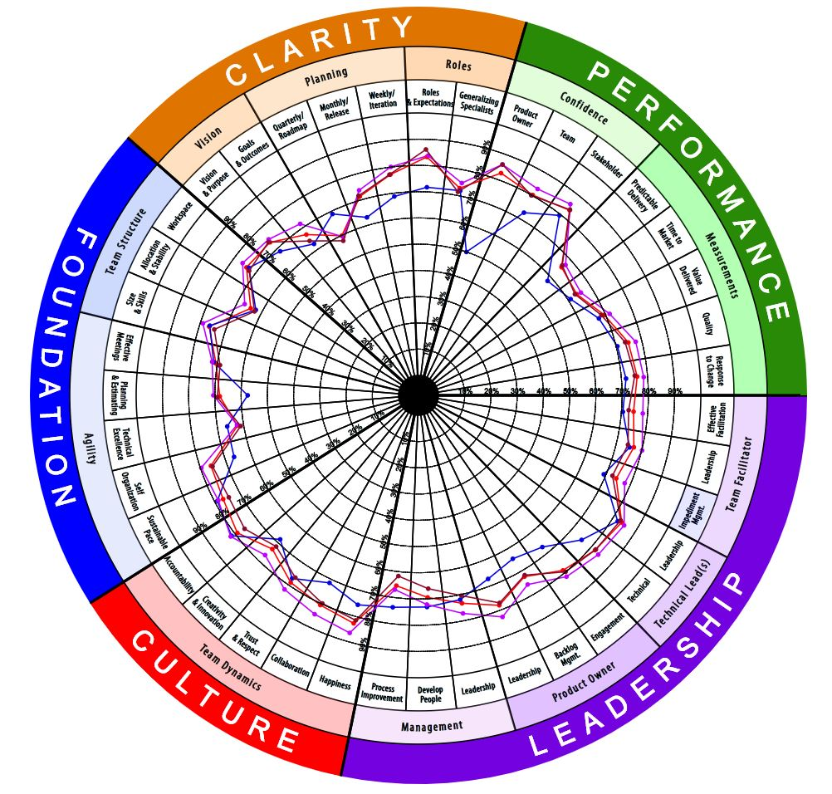
Multi-Team Analysis
** Example **

Slide 14
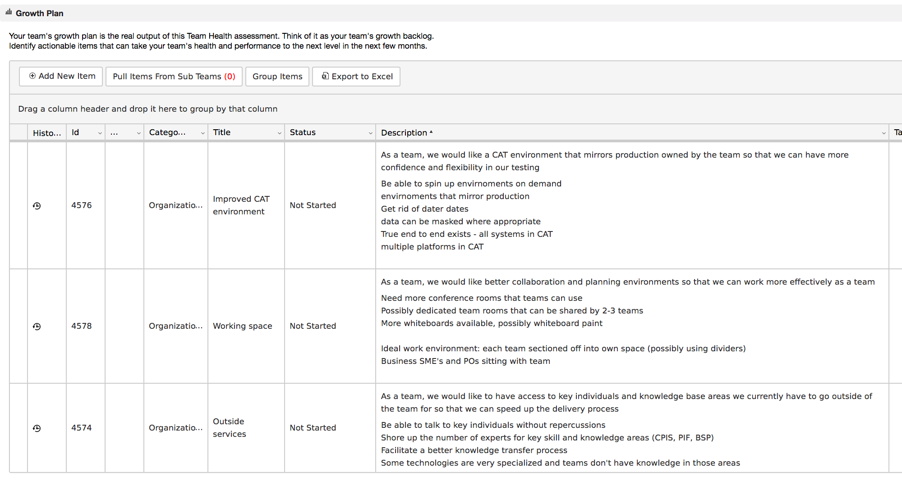
Organizational Growth Items
** Example **

Slide 15

Keys to Success
NEVER Punish or Reward Teams or Leaders Based on their Assessment Results
Leaders Owning Org. Growth Stories for the Quarter
Be Intentional About Growth – Make Time
Create Energy and Excitement ‘Pull’ vs. ‘Push’

